Slide 1
HTC and Your Research
Christina Koch
OSG School 2026
July 13, 2026

Slide 2
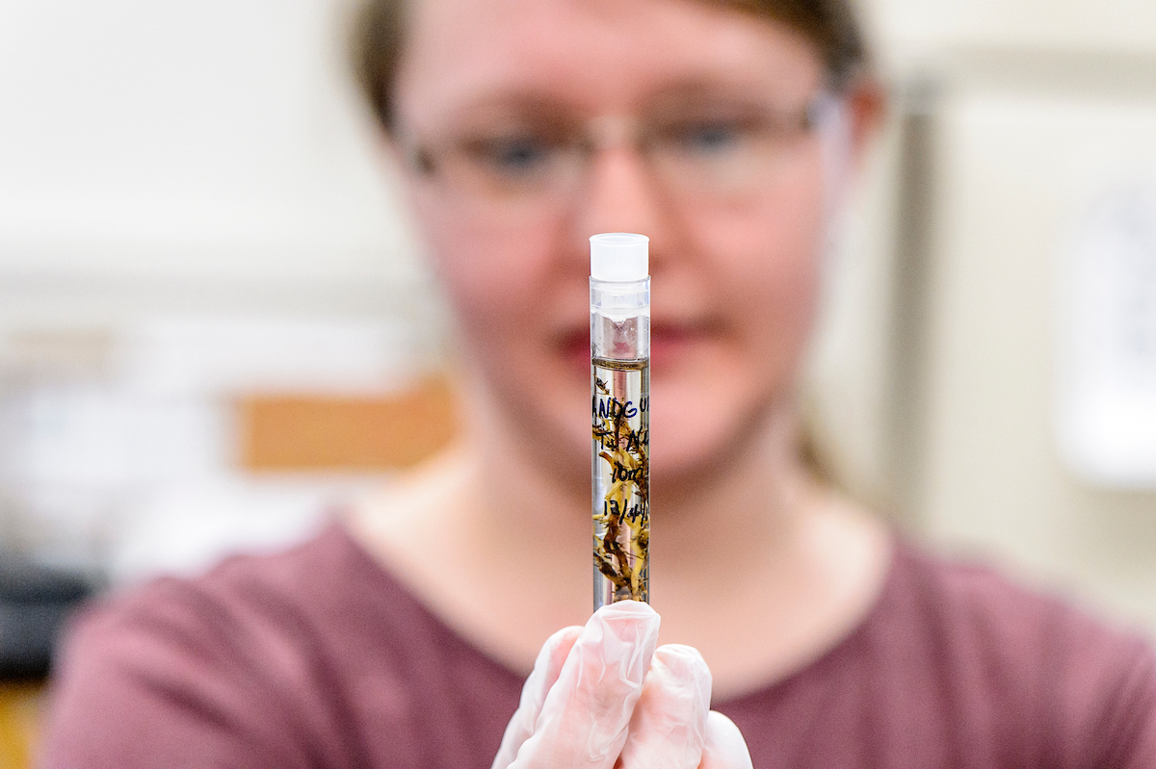
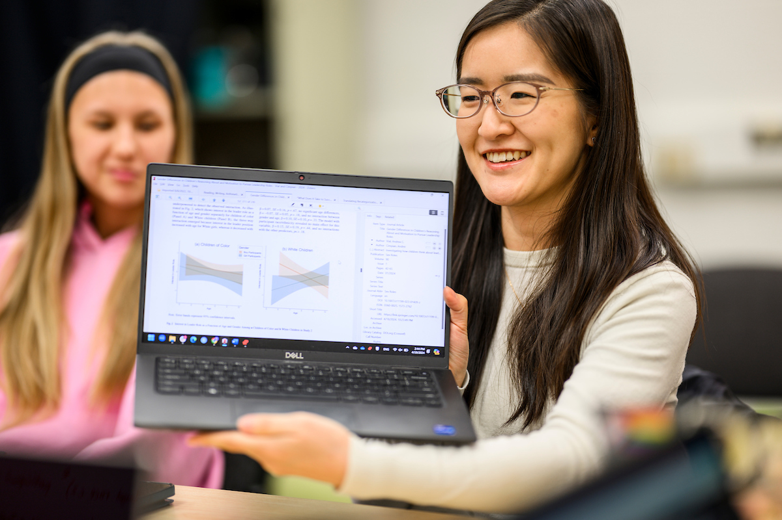
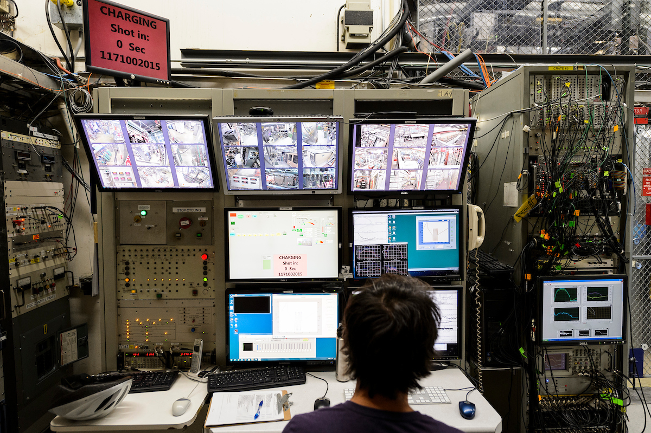
Reminder: Researcher Problems
Each researcher has a (non-ordered) list of tasks that would take too long to run sequentially on their local computer.
Running analysis pipeline for each sample.
Running a simulation for each parameter combination
Running millions of simulations.

Slide 3
Your Turn
In the worksheet, write down the following
A one-sentence summary of your research
A typical computational task
This should be the smallest *self-contained* piece of your workflow
What is your list of tasks?
“I need to run <computational task> for each <list of inputs>”
Estimate how computationally intense *one* task is
How many tasks do you have?

Slide 4
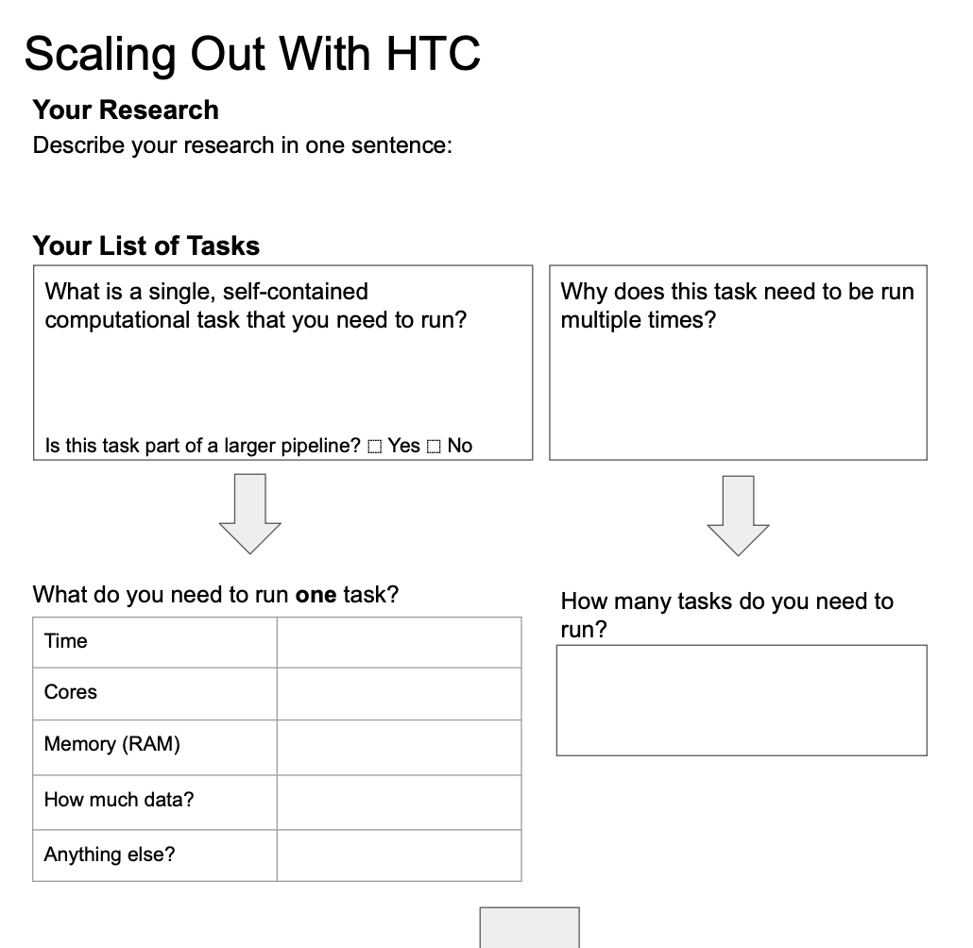
Example
develop a model that can predict the best trial design
one run of my model
model runs for each input parameter from a list
X
4 hours
?? it runs
on my laptop
very small
code is in R
3 x 8 x 4 x 2 parameter combos

Slide 5
Acknowledgements
This work was supported by the National Science Foundation under Cooperative Agreement OAC-2030508 – Partnership to Advance Throughput Computing (PATh)

