Slide 1
Introduction to High Throughput Computing
Christina Koch
OSG School 2026
July 13, 2026

Slide 2
Researcher Problems

Slide 3
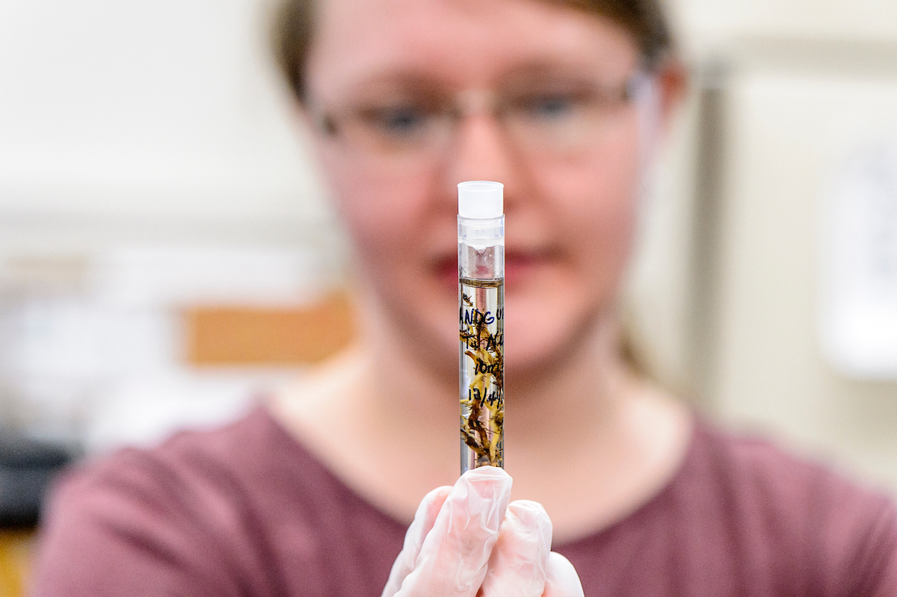
Researcher #1
New research student
Working in plant pathology lab, studying plant genomes
Can run first step of pipeline on one sample
Now has 50 samples to run

Slide 4
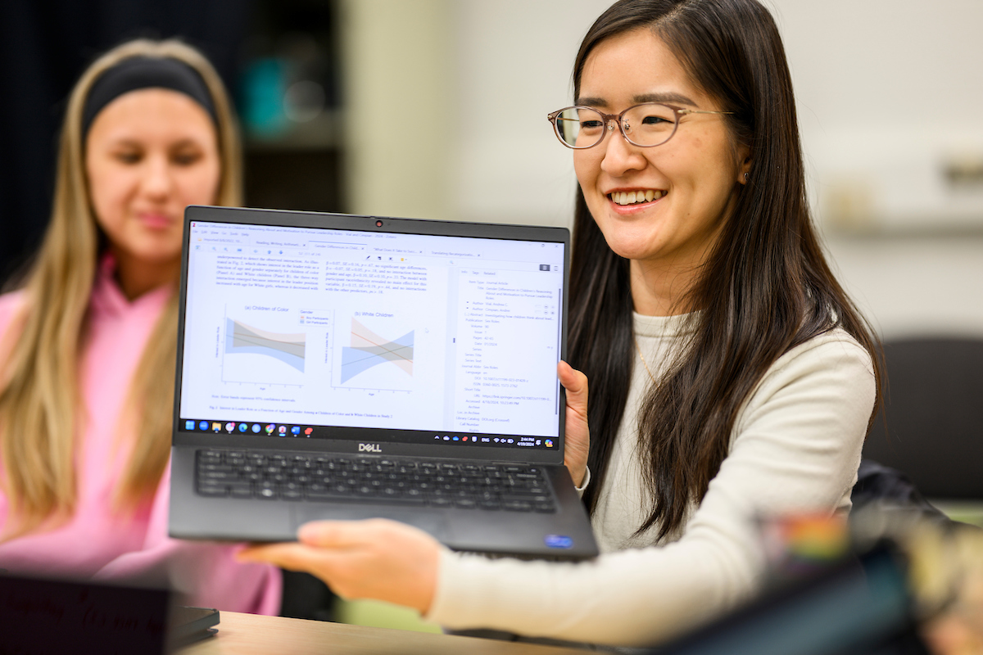
Researcher #2
Starting master’s project
Using self-written model which predicts accuracy of a medical trial design
Model takes 3-4 hours to run
Want to test many designs (each design is expressed as a combination of parameters)

Slide 5
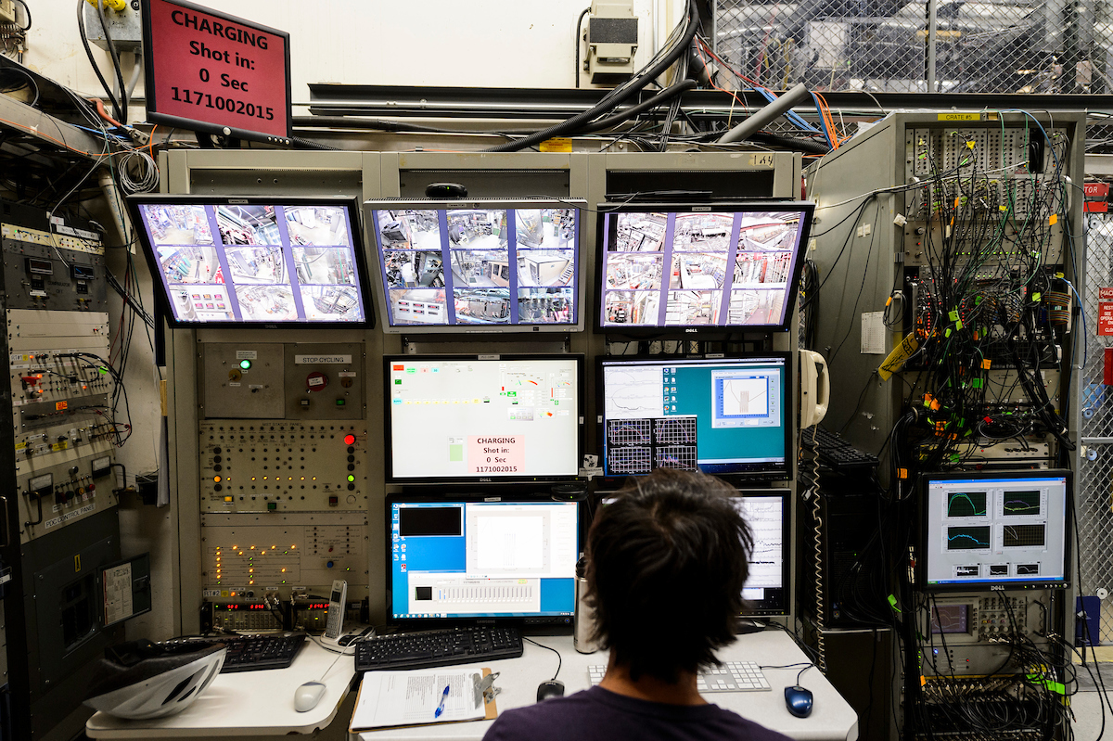
Researcher #3
Member of a large physics collaboration
Want to predict (with probability) behavior of particle in detector
Collaboration has particle simulation code already
Probability estimate comes from running millions of particle simulations

Slide 6
What do they have in common?
Each researcher has a (non-ordered) list of tasks that would take too long to run sequentially on their local computer.
Running analysis pipeline for each sample.
Running a simulation for each parameter combination
Running millions of simulations.

Slide 7
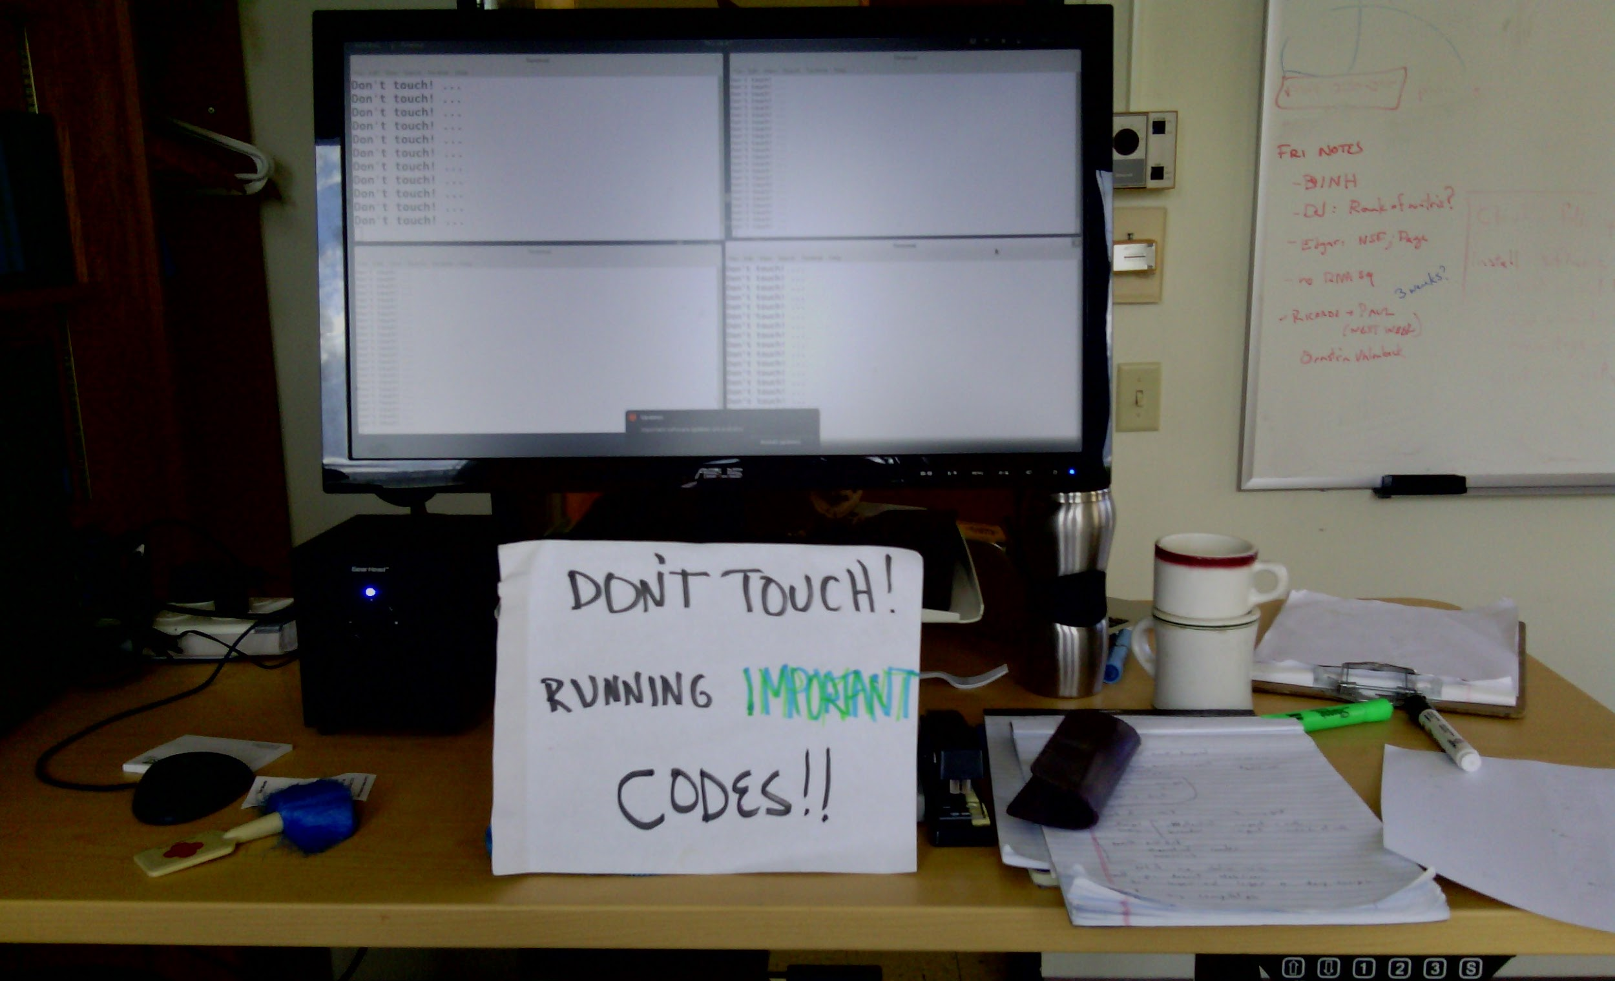
Why do we care?
Each researcher has a (non-ordered) list of tasks that would take too long to run sequentially on their local computer.

Slide 8
Scaling Up
Each researcher has a (non-ordered) list of tasks that would take too long to run sequentially on their local computer.
Don’t let computing be a barrier to your research!! We want to be able to tackle big problems.
The strategy to speed things up with computers is ALWAYS to run in parallel.
Then you can go from using a small number of resources (one computer) to a LOT of resources (for example, many computers).

Slide 9

Running in Parallel
There are different ways to parallelize in computing:
List of tasks
Parallelize on multiple (more) computers.
Parallelize on computer components (CPU/GPU)
This is what we’ll be focusing on; no need to re-write code
Requires special programming; good for dependent or correlated sub-tasks

Slide 10
High Throughput Computing (HTC)
List of tasks
Parallelize on multiple (more) computers.

Slide 11
Some Terms
Execution Point
Computer available to run jobs
List of tasks
Resources in an EP
cores/CPUs: processing unit of computer
memory/RAM: space to temporarily store information (working memory)
disk: space for persistent files
GPUs: specialized processing units
Scheduler
A program that can assign Jobs to Execution Points
Job
Formal description of the task you want to run (usually input, executable, output)

Slide 12
High Throughput Computing (HTC)
List of tasks

Slide 13
What you need to do HTC
A “home” to organize and start the computation
Access to more computing capacity (an HTC system)
Tools to manage and run our list of tasks (the scheduler)
Components needed to run our tasks: software, scripts, data
This is exactly what we’re going to cover this week.

Slide 14
A “Home” for HTC Workflows
Access Point account
ap40.uw.osg-htc.org
some of you have have access to additional Access Points
OSG Online Guides
Main Page > Get Started on the OSPool > Account Setup
Account and guide portal: https://portal.osg-htc.org/

Slide 15
Access to HTC Systems
Open Science Pool – Mon – Fri
OSG School materials
OSPool Introduction (Tuesday)
OSG Online Guides
Main Page > Get Started on the OSPool > Welcome
Account and guide portal: https://portal.osg-htc.org/

Slide 16
Managing and Running Jobs
HTCondor (for most cases) and DAGMan (for workflows)
OSG School materials
HTCondor Introduction (Mon)
Troubleshooting (Thurs)
Workflows with DAGMan (Thurs)
OSG Online Guides
Main Page > Submit HTC Workloads > HTC Workload Planning, Testing and Scaling Up
Main Page > Submit HTC Workloads > Monitor, Review and Troubleshoot Jobs

Slide 17
Job Components: Software, Data, Scripts
OSG School materials:
Software (Tuesday)
Data (Wednesday)
OSG Online Guides
Main Page > Submit HTC Workloads > Managing Data for Jobs
Main Page > Submit HTC Workloads > Using Software

Slide 18
Big picture goals for the week
Mon | Tues | Wed | Thurs | Fri
Identify your job "task", your list of inputs, and be able to express them in an HTCondor submit file. | Follow instructions to create a container and use it in a job; adapt for different software. Describe the components of the OSPool | Enumerate the files needed for your job(s) and stage them in the appropriate place. | Identify where jobs and workflows might run into issues when starting out. Run a job that does *your* work, based on what you’ve learned in the previous three days. | Continue to refine your job/workflow prototype. Identify next steps for your learning and workflow implementation.

Slide 19
A note about LLMs/Agentic AI
LLMs and “AI” agents are powerful tools, well suited to many of the tasks we are doing this week:
Writing scripts or job submit files
Writing container build files
Troubleshooting errors or issues
AND, they are most effective when their user has the background and context to provide meaningful prompts and interpret the results.
AND, we brought you here so you could learn new things! 🤓

Slide 20
Our suggestions
Don’t use any LLMs / AI agents for at least the first 2 days of the School.
Ask School staff/neighbors for help if you get stuck.
Write or type out information yourself
By day 4, use LLMs judiciously for tasks that you could probably do yourself or easily look up.
“Modify this definition file to install this software.”
“Create a template submit file for me, based on the School materials.”
“Where should I look for errors?”

Slide 21
Getting Started
We’re here to help you do the following:
Think about your work as a list of jobs
Get it running on the OSPool
Lots of resources available:
OSG School materials: slides, exercises
OSG guides and training materials
Other technical lessons (unix, git, naming things, docker…let’s crowd-source other materials as needed)

Slide 22
Connecting with Each Other
Connect with people who are doing similar work to you!
Today: lunch with people in similar domains
Tomorrow: lunch with people using similar tools
Do you want to share your contact info? Or a cool resource you know about for computing? Share here:
https://go.wisc.edu/4b3k15
Staff are also a resource! Talk to us and sign up for consultations on the whiteboard.

Slide 23
Acknowledgements
This work was supported by the National Science Foundation under Cooperative Agreement OAC-2030508 – Partnership to Advance Throughput Computing (PATh)

