Slide 1
Facilitation of OSG Services
Christina Koch
OSG School – July 17, 2026

Slide 2
Where we’ve been…
🎉
Research Computing Facilitation is a teenager!
Originated name and principles of facilitation in 2013
Impetus: It’s not enough to have technologies and infrastructure – facilitation is key to deliver impact for campuses.
At UW – Madison, 700+ researcher/student interactions last year, across 80 departments and centers.
In the OSPool, 200+ projects in the last year, completing 360 million jobs.

Slide 3
What is facilitation?
Leveraging of human capabilities to advance research and teaching outcomes through computing.
Principles:
Mutually beneficial partnerships, grounded in trust relationships
Clear ownership of responsibilities and outcomes
Technology agnostic, concept driven
Relies on other skillsets (infrastructure, software engineering, etc.)
A methodology to be developed, tested and improved, alongside our technologies.
Notes:
https://library.educause.edu/-/media/files/library/2016/5/erb1602.pdf

Slide 4
We see facilitation as:
“I want to help you achieve your research (or teaching) goals.”
instead of
“I want to help you do computing.”

Slide 5
Goals for this session
Facilitation with *you* as campus staff / instructors
What are some of your facilitation/teaching goals?
How can we help build human capability with you at your campus?
How can you leverage us? How can we leverage you?

Slide 6

I want to help my users use the OSPool
OSPool
How can your local users access the OSPool?
Option 1: use an OSG-Supported Access Point (like ap40)
Option 2: run an Access Point at your institution – talk to us
Allows users to use local identity for login

Slide 7

I want to help my users use the OSPool
Services we provide
AND/OR
Provide a set of curated containers or container build files
Create github repositories with sample jobs
Do training (see prev. slides)
(See also end of this presentation)

Slide 8

I want to help people share data
OSDF
Option 1: Set up data origins on your local storage to make data available via the OSDF
For example, making a local dataset available for more people to use.
Option 2: Reach out to us; we have a chunk of storage available for use by interested groups.

Slide 9

I want to use the OSPool for teaching
OSPool
Introduce batch computing or job submission in a class
Run a workshop on high throughput methods
Provide experience with computing in a domain science class

Slide 10
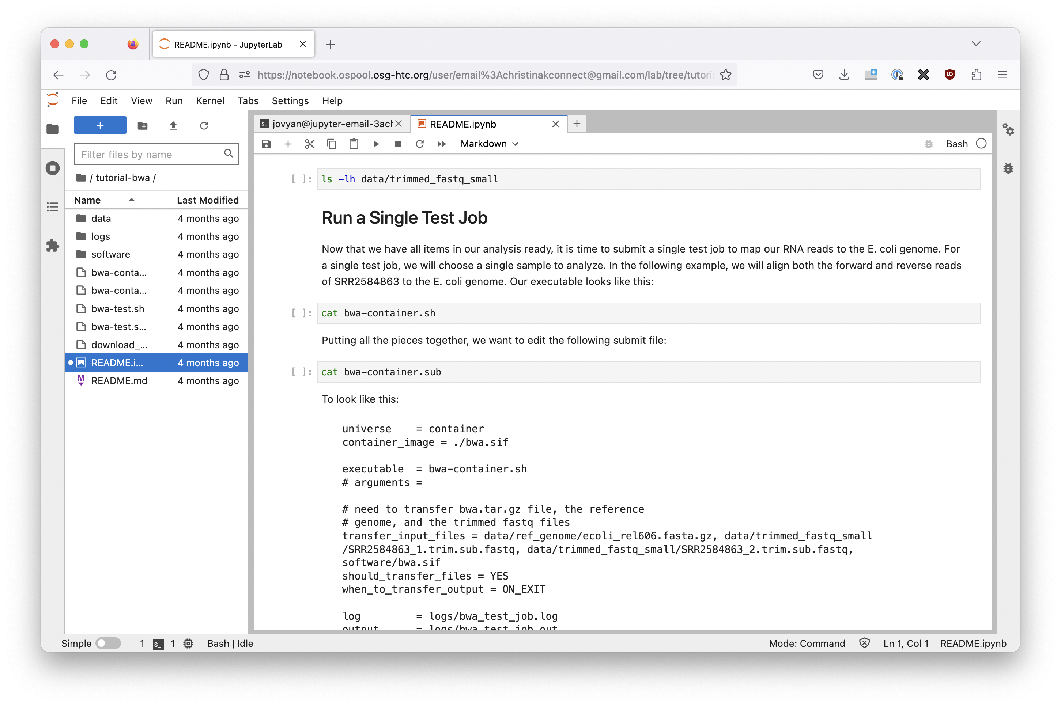
OSPool Notebooks
Starts Jupyter on an HTCondor Access Point
Guest access (no account needed) or full accounts
No software installation required
GUI interface
Can create interactive bash or python notebooks
osg-htc.org/notebooks

Slide 11
Teaching resources
OSPool Resources for Teaching and Education
Bring the OSPool to Your Event (talk)
Use any of our existing training materials:
Slides from monthly training
Tutorials
OSG School materials

Slide 12



Facilitating HTC workloads
Identify
Communicate
Support
Magnifying Glass by Adam Novantio from the Noun Project
Conversation by Maxim Kulikov from the Noun Project
sprout by lastspark from the Noun Project

Slide 13
Find HTC workloads
Where might there be HTC users at your institution?
User submitting 100s of jobs on local cluster.
“Non-traditional” computing domains, especially those doing statistical and “data science” work.
People with lots of pieces of data (sensors? images? samples?)
Places to look
New faculty orientation, new student orientation
Lab/department meetings
Notes:
https://research.cs.wisc.edu/htcondor/HTCondorWeek2016/presentations/ThuKoch_Taxonomy.pdf

Slide 14
Discuss HTC workloads
Tell me about your research
...and how does computing fit in?
How are you running it now?
compute/data requirements?
your computing background?
What is the smallest “piece” of your workflow?
How much would you like to run?

Slide 15
Discuss HTC workloads
Want to understand the long-term goals
of a user
Identify learning curve and potential benefit to user
Determine if problem can be broken into small pieces = HTC
Understand potential to scale

Slide 16
The big picture
The goal is always a better research outcome for the researcher.
Choosing a “best-fit” computing approach that scales as much as possible
HTC workloads compatible with the OSG can get a lot of computing.
Communicating the benefits and effort investment of that approach
Is running on the OSG as “simple” as your desktop? Nope! Is it more powerful? Yes!
Quantify things! “You can achieve 10,000 runs in 2 days.” “You’re starting with 4,000, but you could easily run 40,000!”
Always keep this goal in mind when troubleshooting and providing guidance.
Before solving a researcher’s question, stop and ask: is this the *real* problem?
Introduce skills that will help researchers help themselves.

Slide 17
Building relationships
Responsive: Establish your presence and reliability
Investigative: Get to the “real” problem
When a user asks for something – what do they *really* need?
When issues keep happening – what needs to be fixed systemically?
Proactive: Look out for researcher’s interests
Reach out to researchers with problems; frame issues as something that prevents them from getting research done. Emphasize good citizenship!
Connect users doing similar work

Slide 18
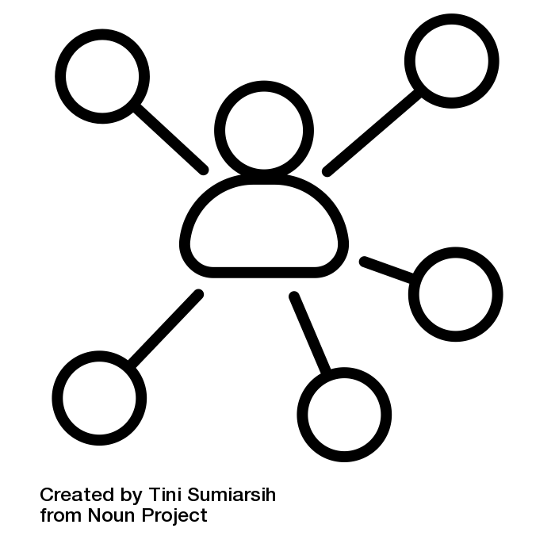
Stay connected
We want to stay connected with YOU!
Would you attend a community meeting every other month?
Other options
Come to office hours
See us at conferences (e.g. PEARC)
Invite us to a local conference or regional meeting!
Visit and shadow the UW Madison team

Slide 19
Working together
You are part of OUR network of support and community of practice in high throughput computing
We can be more effective in transforming science and improving HTC technologies with individual advocates like you.
Let us know how we can help you!!
support@osg-htc.org

Slide 20
Any goals to share with the group?
What is one thing you’d like to try in the next 6-8 weeks?
Let’s try to meet sometime in September and discuss.

Slide 21
Acknowledgements
This work is supported by NSF under Cooperative Agreement OAC-2030508 as part of the PATh Project. Any opinions, findings, and conclusions or recommendations expressed in this material are those of the author(s) and do not necessarily reflect the views of the NSF.

