Slide 1
Containers and GPUs
Thursday, July 28 2022
Mats Rynge
This work was supported by NSF grants MPS-1148698, OAC-1836650, and OAC-2030508

Slide 2
Outline
What are containers?
Why containers on the OSPool?
Finding existing containers
Building containers (Remote builder, On your own machine)
Test container on access points
Use containers in your jobs
Hey, how are GPUs related to all this?

Slide 3





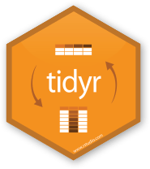
Containers
Containers are a tool for capturing an entire job “environment” (software, libraries, operating system) into an “image” that can be used again.
polaroid photos by Nick Bluth from the Noun Project

Slide 4
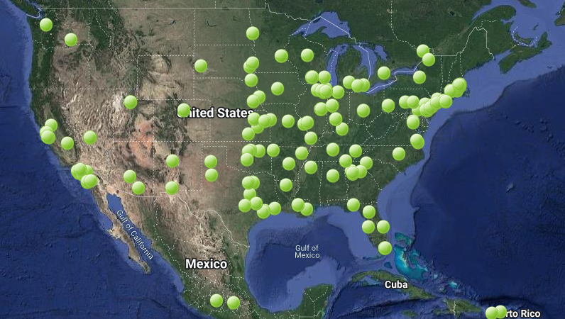

Slide 5
What problems do containers solve for HTC jobs?
Consistent Environment
your job has the same environment where ever it runs.
Complete Environment
everything you need is included
Reproducible Environment
the environment is “software defined” - easy to reproduce if you want to make small changes

Slide 6
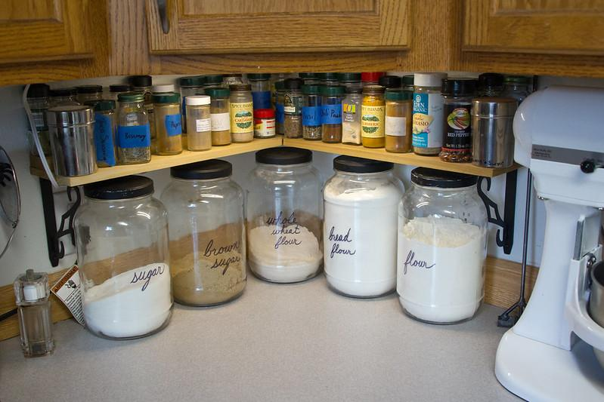
Food Analogy!
Running software on your own computer is like cooking in your own kitchen.
Photo by jschantz on flickr, CC-BY

Slide 7
On Your Computer
You know what you already have.
All the software you need is already installed.
You know where everything is (mostly).
You have full control.
You can add new programs when and where you want.

Slide 8
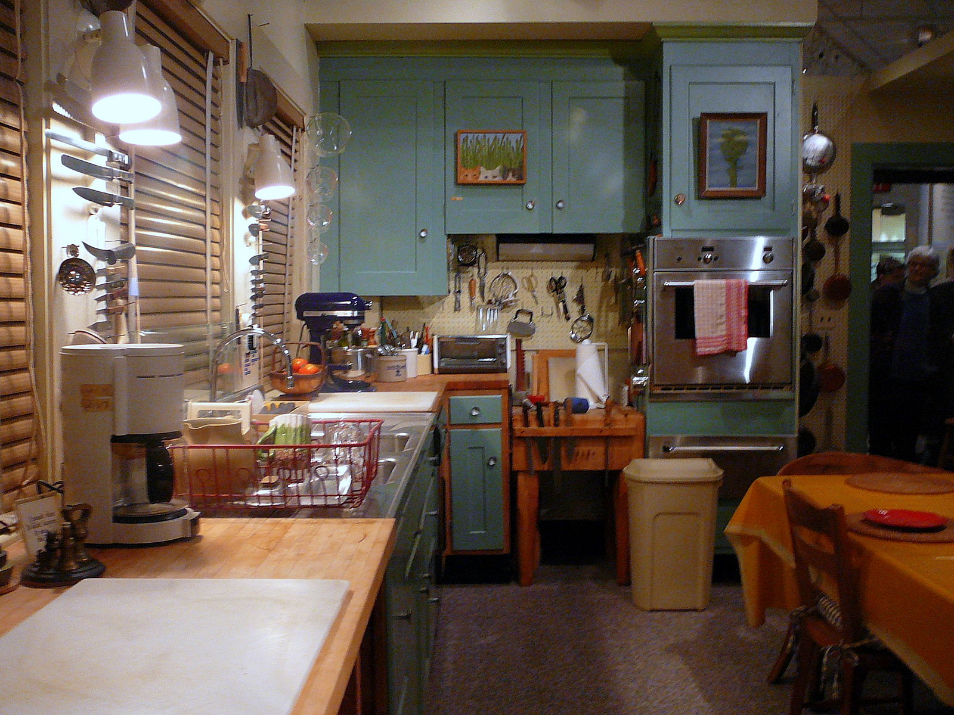
The Problem
Running on a shared computer is like cooking in someone else’s kitchen.
Photo by F Deventhal on Wikimedia, CC-BY

Slide 9
On Someone Else’s Computer
What’s already there?
Is R installed? Or Python? What about the packages you need?
Do you know where anything is?
Are you allowed to change whatever you want?

Slide 10
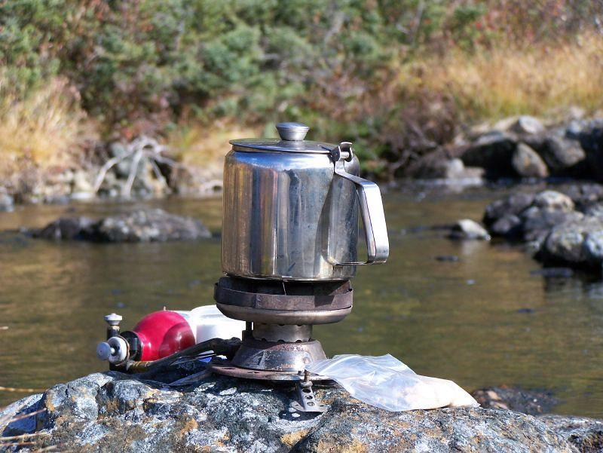
The Solution
Think like a backpacker.
Take your software with you
Install anywhere
Run anywhere
This is called making software portable
Photo by Derrick Mercer on Flickr, CC-BY-SA

Slide 11
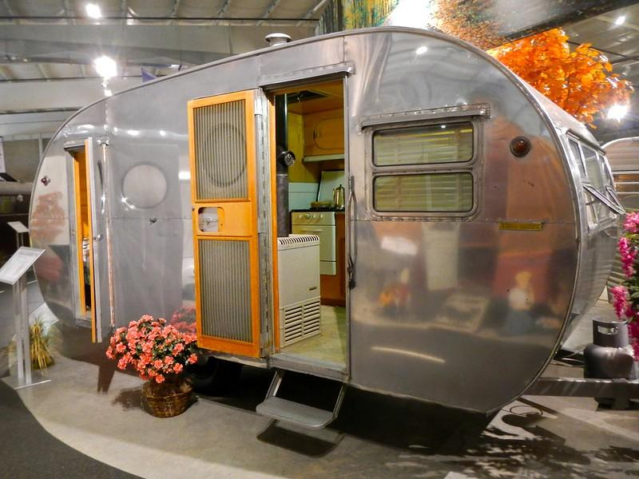
Returning to Our Analogy…
Using a container is kind of like bringing along a whole kitchen…
Photo by PunkToad on Flickr, CC-BY

Slide 12
Container Motivations
Consistent environment (default images) - If a user does not specify a specific image, a default one is used by the job. The image contains a decent base line of software, and because the same image is used across all the sites, the user sees a more consistent environment than if the job landed in the environments provided by the individual sites.
Custom software environment (user defined images) - Users can create and use their custom images, which is useful when having very specific software requirements or software stacks which can be tricky to bring with a job. For example: Python or R modules with dependencies, TensorFlow
Enables special environment such as GPUs - Special software environments to go hand in hand with the special hardware.
Process isolation - Sandboxes the job environment so that a job can not peek at other jobs.
File isolation - Sandboxes the job file system, so that a job can not peek at other jobs’ data.

Slide 13
Container Lifecycle (Hint: ephemeral)
Each and every job is encapsulated in a separate container instance
Container instance dies when the job finishes
An incredible amount of container image reuse, as workloads generally use one or a small number of images for a large number of jobs

Slide 14
Outline
What are containers?
Why containers on the OSPool?
Finding existing containers
Building containers (Remote builder, On your own machine)
Test container on access points
Use containers in your jobs
Hey, how are GPUs related to all this?

Slide 15
You can use existing containers!
OSG provided: https://support.opensciencegrid.org/support/solutions/articles/12000073449-view-existing-ospool-supported-containers
OSG collaboration/user provided (just a list, no descriptions): https://github.com/opensciencegrid/cvmfs-singularity-sync/blob/master/docker_images.txt
Docker Hub: https://hub.docker.com/ (and there are other hubs!)

Slide 16
Outline
What are containers?
Why containers on the OSPool?
Finding existing containers
Building containers (Remote builder, On your own machine)
Test container on access points
Use containers in your jobs
Hey, how are GPUs related to all this?

Slide 17


Container Types
Two common container systems:
Docker Singularity / Apptainer
https://www.docker.com/ https://sylabs.io/

Slide 18
Docker, Singularity (Apptainer)
Containers are defined using Docker or Singularity
Public Docker Hub
.sif files
… and executed with Singularity
No direct access to the Singularity command line - that is controlled by the infrastructure

Slide 19
Docker - Extracted Images
OSG stores Docker container images on CVMFS in extracted form. That is, we take the Docker image layers or the Singularity img/simg files and export them onto CVMFS. For example, ls on one of the containers looks similar to ls / on any Linux machine:
$ ls /cvmfs/singularity.opensciencegrid.org/opensciencegrid/osgvo-el7:latest/ cvmfs host-libs proc sys anaconda-post.log lib64 dev media root tmp bin sbin etc mnt run usr image-build-info.txt singularity home opt srv var lib
Result: Most container instances only use a small part of the container image (50-150 MB) and that part is cached in CVMFS!

Slide 20
Singularity has a great security model, but building…
All containers in the OSPool are invoked with Singularity
Source images can be Singularity SIF files, or Docker images
Singularity containers are run as the user invoking them
Non-privileged user, not root
However, building requires root
Use a remote builder hosted by Sylabs (no “private” files / bindmounts)
Install it on your own Linux system so you can use sudo

Slide 21
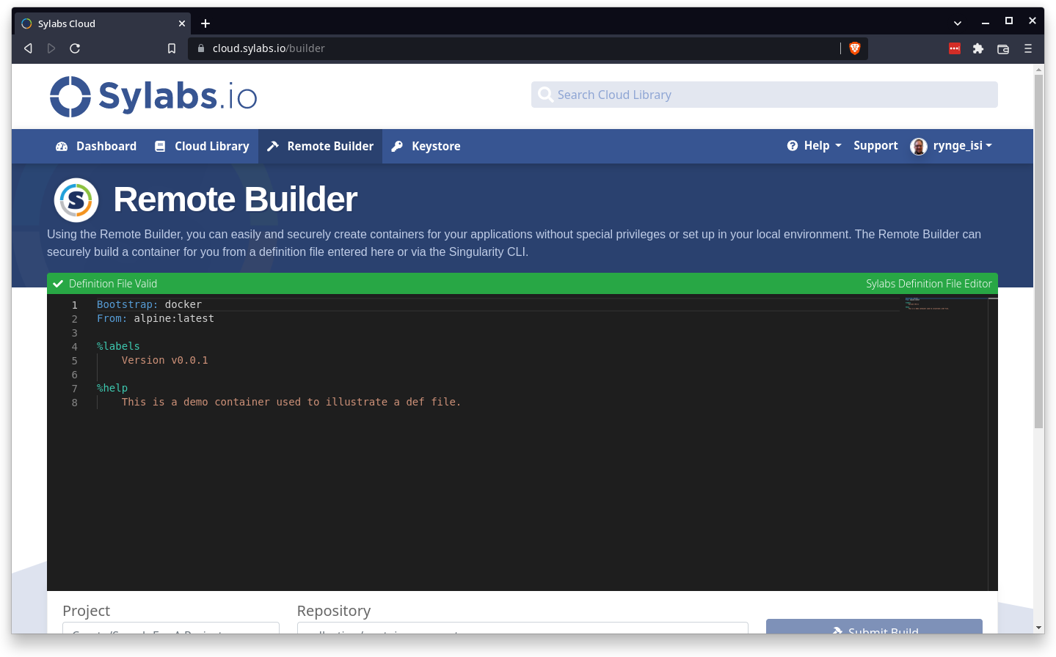
Sylabs Cloud
Create an account on (Google auth is easy):
https://cloud.sylabs.io/
Click on Remote Builder

Slide 22
https://sylabs.io/guides/3.8/user-guide/build_a_container.html#building-containers-from-singularityce-definition-files
Bootstrap: docker
From: opensciencegrid/osgvo-ubuntu-20.04:latest
%post
apt-get update -y
apt-get install -y \
python3-pip \
python3-numpy
python3 -m pip install cowsay

Slide 23
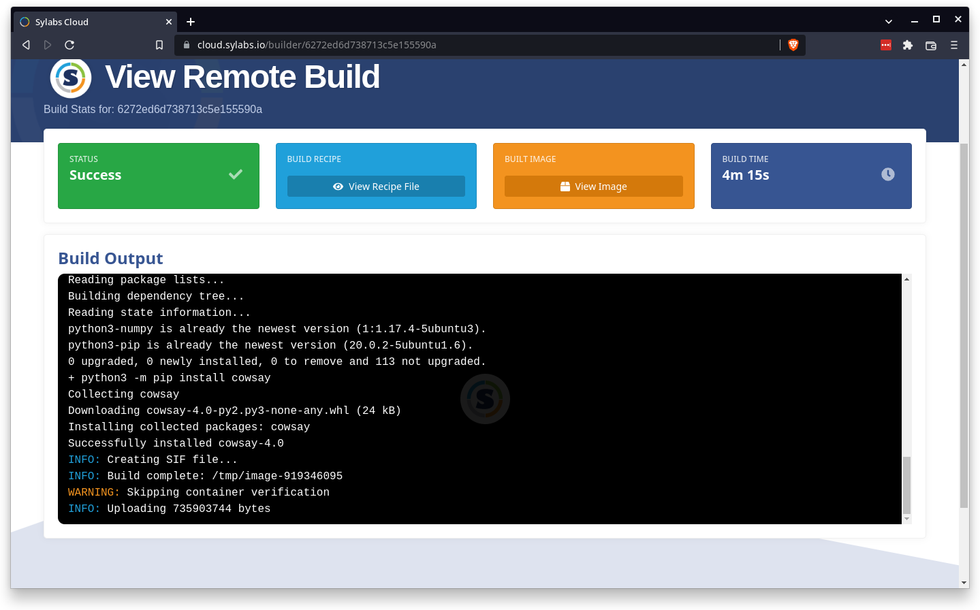

Slide 24
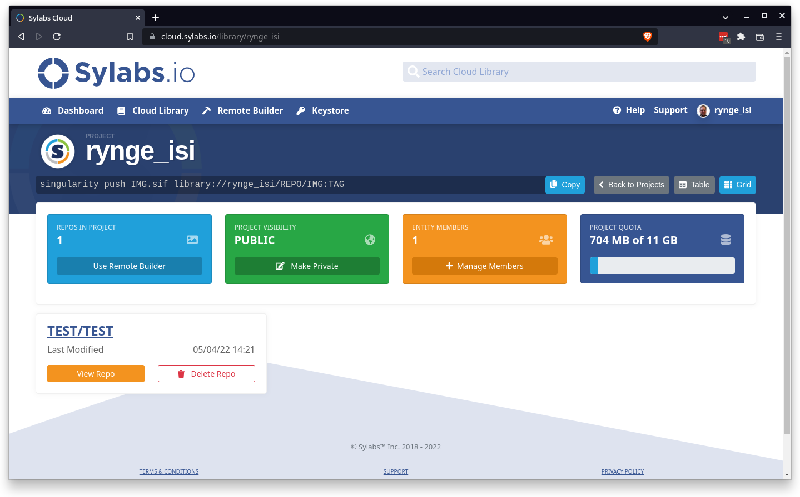
Download Image
To download the image, you have to either setup the access tokens, or make the project public:

Slide 25
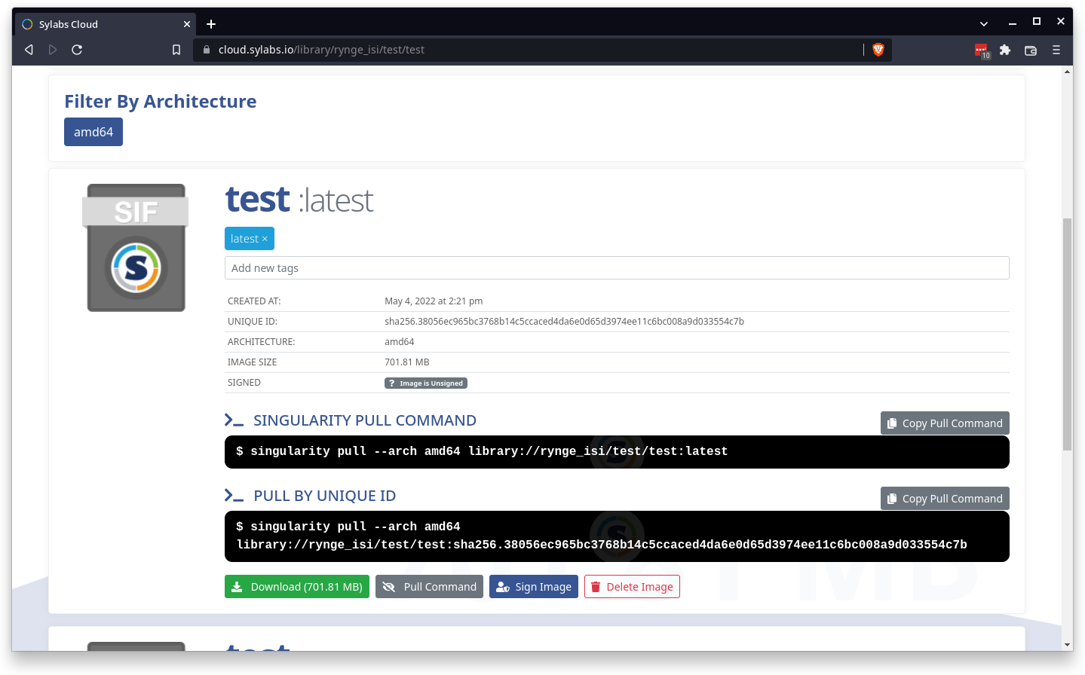
You can use the “pull command” on the OSGConnect access nodes

Slide 26
Download
[login05:~] $ singularity pull --arch amd64 \
library://rynge_isi/test/test:latest
[login05:~] $ ls -lh test_latest.sif
-rwxr-xr-x 1 rynge osg 702M May 16 18:41 test_latest.sif

Slide 27
[~] $ cat my-container.def
Bootstrap: docker
From: opensciencegrid/osgvo-ubuntu-20.04:latest
%post
apt-get update -y
apt-get install -y \
python3-pip \
python3-numpy
python3 -m pip install cowsay
[~] $ sudo singularity build /tmp/my-container.sif my-container.def
Only do this on your own machine - it will not work on OSGConnect servers

Slide 28
Outline
What are containers?
Why containers on the OSPool?
Finding existing containers
Building containers (Remote builder, On your own machine)
Test container on access points
Use containers in your jobs
Hey, how are GPUs related to all this?

Slide 29
Executing containers on access points
Containers can be tried out with the “singularity shell…” command
Your $HOME directory is automatically mounted, which give you an easy way to use your codes/data or compile inside the container, but access the results outside.
As always, do not run long or compute heavy jobs on the access points

Slide 30
[login05:~] $ singularity pull --arch amd64 library://rynge_isi/test/test:latest
INFO: Using cached image
[login05:~] $ singularity shell test_latest.sif
Singularity> python3
Python 3.8.10 (default, Sep 28 2021, 16:10:42)
[GCC 9.3.0] on linux
Type "help", "copyright", "credits" or "license" for more information.
>>> import cowsay
>>> cowsay.cow('Hello World')
___________
| Hello World |
===========
\
\
^__^
(oo)\_______
(__)\ )\/\
||----w |
|| ||

Slide 31
$HOME is automatically mounted
[login05:~] $ singularity shell test_latest.sif
Singularity> pwd
/home/rynge
Singularity> echo "Hello World" >mydata.txt
Singularity> exit
exit
[login05:~] $ cat mydata.txt
Hello World
Data (or for example executables) generated inside the container instance …
… is available “outside” because $HOME was automatically mounted

Slide 32
Outline
What are containers?
Why containers on the OSPool?
Finding existing containers
Building containers (Remote builder, On your own machine)
Test container on access points
Use containers in your jobs
Hey, how are GPUs related to all this?

Slide 33
Should you stash?
Option 1: put your .sif image anywhere under $HOME and just refer to it in the +SingularityImage attribute:
+SingularityImage = “./test_latest.sif”
Downside is that every job has to transfer the full image. Only do this for small sets of jobs.
Option 2: put your .sif image under /public/$USERNAME/ and prepend stash:///osgconnect/. Example:
+SingularityImage = “stash:///osgconnect/public/u/test_latest.sif”
Image is automatically cached.

Slide 34
Outline
What are containers?
Why containers on the OSPool?
Finding existing containers
Building containers (Remote builder, On your own machine)
Test container on access points
Use containers in your jobs
Hey, how are GPUs related to all this?

Slide 35

What is a GPU?
GPU = Graphical Processing Unit
Has hundreds to thousands of “cores” that can be used to parallelize work.

Slide 36
GPU Use Cases
Programs that map well to GPUs include:
Deep learning
Molecular dynamics
Anything with lots of number crunching (like matrix operations) and low(er) data load.

Slide 37
GPUs on the OSG
Scale: 100s (vs 10,000s of CPUs)
Variety of available GPU cards
Same restrictions as always: not sure what you’ll get, jobs can be interrupted
May take longer to start

Slide 38
Making robust GPU jobs
Use a software strategy that can run on different GPU types:
Container
Install inside the job
OR use job requirements to request certain kind of GPU (more limiting)

Slide 39
Submit File options
Request GPUs with “request_gpus”
Can use custom requirements
request_gpus = 1
requirements = (CUDACapability >= 6.0)

Slide 40
End

