Slide 1
Introduction to OSG
Tim Cartwright
OSG Deputy Executive Director and OSG User School Director
University of Wisconsin–Madison

Slide 2
Overview
So far, we have seen how to use HTC on one cluster
Sometimes, that is not enough!
(Don’t let computing hold back your science, remember?)
Today, we see what it takes to get more resources *
* Caveat: I will focus on compute resources; Wed. will focus on data.

Slide 3
What Do We Want?
Lots of resources – available, stretchy, & reliable
Submit locally, run globally (as close as possible)
Automation to get resources, manage them, and run jobs
Free would be nice! (But who is the owner?)

Slide 4
Yesterday
Access Point
$ ls
science.sub input.dat
$ condor_q
CHTC
https://sweetclipart.com/
https://www.flaticon.com/free-icons/server

Slide 5
The Goal
Syracuse
Access Point
$ ls
science.sub input.dat
$ condor_q
CHTC
Nebraska
UCSD
https://sweetclipart.com/
https://www.flaticon.com/free-icons/server

Slide 6
Demo, Part I

Slide 7
Behind the Curtain

Slide 8
Reasons for Continuing
So why learn more about OSG and the OSPool?
May change how you plan to run computing there
May change the way you use the Access Point
May change how you handle issues that arise
What is there to learn? (outline of rest of talk)
Concepts of OSG, Pool, and Access Point
How a pool or AP gets resources
How the OSPool differs from a local (CHTC) pool

Slide 9
What is OSG?

Slide 10
OSG Defined, Version 1
OSG is a Consortium:
The OSG consortium of research collaborations, campuses, national laboratories, and software providers is dedicated to the advancement of all open science via the practice of distributed High Throughput Computing (dHTC), and to the advancement of its state of the art. Established in 2005, the OSG operates a fabric of dHTC services for the National S&E community [OSG home page]
In this view, OSG is people, including:
Users: Researchers like you!
From individual PIs to international collaborations of thousands
Resource Providers
Fun fact: OSG does not own or operate most of the resources!
Team
We provide support, infrastructure, new features, etc.

Slide 11
OSG Defined, Version 2
Some people think of OSG as pools of resources (even though OSG does not own resources!)
What is a pool of resources?
Resources – a set of compute, storage, and other systems that can come and go over time
Services – software infrastructure that manages resources and makes features available
Access Point(s) – where users go

Slide 12
OSG Defined, Version 3
For a user, the Access Point is OSG (or part of it)
Where you go to do computing
Has access to resources (constantly changing)
Provides means for accessing data (see Wednesday)

Slide 13
OSPool Contributors (most)

Slide 14
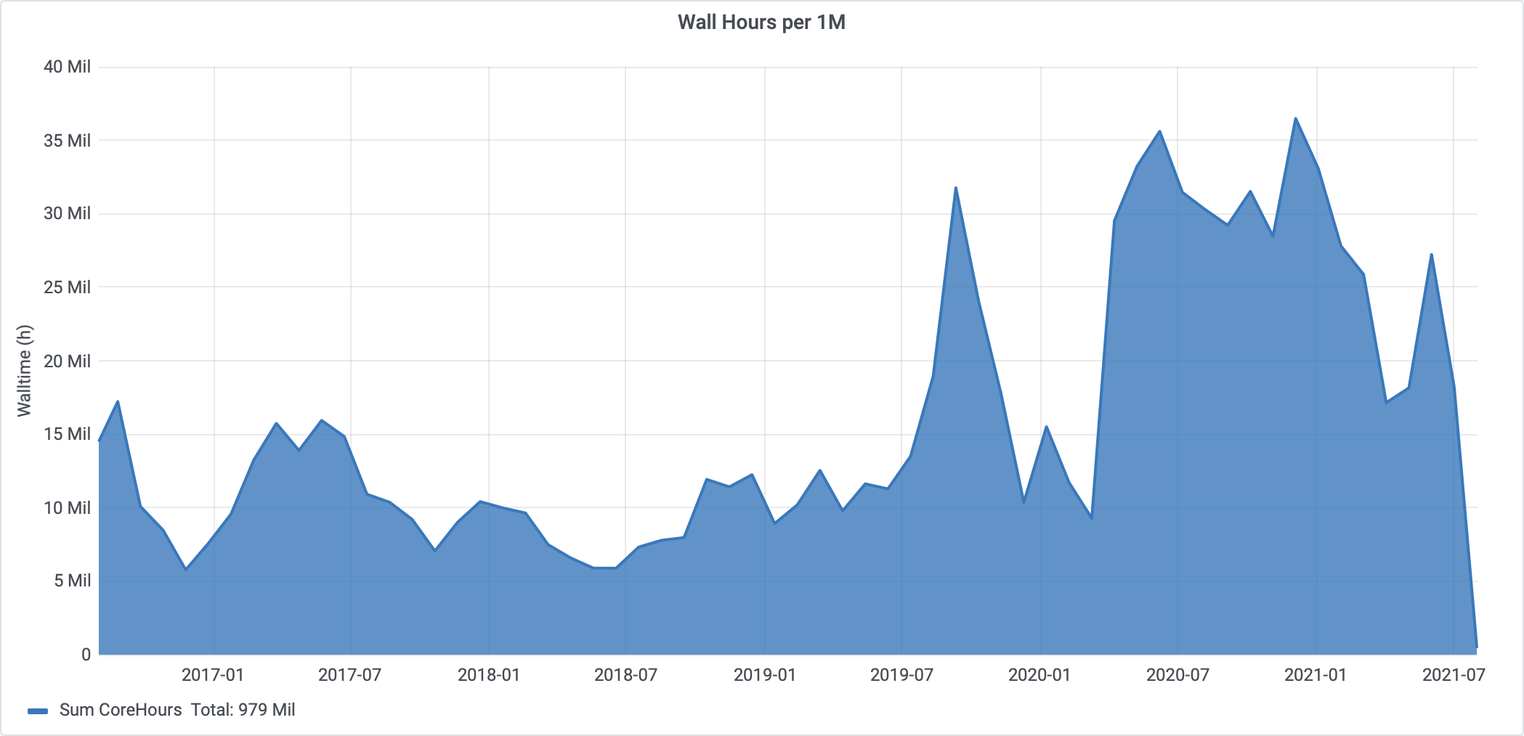
OSPool Usage

Slide 15
OSG: Getting Resources

Slide 16
How OSG Gets Resources
Individual resources are contributed by owners
OSG services consolidate resources into a Pool
Provide users with an Access Point into the Pool
Automate management of resources and jobs
Called distributed High Throughput Computing (dHTC)

Slide 17
OSG dHTC Diagram
1. Before OSG
Nothing available at Wisc. 😭
Wisconsin
Busy
Busy
Busy
Busy
Busy
Access Point
Job1.0
Job1.1
Job1.2
Job1.3
…
Job1.1999

Slide 18
OSG dHTC Diagram
2. Add resource contributors!
Wisconsin
Busy
Busy
Busy
Busy
Busy
Syracuse
Busy
Busy
Busy
Busy
Busy
Busy
Busy
Nebraska
Busy
Busy
Access Point
Job1.0
Job1.1
Job1.2
Job1.3
…
Job1.1999
Chicago
Busy
Busy
Busy
San Diego
Busy
Busy

Slide 19
OSG dHTC Diagram
3. Get resources (method #1)
Try to run “pilots” at sites
Wisconsin
Busy
Busy
Busy
Busy
Busy
Syracuse
Busy
OSG Pilot SU1
Busy
Busy
Busy
OSG Pilot SU4
OSG Pilot SU2
OSG Pilot SU3
Busy
Busy
Busy
Nebraska
OSG Pilot NU1
OSG Pilot NU2
Busy
Busy
Access Point
Job1.0
Job1.1
Job1.2
Job1.3
…
Job1.1999
Chicago
OSG Pilot UC2
OSG Pilot UC1
Busy
Busy
Busy
San Diego
OSG Pilot SD2
Busy
OSG Pilot SD1
OSG Pilot SD3
Busy

Slide 20
OSG dHTC Diagram
4. Pilots add resources to Pool
(I am not explaining how yet)
Wisconsin
Busy
Busy
Busy
Busy
Busy
Syracuse
Busy
OSG Pilot SU1
Busy
Busy
Busy
OSG Pilot SU4
OSG Pilot SU2
OSG Pilot SU3
Busy
Busy
Busy
Nebraska
OSG Pilot NU1
OSG Pilot NU2
Busy
Busy
AP
Job1.0
Job1.1
Job1.2
Job1.3
…
Job1.1999
Pool
OSG Pilot NU1 | idle
OSG Pilot NU2 | idle
OSG Pilot SD1 | idle
OSG Pilot SD2 | idle
OSG Pilot SD3 | idle
OSG Pilot UC1 | idle
OSG Pilot UC2 | idle
OSG Pilot SU1 | idle
OSG Pilot SU2 | idle
OSG Pilot SU3 | idle
OSG Pilot SU4 | idle
Chicago
OSG Pilot UC2
OSG Pilot UC1
Busy
Busy
Busy
San Diego
OSG Pilot SD2
Busy
OSG Pilot SD1
OSG Pilot SD3
Busy

Slide 21
OSG dHTC Diagram
5. Run jobs
HTCondor with AP & Pool
Wisconsin
Busy
Busy
Busy
Busy
Busy
Syracuse
Busy
SU1 > Job1.8
Busy
Busy
Busy
SU4 > idle
SU2 > Job1.12
SU3 > Job1.10
Busy
Busy
Busy
Nebraska
NU1 > Job1.4
NU2 > idle
Busy
Busy
AP
Job1.0
Job1.1
Job1.2
Job1.3
…
Job1.1999
Pool
OSG Pilot NU1 | Job1.4
OSG Pilot NU2 | idle
OSG Pilot SD1 | Job1.0
OSG Pilot SD2 | Job1.3
OSG Pilot SD3 | idle
OSG Pilot UC1 | Job1.2
OSG Pilot UC2 | Job1.6
OSG Pilot SU1 | Job1.8
OSG Pilot SU2 | Job1.12
OSG Pilot SU3 | Job1.10
OSG Pilot SU4 | idle
Chicago
UC2 > Job1.6
UC1 > Job1.2
Busy
Busy
Busy
San Diego
SD2 > Job1.3
Busy
SD1 > Job1.0
SD3 > idle
Busy

Slide 22
OSG dHTC Diagram
6. Get resources (method #2)
Site contributes directly
Wisconsin
Busy
Busy
Busy
Busy
Busy
Syracuse
Busy
SU1 > Job1.8
Busy
Busy
Busy
SU4 > idle
SU2 > Job1.12
SU3 > Job1.10
Busy
SU Pilot OG1
Busy
Busy
Nebraska
NU1 > Job1.4
NU2 > idle
Busy
Busy
Queue
Job1.0
Job1.1
Job1.2
Job1.3
…
Job1.1999
Pool
OSG Pilot NU1 | Job1.4
OSG Pilot NU2 | idle
OSG Pilot SD1 | Job1.0
OSG Pilot SD2 | Job1.3
OSG Pilot SD3 | idle
OSG Pilot UC1 | Job1.2
OSG Pilot UC2 | Job1.6
OSG Pilot SU1 | Job1.8
OSG Pilot SU2 | Job1.12
OSG Pilot SU3 | Job1.10
OSG Pilot SU4 | idle
SU Pilot OG1 | idle
Chicago
UC2 > Job1.6
UC1 > Job1.2
Busy
Busy
Busy
San Diego
SD2 > Job1.3
Busy
SD1 > Job1.0
SD3 > idle
Busy

Slide 23
OSG dHTC – A Few Details
Notes on the pilot method of getting resources
Pilots are special jobs to request resources from other sites
OSG runs a service to submit pilots to contributing sites
A site runs a pilot when they want to contribute more resources
A pilot job runs part of HTCondor itself, reporting the actual resource back to the Pool
Pilots expire after a while or when idle, or are kicked off
OSG and HTCondor manage/automate the details!

Slide 24
Open Science Pool
Open Science Pool (OSPool): for all of Open Science
It has many Access Points (e.g., projects, campuses)
OSG Connect provides Access Points for US projects (including collaborators)
Other pools exist for specific groups
Collaborations (e.g., gravitational-wave projects)
Projects (e.g., DUNE neutrino physics project)
Campuses (e.g., HCC at University of Nebraska)

Slide 25
OSG: Usage

Slide 26
OSG Is HTCondor
OSG (e.g., OSPool) has HTCondor pools:
You have condor_q, condor_submit, DAGMan, etc.
OSPool bonus features!
More resources (usually) than a typical local system
Some storage on Access Point (Data lecture, Wed.)
Some special resources, like GPUs (GPU topic, Fri.)
How does OSPool differ from local one? Variety

Slide 27
Varied Hardware
Wider variety of CPUs (type, speed), memory, …
Request what you need in submit files
(request_cpus, request_memory, request_disk)
Some specific hardware may be specified; search for documentation or contact us
Often in submit-file requirements expression
Example: GPU needs (ask us!)

Slide 28
Varied OSs and Software
Varied Operating Systems
All Linux, mostly recent, but lots of variation
Changes to CentOS 8 => new variants (e.g., Alma)
Software on the Access Point probably won’t exist on Execution Points! (e.g., specific Python version)
Your software
Never assume your software is on Execution Points
The Software lecture (later today) is on this topic!

Slide 29
Varied Access to Data
No shared filesystem
Unlike some local clusters with shared filesystems
Thus, files must be transferred to Execution Points
There are many ways to handle data
Data lecture is Wednesday morning

Slide 30
Varied Policies
Individual sites/clusters have their own policies
Example: Whether to kill jobs that exceed memory
Example: Maximum run-time of a job (or its pilot)
If possible, set requirements for what you need
But this does not help with, e.g., maximum run-time
Generally, try to make “OSG-sized” jobs (see next)

Slide 31
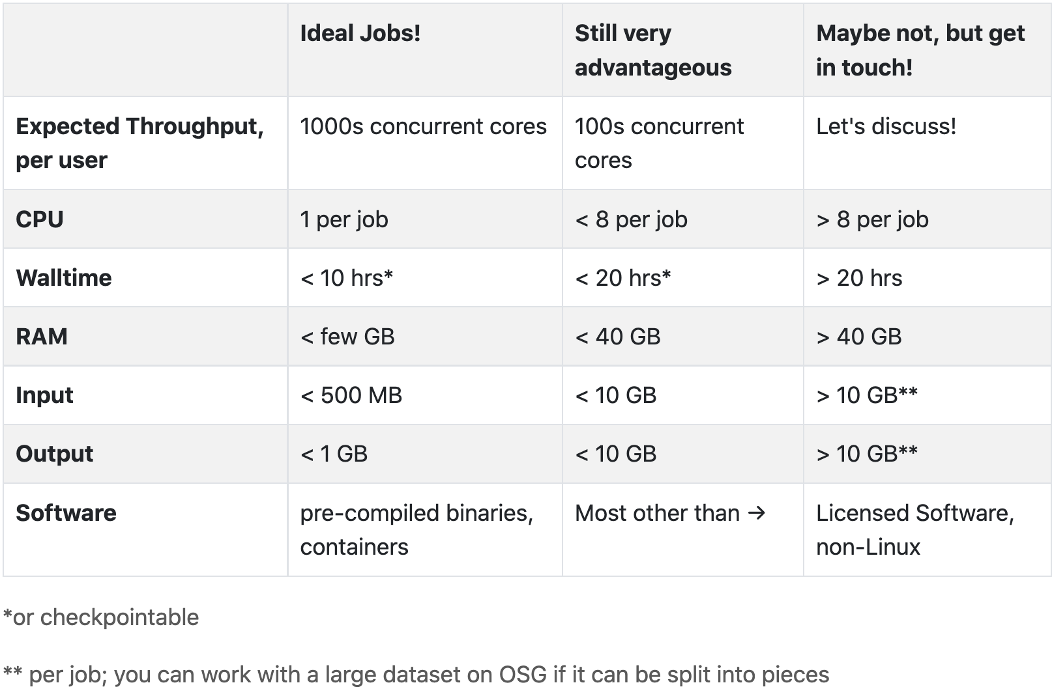
What Makes a Good OSG Job?

Slide 32
More OSG Tips – Security
Computer security is hard — read the headlines!
OSG does its best, but no system is perfect
Some suggestions:
Use strong, distinct passwords for each account
Do not share your account
Avoid world-writable directories and files
Avoid sensitive software and data (no HIPAA!)
Do not try to work around security barriers; contact us to help meet your goals in a safe way

Slide 33
Acknowledgements

Slide 34
You Can Acknowledge OSG!
If you publish or present results that benefitted from using OSG, please acknowledge us!
https://osg-htc.org/acknowledging

Slide 35
Acknowledgements
OSG team, especially Brian Lin, Christina Koch, Mats Rynge, and Jason Patton
This work was supported by NSF grants MPS-1148698, OAC-1836650, and OAC-2030508

Slide 36
Demo, Part II

