Slide 1
Special Environments
There are 2 hard problems in computer science: cache invalidation, naming things, and off-by-1 errors.
Thursday, July 28 2022
Mats Rynge
This work was supported by NSF grants MPS-1148698, OAC-1836650, and OAC-2030508

Slide 2
How do I …
… run GPU jobs?
… find out if my home institution is sharing resources on the OSPool?
… target operating systems?
… my jobs run on the fastest nodes?
… target CPU architecture / extensions?
… find details about the execution points?

Slide 3

What is a GPU?
GPU = Graphical Processing Unit
Has hundreds to thousands of “cores” that can be used to parallelize work.

Slide 4
GPU Use Cases
Programs that map well to GPUs include:
Deep learning
Molecular dynamics
Anything with lots of number crunching (like matrix operations) and low(er) data load.

Slide 5
Submit File options
Request GPUs with “request_gpus”
Can use custom requirements
request_gpus = 1
requirements = (GPUs_Capability >= 8.0)

Slide 6
requirements = (GPUs_Capability >= 8.0)
requirements = (OSGVO_OS_STRING == "RHEL 8") requirements = (HAS_CVMFS_oasis_opensciencegrid_org == TRUE) && (IsOsgVoContainer =!= True)

Slide 7

Classads
Jobs and machines are described in classads
key = value
Matchmaking is two ways - jobs can have requirements on the machines, and the machines can have requirements on the jobs

Slide 8
condor_status
condor_status
. . .
slot1_1@glidein_47384_72490500@wn-ha-40.gina.surfsara.nl LINUX X86_64 Claimed Busy
slot1@glidein_47378_404190132@wn-ha-41.gina.surfsara.nl LINUX X86_64 Unclaimed Idle
slot1_1@glidein_47378_404190132@wn-ha-41.gina.surfsara.nl LINUX X86_64 Claimed Busy
Total Owner Claimed Unclaimed Matched Preempting Backfill Drain
X86_64/LINUX 36630 0 33892 2691 0 47 0 0
Total 36630 0 33892 2691 0 47 0 0

Slide 9
Pick one entry, use -l
condor_status -l slot1@glidein_39459_618000737@uct2-c566.mwt2.org
CPUs = 24
GLIDEIN_ResourceName = "MWT2"
GLIDEIN_Site = "UChicago"
has_avx2 = true
JobStarts = 60
LoadAvg = 1.0
Memory = 64293
Microarch = "x86_64-v3"
Mips = 23578
OSGVO_OS_STRING = "RHEL 8
OSGVO_CPU_MODEL = "AMD EPYC 7402 24-Core Processor"
START = (Owner == “rynge”)

Slide 10
Autoformat
condor_status -autoformat GLIDEIN_Site | sort | uniq -c
190 UConn-HPC
39 University of Arkansas - Fayetteville
33 University of Arkansas for Medical Sciences
105 University of Kansas
102 University of South Dakota
2497 UNL-PATH
524 USD-Lawrence
7 USF
48 UTC-Epyc
34 UW-IT
25 Wichita State University
1514 Wisconsin
2490 WISC-PATH
65 WTAMU-HPC

Slide 11
Fastest machine
condor_status -autoformat Mips GLIDEIN_ResourceName | sort -n | head
38446 Colorado

Slide 12
Only run jobs on faster than…
job.sub
requirements = Mips > 25000

Slide 13
Operating Systems
condor_status -autoformat OSGVO_OS_STRING | sort | uniq -c
1078 DEBIAN 12
13809 RHEL 7
28388 RHEL 8
2550 RHEL 9
183 UBUNTU 20
1078 UBUNTU 22

Slide 14
Pick an OS
job.sub
requirements = (OSGVO_OS_STRING == "RHEL 8")

Slide 15
Or bring an OS
job.sub
container_image = “/cvmfs/singularity.opensciencegrid.org/htc/debian:12”

Slide 16
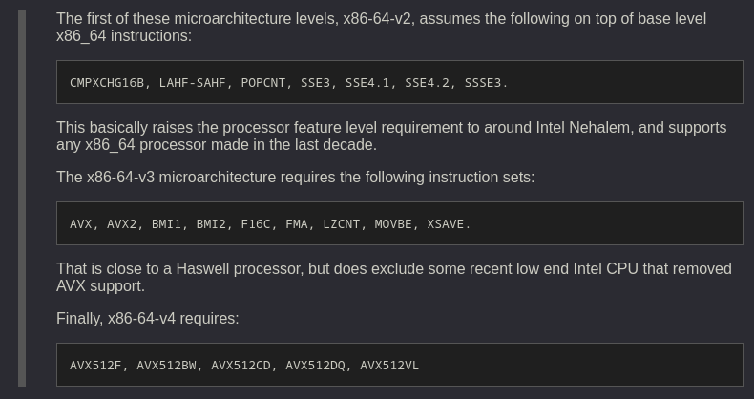
Microarch == "x86_64-v3"

Slide 17
Exercises

