Slide 1
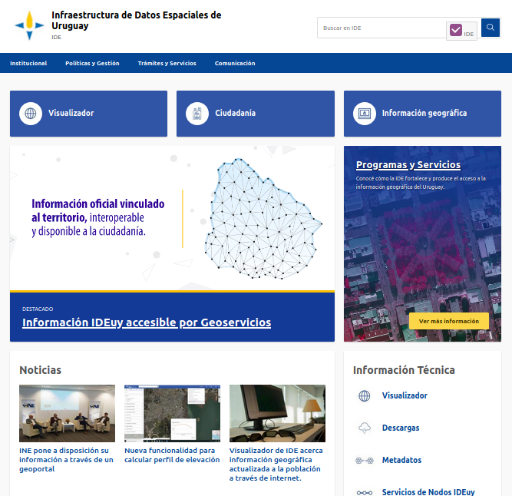
Spatial Data Infrastructure and Central Address System of Uruguay

Slide 2

gvSIG Association
A short introduction...

Slide 3
gvSIG Association
About us
It was born in 2010 within the frame of the gvSIG Project.
Composed of companies (Members) and non business entities (Honour Members). Collaborators and distributors. Reduce asymmetries between countries.
The biggest international network of experts in free geomatics.
References and clients in +30 countries. Software used in +160 countries.
Experience in SDI projects, corporative GIS and free geomatics for public and private entities.
We participate at the main forum and organizations: ISO/TC 211 (AEN/CNT148), OSGeo, OGC, INSPIRE, ICA, GT-IDEE, GODAN, GeoforAll,...

Slide 4
gvSIG Association
Awards and recognitions
2020:
  “Sustainable Entrepreneur” at Innovation+Sustainability+Network Awards by Expansión, Bankinter and Viesgo
2017:
  1st prize in “Cross-border category” at “Sharing & Reuse Awards” of European Commission.
  “Europa Challenge” in Helsinki awarded by NASA to the gvSIG Suite,
  Excellence “Internationalization” Award given by the Professional Union of Valencia.
  “ITC Promoter organization” prize awarded by the Valencian Telecommunications.
2016:
  “Europa Challenge” awarded by NASA (World Wind integration with gvSIG Online).
  “Best open source mobile software” and “Most revolutionary software” Open source software awards.
2015:
  “Europa Challenge” awarded by NASA (World Wind integration with gvSIG Desktop).

Slide 5


























gvSIG Association
Who has trusted us... Examples

Slide 6
Catalog of gvSIG solutions
gvSIG Desktop: Desktop Geographic Information System. It includes different extensions for editing, 3D analysis, geoprocessing, maps, etc.
gvSIG Online: Integral platform for Spatial Data Infrastructure (SDI) implementation.
gvSIG Mobile/gvSIG MApps: Geographic Information System for mobile devices. Oriented to take field data.

Slide 7

Context of Uruguay SDI

Slide 8
New problems and challenges
Technological advancement allows to produce, store and process geographic information in an easier and cheaper way.
But this also causes confusion about the quality of the information, differences in formats, interoperability problems, overlaps and a mismatch between the specific demands of the institutions and the solutions finally adopted.
SDIs present an institutional solution supported and tested in a lot of national and sub-national contexts, to solve the problems identified.
Geographic information as a fundamental public policy instrument.

Slide 9
New problems and challenges
Need to strengthen the capacities of public agencies to use geographic information
Consolidation of spaces for exchange and technical coordination related to geographic information
October 2013: the "Spatial Data Infrastructure" was created by law
The success of Uruguay SDI lies in the conviction that the public availability of updated, official, certified and interoperable geographic information constitutes a fundamental infrastructure for Sustainable Development and that it is, therefore, a public good

Slide 10
Images production and DEM
Production and dissemination of updated, official, certified and interoperable basic geographic information, making it available for citizens, public institutions and companies, as open data to promote creativity and social and economic development
Dissemination of information as open data in a quality environment (SDI / Geoportal)
Tender in December 2015 / awarding in August 2016
Digital images with 0.32 resolution, DEM, basins cartography, population centers, contour lines, hydrography, apparent limits
Digital images with 0.10 resolution in downtown, DEM and Surface, Cartography …

Slide 11
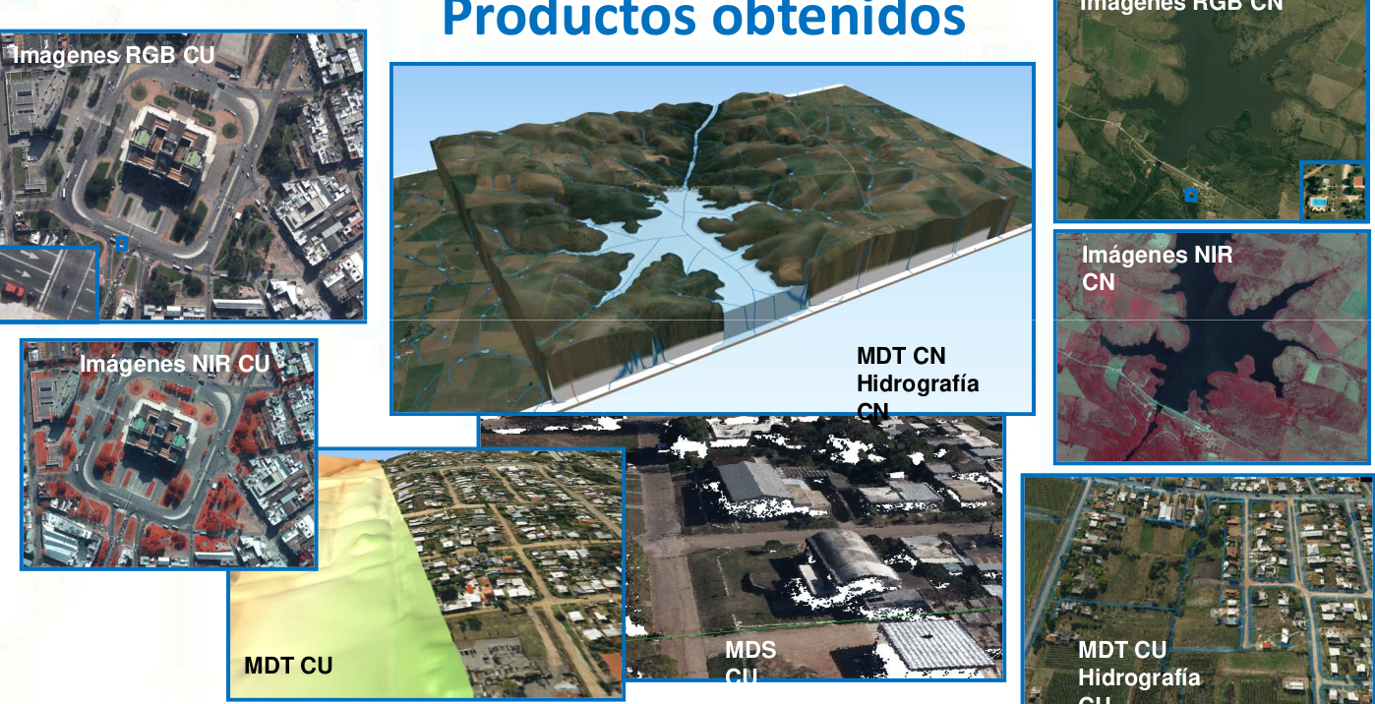

Slide 12
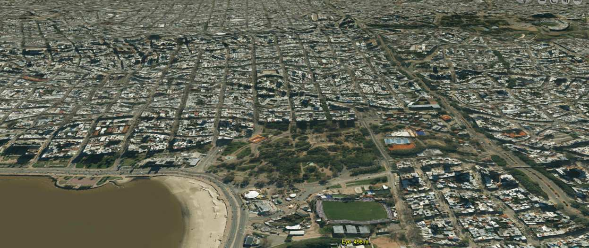
Uruguay SDI https://www.gub.uy/infraestructura-datos-espaciales/

Slide 13
Geoportal
Free technology: gvSIG Online. Developed by gvSIG Association.
Through the Uruguay SDI, all the official cartographic information of the Uruguayan State is available for the citizens, as open data.
Queries, measurement, view sharing, selecting, printing tools, vector file import, standard services import (WMS, WFS), downloads, drawing tools, elevation profiles, GPS location, coordinate calculator, ...
2D viewer and 3D viewer
Metadata catalog
Integration with the National Address System

Slide 14
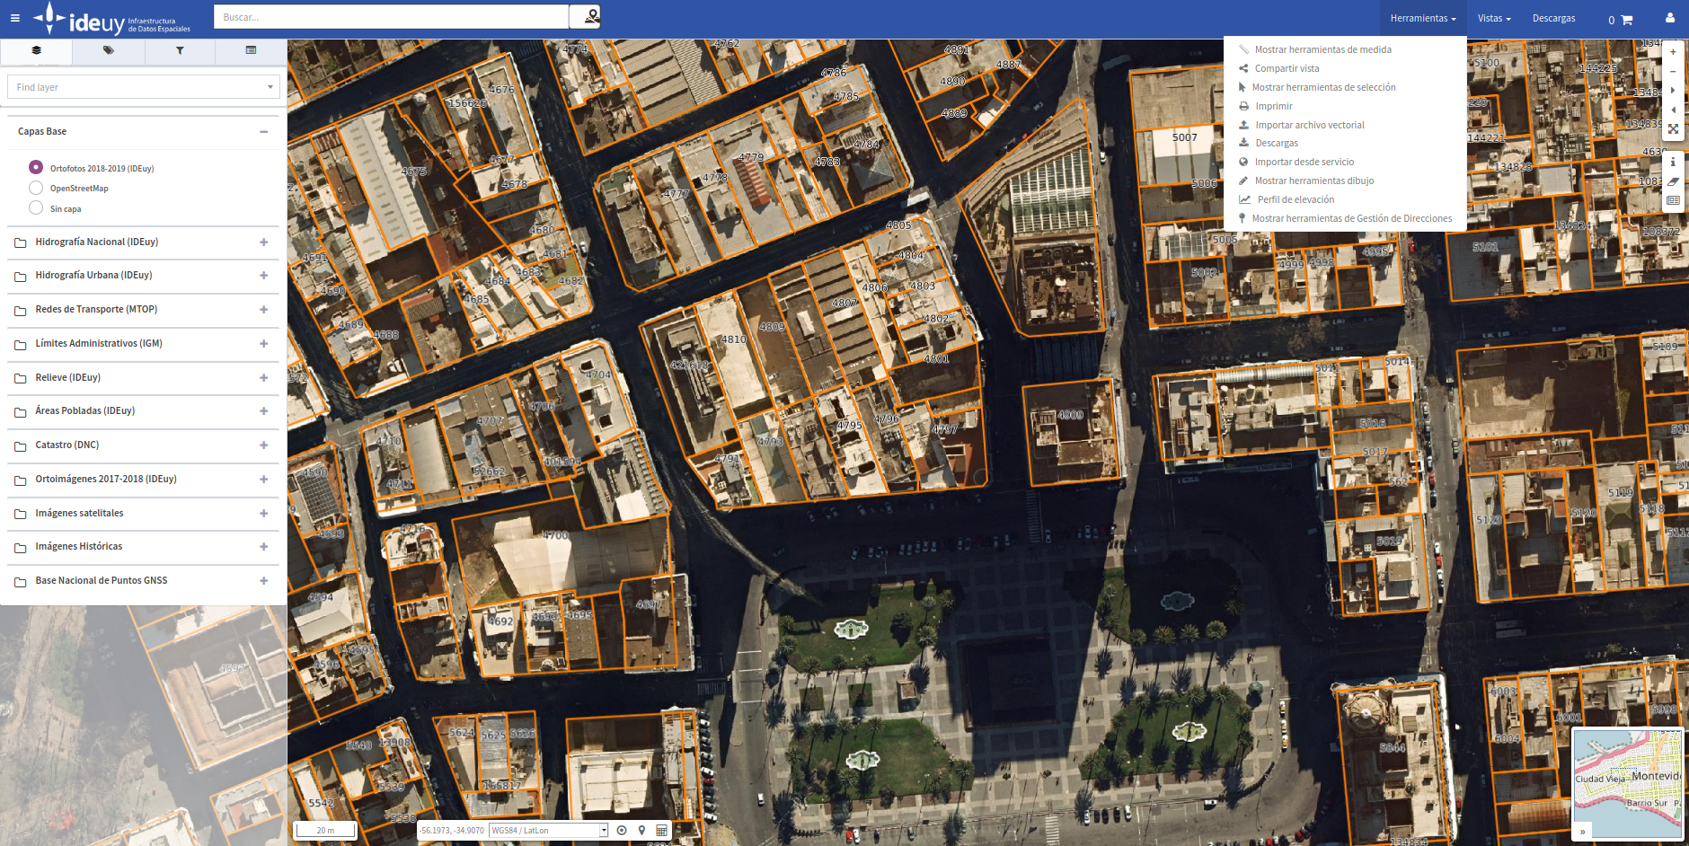
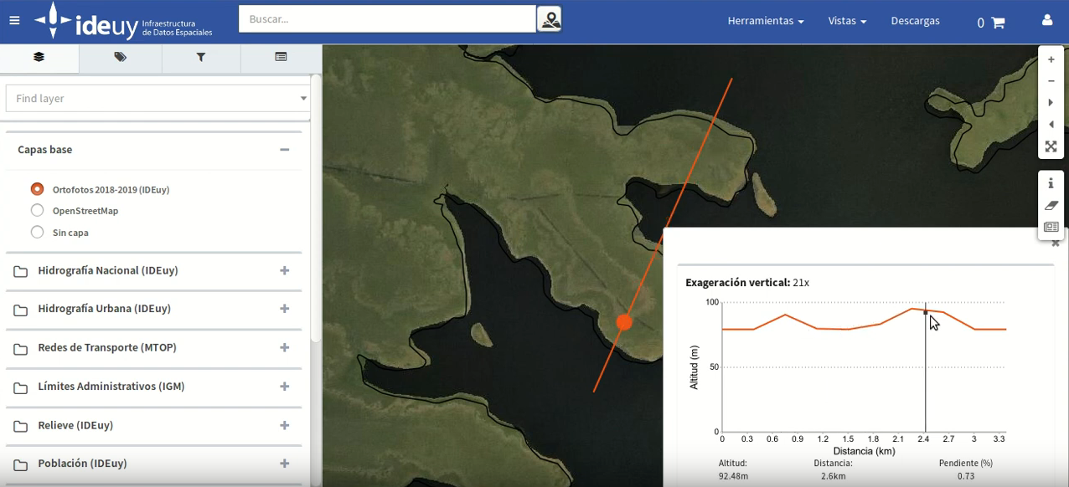

Slide 15
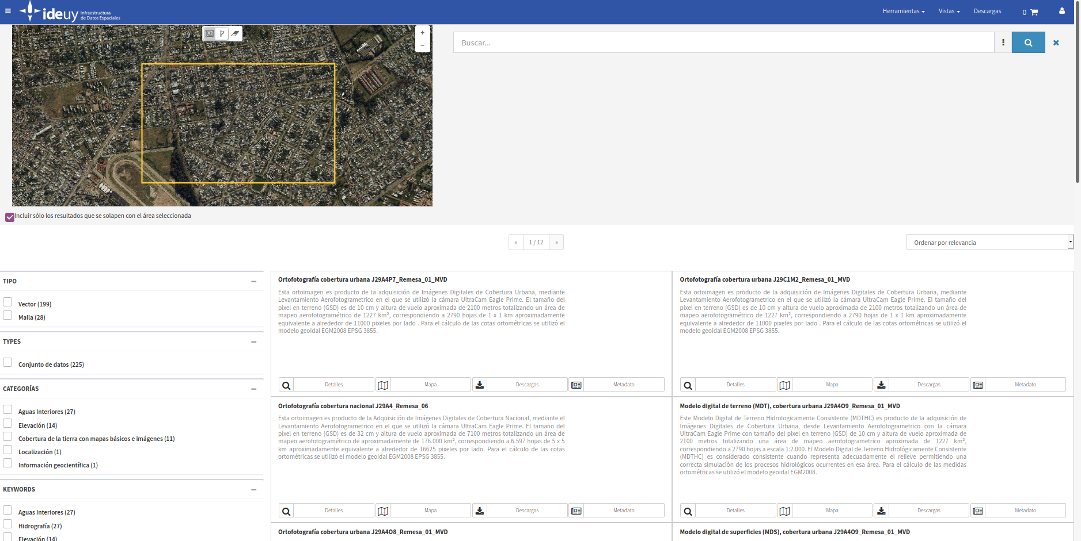
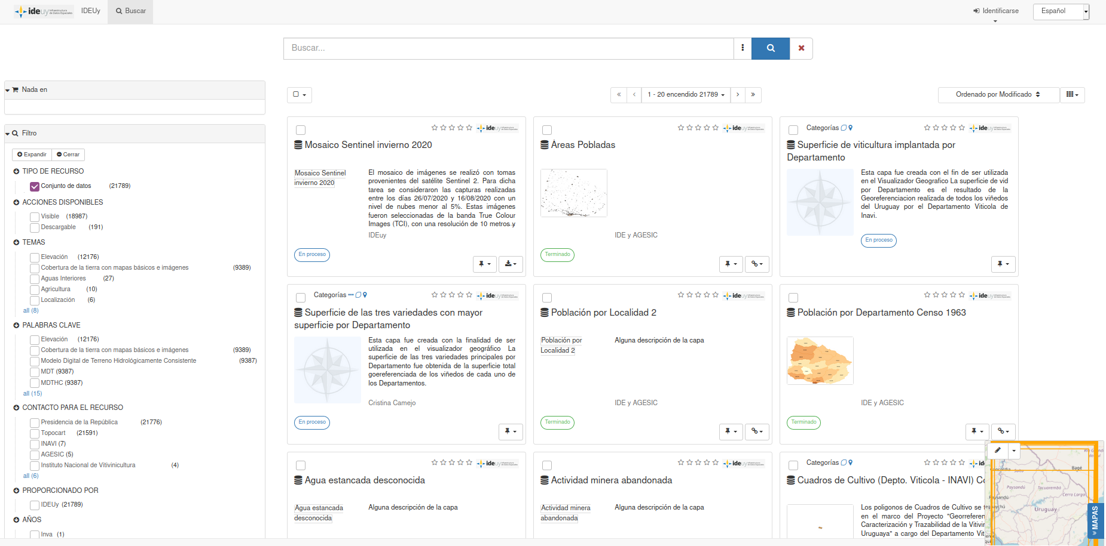

Slide 16
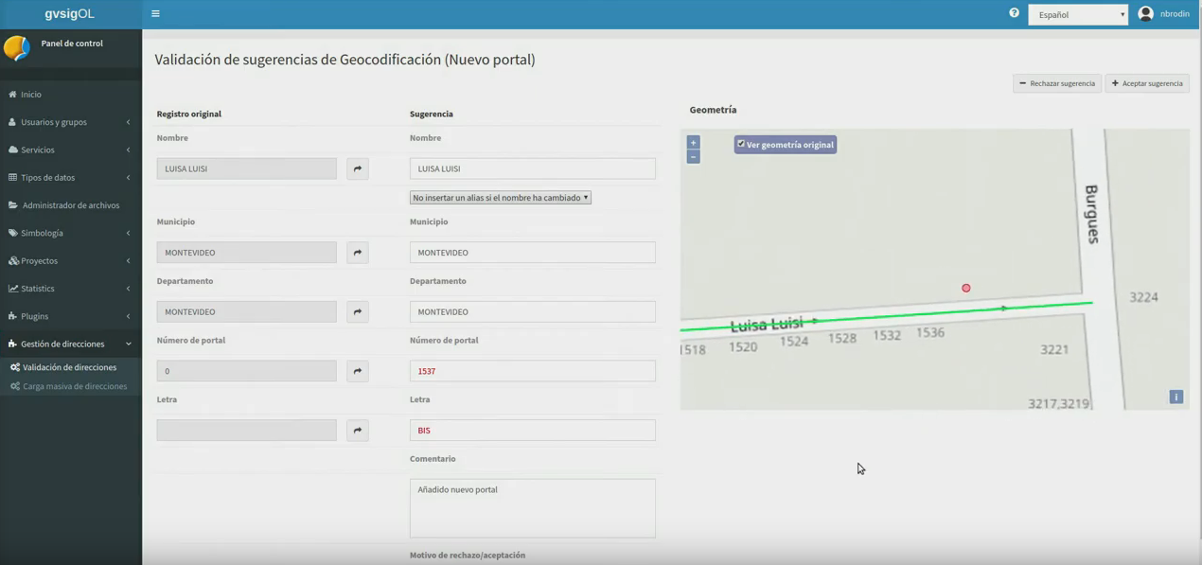
Central Address System https://www.gub.uy/infraestructura-datos-espaciales/tramites-y-servicios/servicios/servicio-direcciones-geograficas

Slide 17
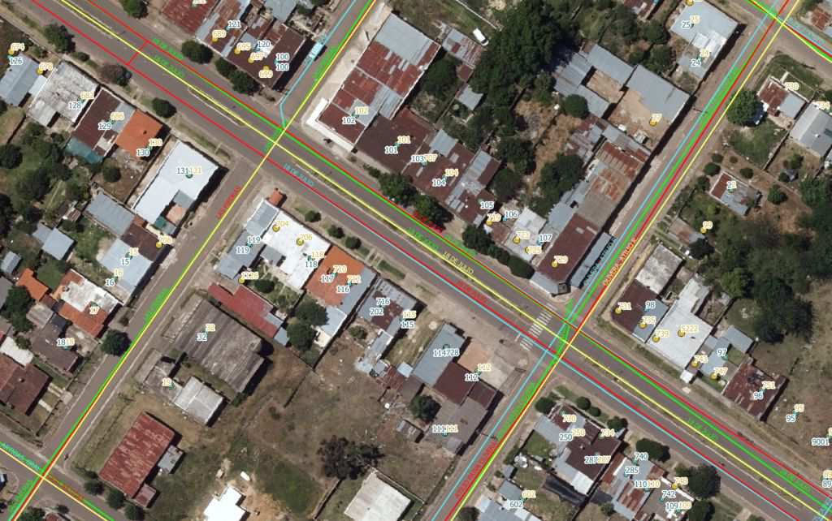
Starting situation

Slide 18
Objective
Single operational address database
Address and Related Data Management (ABM)
Data integration from external sources
Access through web services (Restful and Soap)
System use monitoring and statistics
Tender in 2018. Project starts in 2019: gvSIG Association

Slide 19
Solution
Technological base: gvSIG Suite / gvSIG Online
Integrated with the SDI.
Tools to add or suggest changes are available in the Geoportal. It includes topology validator in the administration area
Creation of services to search for addresses, municipalities, etc.

Slide 20
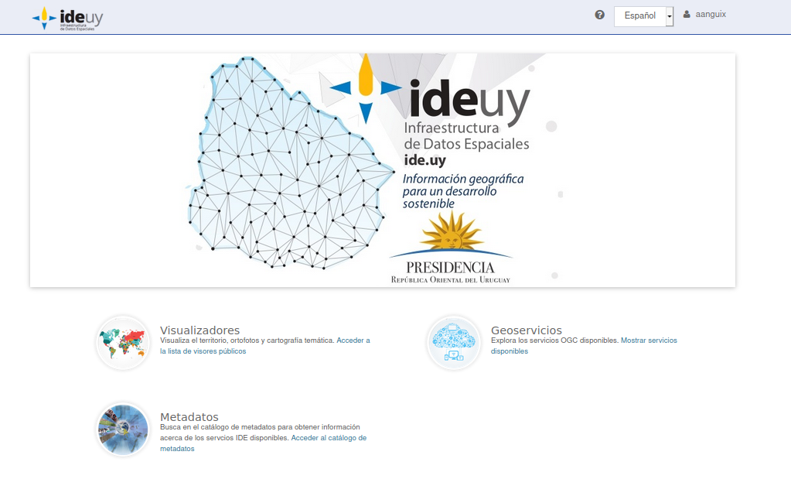
And growing...

Slide 21
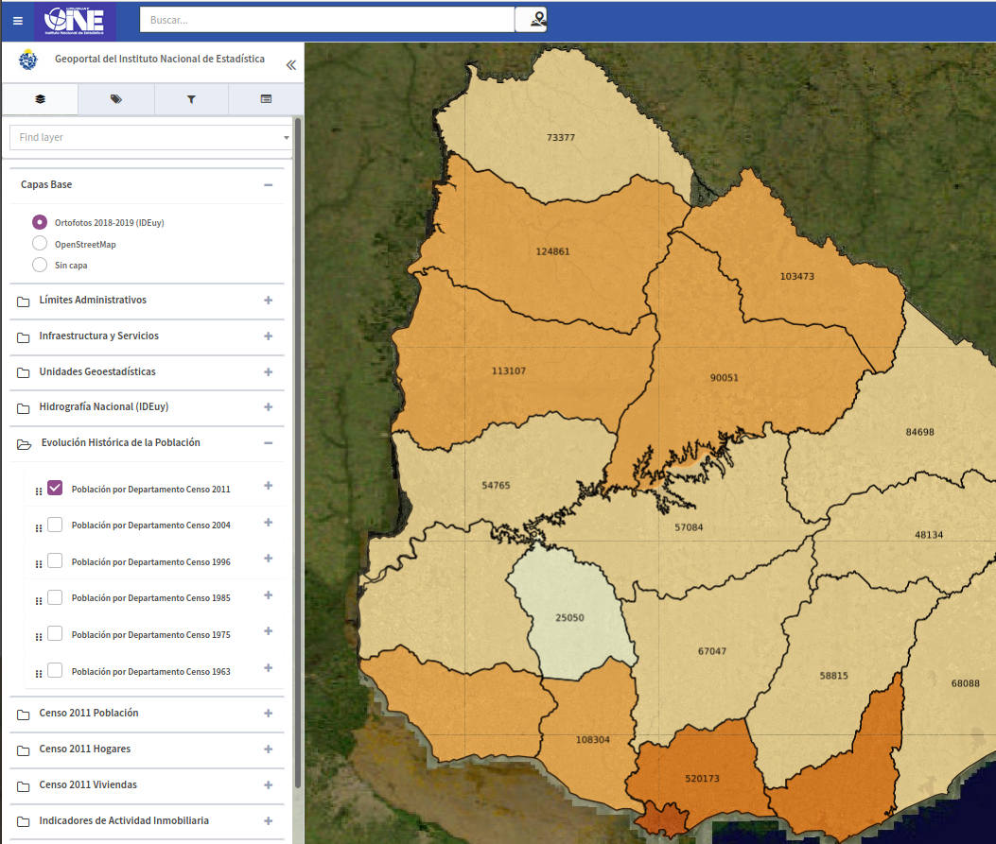
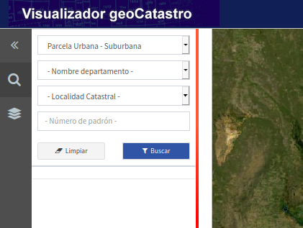
New geoportals and tools
Cadastre
National Statistics Institute
INAVI (Viticulture)
COVID

Slide 22







Follow us...
https://www.facebook.com/gvSIG/
@gvsig
https://www.linkedin.com/groups/4478025
Contact us: info@gvsig.com
gvSIG Blog, to be up to date: https://blog.gvsig.org/
www.gvsig.com

