Slide 1
RFC14 Accounting API
Lars Eriksson, Telia

Slide 2
Contents
Requirements
Payment Flow
Charge Event Descriptor
Security
Examples
Open issues

Slide 3
Changes from last version
A more generic charge event definition
Security mechanism added

Slide 4
Requirements
Event-driven charging mechanism
Flexible security mechanism
  The requirement of security depends both on the surrounding environment and the application
  Should not mess up the code too much
  No shared keys
  Should be not resource-consuming to check the integrity of a charge request
Simple to use

Slide 5
Flow – initiation
1.Bundle obtains
charge event
template
2. Bundle sets
session-specific
information
3.Trust-establishment
between bundle and
accounting system

Slide 6
Flow – charge
1.Bundle creates a
Charge event
instance
2.Bundle sends
Charge event
3.Bundle await until
the charge event is
accepted by the system
4.Bundle commits
the charge event
5.Bundle awaits
response from system

Slide 7
Charge Event descriptor
Very similar to Charge Detail Record (CDR)
Attributes are set at three level:
  System attributes
  Session
  Run-time attributes
Attributes are checked against meta-type definition by accounting system
Bundle cannot modify system attributes
Bundle cannot modify session attributes when first instance of a charge event description is created

Slide 8
Charge Event Descriptor
CEDTemplateFactory
CEDTemplate
CEDInstance

Slide 9
Security Mechanism
Relies on the theory of hash-chains
A hash-chain is a set of iteratively computed hashvalues placed in reversed order.
If { x, y, z } defines a hash-chain it follows
that x = H(y) = H(H(z)) and y=H(z) and z is an arbitrary choosen number and H is a strong one-way hash-algorithm like MD5, SHA …
Many micropayment-schemes is based on hash-chains.

Slide 10
Security Mechanism (con’t)
Basic flow
  Alice obtains or compute a hash-chain
  Alice sends the first token X in hash-chain to Bob, encrypted with her private key
  Bob checks the Alice’s certficate and stores token X
  Alice sends the next token Y in hash-chain to bob, unencrypted.
  Bob checks the token Y that H(X)=Y. If it match, the sender must have send token X. When Alice encrypted X with hers private key it implies that Alice sent token Y.

Slide 11
Security Mechanism (con’t)
Weaknesses
  The hash-chain must be kept SECRET
  The chain itself does not authenticate the sender but it keeps it probable that the last token originated from the sender if the last token was not cracked
  Possible attacks: Brute-force probably using “Birthday” attacks: 50% chance to find a “similar” message (with the same hash-value) within 2^{M/2} variations of the message. M denotes the length of hash-value generated by the hash-value. IMPORTANT TO REQUIRE A CORRECT MESSAGE.

Slide 12
Charge Security Mechanism
Contains of two steps:
  1.trust establishment
  2.message exchange

Slide 13
Trust Establishment
When a trust establishment takes place the both bundles exchange signed tokens with each other
Must include a challenge to prevent reply-attacks.
The exchanged token denotes the start of the chain. A chain cannot be unlimited in size and therefore the parties must redo the trust establishment or when the opponent bundle does not accept the token anymore
Trust is inside the PKI. The asymmetric keys could be replaced with a shared key algorithm.

Slide 14
Message exchange
The message is exchanged combined with:
  The present token
  The message authenticated with a secret.
  Which one? The next token in chain
This implies that the message cannot be checked until the next message is sent.
Otherwise must both parties knows the hash-chain and that is unacceptable.

Slide 15
Strengths
No shared secrets
HMAC can be calculated efficiently
The bundles can control the degree of security. In some cases, each charge event starts with a trust establishment. In other cases, the bundles uses very long chains and authenticate to each other with well-known (!) secret keys.

Slide 16
Flaws
Latency to validate message. The bundle may risk that the last sent message is bogus.
The bundle must be careful when implementing a charge mechanism
The parameters of a charge event can still be modified before the bundle submits it to the accounting system.

Slide 17
Example – Print-On-Demand
The service user pays for printer usage. A fixed amount for each paper.
The printer is equipped with a smart card reader.
The printer requires a smart card with (a very long) pre-generated hash-chain, a private key (to sign tokens) and ACL of trustworthy endpoints.

Slide 18
Example – Print-On-Demand
Entities
  Printer
  PC
  Framework
  Operator (Charging server)
  Printer Provider

Slide 19
Example – trust establishment
{x, y, z, ….}
PC
Printer
6.validateToken()
Printer
driver
2.requestSignedToken()
Encrypted x with
printer’s private key
1.print()
{a, b, c, ….}
OSGi
{a, b, c, ….}
Printer
Bundle
Printer
Provider
4.validateKey()
Operator
3.createSession()
Accounting
Bundle
Encrypted first token
A pre-generated hash-chains contains
10 tokens (secured transport)

Slide 20
Example – charge event exchange
7.validateToken(b) and so forth…
{x, y, z, ….}
PC
Printer
4.validateToken(a) … and print
Returns token Z
Printer
driver
1. spoolPage()
Returns token Y
OSGi
{a, b, c, ….}
Printer
Bundle
Printer
Provider
Operator
2.chargeAndCommit()
Accounting
Bundle
5.getReceipt()
3.validateToken(Y)
Returns token a
6.validateToken(Z)
Returns token b

Slide 21
Example – comments
The the operator ran out of tokens a new trust establishment phase must occur.
If the printer ran out of tokens a new smart card must be delivered to the user

Slide 22
Open issues
Choice of hash-algorithm
Length of hash-key
(security vs performance)
Message encoding

Slide 23
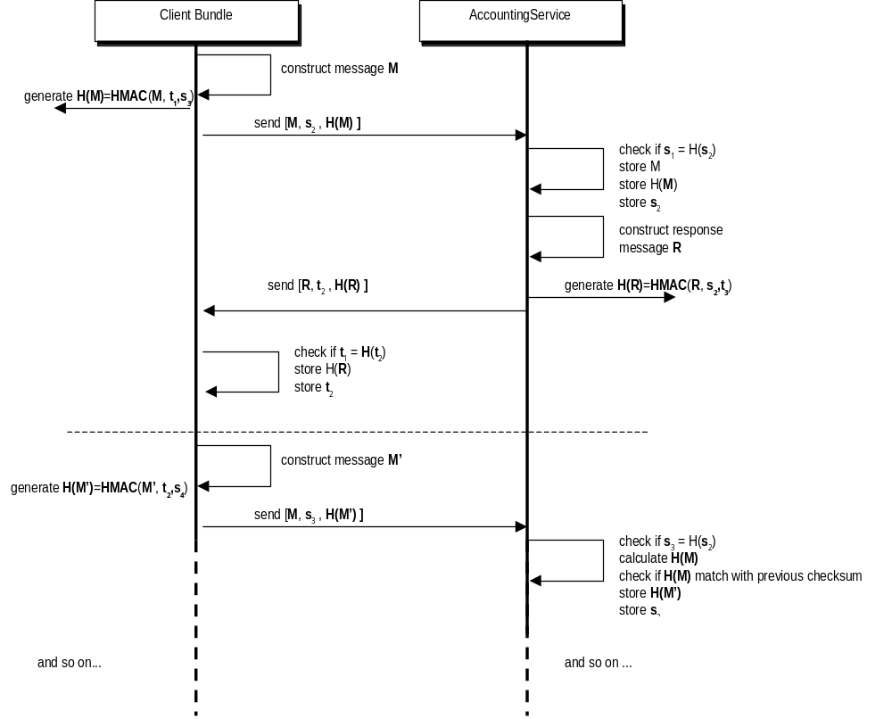
Sequence

