Slide 1
Spring & OSGi Combined
- Short Tutorial –
Exercises
Martin Lippert (akquinet agile GmbH)
BJ Hargrave (IBM Lotus)

Slide 2
Set up for examples
Need Eclipse IDE
  Either 3.3M5 or 3.2 is fine.
JDK 5.0
  Some of the example code uses JavaTM 5 constructs
  Spring does not work with Sun JDK 1.4 Crimson XML parser
New workspace loaded with example code and development target bundles.
  Can be loaded from CVS with a Team Project Set
  Can import existing projects into workspace from local storage (e.g. CD-ROM image).

Slide 3
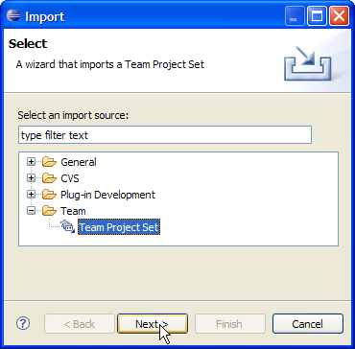
Preparing the Workspace – load from project set
Use the Team Project Set to load the workspace
Select File->Import…
and then Team Project Set

Slide 4
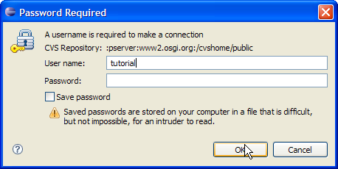
Preparing the Workspace – load from project set
Select the Team Project Set file
  SpringOSGi.psf [1]
and click Finish
The CVS user name is
  tutorial
No password should be entered
This will load the projects into the workspace
Next we need to set the target and rebuild the workspace
[1] http://www2.osgi.org/viewvc/viewvc.cgi/public/eclipsecon07.springosgi/0.Setup/SpringOSGi.psf

Slide 5
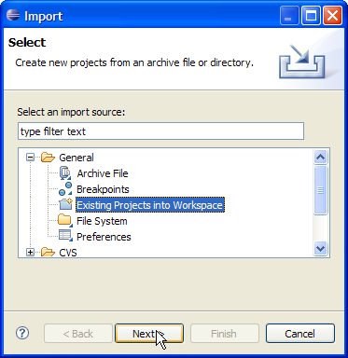
Preparing the Workspace – import existing projects
You can also import the projects from a local storage device
Select File->Import…
and then Existing Projects into Workspace

Slide 6
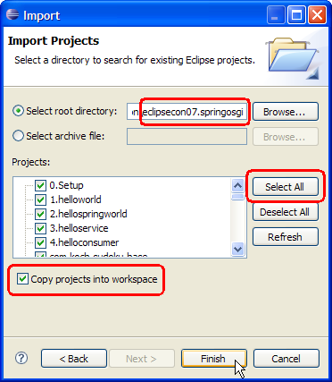
Preparing the Workspace – import existing projects
Select the eclipsecon07.springosgi folder
Make sure all the projects are selected
You will probably want to copy the projects into your new workspace

Slide 7
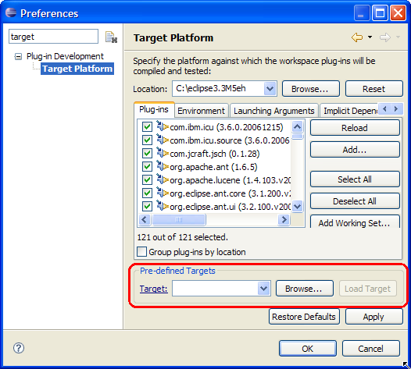
Setting the Target Platform
Next we need to set the target platform
Select Window->Preferences…
and go to the Target Platform page
We are going to load a Pre-defined Target from the workspace

Slide 8
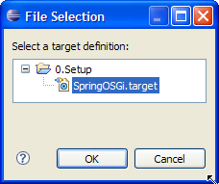
Setting the Target Platform
Click Browse… in the Pre-defined Target area
and select the SpringOSGi.target file in the 0.Setup project
Click OK

Slide 9
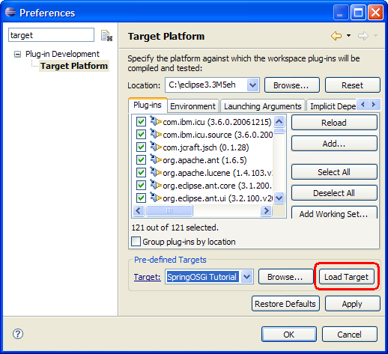
Setting the Target Platform
Now click Load Target
On 3.3M5, I have noticed this may be grayed out
Just select a different item from the Target pull down and then reselect SpringOSGi
This should enable the button
Once the target is loaded, click OK

Slide 10
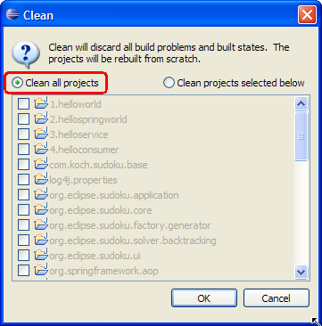
Rebuilding the Workspace
For some reason the workspace does not fully rebuild after setting the new target
So we need to clean the workspace to rebuild
Select Project->Clean… and choose Clean all projects
Then click OK
Some of the Spring projects will still have errors (e.g. hibernate) but that is ok for us since we will not be using them

Slide 11
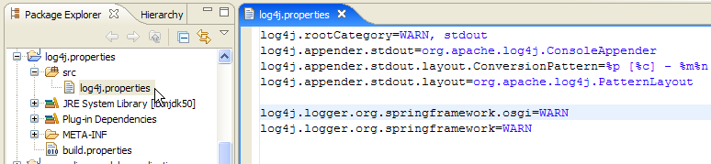
Enabling Logging
If you want, you can enable more detailed logging by editing the log4j fragment and modifying the log levels

Slide 12
Examples
There are five examples or samples in the workspace
Four are very simple and the 5th is more complicated
The first 4 are variations of the famous Hello World program
The 5th is the Eclipse Sudoku RCP sample [1] modified to use Spring beans instead of extension points to decouple the game solver and game generator bundles from the UI bundles
  The use of Spring also decouples the bundles from OSGi and almost Eclipse API!
[1] http://www.eclipse.org/evangelism/samples/sudoku/

Slide 13
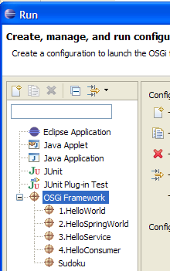
Running the samples
There are launchers for all of the samples
They can be accessed from the Run->Run… menu

Slide 14
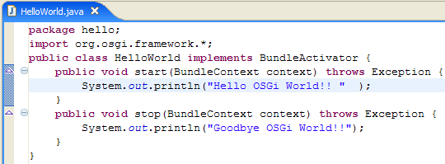
1.helloworld
The first sample is very trivial and sets the stage for the next 3
It is a simple bundle activator which says hello and goodbye

Slide 15
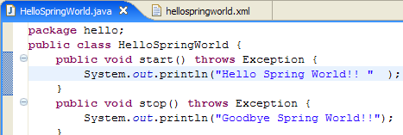
2.hellospringworld
The problem with that bundle was that the code was coupled to the OSGi api
The bundle had to import the OSGi framework package and implement the BundleActivator interface and use the BundleContext interface
Not very POJO!
HelloSpringWorld does not need the OSGi API!

Slide 16
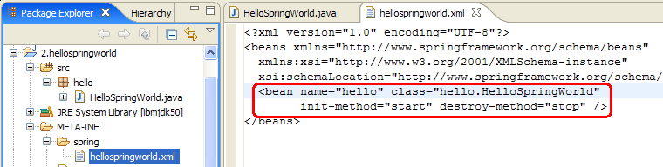
2.hellospringworld
This is because the org.springframework.osgi.extender bundle is watching bundles get STARTED and then processing their Spring descriptors
The xml files in the META-INF/spring folder are processed for Spring Bean definitions
In this example, we just have ordinary Spring beans, nothing OSGi specific yet

Slide 17
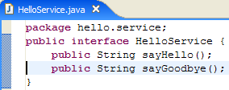
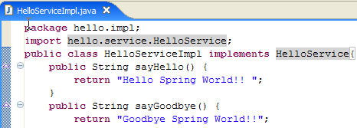
3.helloservice
Now lets use OSGi services between two bundles
We have a bundle which wants to publish its bean as an OSGi service
This can be done without using any OSGi api!
HelloService is a plain service interface
HelloServiceImpl is a POJO
implementation of the service

Slide 18
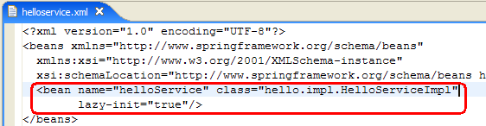
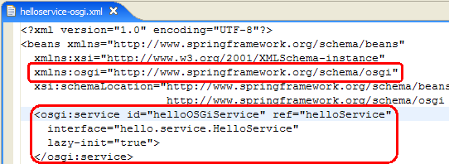
3.helloservice
And we need some beans definitions to register the service…
One bean for the service object
And another to register it as an OSGi service
We use 2 XML files to separate the OSGi beans from the non-OSGi beans for easy unit testing of the POJOs outside of the OSGi runtime environment

Slide 19
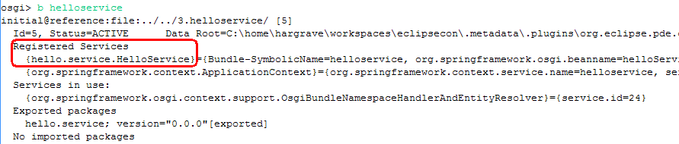
3.helloservice
When we run the sample, we don’t see any output
But at the OSGi console, we can inspect the bundle and see that it has registered a HelloService

Slide 20
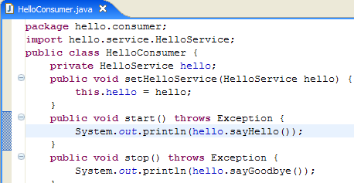
4.helloconsumer
Now that we have a HelloService, we need a bundle that will consume that service and display the results
helloconsumer is also a POJO and does not use any OSGi api

Slide 21

4.helloconsumer
We also have 2 Spring XML files to configure this bundle
The first one defines a bean which references the OSGi service
The second one defines the consumer object and injects it with the service object

Slide 22
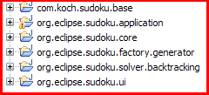
Spring powered Sudoku RCP
We will now take a look the what it took to Spring power the Sudoku RCP sample
The sample consists of 6 bundles (well there were 7 but one did not seem to actually do anything ☺ so I ignored it!)
There are 2 bundles which generate sudoku games
  com.koch.sudoku.base and org.eclipse.sudoku.factory.generator
One bundle has a sudoku game solver
  org.eclipse.sudoku.solver.backtracking
One bundle is the game engine
  org.eclipse.sudoku.core
And 2 bundles are the UI
  org.eclipse.sudoku.application and org.eclipse.sudoku.ui

Slide 23
Spring powered Sudoku RCP
Originally all the bundles were connected via extension points and thus was some coupling to the Eclipse RCP “container”
The game factory and solver bundles are clearly “business logic” and should be decoupled
So we changed the bundles to expose their function via osgi:service beans
  These bundles then no longer needed bundle activator classes and become decoupled from RCP (except for use of IProgressMonitor ☹)
The core bundle is changed to access these “business logic” beans via osgi:reference beans
  Instead of using extension registry API
So all interaction between the bundle’s is in the for of OSGi services

Slide 24
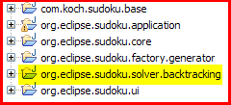
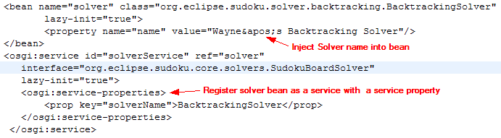
Solver bundle
The solver class becomes a simple POJO that is injected with its name from the bean description
The core bundle now gets the solver name by asking the solver rather than processing the extension point

Slide 25
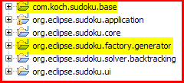
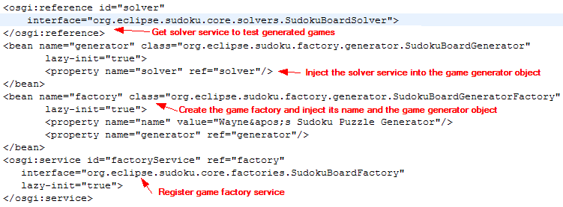
Game factory bundles
com.koch.sudoku.base is now a plain POJO bundle and has no references to Eclipse or OSGi
The bean definitions look basically the same as the solver’s
But org.eclipse.sudoku.factory.generator bundle uses a solver to verify its generated game

Slide 26
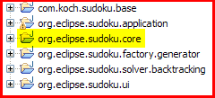

Core game engine
The core bundle has bundle activator, SudokuCoreActivator, which extends Plugin whose methods are used by the bundle
SudokuCoreActivator also creates the SudokuGame object
But we need to inject the SudokuGame object with the game factory services and solver services
Since we can not have Spring create the SudokoGame object, we use the static getGame method on SudokuCoreActivator to obtain the game object so Spring can then inject its dependencies

Slide 27


Core game engine
There may be many solver services and many game factory service
So the core bundle must track these services with a cardinality of 0..n
Spring support for this injects a Spring managed Collection to hold the multiple services
In Java5, the Collection is of the type of the service interface
The contents of the Collection will vary as services come and go

Slide 28
Notes
The spring-osgi code is still under development so there will be problems
There will be changes and additions before it goes final
Here are some problems I encountered with the snapshot of the spring-osgi code used in this tutorial
  The extender bundle only see bundle’s started AFTER it
    So the launchers are all set up to make sure the extender is started before any of the sample bundles
  The filter attribute of the osgi:reference element did not seem to be working
  The current code is not very friendly to class loader laziness
    It should do everything possible to avoid using a bundle’s classloader until absolutely necessary
    This will allow the framework to delay classloader creation and attendant resource consumption as much as possible

Slide 29
Legal Notices
Java and all Java-based trademarks are trademarks of Sun Microsystems, Inc. in the United States, other countries, or both
Other company, product, or service names may be trademarks or service marks of others

