Slide 1
OSGi™ Component Programming
Thomas Watson
IBM Lotus
Equinox Committer
Peter Kriens
OSGi Technical Director
OSGi Evangelist
CEO aQute

Slide 2
Contents
Setup
Introduction to OSGi
Managing your Target Environment
The Equinox/OSGi Development Model
OSGi Basics
Components
Services
Remoting
Conclusion

Slide 3
Your Infrastructure
You need to have the following software installed on your machine in a new workspace:
  Eclipse SDK 3.2 M5 (http://www.eclipse.org)
  The tutorial projects from CVS:
    Server: bundles.osgi.org
    Repository /cvshome/bundles
    User eclipsecon
    Password 2006
    Projects all projects under eclipsecon06.tutorial
Notes:
We need to put this up on the web site, when we give the tutorial, it is a bit late to bring a laptop ☺
It is inevitable that some people will not do this ahead of time. We need to make copies of CDs with the necessary software needed to run the complete tutorial. This includes:
The latest presentation
A freely available VM (not sure if we can do that)
Eclipse M5
A workspace pre-populated with the tutorial projects

Slide 4
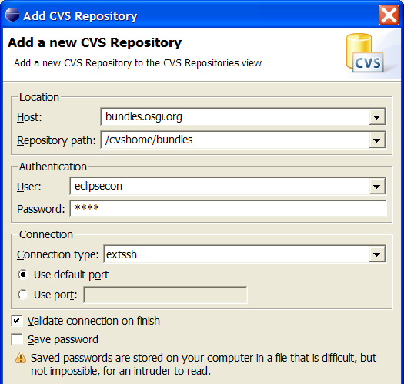
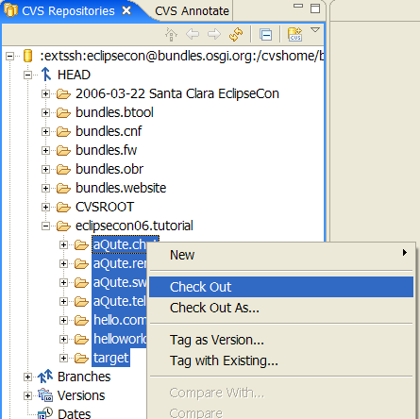
Loading the tutorial projects from CVS
Window > Open Perspective > Other > CVS Repository Exploring
In CVS Repository view context menu: New > Repository Location
  Fill in the necessary CVS Repository information
In CVS Repositories view, expand: HEAD/eclipsecon06.tutorial
Select all projects under eclipsecon06.tutorial and choose Check Out

Slide 5
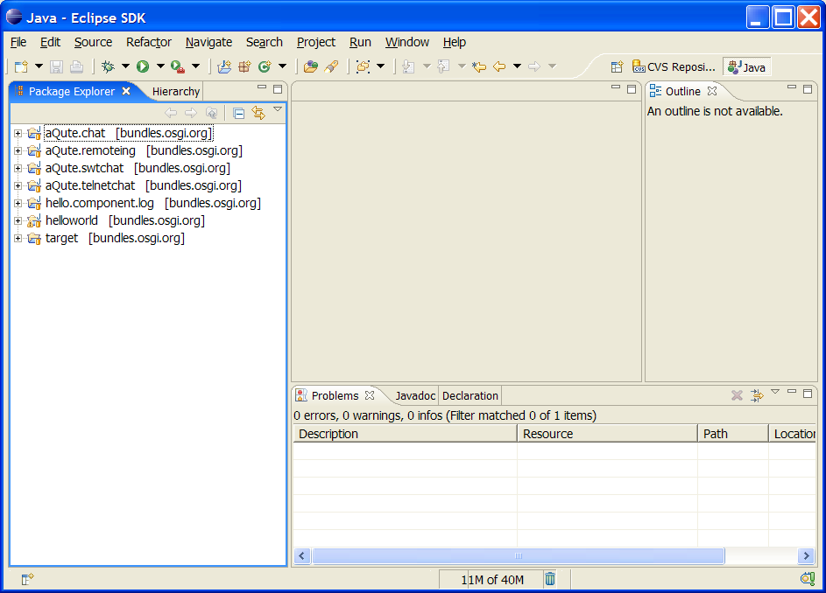
Your Workspace (more or less)

Slide 6
Section I - OSGi Background

Slide 7
What is the OSGi service platform?
A Java™ framework for developing remotely deployed service applications, that require:
  Reliability
  Large scale distribution
  Wide range of devices
  Collaborative
Created through collaboration of industry leaders
Spec 4.0 publicly available at www.osgi.org …
Cool!

Slide 8
Why the OSGi Service Platform?
What problems does the OSGi Service Platform address?
A unified software market:
  The limited (binary) software portability problem
  The complexity of building heterogeneous software systems
    Supporting the myriad of configuration, variations, and customizations required by today’s devices
  Managing the software life-cycle on the device

Slide 9
Limited Binary Software Portability
Lack of portability causes
  Market friction: No large market of reusable components and applications
  Reduced quality
Unnecessary constraints on hardware and software architectures
  CPUs differ widely in cost and performance
  Linux is nice, but it is sub-optimal for smaller devices
Benefits of the OSGi Platform
  Applications run unmodified on different hardware and software architectures

Slide 10
Complexity of Software
A DVD player can contain 1 Million lines of code
  Comparison: Space Shuttle ~ 0.5 Million
A BMW car can contain up to 50 networked computerized devices
Eclipse contains 2.5 million lines of code
An average programmer writes an average of 10 lines a day …
Houston … we have a problem

Slide 11
Complexity of Software
Service Oriented Programming
Productivity
Structured
Programming
Assembly
Complexity and Size

Slide 12
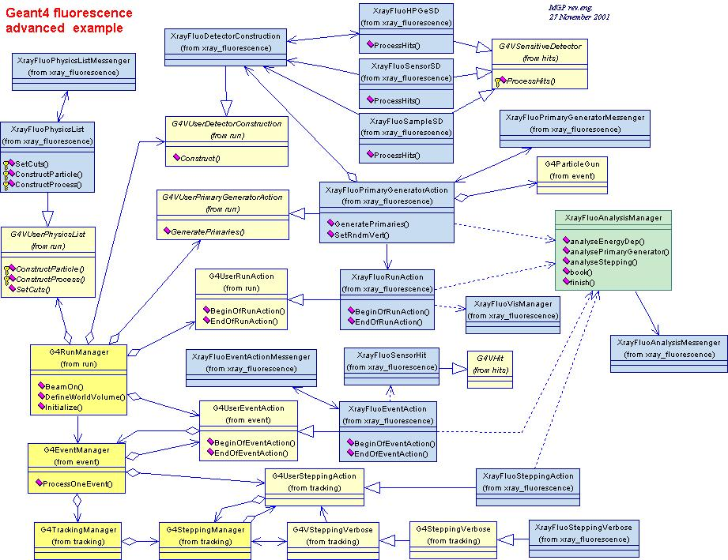
Limits Object Oriented Technology
Objects are great, but oh, the tangled webs we weaves …
Coupling severely limits reusability
  Using a generic object, can drag in a large number of other objects
Creates overly large systems after a certain complexity is reached
Flexibility must be built in by the programmer
  Plug-in architectures

Slide 13
Service Oriented Architectures
Separate the contract from the implementation
Allows alternate implementations
Dynamically discover and bind available implementations
Based on contract (interface)
Components are reusable
Not coupled to implementation details
Service Contract
provides
Component
uses

Slide 14
Framework
Allows applications to share a single Java VM
Classloading
Isolation/Security
Communication `& Collaborations between applications
Life cycle management
Policy free
  Policies are provided by bundles
API is fully self managed
The Application
The Application
Application
Application
Application
Speech
Application
Application
Blue-
tooth
XML
USB
Application
Application
OSGi
Library
OSGi
OSGi
JTAPI
3D
Web
Server
Math
OSGi
Java
VM
Java
VM
Mail
Comm
Ports
Security
TCP/IP
Java
VM
System Class Libraries
Java
VM
Imaging
Media
FW
SQL
Distri-
buted
Java
VM
Java
VM
Java
VM
Operating System
Crypto-
graphy
UPnP
Direc-
tories
GUI
Operating System
Operating System
Operating System
Java
VM
Java
VM
Operating System
Operating System

Slide 15
Layering
Services
Life Cycle
Security
Applications
Module
Execution Environment

Slide 16
Execution Environment
OSGi APIs only use a subset of J2SE and J2ME CDC
  OSGi Minimum EE
Matches most profiles
Implementations can use more than the OSGi Minimum EE
Security is not mandatory
CLDC is possible if class loaders are added in a device specific way
CLDC/
MIDP
J2SE
CDC/FP
OSGi
Min.

Slide 17
Module Layer
Packaging of applications and libraries in Bundles
  Raw Java has significant deployment issues
Class Loading modularization
  Raw Java provides the Class Path as an ordered search list, which makes it hard to control multiple applications
Protection
  Raw Java can not protect certain packages and classes
Versioning
  Raw Java can not handle multiple versions of the same package
bundle
bundle
bundle
bundle
bundle
bundle
bundle

Slide 18
Life Cycle Layer
System Bundle represents the OSGi Framework
Provides an API for managing bundles
  Install
  Resolve
  Start
  Stop
  Refresh
  Update
  Uninstall
Based on the module layer
System
bundle
bundle
M
Bundle
X
Bundle
X-v2
Bundle
B
Bundle
A

Slide 19
Life Cycle Layer
Bundle is started by the Bundle Activator class
Header in Manifest refers to this class
Interface has 2 methods
  Start: Initialize and return immediate
  Stop: Cleanup
The Activator gets a Bundle Context that provides access to the Framework functions
Framework provides Start Level service to control the start/stop of groups of applications
INSTALLED
STARTING
start
RESOLVED
ACTIVE
stop
UNINSTALLED
STOPPING

Slide 20
Service Layer
Provides an in-VM service model
  Discover (and get notified about) services based on their interface or properties
  Bind to one or more services by
    program control,
    default rules, or
    deployment configuration
SOA Confusion
  Web services bind and discover over the net
  The OSGi Service Platform binds and discovers inside a Java VM
The OSGi Alliance provides many standardized services

Slide 21
Evolution
Planned R4
Home Automation
Vehicle
Mobile
Application Manager
MIDP Container
Signed Bundles
Declarative Services
Power Management
Device Management
Security Policies
UPnP Exporter
Diagnostics/Monitoring
Framework Layering
Initial Provisioning
UPnP
…
R3
UPnP
Initial Provisioning
Name Space
Jini
Start Level
IO Connector
Wire Admin
XML Parser
Measurement & State
Position
Execution Env.
R2
Package Admin
Configuration Admin
Permission Admin
User Admin
Preferences
MetaType
Service Tracker
R1
Framework
Http
Log
Device Access
2000
2001
2003
2005

Slide 22
Benefits of Using the OSGi Service Platform
Components are smaller
  Easier to make
Components are not coupled to other components
  Gives reusability
Excellent model for the myriad of customizations and variation that are required of today’s devices
Collaborative model
  Allows reuse of other components for most problems

Slide 23
Section II – Eclipse/Equinox

Slide 24
What is Equinox ?
An open source community focused on OSGi Technology
  Develop OSGi specification implementations
  Prototype ideas related to OSGi
An OSGi Framework implementation
  Core of the Eclipse runtime
  Provides the base for Eclipse plug-in collaboration
  Fully compatible with the OSGi R4 specification
New for Eclipse 3.2 – Other specification implementations
  Device Manager, Declarative Services, Event Admin, HTTP Service, Log Service, Metatype Service, Preferences Service, User Admin, Wire Admin – More on the way!!

Slide 25
The Equinox Target Environment
Bundle A
{}
Eclipse makes it easy to develop for OSGi Service Platforms
A target platform
  Contains a set of bundles
  Defines runtime parameters
To Define the Target Platform, goto:
  Preferences ->Plug-in Development ->Target Platform
  Select the target project in your workspace as location
Install
Target
OSGi Framework
(Equinox)
Bundle c
{}
Bundle B
{}
Bundled
{}
Bundle F
{}
BundleG
{}
Bundle E
{}

Slide 26
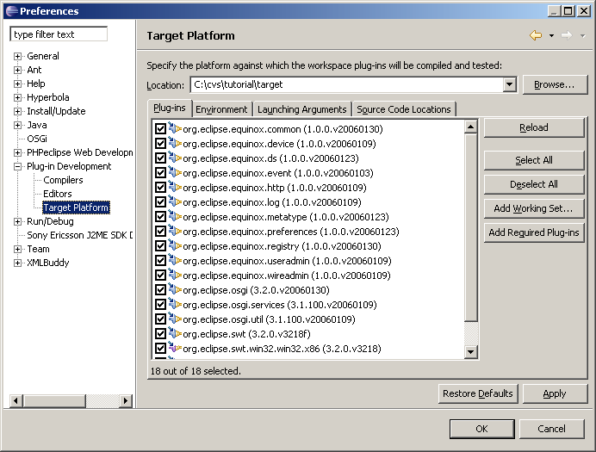
Setting up the Target Platform

Slide 27
What Did We Learn
The OSGi Service Platform is kind of a Java Operating System
It simplifies:
  Deployment Problems
  Software composition
  Software management
Eclipse provides a development environment for OSGi Bundles
Eclipse provides open source implementations of the OSGi specifications in the Equinox project

Slide 28
Section III - Fundamental OSGi concepts

Slide 29
Framework Entities
OSGi Framework
Bundle A
{}
Bundle B
{}
Bundle C
{}
= service, java interface

Slide 30
Bundles
A bundle is the deliverable application
  Like a Windows EXE file
  Content is a JAR file
A bundle registers zero or more services
  A service is specified in a Java interface and may be implemented by multiple bundles
  Services are bound to the bundle life-cycle
Searches can be used to find services registered by other bundles
  Query language

Slide 31
What is in a Bundle?
A Bundle contains (normally in a JAR file):
  Manifest
  Code
  Resources
The Framework:
  Reads the bundle’s manifest
  Installs the code and resources
  Resolves dependencies
During Runtime:
  Calls the Bundle Activator to start the bundle
  Manages java classpath
  Handles the service dependencies
  Calls the Bundle Activator to stop the bundle
Bundle A
{}

Slide 32
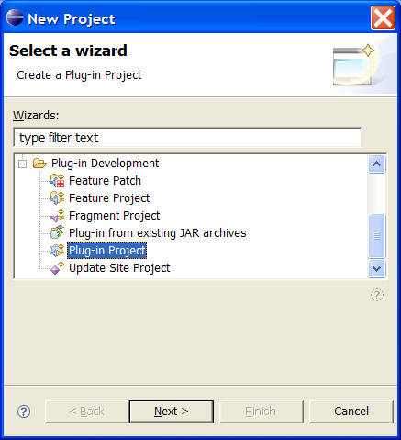
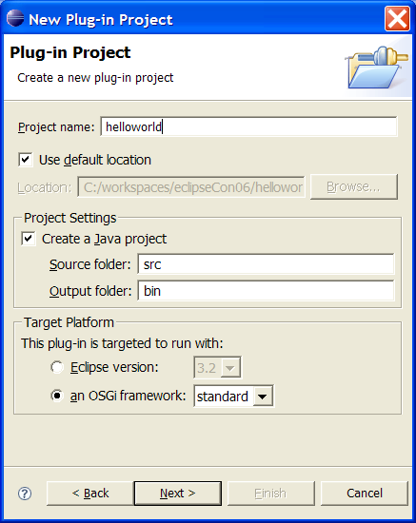
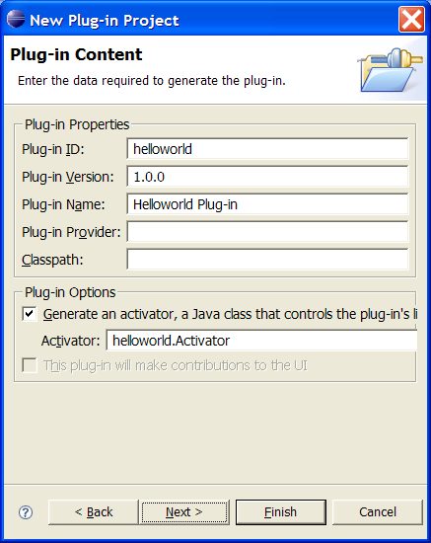
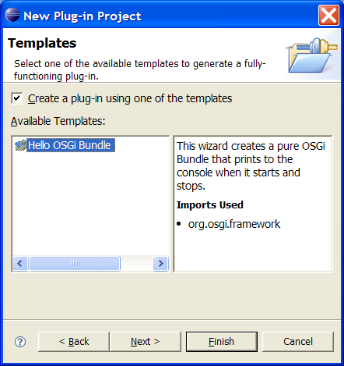
Create the Hello World bundle
_{Step 1.}
_{Create new plug-in project}
_{Step 2}
_{Project name: helloworld}
_{an OSGi framework: standard}
_{Step 3}
_{Generate an activator}
_{Step 4}
Use the Hello OSGi Bundle template

Slide 33
Real code! Hello World (and Goodbye)
The wizard has generated the code on the left
This class implements the BundleActivator so that the Framework can start/stop the class
The activator is referenced in the manifest
HelloWorld.java
package helloworld
public class HelloWorld
implements BundleActivator {
public void start(
BundleContext context)
throws Exception{
System.out.println(
"Hello world!!");
}
public void stop(
BundleContext context)
throws Exception {
System.out.println(
"Goodbye world!!");
}
}

Slide 34
Real code! Hello World (and Goodbye)
The Manifest (in META-INF/MANIFEST.MF) is also generated by the wizard
Eclipse provides convenient editors for the manifest
  For the source: click on MANIEST.MF
Notice:
  Bundle-Activator (used to notify the bundle of lifecycle changes)
  Import-Package (dependencies)
META-INF/MANIFEST.MF
Manifest-Version: 1.0
Bundle-ManifestVersion: 2
Bundle-Name: Helloworld Plug-in
Bundle-SymbolicName: helloworld
Bundle-Version: 1.0.0
Bundle-Localization: plugin
Bundle-Activator: helloworld.Activator
Import-Package:
org.osgi.framework;version="1.3.0"

Slide 35
Eclipse Launch Configuration
The Launch Configuration is prepared for you
  Run -> Run … -> EclipseTutorial
Deselect “Target Platform” checkbox
  This removes all possible bundles from the launch configuration
Select “Add Required Plug-ins”
  This calculates from the dependency information, which bundles are required to run our helloworld example
Press Run
The Framework is a console application

Slide 36
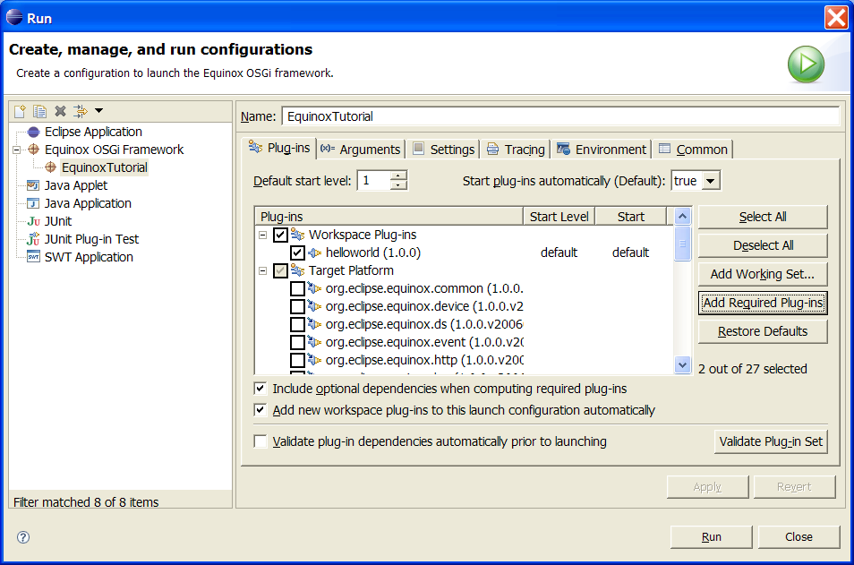
Equinox Launch Configuration

Slide 37
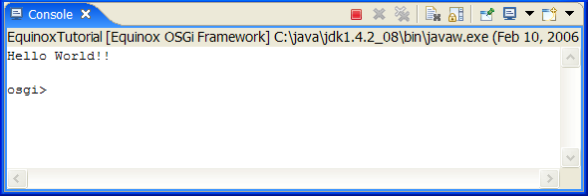
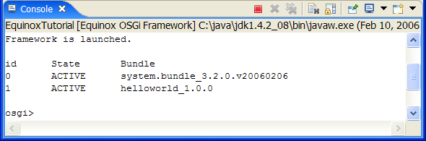
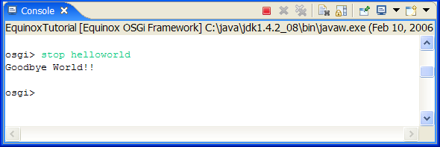
Run the Hello World bundle
The Framework now runs the helloworld example
  See the printed text
It also runs a Framework console
  Equinox specific
Type “ss” (show status)
  Look at the active bundles
  Notice the number for the helloworld bundle. This is the bundle id.
Type “stop <symbolic-name>”

Slide 38
Self-Hosting Bundle Projects
JAR file layout
Normally, a bundle is packaged in a JAR file
  The traditional edit-compile-debug cycle.
Self-Hosting Allows for quick debugging of bundle code
  No packaging steps
  No deployment steps
  Just code/save/run
Some changes require update of the bundle in the Framework
  Console:
  update <symbolic-name>
META-INF/MANIFEST.MF
helloworld/HelloWorld.class
file:c;/…
Target Platform
Project Layout
META-INF/MANIFEST.MF
.project
.classpath
src/helloworld/HelloWorld.java
bin/helloworld/HelloWorld.class
reference:file:C:/…
Complied into bin directory, non java files copied
bin dir content automatically added to root

Slide 39
Creating deployable bundles – how it works
The build.properties file specifies the content of the bundle jar
  Specifies the source and output folders of the different libraries
  source.. – The source directory of the project. Used for compilation and resources.
  output.. – The output directory where class files and resources are copied to
  bin.includes – What is included in the JAR from the project directory
Export the content of a project into a bundle jar
  Bundle jars can be installed across multiple OSGi Framework implementations
  The Deployable plug-ins and fragments wizard can be used to generate a bundle jar from a project.
  File -> Export -> Deployable plug-ins and fragments
build.properties
source.. = src/
output.. = bin/
bin.includes = META-INF/,\
.

Slide 40
What Did We Learn
The unit of deployment of an OSGi Service Platform
The Eclipse Target Environment
How to launch an Equinox environment with a defined set of bundles
How to start/stop bundles
How the Equinox console works
How the classpath is managed for self hosted bundles

Slide 41
Section IV – Component interaction and collaboration

Slide 42
Collaborative model
OSGi is more than an Applet, MIDlet, Xlet runner
Bundles can collaborate through:
  service objects
  package sharing
A dynamic registry allows a bundle to find and track service objects
Framework fully manages this collaboration
  Dependencies, security

Slide 43
Collaborative model
OSGi Framework
Bundle
Service
registry
Bundle
packages
packages
JAVA
Operating System
Hardware

Slide 44
Collaborative model
Java Application Manager
No management bundles
Service
registry
Midlet,
Xlet,
or
Applet
Midlet,
Xlet,
or
Applet
No collaboration
packages
No package management
(versions!)
packages
JAVA
Operating System
No native code
Hardware

Slide 45
Classpath issues
Java applications consists of classes placed in packages
Java searches for a package or class in different jar files and directories
  These are usually specified in the CLASSPATH environment variable
An OSGi Framework is a network of class loaders.
  Parameterized by the Manifest headers
Any dependencies between bundles are resolved by the Framework
It is possible to fetch bundles on demand
Complicated – But an OSGi Framework makes it painless to use
q
q-1.0
p
r
p
q
q-2.0
Bundle
Wire
Exported package
Constraint
Exported package

Slide 46
OSGi dependency resolution
Framework
org.osgi.framework
org.osgi.service.http
Bundle A
Export org.osgi.service.log
com.ibm.service.log
com.ibm.j9
Import org.osgi.service.http
javax.servlet.http
A resolved
Bundle B
Export ericsson.osgi
javax.servlet
javax.servlet.http
org.osgi.service.log
Import org.osgi.service.http
B resolved

Slide 47
Package or Bundle Dependencies?
The OSGi Specifications supports both Require-Bundle and Import-Package
Require-Bundle creates a dependency on a complete bundle
  Simple to use
  Imports packages that are not used
Import-Package creates a dependency on just a package
  Creates less brittle bundles because of substitutability
  More cumbersome to use (Tools!)
In almost all cases, Import-Package is recommended because it eases deployment and version migration
The specifications detail a number of additional problems with Require-Bundle
p
q
Import-Package
r
r
s
Require-Bundle
r

Slide 48
Service Specifics
discover
bind
service
register
A service is an object registered with the Framework by a bundle to be used by other bundles
The semantics and syntax of a service are specified in a Java interface
A bundle can register a service.
A bundle can use a service (bind to)
  1..1
  0..1
  0..n
A service can be discovered dynamically
Services can go away at any time!
package org.osgi.service.log;
import org.osgi.framework.ServiceReference;
public interface LogService {
public static final intLOG_ERROR= 1;
public static final intLOG_WARNING= 2;
public static final intLOG_INFO= 3;
public static final intLOG_DEBUG= 4;
public void log(int level,
String message);
public void log(int level,
String message, Throwable exception);
public void log(ServiceReference sr,
int level, String message);
public void log(ServiceReference sr,
int level, String message,
Throwable exception);
}

Slide 49
Services continued
The Framework Service Registry is available to all bundles to collaborate with other bundles
Different bundles (from different vendors) can implement the same interface
  Implementation is not visible to users
  Allows operator to replace implementations without disrupting service
OSGi defines a standard set of services
  Other organizations can define more (AMI-C)
Extensive notifications for services life cycles
Services have a unique id
Services require permission
  Under Operator control
Services are associated with properties
  Query language to find appropriate service
  Bundles can update the properties

Slide 50
Manipulating Services
The BundleContext provides the methods to manipulate the service registry
Services registrations are handled by ServiceRegistration objects
  They can be used to unregister a service or modify its properties
Service References give access to the service as well as to the service’s properties
Access to service objects is through the getService method. These services should be returned with the ungetService method
ServiceRegistration registerService(
String clss,
Object srvc,
Dictionary prprts)
ServiceReference[]
getServiceReferences(
String clss,
String fltr)
Object getService(
ServiceReference reference)
boolean ungetService(
ServiceReference rfrnc);

Slide 51
What Did We Learn
The OSGi Service Platform provides a collaboration model that is based on
  Services
  Package sharing
Sharing is complicated, but the well defined specifications make it quit painless for bundle developers
Services provide a very powerful dynamic programming model

Slide 52
Section V – Service Components

Slide 53
Components Simplify Service Programming
The dynamic nature of services make programming more complicated
The declarative service model simplifies handling these dynamics
  Dependencies are defined in an XML file
Declarative Services:
  Optionally Depend on one or more services
  Optionally Provide a service
  Optionally lazy initialized
  Configurable
Example shows a hello world bundle that logs Hello and Goodbye
First add dependencies by selecting MANIFEST.MF, on the Dependencies tab
  Add the component and log package
META-INF/MANIFEST.MF
Manifest-Version: 1.0
…
Import-Package: org.osgi.framework;version="1.3.0“,
org.osgi.service.component,
org.osgi.service.log
Service-Component:
OSGI-INF/component.xml
OSGI-INF/component.xml
<?xml version="1.0" encoding="UTF-8"?>
<component name="hello.component.log">
<implementation
class="hello.Component"/>
<reference name="LOG”
interface=
"org.osgi.service.log.LogService"/>
</component>

Slide 54
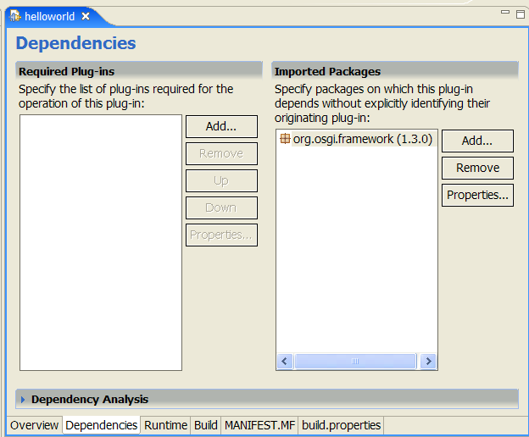
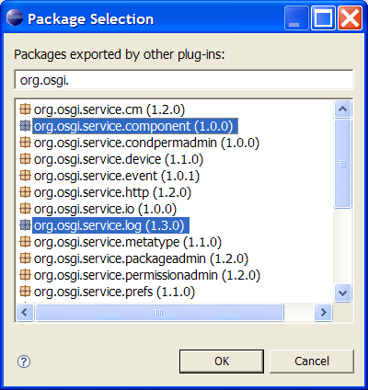
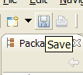
Import the necessary packages
Step 1 – Add new Imported Packages
Step 2 – Select the necessary packages
Step 3 – Save the bundle manifest

Slide 55
The Login Component Source Code
OSGI-INF/component.xml
A component can be any class
  No specific interface
The activate and deactivate methods are called when the component is activated/deactivated
  Dependencies must be resolved: Log Service
The ComponentContext class provides access to the referenced services
  The locateService methods finds a reference
The component instance can be sure that at any moment in time between activate and deactivate there is a valid Log Service
<?xml version="1.0" encoding="UTF-8"?>
<component name="hello.component.log">
<implementation
class="hello.Component"/>
<reference name="LOG"
interface=
"org.osgi.service.log.LogService"/>
</component>
Component.java
package hello;
import org.osgi.service.component.*;
import org.osgi.service.log.*;
public class Component {
LogService log;
protected void activate( ComponentContext context){
log = (LogService)
context.locateService("LOG");
log.log(LogService.LOG_INFO,
"Hello World"); }
protected void deactivate(
ComponentContext context) {
log.log(LogService.LOG_INFO,
"Goodbye World");}}

Slide 56
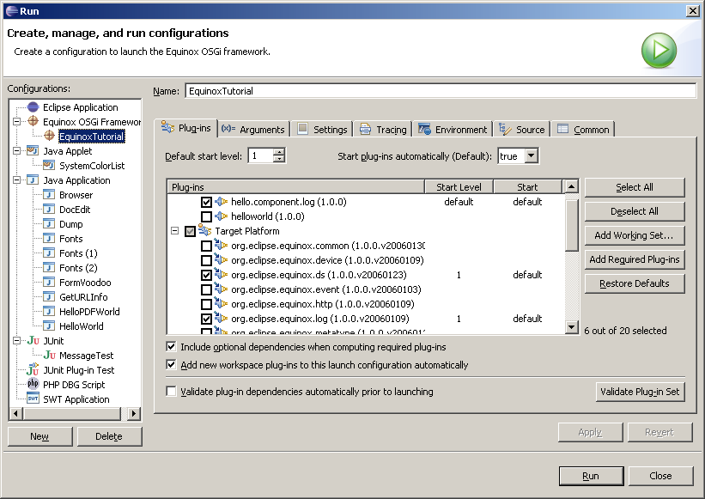
Add Declarative Services, Log, and Component

Slide 57
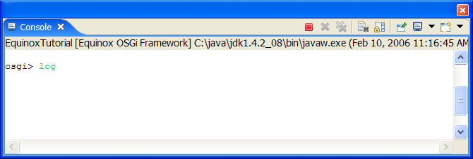
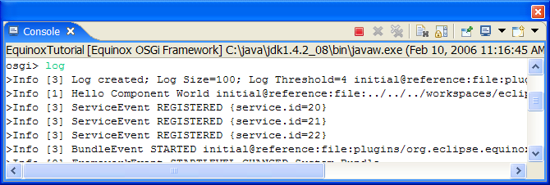
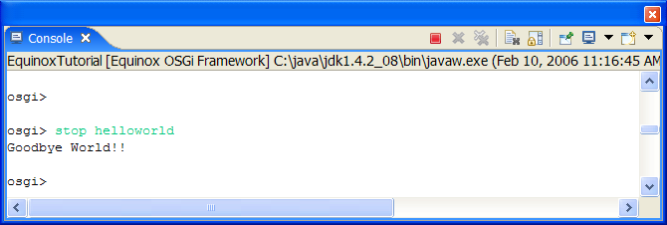
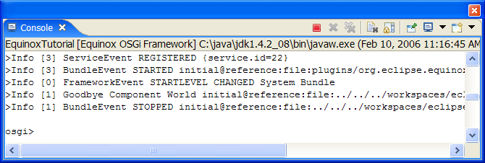
Launching
Launch the EquinoxTutorial launch configuration
You can look in the log with the log command
  Last event is at bottom
Stop the bundle
  Stop <symbolic-name>
Run log again

Slide 58
What Did We Learn
Programming with services is complicated
The Declarative Services model makes service programming much simpler
How the component XML is constructed
We used the Log Service

Slide 59
Section VI – Use Case: Developing a Chat Service

Slide 60
A Chat Service
We will now design a service that simplifies Chat/Instant Messaging clients
  We do the clients later, this is just intended to support clients.
A Chat client should be able to communicate with a user through:
  A window, telnet session, MSN, AOL, Skype, etc. interface.
We base the communication between chat clients on a Channel interface.
  We register a service we receive messages from
  The registry contains other channel services we can send messages to
  A property contains the user name
For ease of use, we use a command based interface for login and listing buddies
SWT
Chat
Chat
Service
Telnet
Chat
Output
channel
Input channel
Window
Chat
Channel service
send(from,msg)
Telnet
Connections
Peter
session
Thomas
sessions
Channel services

Slide 61
Channel Service Design
Channel.java
Create a new project to hold our service interface
  Call this project <myname>.chat
  This is a Plug-in Project
The Channel service is one way:
  We only receive through a channel service
A service property is defined. This property must be registered with the service
  CH_NAME – This is the name of the user, e.g. pkriens
A single method send with the following arguments
  from – The user name that sends the message
  msg – The message to be send
Export the service channel package
package aQute.service.channel;
import java.io.*;
public interface Channel {
String CH_NAME="channel.name";
void send(String from, String msg) throws IOException ;
}
META-INF/MANIFEST.MF
Manifest-Version: 1.0
Bundle-ManifestVersion: 2
Bundle-Name: Chat Plug-in
Bundle-SymbolicName: aQute.chat
Bundle-Version: 1.0.0
Bundle-Localization: plugin
Import-Package:
org.osgi.framework;version="1.3.0"
Export-Package: aQute.service.channel

Slide 62
White Board Approach
Bundle C
{ }
Bundle B
{ }
Bundle A
{ }
The White Board approach is:
  Register a service
  Let any interested bundle use it
The White Board approach was discovered during finishing of R1
We were not brave enough to scrap, that is why the Log Service and Http Service are not white board
It is very effective because it reduces the number of couplings between bundles
There is a white-paper comparing a whiteboard approach with a non whiteboard approach.
register
Registry
Publisher
Events: register,
unregister,
modified
get
Server
bundle

Slide 63
Telnet Based Chat Client
Thread
The best way to start is to design a small test program.
The easiest way to a “UI” is a telnet server that uses the Channel service to communicate with siblings
  This also shows how Internet servers should be constructed
The telnet Chat server will create a Handler for each opened session.
  The Handler is a thread that waits for input from the user
  The Handler registers a Channel.
The Handler is stopped when the session closes.
  This unregisters the Channel service
Activated by
Declarative Services
LogService
TelnetChat
1
*
For each session
User
Handler
Channel

Slide 64
The TelnetChat Manifest and component.xml
META-INF/MANIFEST.MF
Create a new project for a telnet chat
  Call this project <myname>.telnetchat
  This is a Plug-in Project
Define the manifest and component definition
Add the package import dependencies to the manifest. Either
  Direct in the source code
  Via the Dependencies tab
Add the reference to the component.xml
The component.xml must reside in OSGI-INF
We only specify a reference to the Log Service
Manifest-Version: 1.0
Bundle-ManifestVersion: 2
Bundle-Name: Telnetchat Plug-in
Bundle-SymbolicName: aQute.telnetchat
Bundle-Version: 1.0.0
Bundle-Localization: plugin
Service-Component: OSGI-INF/component.xml
Import-Package: aQute.chat,
aQute.service.channel,
org.osgi.framework;version="1.3.0",
org.osgi.service.component,
org.osgi.service.log
OSGI-INF/component.xml
<?xml version="1.0" encoding="UTF-8"?>
<component name="aQute.telnetchat">
<implementation class=
"aqute.telnetchat.TelnetChat"/>
<reference name="LOG" interface=
"org.osgi.service.log.LogService"/>
</component>

Slide 65
The TelnetChat Component code
TelnetChat.java
The code does not show the import packages and field definitions
  The source code is provided for you to further check in aQute.telnetchat
  Eclipse will tell you when they miss
The activate method:
  Remembers the context for later
  Gets the log service
  Starts the thread.
The deactivate method:
  Sets the quit flag so any loops in the started Thread will finally end
  Closes all created Handlers
  Exceptions are ignored because we are closing
  And closes the server socket object, this will surely quit the main socket accept loop.
protected void activate( ComponentContext context) {
this.context = context;
this.log = (LogService)
context.locateService("LOG");
start();
}
protected void deactivate(
ComponentContext context) throws Exception {
quit = true;
for (Iterator i =
handlers.iterator();
i.hasNext();) {
Handler h = (Handler) i.next();
try { h.close();}
catch (Throwable e) {
// We are closing
}
}
server.close();
}

Slide 66
The TelnetChat run method
TelnetChat.java
The run method creates a socket and accepts incoming connections.
For bundles, it is crucial that this loop never quits, but also not overloads the system
  There is usually no end user watching a server …
The outer loop therefore catches errors, sleeps and try again
  A lot of problems disappear over time. For example, an Internet connection can be temporarily be down
The socket has a timeout to check the flag regularly
The inner loop
  Wait for an incoming socket
  Creates a handler
  And starts the handler’s thread
public void run() {
while (!quit) try {
server = new ServerSocket(2030);
server.setSoTimeout(1000);
loop();
} catch (Exception e) {
log.log(LogService.LOG_ERROR,
"[TelnetChat] Inner loop",
e);
sleep(10000);
}}
void loop() throws Exception {
while (!quit) try {
Socket socket = server.accept();
Handler handler = new Handler(
context.getBundleContext(),
socket, this);
handlers.add(handler);
handler.start();
} catch (SocketTimeoutException e) {
// Just for checking the quit flag
// at a regular basis
}}

Slide 67

TelnetChat convenience methods
TelnetChat.java
Convenience methods
void remove(Handler handler) {
handlers.remove(handler);
}
void sleep(int ms) {
try {
Thread.sleep(ms);
} catch (InterruptedException e1) {}
}

Slide 68
The Handler Source Code
Handler.java
The constructor receives the socket for the session with the end user. It initializes:
  The fields
  A Writer object to send text to the end user
The send method writes the message in the Write object and flushes it to ensure the user sees it
The close method closes the different objects and quits the main loop:
  By setting the quit flag
  By closing the socket
public Handler(BundleContext context, Socket socket, TelnetChat activator)
throws Exception {
this.ctxt = context;
this.socket = socket;
this.parent = activator;
writer = new PrintWriter(
new OutputStreamWriter(
socket.getOutputStream()));
}
public void send(String source,
String msg) throws IOException {
writer.println(source + "> " + msg);
writer.flush();
}
void close() {
try {
quit = true;
writer.close();
socket.close();
} catch (IOException e) {
// Ignore in close
}}

Slide 69
The Handler Source Code
Handler.java
The run() method loops as long as there is input from the user. It quits when the socket is closed or an error occurs.
Errors are only logged when the session has not quit because there are usually socket errors during closing
The finally clause is used to guarantee that the handler is removed from the parent when it is closed.
If a valid line is received, it is send to the process method
public void run() {
writer.println("Welcome … Chat");
writer.print("Enter name: ");
writer.flush();
try {
BufferedReader rdr =
new BufferedReader(
new InputStreamReader(
socket.getInputStream()));
while (!quit &&
(line=rdr.readLine()) != null) {
line = line.trim();
process(line);
}} catch (Exception e) {
if (!quit)
parent.log.log(
LogService.LOG_ERROR,
"reading user input", e);
} finally {
if ( channel != null )
channel.unregister();
parent.remove(this);
parent = null;
close();}}

Slide 70
The Handler Source Code
Handler.java
The process method handles a line of input from the user
If we did not have a login name yet, we assume it is the given line
If the line starts with /quit, we quit the program
Otherwise we assume it is a line we need to send to another user, which is handled in the dispatch method
void process(String line) throws IOException, Exception {
if ( user == null) {
user = line;
Hashtable props = new Hashtable();
props.put(Channel.CH_NAME, user);
channel =ctxt.registerService(
Channel.class.getName(), this,
props);
send("info", "User set to: "
+ user);
} else {
if (line.startsWith("/quit")) {
writer.println("bye ");
} else dispatch(line);
}
}

Slide 71
The Handler Source Code
Handler.java
The dispatch method parses the destination name from the input
For this name , finds a Channel service
It then sends the remainder of the line to that service
void dispatch(String line) throws Exception {
String parts[] = line.split("\\W");
ServiceReference channels[] =
ctxt.getServiceReferences(
Channel.class.getName(),
"(" + Channel.CH_NAME + "="
+ parts[0] + ")");
if (channels != null) {
Channel toChannel =
(Channel) ctxt.getService(
channels[0]);
toChannel.send(user,
line.substring(
parts[0].length()));
ctxt.ungetService(channels[0]);
} else {
send("error",
"no such user: " + parts[0]);
}
}

Slide 72
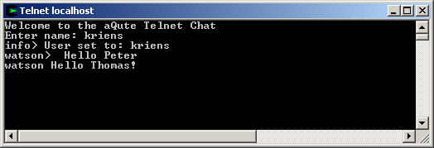
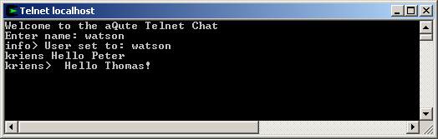
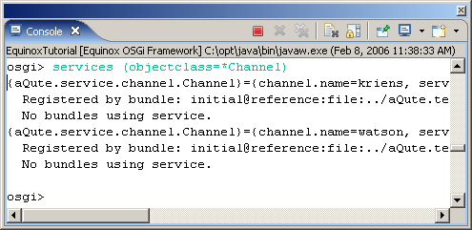
Run the Telnet Chat
Launch the EquinoxTutorial
Do not forget to check the launch configuration
  The TelnetChat bundle included?
  Includes all required bundles from the Target environment?
  Do not forget to start the bundle via the console
Create 2 telnet sessions:
  Open a telnet session into port 2030
  Login with your last name
  Open a second telnet session into port 2030
  Login with another name
See if you can send messages Check the services, and see that two channel services are registered
  Services (objectclass=*Channel)

Slide 73
What Did We Learn
How services are designed
  White board approach
Developed a simple telnet chat application
  Chat sessions use the white board approach to find Channel services
  The Channel service is used to send messages

Slide 74
Section VII – Service Tracking

Slide 75
Finishing the Chat Service
Chat.java
The TelnetChat contains code that must be repeated between different clients
A Chat library that captures the shared code would be useful
  As a bundle, this could run on phones, Eclipse, etc.
For this example, we create a Chat class that works on a command line basis
  The Chat class will be added to the <myname>.chat bundle
  /xxx are commands
This bundle will therefore act as a library and exports the chat package
Not all code is shown, however, this is available in the aQute.chat project
Chat(BundleContext cntxt,Channel user)
void execute(String ln) throws IOException
String[] getBuddies()
void close()
String getName()
void login( String user, String passwd)
META-INF/MANIFEST.MF
Manifest-Version: 1.0
Bundle-ManifestVersion: 2
Bundle-Name: Chat Plug-in
Bundle-SymbolicName: aQute.chat
Bundle-Version: 1.0.0
Bundle-Localization: plugin
Import-Package:
org.osgi.framework;version="1.3.0"
Export-Package: aQute.service.channel,
aQute.chat

Slide 76
The Case for the ServiceTracker
Finding services for each message is kind of expensive.
The ServiceTracker in org.osgi.util.tracker package is intended to simplify this task
A service tracker maintains a list of services based on:
  A filter
  A specific class
It reports any existing or new services as well as any services that become unregistered
  Object addingService
  void modifiedService
  void removedService
The service tracker is used to track channels and store them in a Map

Slide 77
ServiceTracker: create
Framework
Bundle
A
Bundle
B
Bundle
C

Slide 78
ServiceTracker: open
Framework
Bundle
A
addServiceListener
Bundle
B
Bundle
C
Object addingService(ServiceReference r){…}
Object addingService(ServiceReference r){…}

Slide 79
ServiceTracker: adding
Framework
Bundle
A
addServiceListener
Bundle
B
Bundle
C
Object addingService(ServiceReference r){…}

Slide 80
ServiceTracker: removing
Framework
Bundle
A
addServiceListener
Bundle
B
Bundle
C
void removedService(ServiceReference r,Objecto){…}

Slide 81
ServiceTracker: modified
Framework
Bundle
A
addServiceListener
Bundle
B
Bundle
C
void modifiedService(ServiceReference r, Object o){…}

Slide 82
The Chat Library
Chat.java
The Constructor initializes some fields and creates the service tracker
The user is given as a Channel. The user of this library must implement this service to get a callback with any incoming messages.
public Chat(BundleContext context, final Channel user) {
this.user = user;
this.cntxt = context;
channels = doChannelTracker(
context, user);
channels.open();
}

Slide 83
The Chat Library Service Tracker
Chat.java
The Service Tracker is used to track Channel services
  The addingService method gets the Channel and puts the Channel in a Map under the given name
  The removedService method just cleans up the Map when a Channel service is removed
ServiceTracker doChannelTracker(
BundleContext cntxt,
final Channel user) {
return new ServiceTracker(
cntxt,
Channel.class.getName(), null) {
public Object addingService(
ServiceReference ref) {
Channel buddy = (Channel)
context.getService(ref);
if (buddy != user) {
String name = (String)
ref.getProperty(Channel.CH_NAME);
String rn = name; int n = 0;
synchronized (bdds) {
while(bdds.containsKey(rn))
rn = name + "-" + n++;
bdds.put(rn, buddy);
}}return buddy;}
public void removedService(
ServiceReference ref,Object buddy){
bdds.remove( ref.getProperty(
Channel.CH_NAME)); }}; }

Slide 84
The Chat Library
Chat.java
The login method registers a new Channel service
The password is ignored
The result is sent as a message to the user
public void login(String name,
String password) throws IOException {
if (registration != null)
registration.unregister();
registration = null;
this.name = name;
Hashtable properties =
new Hashtable();
properties.put(
Constants.SERVICE_PID,
"pid:chat[" +
InetAddress.getLocalHost()
+ "]:" + name);
properties.put(
Channel.CH_NAME, name);
registration = cntxt.registerService(
Channel.class.getName(),
user, properties);
user.send("", "Logged in as "
+ name);
}

Slide 85
The Chat Library: execute
Chat.java
The execute method looks at the command line and scans for ‘/’ characters, which are commands
  /help – Show short help
  /buddies – List the buddies
  /login – Login
  /<buddy> to send to a buddy
If no / is given the message is sent to the last used buddy
public void execute(String line)
throws IOException {
if (!line.startsWith("/"))
send(line);
else {
String ws[]=line.split("\\s+");
if ("/buddies".startsWith(ws[0]))
doBuddies();
else if("/help".startsWith(ws[0]))
doHelp();
else if("/login".startsWith(ws[0]))
login(ws[1], null);
else {
lastTo = ws[0].substring(1);
send(line.substring(ws[0].length()
+ 1));
}
}
}

Slide 86
The Chat Library: send
Chat.java
The send method must transfer the message to the lastTo buddy.
We maintain all the buddy Channel services in the bdds Map field, so it is easy to find them
void send(String line)
throws IOException {
if ( lastTo == null )
user.send("", "No buddy");
else {
Channel channel =
(Channel) bdds.get(lastTo);
if (channel != null) {
channel.send(name, line);
user.send(name, line);
} else
user.send("?", "Can't find "
+ lastTo);
}
}

Slide 87
The Chat Library: doBuddies, getBuddies
Chat.java
The doBuddies method sends the list of currently logged in buddies to the user
The getBuddies method returns the buddies as a String[]
void doBuddies() throws IOException {
StringBuffer sb = new StringBuffer();
String del = "";
for( Iterator i=
bdds.keySet().iterator();
i.hasNext();) {
sb.append(del);
sb.append(i.next());
del = ", ";
}
user.send("", sb.toString());
}
public synchronized String[] getBuddies() {
return (String[])
bdds.keySet().toArray(
new String[0]);
}

Slide 88
The Chat Library: utiltities
Chat.java
The doHelp method sends some help text to the user
The getName method returns the currently logged name
The close method uses a careful way to unregister the associated Channel service only once
  Often it is not easy to control how many time close is called
void doHelp() throws IOException {
user.send("", "…n as: " + name);
user.send("", "/bdds …");
user.send("", "/help …");
user.send("", "/login …");
user.send("", "/<name> … ");
user.send("", "…");
}
public String getName() {
return name;
}
public void close() {
ServiceRegistration reg;
synchronized (this) {
reg = registration;
if (reg == null)
return;
registration = null;
}
reg.unregister();
}

Slide 89
What Did We Learn
How to track services and react appropriately on their arrival and departure
How to use the Service Tracker
The white board pattern as a solution to many dynamic problems

Slide 90
Section VIII – Finishing Touch

Slide 91
Using the Chat Library
META-INF/MANIFEST.MF
Manifest-Version: 1.0
Bundle-ManifestVersion: 2
Bundle-Name: Swtchat Plug-in
Bundle-SymbolicName: aQute.swtchat
Bundle-Version: 1.0.0
Service-Component:
OSGI-INF/component.xml
Bundle-Localization: plugin
Import-Package: aQute.chat,
aQute.service.channel,
org.eclipse.swt,
org.eclipse.swt.events,
org.eclipse.swt.layout,
org.eclipse.swt.widgets,
org.osgi.framework,
org.osgi.service.component
We now have a library bundle that is easy to use
We could adapt the Telnet Chat, but that is old news
Lets make a small SWT program that shows a simple chat window
  Call this project <myname>.swtchat
  This is a Plug-in Project
Such a program is provided in the aQute.swtchat bundle
OSGI-INF/component.xml
<?xml version="1.0" encoding="UTF-8"?>
<component name="aQute.swtchat.component">
<implementation class=
"aqute.swtchat.ChatWindow"/>
</component>

Slide 92
Using the Chat Library
ChatWindow.java
protected void activate(
ComponentContext context)
throws Exception {
this.chat = new Chat(
context.getBundleContext(), this);
start();
}
protected void deactivate(
ComponentContext context)
throws Exception {
quit = true; interrupt();
}
public void run() {
createShell();
shell.open();
display = shell.getDisplay();
while (!shell.isDisposed() && !quit)
try {
if (!display.readAndDispatch())
display.sleep();
} catch (Exception e) {
error(e);}
if (!shell.isDisposed())
shell.dispose();chat.close();
}
The activate method creates a new Chat instance and starts the thread
The deactivate method sets a quit flag and interrupts the running thread so that it can exit
The run method creates and opens a new window
  Reads quit flag to determine when to close the application

Slide 93
Using the Chat Library
The usual window verbosity …
The window creates:
  A shell (the window itself),
  A text field that will contain the chat output, and
  A line field that will contain the chat input
void createShell() {
shell = new Shell();
shell.setText("SWT Chat");
GridLayout layout = new GridLayout();
layout.numColumns = 1;
shell.setSize(500, 300);
shell.setLayout(layout);
text = new Text(shell,
SWT.MULTI|SWT.BORDER|SWT.MULTI|SWT.V_SCROLL |SWT.READ_ONLY);
GridData spec = new GridData();
spec.horizontalAlignment = GridData.FILL;
spec.grabExcessHorizontalSpace = true;
spec.verticalAlignment = GridData.FILL;
spec.grabExcessVerticalSpace = true;
text.setLayoutData(spec);
line = new Text(shell,
SWT.MULTI|SWT.BORDER|SWT.V_SCROLL);
spec = new GridData();
spec.horizontalAlignment = GridData.FILL;
spec.grabExcessHorizontalSpace = true;
spec.verticalAlignment = GridData.FILL;
spec.grabExcessVerticalSpace = false;
spec.heightHint = 40;
line.setLayoutData(spec);
line.addKeyListener(this);
}

Slide 94
Using the Chat Library
public void keyPressed(KeyEvent ev){}
public void keyReleased(KeyEvent ev){
switch (ev.keyCode) {
case SWT.CR : try {
String txt = line.getText();
chat.execute(txt.trim());
line.setText("");
} catch (IOException e1) {
error(e1);
}
break;}}
void error(Exception e) {
if (!quit) {
text.append("error> ");
text.append(e + "");}}
public void send(final String from, final String str) {
display.asyncExec(new Runnable() {
public void run() {
text.append(from + "> " + str
+ "\r\n");
}});}
The keyReleased method processes when the new line is entered
The error method displays an error to the user
The send method displays a message to the user from another client

Slide 95
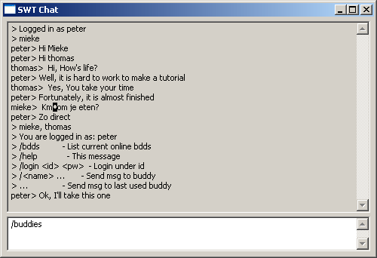
Running the SWT Chat
Run the SWT Chat in the normal way
  Verify the target bundles

Slide 96
Remoting
The chat is kind of boring because it only works on our own laptop. Missing is discovery of each other’s bundles! Rescue is on the way …
Enable the aQute.remoting project
  This project can export services to other participating machines
The only requirement is that you have a property remote=* on your service. See code
The aQute.remoting project will then export this service to any participating machine
Our Channel objects will therefore be spread all over the place
Enable the aQute.remoting bundle, launch, and test with your buddies.
public void login(String name,
String password) throws IOException{
if (registration != null)
registration.unregister();
registration = null;
this.name = name;
Hashtable properties =
new Hashtable();
properties.put(“remote”, “*” );
properties.put(
Constants.SERVICE_PID,
"pid:chat[“ +
InetAddress.getLocalHost()
+ "]:" + name);
properties.put(
Channel.CH_NAME, name);
registration = cntxt.registerService(
Channel.class.getName(),
user, properties);
user.send("", "Logged in as "
+ name);
}

Slide 97
Remoting
Machine B
Machine A
Machine C
Broadcast +p2p
network
Machine E
Machine D
Proxy of Channel
Real Channel

Slide 98
What did we learn?
That the OSGi Service Registry is a surprisingly powerful model for collaboration
The decoupling that it promotes allows additional functionality without influencing existing functions

Slide 99
What We Did Not Learn
Security Architecture
Permission Management
Signed Bundles
Package Management
Bundle Life Cycle Management
Configuration Management and Preferences
Servlet Support/Web Server
Device Access
Event Manager
UPnP
User Admin
Wire Admin
Application Model
Deployment Admin and Autoconf
Device Management Tree
Initial Provisioning
Position, Measurement, State
MetaType
And much, much, more

Slide 100
Conclusion
The OSGi R4 Specifications consists of considerable more details than elucidated in this tutorial
There are many independent OSGi implementations on the market, both commercial and open source
  Apache Felix, Atinav, Eclipse Equinox, Espial, IBM SMF, Knopflerfish/Ubiserv of Gatespace, ProSyst, …
The OSGi specification are today running on mobile phones, PDAs, embedded computers, desktops, and mainframes
Both in managed and unmanaged configurations
The OSGi specifications solve real world problems
The OSGi Alliance is working on making the OSGi specifications the standard for portable applications. Join us!

Slide 101
The End
Further reading:
http://www.osgi.org
http://bundles.osgi.org
http://www.eclipse.org/osgi
http://www.aqute.biz
OSGi is a trademark of the OSGi Alliance in the United States, other countries, or both.
Java and all Java-based trademarks are trademarks of Sun Microsystems, Inc. in the United States, other countries, or both.

