Slide 1

Building a Web Application
Using Flask (Python), JavaScript, and HTML
Yoobee Colleges

Slide 2
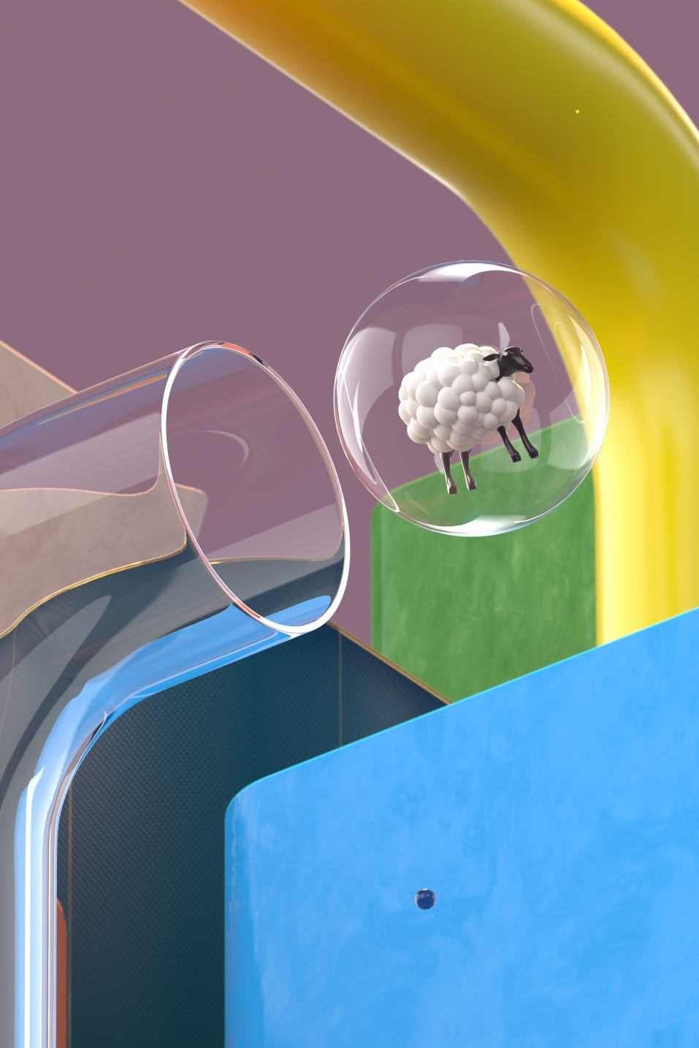
Introduction to Flask
Lightweight Python web framework
Ideal for rapid web development
Simple routing and rendering templates
- Example (app.py):
from flask import Flask, render_template
app = Flask(__name__)
@app.route('/')
def home():
return render_template('index.html')
if __name__ == '__main__':
app.run(debug=True)

Slide 3

HTML Template
Basic HTML structure (templates/index.html):
<!DOCTYPE html>
<html lang='en'>
<head>
<meta charset='UTF-8'>
<title>Flask Web App</title>
</head>
<body>
<h1>Web Developing Project!</h1>
<button id='alertBtn'>Click Me</button>
<script src='/static/script.js'></script>
</body>
</html>

Slide 4

JavaScript Integration
Basic JavaScript interaction (static/script.js):
document.getElementById('alertBtn').addEventListener('click', function() {
alert('Hello from JavaScript!');
});

Slide 5

File Structure
project_folder/
├── app.py
├── templates/
│ └── index.html
└── static/
└── script.js

Slide 6

Running the Application
Install Flask:
pip install flask
Run your Flask app:
python app.py
Visit:
http://127.0.0.1:5000/

Slide 7
Activity
Develop a Web-base project including two or three pages.
1
Add one more feature to load an image into your “Home” page.
2
Browse an image from your local directory.
3

Slide 8
Conclusion
Flask facilitates quick web app creation
Easy integration with HTML & JavaScript
Great for teaching software development fundamentals

Slide 9

Q&A?

