Slide 1
Classical vs. Agile Development
A Comparative Analysis

Slide 2
Introduction
Software development has evolved over time, leading to two major methodologies: Classical (Waterfall) and Agile. This presentation compares these two approaches.

Slide 3
Classical Development (Waterfall)
- Follows a sequential, step-by-step process
- Phases: Requirements → Design → Implementation → Testing → Deployment → Maintenance
- Changes are difficult to implement after the process starts
- Suitable for projects with well-defined requirements

Slide 4

Agile Development
- Iterative and incremental approach
- Works in short cycles (sprints) with continuous feedback
- Adaptable to changing requirements
- Suitable for complex, evolving projects

Slide 5

Key Differences
- Flexibility: Agile allows changes; Classical is rigid
- Project Scope: Classical requires full scope upfront; Agile evolves over time
- Testing: Classical tests at the end; Agile tests continuously
- Team Collaboration: Agile promotes teamwork; Classical follows a structured hierarchy

Slide 6
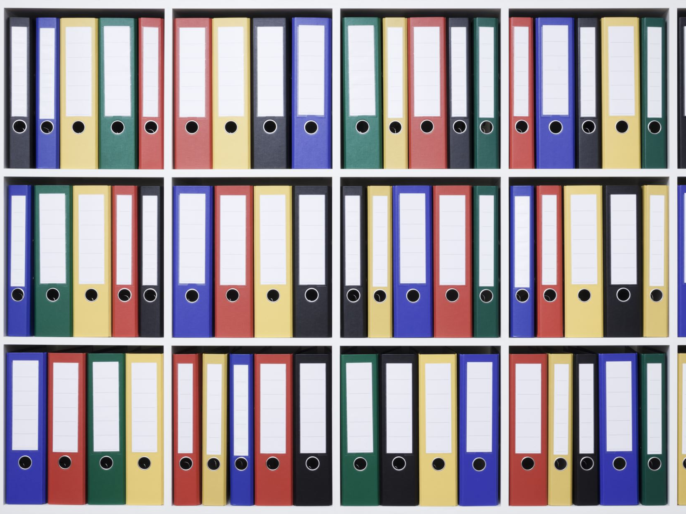
Pros & Cons of Classical Development
Pros:
Clear structure and documentation
Good for stable projects
Easier to manage large teams
Cons:
Inflexible to changes
Late testing phase may lead to issues
High risk of failure if requirements are unclear

Slide 7
Pros & Cons of Agile Development
Pros:
Flexible and adaptive
Encourages continuous improvement
Delivers working software faster
Cons:
Requires active customer involvement
Harder to estimate time and budget
Less structured documentation

Slide 8
When to Use Each Approach
- **Use Classical:** When requirements are clear and stable (e.g., government projects, safety-critical systems)
- **Use Agile:** When requirements are evolving and rapid feedback is needed (e.g., startups, software products)

Slide 9
Conclusion
Both Classical and Agile development have their place in software engineering. Choosing the right approach depends on the project's nature, requirements, and flexibility needs.

