Slide 1
Heuristics for Resource Matching in Intel’s Compute Farm
Masters Thesis By Ohad Shai, Supervised by Prof. Dror G. Feitelson
Notes:
Hello
My name is Ohad, I am a master degree student at tel aviv university and work at intel.
I will present a paper discussing how to match jobs to machines, and a way to optimize that process based on intel’s compute farms

Slide 2
Agenda
Background
Job’s at Intel data-center characteristics
Proposed algorithms
Mix-Fit
Max-Jobs
Simulation results
Related work
Conclusion
Notes:
I will start with some background on intel’s grid and its workload
And later, discuss proposed optimization to its scheduling, based on simulations that we did.

Slide 3
Background
Intel owns an Internet-scale distributed compute farm
Massive chip-simulation workloads
Tens of thousands of servers
Dozens of data-centers around the world
Thousands of newly incoming jobs every second
Capable of running hundreds of thousands of jobs simultaneously
Netbatch used for resource and scheduling management
An in-house developed application
Notes:
Intel owns an Internet-scale distributed compute farm
It is used for running its massive chip-simulation workloads
The farm is composed of tens of thousands of servers that are located in multiple data centers that are
geographically spread around the globe.
It is capable of running hundreds of thousands of simulation jobs simultaneously,
and handles a rate of thousands of newly incoming jobs every second.
This huge compute capacity is managed by an in-house developed application called Netbatch

Slide 4
Netbatch components
Virtual Pool (VPM)
Physical Pool (PPM)
Physical Pool (PPM)
Machine
Machine
Machine
Machine
Machine
Machine
Notes:
This is a high level description of netbatch.
Netbatch is a two-tier resource management and scheduling system.
At the lower level NetBatch groups the servers into autonomous clusters that are
Called in Intel terminology “Physical Pools.”
Each such pool contains up to thousands of servers and is managed by a single NetBatch entity that is
called the Physical Pool Manager or PPM.
The role of the PPM is to accept jobs from the upper level, and to schedule them on underlying servers efficiently and with minimal waste.

Slide 5
Netbatch components
Virtual Pool (VPM)
Physical Pool (PPM)
Physical Pool (PPM)
Machine
Machine
Machine
Machine
Machine
Machine
Notes:
At the upper level NetBatch deploys a second set of pools that are called Virtual Pools.
Just like in the lower level, each virtual pool is managed by a single
NetBatch component that is called the Virtual Pool Manager or VPM.
The role of the VPMs is to cooperatively accept jobs from the users and distribute them to the different PPMs in order to spread the load across the farm.
Together, these two layers, VPMs at the top and PPMs at the bottom, strive to utilize
every compute resource across the farm.
Our work focuses on the work done at the PPM level.

Slide 6
Background
Resource matching is done at the PPM level
Matching jobs to machines based on cores and memory requirements - resources are allocated exclusively
Preserve fairness among teams at Intel - that part was not covered in the work
We show that neither heuristic used today is optimal
We suggest other heuristics to improve flexibility and utilization in the pools
Notes:
As mentioned before, the jobs that are submitted to netbatch are mainly chip-simulations.
Jobs that are submitted to netbatch arrives with memory and cpu-cores resources requirements
Netbatch allocates an available machine to each job. The required resources are allocated exclusively.
A basic requirement in NetBatch is the enforcement of fair-share scheduling
among the various projects and business units within Intel that share the farm.
Once the shares are calculated, they are propagated to the PPMs where they are physically enforced
In the paper we did not investigate fairness at all.
We investigated the heuristics that are used to select a machine for each job.
We show that these heuristics are not optimal and suggest other heuristics to improve pool utilization

Slide 7
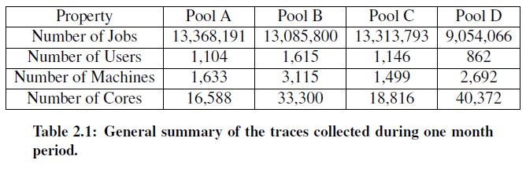
The workload
Traces from 4 of Intel’s largest physical pools
9– 13 million jobs each
One month period (November 2012)
Publicly available at Parallel Workloads Archive
Notes:
We started by analyzing traces from 4 of Intel’s largest physical pools
The traces consists about 10-13 millions jobs each
They were taken in last November (2012)

Slide 8
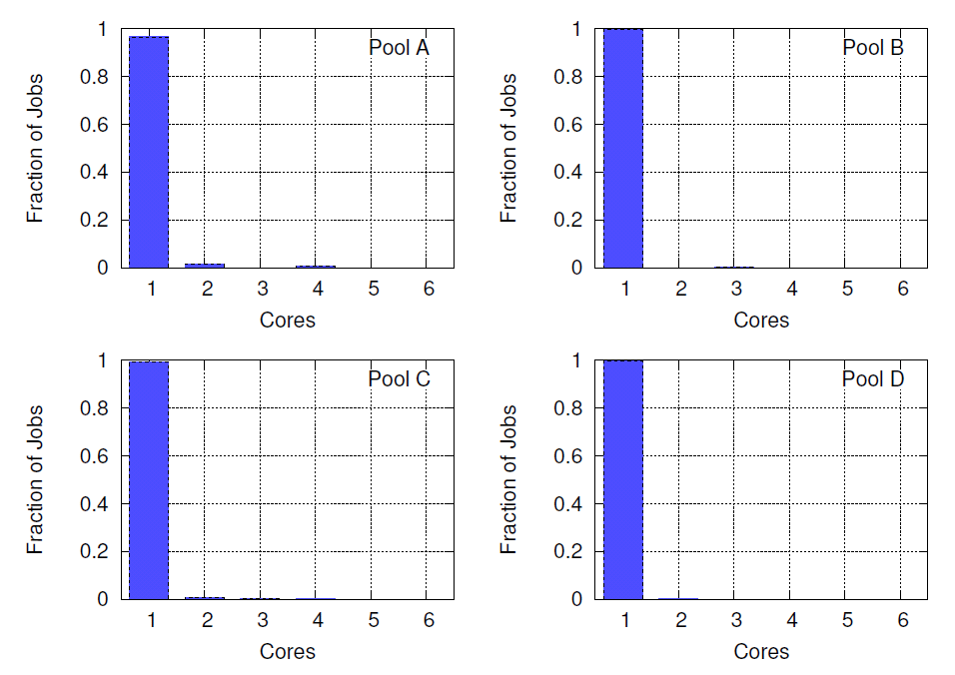
Resource requirements by Jobs
Most of the jobs require 1 core
Notes:
In the graphs you can see the jobs distribution by number of required cores.
The x axis represents the cores, and y axis represents the fraction of jobs that required that amount
We can see that the vast majority of jobs are single cores jobs (according to their resource requirements)

Slide 9
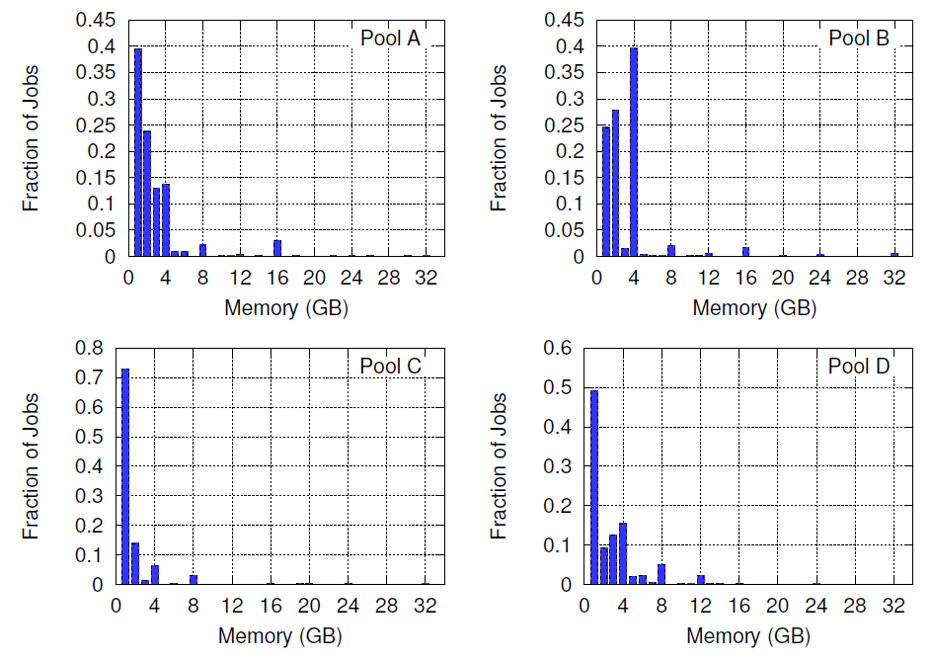
Resource requirements by Jobs
Most of the jobs require 1 core
Most of the jobs require less than 5 GB memory
Notes:
In these graphs we can see memory requirements distribution of jobs
The x axis represents the memory in GB.
Also most jobs requires less than 5 GB of memory, although in that case variability is a little bit bigger.
So generally speaking, most of jobs are pretty much the same (the workload is homogenous), hence no fragmentation is expected

Slide 10
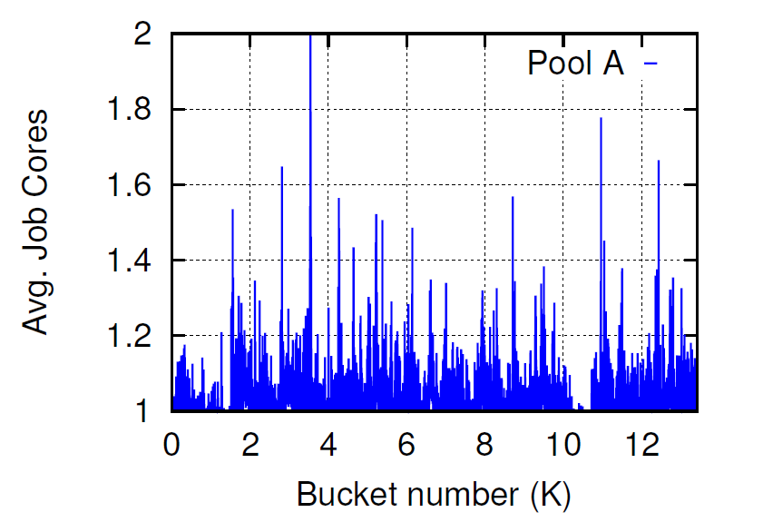
Resource requirements by Jobs
Most of the jobs require 1 core
Most of the jobs require less than 5 GB memory
But still, there are bursts of higher demand
Buckets of 1000 jobs
Ordered by arrival
Notes:
But still, there are bursts of higher demand, as you can see in the following experiment
We bucket the job in the traces by their arrival order in buckets of 1000 jobs
In the graphs, x Axis represents the buckets of arrival and y axis represents the average of required cores by jobs in that bucket
(Here we can see some examples)

Slide 11
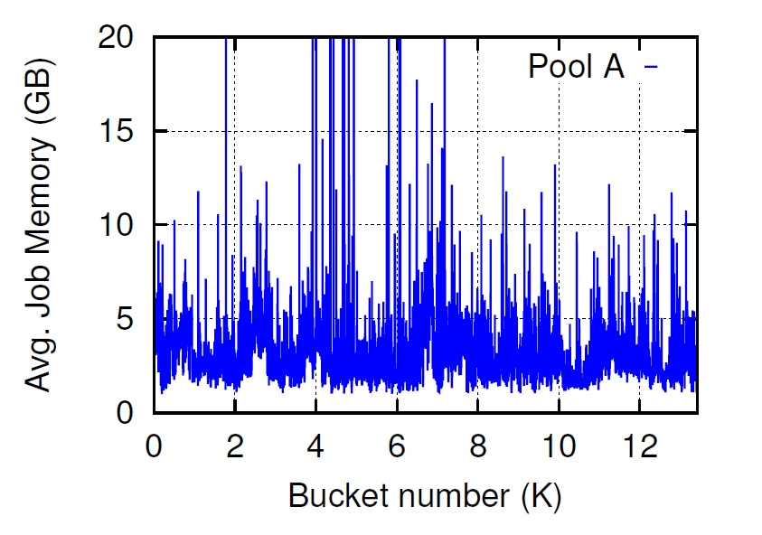
Resource requirements by Jobs
Most of the jobs require 1 core
Most of the jobs require less than 5 GB memory
But still, there are bursts of higher demand
Buckets of 1000 jobs
Ordered by arrival
Notes:
In these graphs we can see example of memory bursts
We can see that pool A has the highest variability of bursts

Slide 12
Heuristics for Resource Matching
Varying resource requirements can cause fragmentation
There are various heuristics to reduce fragmentation and improve utilization: Best-Fit / Worse-Fit
Let’s see an example

Slide 13
Example
Machines A and B, each having 4 cores and 32 GB of memory
Assume that 8 jobs arrive at the PPM in the following order:
2 jobs of 1 core and 16 GB of memory
Followed by 6 jobs of 1 core and 4 GB of memory

Slide 14
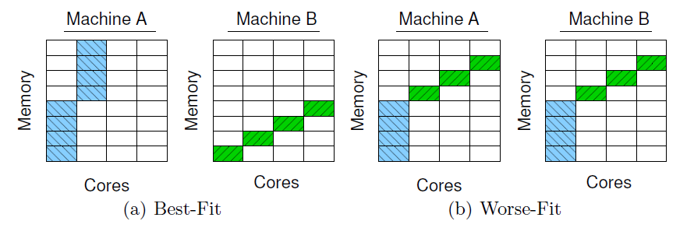
Example
Machines A and B, each having 4 cores and 32 GB of memory
Assume that 8 jobs arrive at the PPM in the following order:
2 jobs of 1 core and 16 GB of memory
Followed by 6 jobs of 1 core and 4 GB of memory
Notes:
Best fit and worse fit here refers to (available) memory
Best fit will find the machine that is best fitted to current job, means with lowest available memory that can still execute the job
Worse fit will find the machine that has the most available memory and will execute the jobs on that machine
We can see in that example worse fit is a better heuristic and executed 2 jobs more than BF

Slide 15
Another Example
The order of arrival is:
3 jobs of 1 core and 8 GB of memory
Followed by 1 job of 1 core and 32 GB of memory

Slide 16
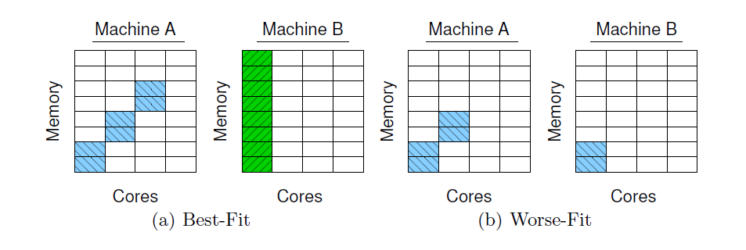
Another Example
The order of arrival is:
3 jobs of 1 core and 8 GB of memory
Followed by 1 job of 1 core and 32 GB of memory
Notes:
In that example we can see that best-fit is better and was able to match one more job

Slide 17
Heuristics for Resource Matching
Different heuristics are optimal in different cases
At Intel, one dimensional heuristics are used
The are 4 options:
Best-Fit/Worse-Fit on Cores/Memory
Notes:
So we saw examples that different heuristics are optimal in different cases
(Now talk from the slide)

Slide 18
Comparing heuristics
The heuristics were compared by buckets
Buckets of 1000 jobs each by arrival order
Allocate the jobs in each bucket synthetically on 500 empty cores
Jobs that were not allocated were ignored
Notes:
What we did is to take each 1000 jobs bucket and check which heuristic is better allocating the jobs to machines
We used a constant number of 500 cores and dropped the jobs that were not allocated
We then count the percent of wins of each heuristic

Slide 19
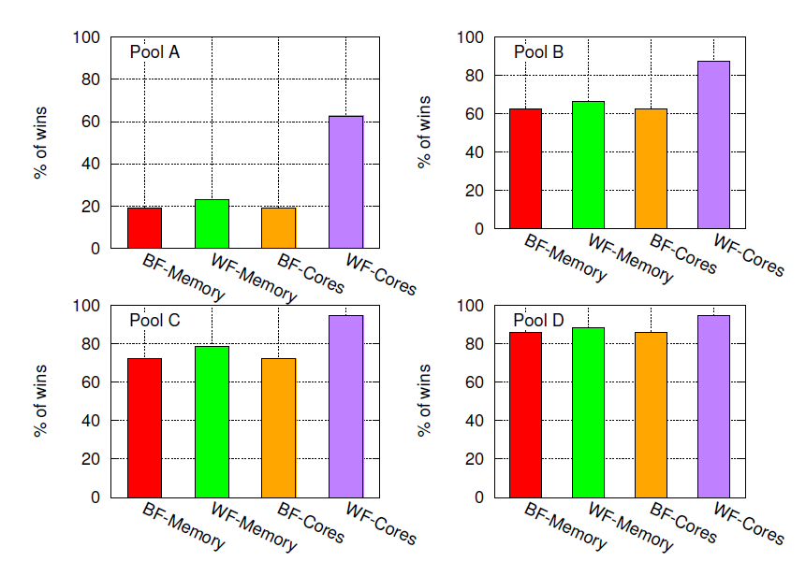
Comparing heuristics
The heuristics were compared by buckets
There is no single heuristic that gets to 100%
Notes:
2 observations can be noticed:
WF cores looks like the best heuristic for the majority of buckets
There is no heuristic that win 100% of the time (means in different periods it might better to use different heuristics)
Another observation that is not obvious from that graph is that locality play its role, it is not always possible to predict from past what is the current best heuristic
Note that this is a synthetic tests
In real world pool is not empty while we schedule new jobs. In such case it might appear that WF cores is not the best policy
It is still not obvious what heuristic should be used

Slide 20
Mix-Fit
As seen before, one dimensions heuristics are lack of information
Notes:
Trying to confront the problems that are inherent in one dimensional heuristics we come with a new 2 dimensional heuristics called mix-fit…
(move to next slide)

Slide 21
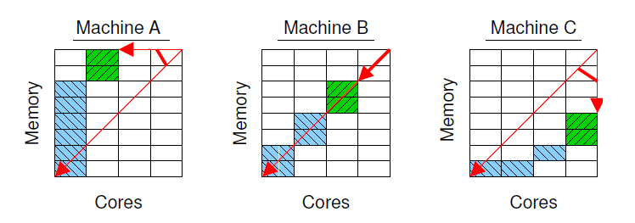
Mix-Fit
As seen before, one dimensions heuristics are lack of information
Mix-Fit is:
Trying to “Best-Fit” on two-dimensions
Notes:
The configured ratio is represented by the diagonal of cores to memory grid
The used ratio represented by a line connecting top-right point of the grid with the top right point of the right job
When selecting a machine for specific job, we will look for machine with the minimal angle between the 2 lines.
In the case here, machine B is preferred.
Mix fit is aimed for balanced resource utilization

Slide 22
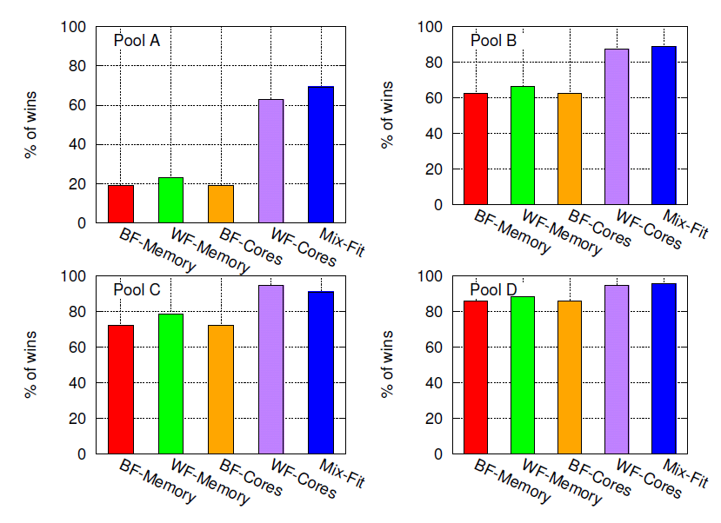
Mix-Fit
Same bucket experiment
Yet, experiments shows “Mix-Fit” is not 100% also
Notes:
We run the same bucket experiment, this time with mix-fit also
Though mix fit wins in the majority of cases it is still not reach 100% and not best for all cases

Slide 23
Max-Jobs
Yet, experiments shows “Mix-Fit” is not always the best heuristic
Max-Jobs means always take the best heuristic
Max-Jobs uses the heuristics as “black-box” algorithms
Each heuristic compute a mapping from jobs to hosts - the “schedule”
Best-Fit
Max-Jobs
Worse-Fit
Mix-Fit
Notes:
So we suggested another heuristic called max-jobs
Max jobs get a “schedule” from each heuristic, and dispatch jobs by the heuristic that its scheduled jobs had the highest number of jobs
Max-Jobs uses the heuristics as “black-box” algorithms
The heuristics are pluggable and other heuristics can be added later

Slide 24
Simulation results
Java based event-driven simulator that was developed for the simulations
Open source: https://code.google.com/p/batch-simulator/
Same workload that was described earlier:
9-13 million jobs
1 month
4 of Intel largest pools
Notes:
To experiment with Max-Jobs, Mix-Fit and the rest of the heuristics, we developed
a Java-based event-driven simulator that mimics the matching behavior
at the PPM.
For the workload we used the traces that were described previously, and
which contains 10–13 million jobs each.
In this graphs we see…

Slide 25
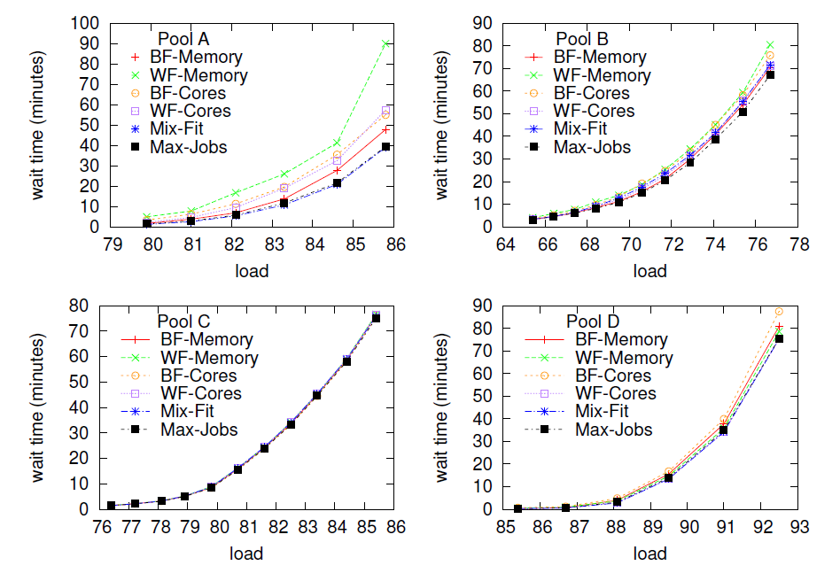
Simulation results
Up to 22% reduction in wait time for jobs
Notes:
In this graphs we see…
Pool A – Mix Fit wins
Pool B BFM Wins MF because of bursts and high memory jobs (BFM was bad on pool D)
WFC – good only on buckets (similar to round robin in buckets)
Pool C – unchallenging workload
Pool D – non bursty nature (good for balancing)
Max Job - robust

Slide 26
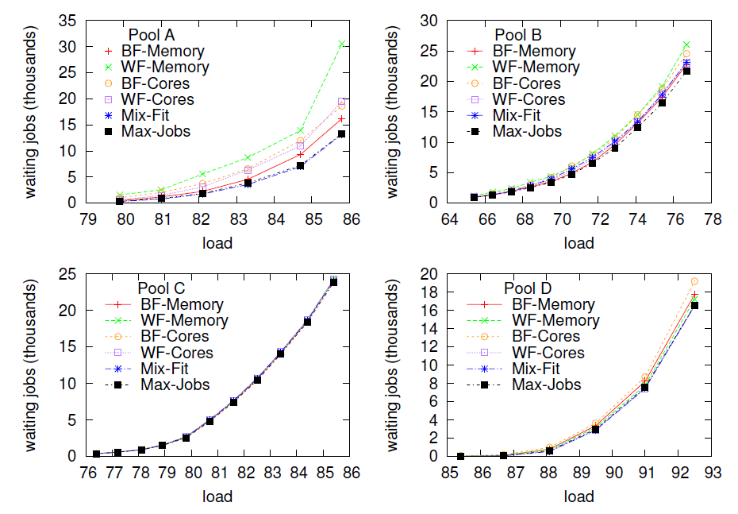
Simulation results
Up to 22% reduction in number of waiting jobs in PPM
Notes:
In this graphs we see…

Slide 27
Related work
Vector bin-packing problem:
allocating virtual machines to physical servers (virtual machine placement problem) Rina Panigrahy et al. Heuristics for vector bin packing
Meta-schedulers:
David Talby and Dror G. Feitelson. Improving and stabilizing parallel computer performance using adaptive backfilling
Other approaches:
Reservations with on-line backfilling (Srinivasan et al.)
Altering resources requirements of job submission. (Yom-Tov And Aridor)

Slide 28
Conclusions
In this work we investigated the problem of resource matching in Intel’s compute farm
Improvements to matching heuristics were suggested: Mix-Fit & Max-Jobs
Implementation in Intel is still on-going.
Other contributions: Public Traces and Simulator.
Paper was presented at JSSPP 2013

Slide 29
Thank you!

