Slide 1
R Store
Angelique Moscicki
Oshani Seneviratne
Sergio Herrero-Lopez

Slide 2
Agenda
Introduction/Problem/Goal
Design
Implementation
Algorithm I
Algorithm II
Tools/Demo
Conclusion/Limitations/Future Work

Slide 3

Introduction
Background:
  RDF is a standard developed by the W3C for Web Based meta data
  Statements about resources in the form of Subject-Predicate-Object expressions, called triples
  RDF Schema (RDFS): basic elements for the description of ontologies, intends to structure RDF resources
Problem:
  Solutions that persist RDF data store triples in a single flat
  table without associating the ER model of database
  Such a table leads to serious performance issues as queries involve
  many self-joins over this table
Goal:
  Provide the database community a tool to convert an RDF document into a suitable Relational Database Schema.

Slide 4






RDF Graph
Sam Madden
seq
Database Systems
name
teachers
MIT6.033
name
1
ONE TO MANY
32-G938
Stata,
G9, 38
1
sm
office
office n
MIT6.830
Mike Stonebraker
ONE TO ONE
seq
name
teachers
2
ms
office n
32-G916
office
Stata,
G9,16
students
MANY TO ONE
name
Sergio Herrero
1
G
MANY TO MANY
sh
year
seq
department
2
name
Angelique Moscicki
Electrical Eng. And Computer Science
am
EECS
name
department
3
department
os
Oshani Seneviratne
name

Slide 5
RDB Schema
table_student
table_student
table_teacher
table_course
pkey_student | col_name | col_year
sh | Sergio Herrero | Graduate
am | Angelique Moscicki | Senior
os | Oshani Seneviratne | Graduate
pkey_teacher | col_name
ms | Mike Stonebraker
sm | Sam Madden
pkey_course | col_name
MIT6.830 | Database Systems
MIT6.033 | Introduction to Systems
table_department
table_course_teacher
table_location
pkey_department | col_name
EECS | Electrical Eng & Comp Sci
pkey_course | pkey_teachers
MIT6.830 | Sm
MIT6.830 | Ms
MIT6.033 | Sm
pkey_location | col_address
32-G938 | Stata, G9, 38
table_course_students
table_student_department
table_teacher_location
pkey_course | pkey_students
MIT6.830 | sh
MIT6.830 | am
MIT6.830 | os
pkey_student | pkey_department
sh | EECS
am | EECS
os | EECS
pkey_teacher | pkey_location
sm | 32-G938

Slide 6









Design
RDF
RDF Store
Schema Generator
RDFS
Algorithm 1
Algorithm 2
DB Populator
SQL DDL
SQL
DML
SQL Queries

Slide 7
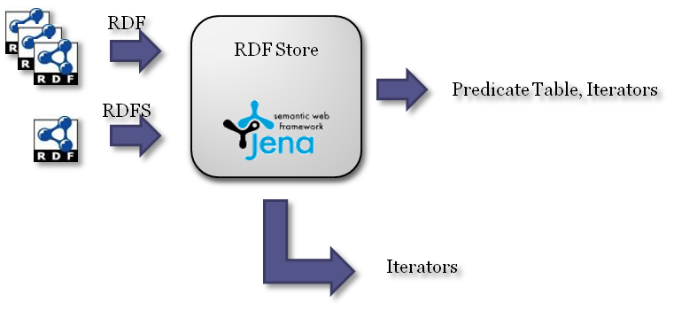
RDF Store
Provides resources to the SchemaGenerator and DB Populator to analyze RDF triples
  Parses RDF files and a RDFS schema
  Generates iterators over the triples
  Classifies triples according to their Subject class using the schema
  Constructs a Predicate Table
    For each Predicate -> groups pairs (subject class and object class) → Statistics

Slide 8


Schema Generator
Analyzes the triples to produce a good relational schema
  Gathers statistics on the triples
  Constructs arc templates
  Constructs Property Tables, and rules for how to populate them with statements
    A Property Table consists of a Class which is the primary key, and a collection of arcs whose source is that Class
Schema Generator
Algorithm 1
Algorithm 2

Slide 9
Algorithm I
Schema Generation
  Infers subclass relationships from RDF Schema
  Uses the domain and range constraints on properties in constructing meaningful relationships
DB Population
  Uses customized SPARQL queries over the RDF Store
Class relationships
Entities
Property Constraints
Relationships
Strategy: Use the semantics expressed in the RDF Schema in constructing and populating the RDB Schema

Slide 10
Algorithm II
  Gathers statistics about cardinality and frequency
  Arc reversal
Forward Direction
Subject
Property
Object
Reverse Direction
Strategy: Reverse arcs for one-to-many relations, and for one-to-one relations when its cheaper

Slide 11
DB Populator
Creates and populates RDB tables according to the generated schemas
  Assembles tuples triple by triple
  Abstraction allows extension to any RDB platform
DB Populator
SQL DDL
SQL
DML

Slide 12






Tools
  Google Code and SVN Tortoise
  Eclipse. JRE 1.6.0
  Jena RDF API
  PostgreSQL 8.1

Slide 13

Demo

Slide 14
Conclusions
+ Translates an RDF store into an RDB
+ Preserves wide Property Tables to improve query performance, greatly reduces the null problem
Only works for a small subset of reasonably written RDF syntax
Does not eliminate all nulls / wasted space
Requires an RDF Schema
Graph traversal is expensive

Slide 15

Questions??

