Slide 1
Hardware communication p.1
GPIO subsystem driver interface “gpiolib”
GPIO Programming example
struct irq_chip IRQ subsystem interface
CHAINED GPIO irqchips

Slide 2
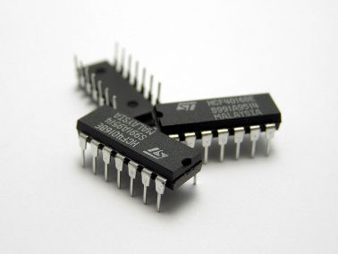
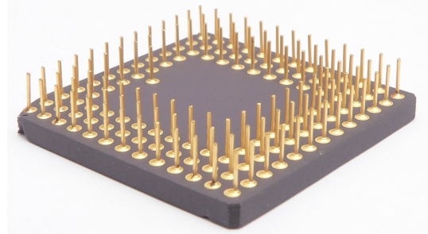
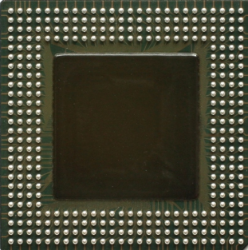
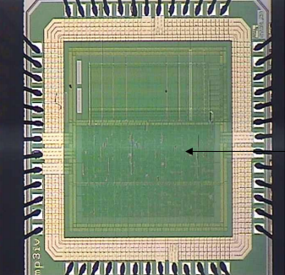
Pin from HW Engineer Point of View
Dual in line (DIP) package
Pin Grid Array (PGA) Package
Ball Grid Array (BGA) Pachage
Pad ring
Pad with bonding wire
System on chip (SoC)

Slide 3
Simplified GPIO hardware cell
Hardware
I/O Cell
OEN
OUT
I/O Pad
IN
The cell signals are connected to register maps that are controlled by software
IEN

Slide 4
Pin from HW Engineer Point of View
Pins are equivalent to balls found on a BGA etc.
In an SoC pins are connected to a pad on a silicon chip
Each pad is driven by a specific piece of logic, called a I/O cell.
Using a CAD tool, the hardware designer place pads around the edges of the chip, forming a pad ring
Each cell has a number of discrete control signals, for example this simple bidirectional I/O cell:
OEN – output enable
OUT – value of output
IEN – input enable
IN – value of input
PUEN – pull-up enable (not shown)
PDEN – pull-down enable (not shown)
The cell signals are connected to register maps that are controlled by software.
I/O cell is used for various things: busses, memories, etc, one specific use case is GPIO (general purpose I/O) which typically group e.g. 32 cells into a GPIO block

Slide 5
How GPIO block is formed from I/O cells
A GPIO block is formed by taking a number of IO cells and lumping them into a block. For example it is convenient to take 8 cells and create a 8 bit GPIO block
Control registers for each cell such as “OUT” are then typically grouped into a 32 bit register where you can set output state by setting/clearing bit N in the register, OEN, OUT, IN, PUEN, PDEN are just passed through to one bit each in a register
The GPIO logic then typically adds asynchronous edge detection logic for rising/falling/both edges when the pin us used as input and builds IRQ signals from edges and an IRQ enable bit per pin.
Copy-paste 8 I/O cells would give us 4 registers 8-bit wide each:
0x00 8-bits GPIO_PORTA_OEN
0x01 8-bits GPIO_PORTA_OUT
0x02 8-bits GPIO_PORTA_IEN
0x03 8-bits GPIO_PORTA_IN

Slide 6
GPIO subsystem driver interface “gpiolib”
GPIO[0.. ARCH_NR_GPIOS-1]
gpiolib
SoC GPIO registers
GPIO_PORTA_xxx
SPI Driver
I2C Driver
GPIO_PORTB_xxx
SPI
I2C
SPI GPIO expander IC
I2C GPIO expander IC
GPIO_PORTC_xxx

Slide 7
GPIO subsystem driver interface “gpiolib”
Hardware
I/O Cell
OEN
OUT
I/O Pad
gpiolib
IN
IEN

Slide 8
GPIO subsystem driver interface “gpiolib”
#include/asm-generic/gpio.h
struct gpio_chip {
const char *label;
struct device *dev;
struct module *owner;
int (*request)(struct gpio_chip *chip, unsigned offset);
void (*free)(struct gpio_chip *chip, unsigned offset);
int (*direction_input)(struct gpio_chip *chip, unsigned offset);
int (*get)(struct gpio_chip *chip, unsigned offset);
int (*direction_output)(struct gpio_chip *chip, unsigned offset, int value);
int (*set_debounce)(struct gpio_chip *chip, unsigned offset, unsigned debounce);
void (*set)(struct gpio_chip *chip, unsigned offset, int value);
int (*to_irq)(struct gpio_chip *chip, unsigned offset);
void (*dbg_show)(struct seq_file *s, struct gpio_chip *chip);
int base;
u16 ngpio;
const char *const *names;
unsigned can_sleep:1;
unsigned exported:1;
};

Slide 9
GPIO subsystem driver interface “gpiolib”
#include/asm-generic/gpio.h
struct gpio_chip {
const char *label;
struct device *dev;
struct module *owner;
int (*direction_input) (struct gpio_chip *chip, unsigned offset);
int (*get) (struct gpio_chip *chip, unsigned offset);
int (*direction_output) (struct gpio_chip *chip, unsigned offset, int value);
void (*set) (struct gpio_chip *chip, unsigned offset, int value);
int (*to_irq) (struct gpio_chip *chip, unsigned offset);
int base;
u16 ngpio;
const char *const *names;
unsigned can_sleep:1;
unsigned exported:1;
};
int gpiochip_add (struct gpio_chip *chip)
Set base GPIO number
Set number of GPIOs in block
Call to register

Slide 10
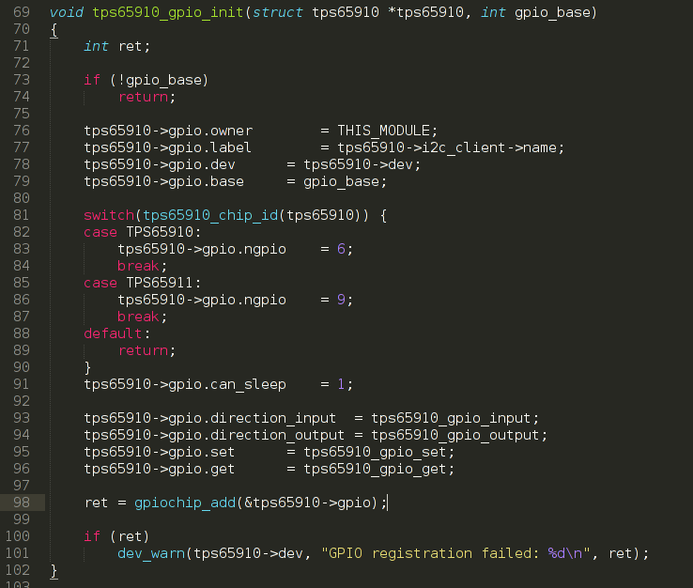
GPIO subsystem driver interface “gpiolib”

Slide 11
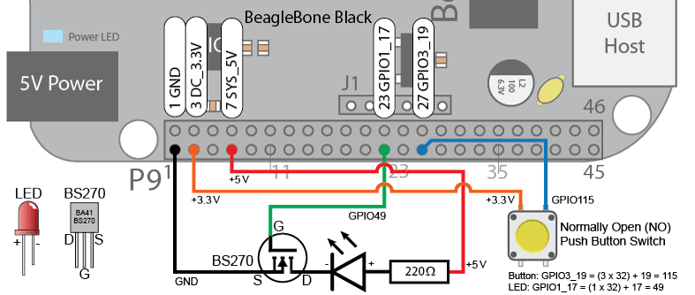
GPIO Programming example
Programming buttons and LEDs

Slide 12
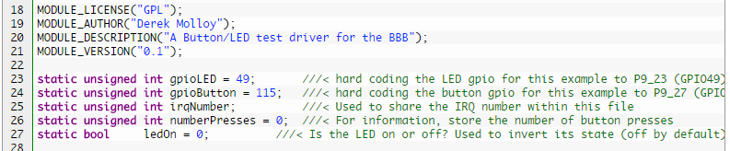
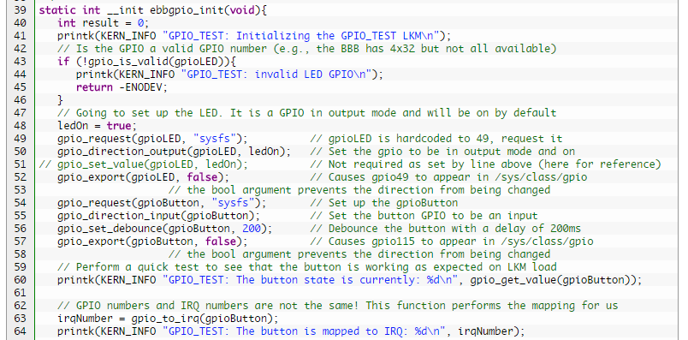
GPIO Programming example

Slide 13
sysfs interface of the GPIOlib
Define env. variable
# export LED=49
Ask Kernel to export the GPIO
# echo $LED > /sys/class/gpio/export
Export functions are created:
# ls /sys/class/gpio/gpio$LED
active_low edge subsystem value
direction power uevent
Put GPIO direction in output
# echo out > /sys/class/gpio/gpio$LED/direction
# cat /sys/class/gpio/gpio$LED/direction
out
Play with GPIO to blink LED
# echo 1 > /sys/class/gpio/gpio$LED/value
# echo 0 > /sys/class/gpio/gpio$LED/value
CONFIG_GPIO_SYSFS must be enabled in kernel configuration

Slide 14
GPIO interrupts
The GPIO logic adds asynchronous edge detection logic for rising/falling/both edges when the pin is used as input and builds IRQ signals from edges and an IRQ enable bit per pin.
0x00 8-bits GPIO_PORTA_OEN
0x01 8-bits GPIO_PORTA_OUT
0x02 8-bits GPIO_PORTA_IEN
0x03 8-bits GPIO_PORTA_IN
0x04 8-bits GPIO_PORTA_IRQ_EN

Slide 15
GPIO interrupts
Hardware
I/O Cell
OEN
OUT
I/O Pad
IRQ EN
IRQ
Edge Detector
RISING/
-FALLING
IN
IEN

Slide 16
GPIO interrupts
Hardware
I/O Cell
OEN
OUT
I/O Pad
IRQ EN
IRQ
Edge Detector
RISING/
-FALLING
IN
IEN

Slide 17
struct irq_chip IRQ subsystem interface
struct irq_chip {
const char *name;
void (*irq_enable)(struct irq_data *data);
void (*irq_disable)(struct irq_data *data);
int (*irq_set_type)(struct irq_data *data, unsigned int flow_type);
…
unsigned long flags;
};
void irq_set_chip_and_handler (unsigned int irq, struct irq_chip *chip,
irq_flow_handler_t handle)
int irq_set_chip_data (unsigned int irq, void *data)

Slide 18
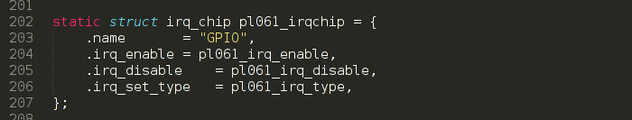
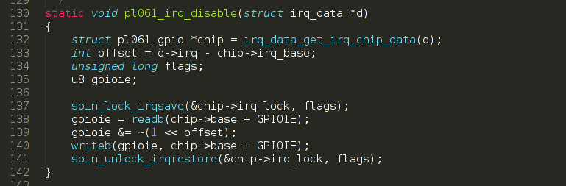
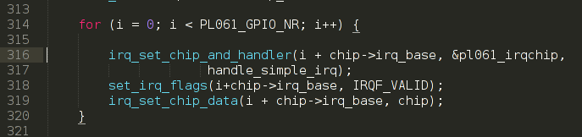
struct irq_chip IRQ subsystem interface
If we had separate interrupt per each cell
we would only need to do:
We only implement
hardware-related stuff,
this handler is from
Kernel IRQ sub-system!

Slide 19
CHAINED GPIO irqchips
But we have Hardware interrupts from GPIOs chained –
one hardware interrupt for several GPIOs.
So one more step is needed:
Register HW interrupt handler:
void irq_set_chained_handler (unsigned int irq, irq_flow_handler_t handle)
Don’t forget about custom data that might needed in handler
int irq_set_handler_data (unsigned int irq, void *data)
Invoke interrupt handler for each particular cell using:
int generic_handle_irq (unsigned int irq)

Slide 20
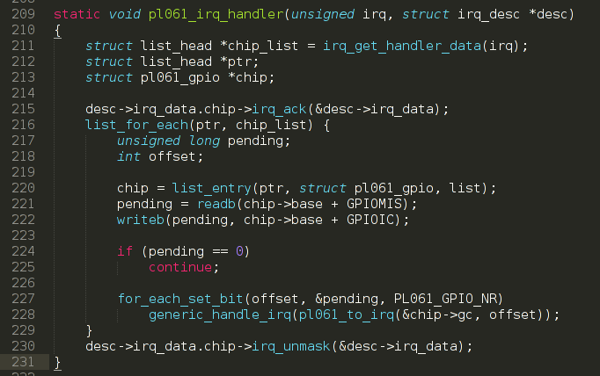
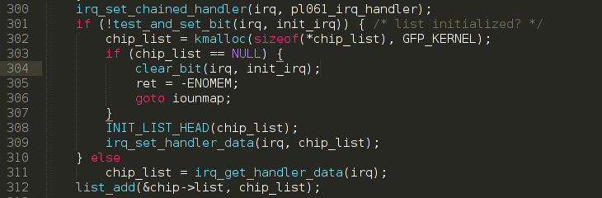
CHAINED GPIO irqchips in pl061 driver

Slide 21
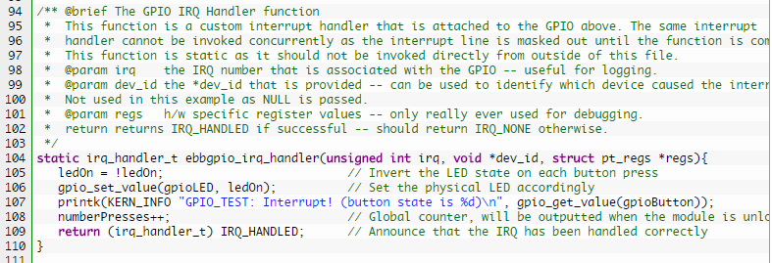
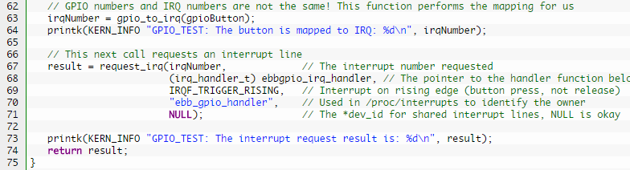
GPIO Interrupts Programming Example

Slide 22
Homework
Read https://repo.zenk-security.com/Linux%20et%20systemes%20d.exploitations/Linux%20generic%20IRQ%20handling.pdf
Check src/drivers/gpio/gpio-pl061.c implementation
Check http://infocenter.arm.com/help/topic/com.arm.doc.ddi0190b/DDI0190.pdf

Slide 23
Thank you!

