Slide 1
Hardware communication p.2
Using I/O Ports
I/O Memory Allocation and Mapping
Accessing I/O Memory
String Operations
Memory Barriers

Slide 2
Using I/O Ports
Allocate
struct resource *request_region(unsigned long first, unsigned long n, const char *name);
void release_region(unsigned long start, unsigned long len);
All port allocations show up in /proc/ioports.
Manipulating I/O ports
unsigned inb (unsigned port);
void outb (unsigned char byte, unsigned port);
Read or write byte ports (eight bits wide). The port argument is defined as unsigned long for some platforms and unsigned short for others. The return type of inb is also different across architectures.

Slide 3
I/O Memory Allocation and Mapping
Allocate
struct resource *request_mem_region(unsigned long start, unsigned long len, char *name);
void release_mem_region(unsigned long start, unsigned long len);
Depending on the computer platform and bus being used, I/O memory may or may not be accessed through page tables. When access passes though page tables, the kernel must first arrange for the physical address to be visible from your driver, and this usually means that you must call ioremap before doing any I/O
void *ioremap(unsigned long phys_addr, unsigned long size);

Slide 4
Accessing I/O Memory
To read from I/O memory, use one of the following:
unsigned int ioread8 (void *addr);
unsigned int ioread16 (void *addr);
unsigned int ioread32 (void *addr);
Here, addr should be an address obtained from ioremap (perhaps with an integer offset); the return value is what was read from the given I/O memory.
There is a similar set of functions for writing to I/O memory:
void iowrite8 (u8 value, void *addr);
void iowrite16 (u16 value, void *addr);
void iowrite32 (u32 value, void *addr);

Slide 5
String Operations
In addition to the single-shot in and out operations, some processors implement special instructions to transfer a sequence of bytes, words, or longs to and from a single I/O port or the same size.
void insb (unsigned port, void *addr, unsigned long count);
void outsb (unsigned port, void *addr, unsigned long count);
Read or write count bytes starting at the memory address addr. Data is read from or written to the single port port.
void insw (unsigned port, void *addr, unsigned long count);
void outsw (unsigned port, void *addr, unsigned long count);
Read or write 16-bit values to a single 16-bit port.
void insl (unsigned port, void *addr, unsigned long count);
void outsl (unsigned port, void *addr, unsigned long count);
Read or write 32-bit values to a single 32-bit port.

Slide 6
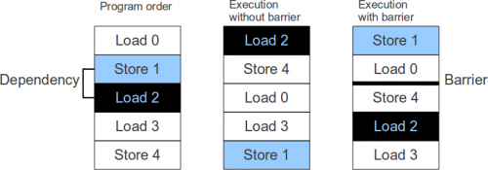
Memory barriers
#include <linux/kernel.h>
void barrier (void)
This “software” memory barrier requests the compiler to consider all memory volatile across this instruction.

Slide 7
Memory barriers
#include <asm/system.h>
void rmb (void);
void read_barrier_depends (void);
void wmb (void);
void mb (void);
Hardware memory barriers. They request the CPU (and the compiler) to checkpoint all memory reads, writes, or both across this instruction.

Slide 8
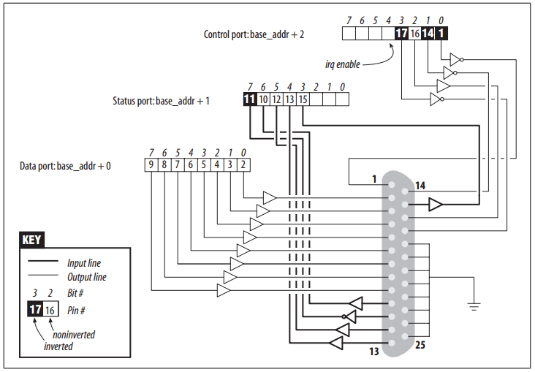
LPT I/O Port Example

Slide 9
Thank you!

