Slide 1
USB Drivers p.1 Introduction to USB
Connectors
Speed Identification
Signaling
USB Packets
USB Transactions
Isochronous, Bulk, Interrupt and Control Transfers
USB Descriptors
Enumeration Flow

Slide 2
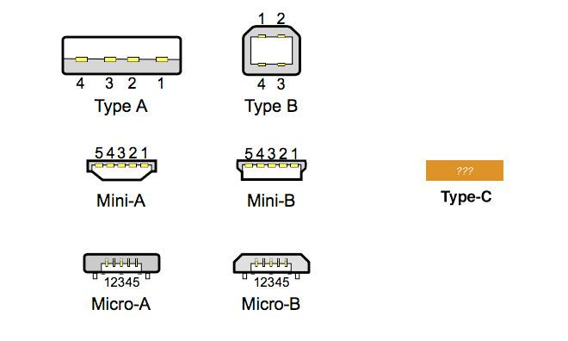
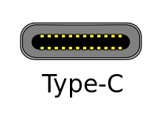
Connectors

Slide 3
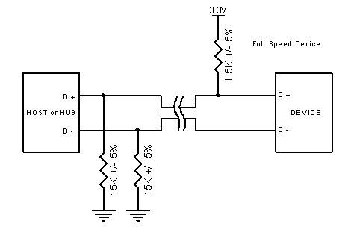
Speed Identification
Full speed (12 Mbit/s) device with pull up resistor connected to D+

Slide 4
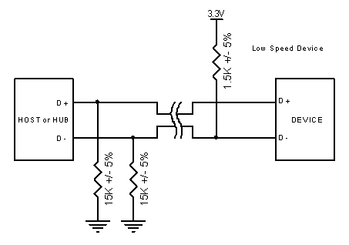
Speed Identification
Low speed (1.5 Mbit/s) device with pull up resistor connected to D-

Slide 5
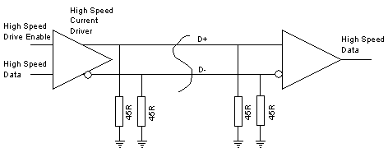
Speed Identification
Data is sent by steering a current of 17.78 mA (derived from the positive supply) into either the D+ or the D- line. This results in a voltage of 400mV on the line being fed with current. The differential state of the line is detected at the receiving end by a differential receiver. This arrangement is able to reliably receive data sent at 480 Mb/s.

Slide 6
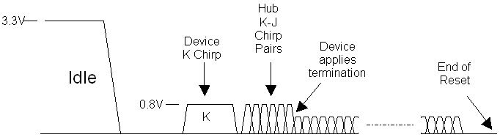
Speed Identification
1. While Reset drives high speed current (17.78mA) into the D- line for at least a millisecond (K-chirp).
2. Hub sees K-chirp and sends a series of K-J chirp pairs (50 uS each) to the device
3. Device disconnects its 1.5K pull-up resistor, applies the 45 Ohm high speed terminations.

Slide 7
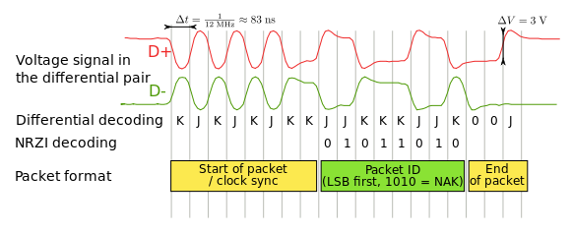
Signaling
a 0 bit is transmitted by toggling the data lines from J to K or vice versa
a 1 bit is transmitted by leaving the data lines as-is.

Slide 8
Common USB Packet Fields
Sync
All packets must start with a sync field. The sync field is 8 bits long at low and full speed or 32 bits long for high speed and is used to synchronize the clock of the receiver with that of the transmitter. The last two bits indicate where the PID fields starts.

Slide 9
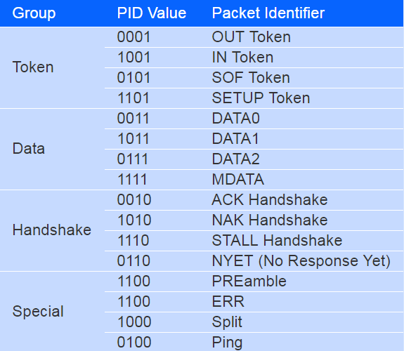
Common USB Packet Fields
PID
PID stands for Packet ID. This field is used to identify the type of packet that is being sent. The following table shows the possible values.

Slide 10
Common USB Packet Fields
ADDR
The address field specifies which device the packet is designated for. Being 7 bits in length allows for 127 devices to be supported. Address 0 is not valid, as any device which is not yet assigned an address must respond to packets sent to address zero.
ENDP
The endpoint field is made up of 4 bits, allowing 16 possible endpoints. Low speed devices, however can only have 2 additional endpoints on top of the default pipe. (4 endpoints max)

Slide 11
Common USB Packet Fields
CRC
Cyclic Redundancy Checks are performed on the data within the packet payload. All token packets have a 5 bit CRC while data packets have a 16 bit CRC.
EOP
End of packet. Signaled by a Single Ended Zero (SE0) for approximately 2 bit times followed by a J for 1 bit time.

Slide 12
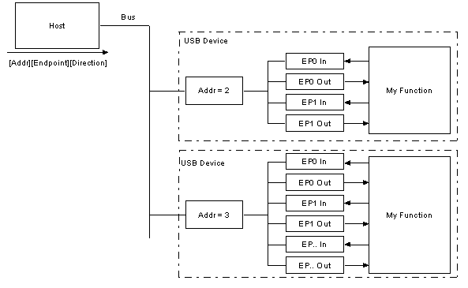
Common USB Packet Fields
Most functions will have a series of buffers, typically 8 bytes long. Each buffer will belong to an endpoint - EP0 IN, EP0 OUT etc.

Slide 13
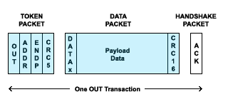
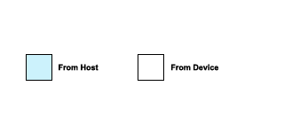
USB Transactions
Each USB transaction consists of a
Token Packet (Header defining what it expects to follow)
Optional Data Packet, (Containing the payload) and a
Handshake Packet (Used to acknowledge transactions and to provide a means of error correction)

Slide 14
USB Transactions - OUT
A successful OUT transaction comprises two or three sequential packets. If it were being used in an Isochronous Transfer there would not be a handshake packet from the device.

Slide 15
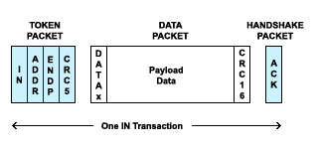
USB Transactions - IN
A successful IN transaction comprises two or three sequential packets. If it were being used in an Isochronous Transfer there would not be a handshake packet from the host.

Slide 16
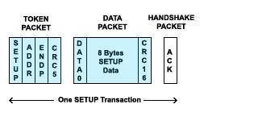
USB Transactions - Setup
Similar to an OUT transaction, but the data payload is exactly 8 bytes long, and the SETUP PID in the token packet informs the device that this is the first transaction in a Control Transfer

Slide 17
Data Flow Types
Data Flow Type | Description
Control Transfer | Mandatory using Endpoint 0 OUT and Endpoint 0 IN.
Bulk Transfer | Error-free high volume throughput when bandwidth available.
Interrupt Transfer | Regular Opportunity for status updates, etc. Error-free Low throughput
Isochronous Transfer | Guaranteed fixed bandwidth. Not error-checked.

Slide 18
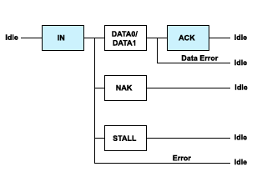
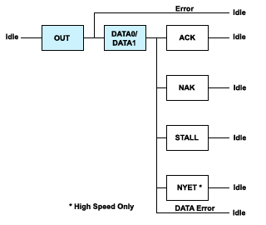
Bulk Transfers
The max packet size is 8, 16, 32 or 64 at full Speed and 512 for high speed. Bulk transfers are not allowed at low speed.
Use Bulk transfers when you have a lot of data to shift, as fast as possible, but where you would not have a large problem if there is a delay caused by insufficient bandwidth. Example – USB Flash Stick.

Slide 19
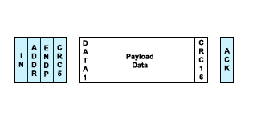
Bulk Transfers
The max packet size is 8, 16, 32 or 64 at full Speed and 512 for high speed. Bulk transfers are not allowed at low speed.
Use Bulk transfers when you have a lot of data to shift, as fast as possible, but where you would not have a large problem if there is a delay caused by insufficient bandwidth. Example – USB Flash Stick.

Slide 20
Bulk Transfers
The max packet size is 8, 16, 32 or 64 at full Speed and 512 for high speed. Bulk transfers are not allowed at low speed.
Use Bulk transfers when you have a lot of data to shift, as fast as possible, but where you would not have a large problem if there is a delay caused by insufficient bandwidth. Example – USB Flash Stick.

Slide 21
Interrupt Transfers
Typically the host will only fetch one packet, at an interval specified in the endpoint descriptor
Interrupt packets can have any size from 1 to 8 bytes at low speed, from 1 to 64 at full speed or up to 1024 bytes at high speed.
Example – USB Mouse or Keyboard.

Slide 22
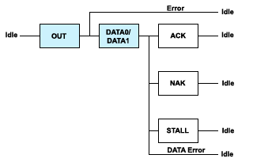
Interrupt Transfers
Typically the host will only fetch one packet, at an interval specified in the endpoint descriptor
Interrupt packets can have any size from 1 to 8 bytes at low speed, from 1 to 64 at full speed or up to 1024 bytes at high speed.
Example – USB Mouse or Keyboard.

Slide 23
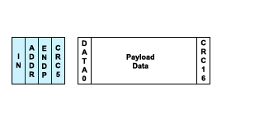
Isochronous Transfers
The main purpose of isochronous transfers is applications such as audio data transfer, where it is important to maintain the data flow, but not so important if some data gets missed or corrupted.
An isochronous packet may contain up to 1023 bytes at full speed, or up to 1024 at high speed. Isochronous transfers are not allowed at low speed.

Slide 24
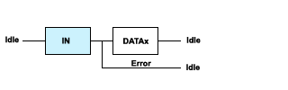

Isochronous Transfers
The main purpose of isochronous transfers is applications such as audio data transfer, where it is important to maintain the data flow, but not so important if some data gets missed or corrupted.
An isochronous packet may contain up to 1023 bytes at full speed, or up to 1024 at high speed. Isochronous transfers are not allowed at low speed.

Slide 25
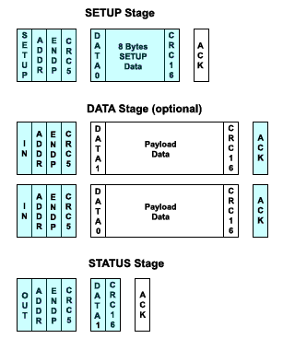
Control Transfers
Control transfers are used for initial configuration of the device by the host, using Endpoint 0 OUT and Endpoint 0 IN, which are reserved for this purpose. They may be used (on the same endpoints) after configuration as part of the device-specific control protocol, if required.
The max packet size for the data stage is 8 bytes at low speed, 8, 16, 32 or 64 at full Speed and 64 for high speed.

Slide 26

Control Transfers
Control transfers are used for initial configuration of the device by the host, using Endpoint 0 OUT and Endpoint 0 IN, which are reserved for this purpose. They may be used (on the same endpoints) after configuration as part of the device-specific control protocol, if required.
The max packet size for the data stage is 8 bytes at low speed, 8, 16, 32 or 64 at full Speed and 64 for high speed.
Notice that it is not permitted for a device to respond to a SETUP with a NAK or a STALL.

Slide 27
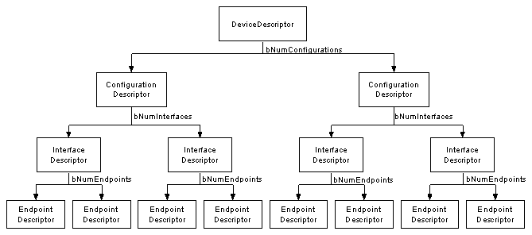
USB Descriptors
USB devices can only have one device descriptor. The device descriptor includes information such as what USB revision the device complies to, the Product and Vendor IDs used to load the appropriate drivers and the number of possible configurations the device can have. The number of configurations indicate how many configuration descriptors branches are to follow.

Slide 28
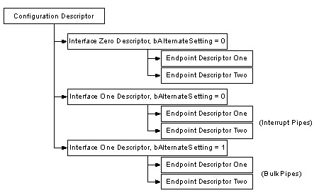
USB Descriptors
The configuration descriptor specifies values such as the amount of power this particular configuration uses, if the device is self or bus powered and the number of interfaces it has. When a device is enumerated, the host reads the device descriptors and can make a decision of which configuration to enable.
It can only enable one configuration at a time.

Slide 29
USB Descriptors
The interface descriptor could be seen as a header or grouping of the endpoints into a functional group performing a single feature of the device. For example you could have a multi-function scanner/printer device. Interface descriptor one could describe the endpoints of the scanner function and Interface descriptor two the printer function. Unlike the configuration descriptor, there is no limitation as to having only one interface enabled at a time. A device could have 1 or many interface descriptors enabled at once.

Slide 30
USB Descriptors – Device Descriptor
Offset | Field | Size | Value | Description
0 | bLength | 1 | Number | Size of the Descriptor in Bytes (18 bytes)
1 | bDescriptorType | 1 | Constant | Device Descriptor (0x01)
2 | bcdUSB | 2 | BCD | USB Specification Number which device complies too.
4 | bDeviceClass | 1 | Class | Class Code (Assigned by USB Org)
5 | bDeviceSubClass | 1 | SubClass | Subclass Code (Assigned by USB Org)
6 | bDeviceProtocol | 1 | Protocol | Protocol Code (Assigned by USB Org)
7 | bMaxPacketSize | 1 | Number | Maximum Packet Size for Zero Endpoint. Valid Sizes are 8, 16, 32, 64
8 | idVendor | 2 | ID | Vendor ID (Assigned by USB Org)
10 | idProduct | 2 | ID | Product ID (Assigned by Manufacturer)
12 | bcdDevice | 2 | BCD | Device Release Number
14 | iManufacturer | 1 | Index | Index of Manufacturer String Descriptor
15 | iProduct | 1 | Index | Index of Product String Descriptor
16 | iSerialNumber | 1 | Index | Index of Serial Number String Descriptor
17 | bNumConfigurations | 1 | Integer | Number of Possible Configurations

Slide 31
USB Descriptors – Configuration Descriptor
Offset | Field | Size | Value | Description
0 | bLength | 1 | Number | Size of Descriptor in Bytes
1 | bDescriptorType | 1 | Constant | Configuration Descriptor (0x02)
2 | wTotalLength | 2 | Number | Total length in bytes of data returned
4 | bNumInterfaces | 1 | Number | Number of Interfaces
5 | bConfigurationValue | 1 | Number | Value to use as an argument to select this configuration
6 | iConfiguration | 1 | Index | Index of String Descriptor describing this configuration
7 | bmAttributes | 1 | Bitmap | D7 Reserved, set to 1. (USB 1.0 Bus Powered) D6 Self Powered D5 Remote Wakeup D4..0 Reserved, set to 0.
8 | bMaxPower | 1 | mA | Maximum Power Consumption in 2mA units

Slide 32
USB Descriptors – Interface Descriptor
Offset | Field | Size | Value | Description
0 | bLength | 1 | Number | Size of Descriptor in Bytes (9 Bytes)
1 | bDescriptorType | 1 | Constant | Interface Descriptor (0x04)
2 | bInterfaceNumber | 1 | Number | Number of Interface
3 | bAlternateSetting | 1 | Number | Value used to select alternative setting
4 | bNumEndpoints | 1 | Number | Number of Endpoints used for this interface
5 | bInterfaceClass | 1 | Class | Class Code (Assigned by USB Org)
6 | bInterfaceSubClass | 1 | SubClass | Subclass Code (Assigned by USB Org)
7 | bInterfaceProtocol | 1 | Protocol | Protocol Code (Assigned by USB Org)
8 | iInterface | 1 | Index | Index of String Descriptor Describing this interface

Slide 33
USB Descriptors – Endpoint Descriptor
Offset | Field | Size | Value | Description
0 | bLength | 1 | Number | Size of Descriptor in Bytes (7 bytes)
1 | bDescriptorType | 1 | Constant | Endpoint Descriptor (0x05)
2 | bEndpointAddress | 1 | Endpoint | Endpoint Address Bits 0..3b Endpoint Number. Bits 4..6b Reserved. Set to Zero Bits 7 Direction 0 = Out, 1 = In (Ignored for Control Endpoints)

Slide 34
USB Descriptors – Endpoint Descriptor
3 | bmAttributes | 1 | Bitmap | Bits 0..1 Transfer Type00 = Control 01 = Isochronous 10 = Bulk 11 = Interrupt Bits 2..7 are reserved. If Isochronous endpoint, Bits 3..2 = Synchronisation Type (Iso Mode)00 = No Synchonisation 01 = Asynchronous 10 = Adaptive 11 = Synchronous Bits 5..4 = Usage Type (Iso Mode)00 = Data Endpoint 01 = Feedback Endpoint 10 = Explicit Feedback Data Endpoint 11 = Reserved
4 | wMaxPacketSize | 2 | Number | Maximum Packet Size this endpoint is capable of sending or receiving
6 | bInterval | 1 | Number | Interval for polling endpoint data transfers. Value in frame counts. Ignored for Bulk & Control Endpoints. Isochronous must equal 1 and field may range from 1 to 255 for interrupt endpoints.

Slide 35
USB Descriptors – Endpoint Descriptor
Offset | Field | Size | Value | Description
0 | bLength | 1 | Number | Size of Descriptor in Bytes
1 | bDescriptorType | 1 | Constant | String Descriptor (0x03)
2 | wLANGID[0] | 2 | number | Supported Language Code Zero (e.g. 0x0409 English - United States)
4 | wLANGID[1] | 2 | number | Supported Language Code One (e.g. 0x0c09 English - Australian)
n | wLANGID[x] | 2 | number | Supported Language Code x (e.g. 0x0407 German - Standard)
Offset | Field | Size | Value | Description
0 | bLength | 1 | Number | Size of Descriptor in Bytes
1 | bDescriptorType | 1 | Constant | String Descriptor (0x03)
2 | bString | n | Unicode | Unicode Encoded String

Slide 36
Enumeration Flow
Plug in Device to Host
Detect Device
Identify Speed of Device
Get Device Descriptors
Reset Device and Assign Address
Get Config Descriptors
Get Interface Descriptors
Load Drivers
Device Ready to Use

Slide 37
Further Reading
USB in a nutchel http://www.beyondlogic.org/usbnutshell/usb1.shtml
USB Made Simple http://www.usbmadesimple.co.uk/

Slide 38
Thank you!

