Slide 1
Net Drivers p.1 Introduction to TCP/IP
IP Packet Structure
TCP/IP Header
IPv4 address
Reserved address blocks
Private IP addresses
NAT Traversal
NATP Traversal
Dynamic Host Configuration Protocol
Ethernet Frame
Address Resolution Protocol
Linux Route Examples
ICMP Protocol (Ping)

Slide 2
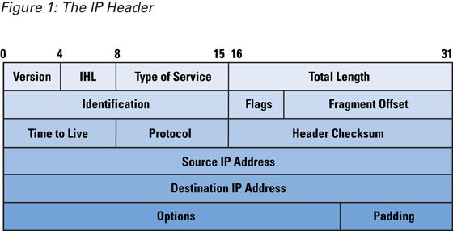
IP Packet Structure
Version
Data

Slide 3
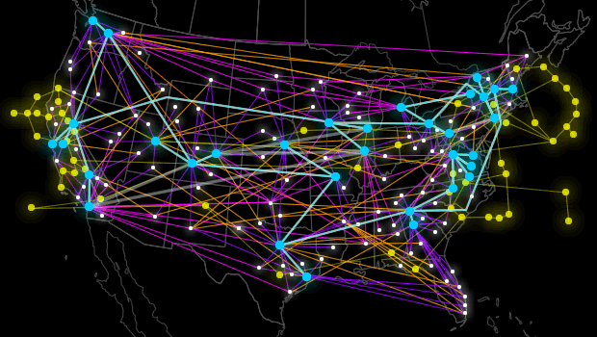

IP Packet Structure
IP Packets can reach their destination by more than one path.

Slide 4
IP Packet Structure
Protocol Number | Protocol Name | Abbreviation
1 | Internet Control Message Protocol | ICMP
2 | Internet Group Management Protocol | IGMP
6 | Transmission Control Protocol | TCP
17 | User Datagram Protocol | UDP
41 | IPv6 encapsulation | ENCAP
89 | Open Shortest Path First | OSPF
132 | Stream Control Transmission Protocol | SCTP
The data portion of the packet is not included in the packet checksum. Its contents are interpreted based on the value of the Protocol header field.

Slide 5
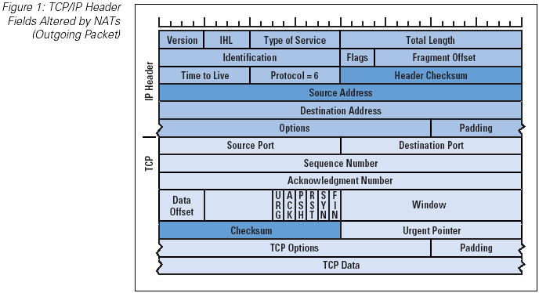
TCP/IP header
Version
Source port (16 bits) Identifies the sending port
Destination port (16 bits) Identifies the receiving port
Socket is an entity that combines ADDRESS + PORT

Slide 6
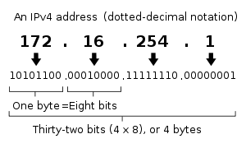
IPv4 address
IPv4 uses 32-bit (four-byte) addresses, which limits the address space to 4’294’967’296 addresses. This limitation stimulated the development of IPv6 in the 1990s, which has been in commercial deployment since 2006.

Slide 7
Reserved address blocks
Range | Description | Reference
0.0.0.0/8 | Current network (only valid as source address) | RFC 6890
10.0.0.0/8 | Private network | RFC 1918
172.16.0.0/12 | Private network | RFC 1918
192.0.0.0/24 | IETF Protocol Assignments | RFC 6890
192.0.2.0/24 | TEST-NET-1, documentation and examples | RFC 5737
192.88.99.0/24 | IPv6 to IPv4 relay (includes 2002::/16) | RFC 3068
192.168.0.0/16 | Private network | RFC 1918
198.18.0.0/15 | Network benchmark tests | RFC 2544
198.51.100.0/24 | TEST-NET-2, documentation and examples | RFC 5737
203.0.113.0/24 | TEST-NET-3, documentation and examples | RFC 5737
224.0.0.0/4 | IP multicast (former Class D network) | RFC 5771
255.255.255.255 | Broadcast | RFC 919

Slide 8
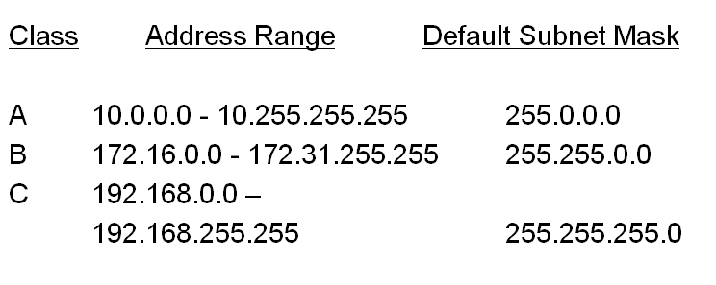
Private IP addresses
Most LAN networks use the “Class C” private IP address range. So in a typical network in a home or business the local IP addresses will start with 192.168. In a Class C network the first three groups of the IPV4 address must match exactly for the devices to be able to communicate.

Slide 9
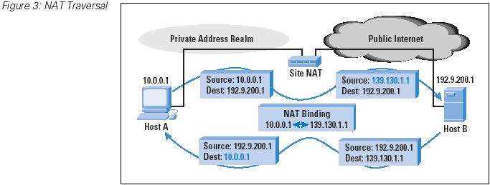
NAT Traversal
Version

Slide 10
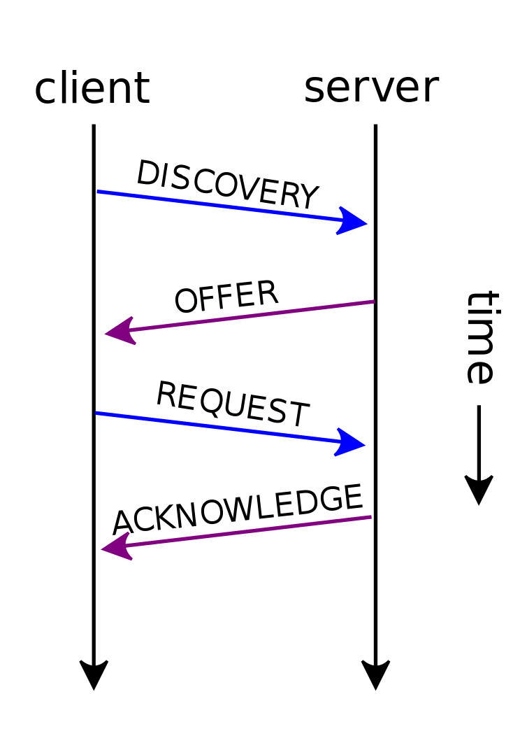
Dynamic Host Configuration Protocol
Version
DHCP server can manage TCP/IP settings for devices on a network, by automatically or dynamically assigning Internet Protocol (IP) addresses to the devices

Slide 11
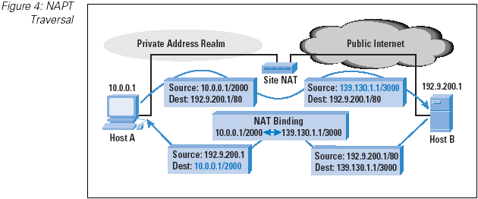
NATP Traversal
Version

Slide 12
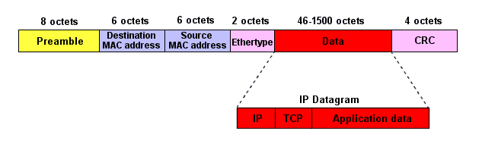
Ethernet Frame

Slide 13
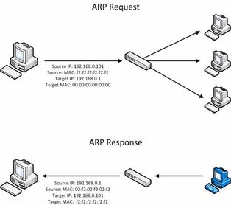
Address Resolution Protocol
ARP
To determine the MAC address of a destination machine, the sending station sends out an ARP Request. What this means is that it broadcasts a message to all nodes on the LAN, by specifying a destination MAC address of FF:FF:FF:FF:FF:FF (i.e. all 1s in binary) in the Ethernet frame's destination MAC address field. The frame contains an ARP Request datagram, including the target station's IP address (which is known). However, the destination MAC address field of the ARP datagram is not filled since this is the value we are trying to determine by sending out the request.

Slide 14
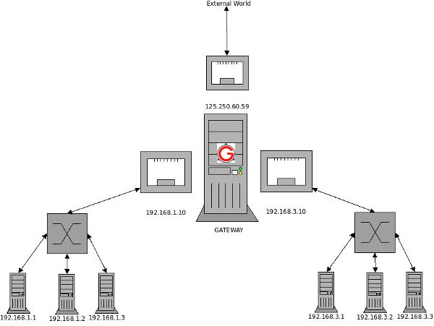
Linux Route Examples
Make 192.168.3.* Accessible from 192.168.1.*
External World
125.250.60.59
ping 192.168.3.1
192.168.1.10
192.168.3.10
GATEWAY
192.168.1.2
192.168.3.2
192.168.1.1
192.168.1.3
192.168.3.1
192.168.3.3
On each machine in 192.168.1.* network a default gateway will be added:
$ route add default gw 192.168.1.10

Slide 15
Linux Route Examples
External World
125.250.60.59
ping 192.168.3.1
192.168.1.10
192.168.3.10
GATEWAY
192.168.1.2
192.168.3.2
192.168.1.1
192.168.1.3
192.168.3.1
192.168.3.3
On GATEWAY add the following routing entry:
$ route add -net 192.168.3.0 netmask 255.255.255.0 gw 192.168.3.10

Slide 16
Linux Route Examples
Make 192.168.1.* Accessible from 192.168.3.*
External World
125.250.60.59
ping 192.168.1.1
192.168.1.10
192.168.3.10
GATEWAY
192.168.1.2
192.168.3.2
192.168.1.1
192.168.1.3
192.168.3.1
192.168.3.3
On each machine in 192.168.3.* network a default gateway will be added as shown below. :
$ route add default gw 192.168.3.10

Slide 17
Linux Route Examples
External World
125.250.60.59
ping 192.168.1.1
192.168.1.10
192.168.3.10
GATEWAY
192.168.1.2
192.168.3.2
192.168.1.1
192.168.1.3
192.168.3.1
192.168.3.3
On GATEWAY add the following routing entry:
$ route add -net 192.168.1.0 netmask 255.255.255.0 gw 192.168.1.10

Slide 18
Linux Route Examples
External World
125.250.60.59
ping google.com
ping google.com
192.168.1.10
192.168.3.10
GATEWAY
192.168.1.2
192.168.3.2
192.168.1.1
192.168.1.3
192.168.3.1
192.168.3.3
On GATEWAY add the defaule routing entry:
$ route add default gw 125.250.60.59

Slide 19
Linux Route Examples
GATEWAY $ route
Kernel IP routing table
Destination Gateway Genmask Flags Metric Ref Use Iface
default 125.250.60.59 0.0.0.0 UG 0 0 0 eth2
192.168.1.0 * 255.255.255.0 U 0 0 0 eth1
192.168.3.0 * 255.255.255.0 U 0 0 0 eth3
192.168.3.0 192.168.3.10 255.255.255.0 UG 0 0 0 eth1
192.168.1.0 192.168.1.10 255.255.255.0 UG 0 0 0 eth3
192.168.1.x $ route
Kernel IP routing table
Destination Gateway Genmask Flags Metric Ref Use Iface
default 192.168.1.10 0.0.0.0 UG 0 0 0 eth1
192.168.1.0 * 255.255.255.0 U 0 0 0 eth1
192.168.3.x $ route
Kernel IP routing table
Destination Gateway Genmask Flags Metric Ref Use Iface
default 192.168.3.10 0.0.0.0 UG 0 0 0 eth1
192.168.3.0 * 255.255.255.0 U 0 0 0 eth1

Slide 20
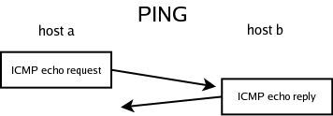
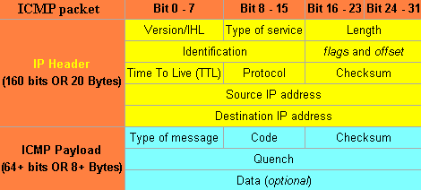
ICMP Protocol (Ping)
On GATEWAY add the defaule routing entry:
$ route add default gw 125.250.60.59

Slide 21
Further Reading
The TCP/IP Guide
https://doc.lagout.org/network/The%20TCPIP%20guide.pdf

Slide 22
Thank you!

