Slide 1
Concurrency and race conditions p.2
Spinlocks
Reader/Writer spinlocks
Alternatives to locking
Atomic variables
Atomic Bit Operations
Sequential Locks
Read-Copy-Update

Slide 2
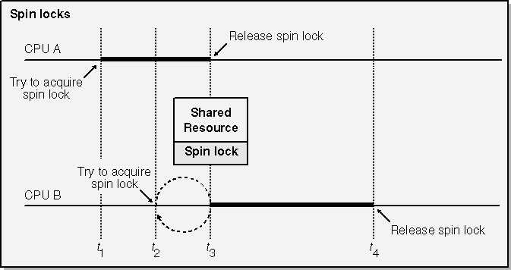
Spinlocks
Use on multiprocessor system
For kernels compiled without CONFIG_SMP, spinlocks do not exist at all.

Slide 3
Spinlocks
Test set, loop
Test set, loop
Test set, loop
Test set, loop
…
Use on multiprocessor system

Slide 4
Spinlocks
Any time kernel code holds a spinlock,
preemption is disabled on the relevant processor.
CPU A
spinlock
Spinlock
acquired
Thread B tries to acquire spinlock
CPU A spins forever
A
B
A
B
Thread A
Thread B
Thread A
has slept
Thread B
started
scheduler

Slide 5
Spinlocks
Any time kernel code holds a spinlock,
preemption is disabled on the relevant processor.
CPU A
spinlock
Spinlock
acquired
Thread B tries to acquire spinlock
CPU A spins forever
A
B
A
B
Thread A
Thread B
Thread A
has slept
Thread B
started
scheduler
Do not sleep while holding spinlock!!!

Slide 6
Spinlocks
Things Which Sleep
You can never call the following routines while holding a spinlock, as they may sleep:
• Accesses to userspace:
• copy_from_user()
• copy_to_user()
• get_user()
• put_user()
• kmalloc(GFP_KERNEL)
• printk()

Slide 7
Spinlocks
Interrupt can acquire spinlock.
CPU A
spinlock
Spinlock
acquired
Interrupt tries to acquire spinlock
CPU A spins forever
A
B
A
B
Thread A
Interrupt

Slide 8
Spinlocks
Interrupt can acquire spinlock.
CPU A
spinlock
Spinlock
acquired
Interrupt tries to acquire spinlock
CPU A spins forever
A
B
A
B
Thread A
Interrupt
Disable interrupts before acquiring spinlock
if it can hold the same spinlock!!!

Slide 9
Spinlocks
Now a question:
Why do we need to acquire a spinlock in the interrupt if we always disable interrupts while acquiring the spinlock in the thread?

Slide 10
Spinlocks
Now a question:
Why do we need to acquire a spinlock in the interrupt if we always disable interrupts while acquiring the spinlock in the thread?
Answer:
No need on single-core CPU.
On multiprocessor system interrupt could run on different CPU. “spin_lock_irqsave” only disables interrupts on local CPU.

Slide 11
Spinlock Functions
#include/linux/spinlock.h
void spin_lock(spinlock_t *lock);
grab the lock. Use it if you are sure that respective spinlock is not used in interrupts.
void spin_unlock(spinlock_t *lock);
does the reverse.

Slide 12
Spinlock Functions
void spin_lock_irq(spinlock_t *lock);
disable interrupts on that cpu, then grab the lock. spin_unlock_irq() does the reverse. This works perfectly for UP as well: the spin lock vanishes, and this macro simply becomes local_irq_disable() (include/asm/smp.h), which protects you from the softirq/tasklet/BH being run.
spin_lock_irqsave(spinlock_t *lock, unsigned long flags)
A variant which saves whether interrupts were on or off in a flags word, which is passed to spin_lock_irqrestore(). This means that the same code can be used inside an hard irq handler (where interrupts are already off) and in softirqs (where the irq disabling is required).

Slide 13
Spinlock Functions
If a bottom half shares data with user context, you have two problems. Firstly, the current user context can be interrupted by a bottom half, and secondly, the critical region could be entered from another CPU. This is where spin_lock_bh() is used. It disables bottom halves on that CPU, then grabs the lock. spin_unlock_bh() does the reverse. This works perfectly for UP as well: the spin lock vanishes, and this macro simply becomes local_bh_disable(), which protects you from the bottom half being run.

Slide 14
Reader/Writer Spinlocks
The kernel provides a reader/writer form of spinlocks that is directly analogous to
the reader/writer semaphores. These locks allow any number of readers into a critical section simultaneously, but writers have exclusive
access. Reader/writer locks have a type of rwlock_t, defined in <linux/spinlock.h>.

Slide 15
Reader/Writer Spinlocks
For readers:
void read_lock(rwlock_t *lock);
void read_lock_irqsave(rwlock_t *lock, unsigned long flags);
void read_lock_irq(rwlock_t *lock);
void read_lock_bh(rwlock_t *lock);
void read_unlock(rwlock_t *lock);
void read_unlock_irqrestore(rwlock_t *lock, unsigned long flags);
void read_unlock_irq(rwlock_t *lock);
void read_unlock_bh(rwlock_t *lock);
there is no read_trylock.

Slide 16
Reader/Writer Spinlocks
For writers:
void write_lock(rwlock_t *lock);
void write_lock_irqsave(rwlock_t *lock, unsigned long flags);
void write_lock_irq(rwlock_t *lock);
void write_lock_bh(rwlock_t *lock);
int write_trylock(rwlock_t *lock);
void write_unlock(rwlock_t *lock);
void write_unlock_irqrestore(rwlock_t *lock, unsigned long flags);
void write_unlock_irq(rwlock_t *lock);
void write_unlock_bh(rwlock_t *lock);

Slide 17
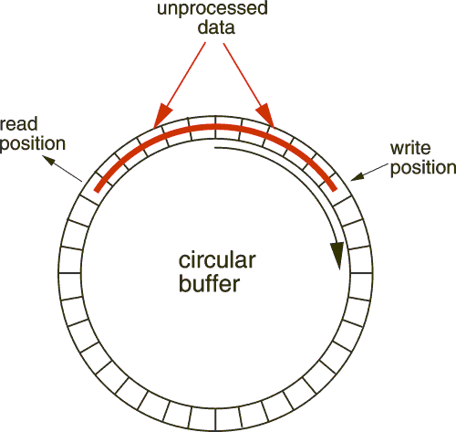
Alternatives to locking.
Lockless producer/consumer tasks is the circular buffer

Slide 18
Alternatives to locking. Atomic Vars.
Atomic Variables
Utilize processor capabilities for performing simple operations atomically.
void atomic_set(atomic_t *v, int i);
atomic_t v = ATOMIC_INIT(0);
Set the atomic variable v to the integer value i. You can also initialize atomic values at compile time with the ATOMIC_INIT macro.

Slide 19
Alternatives to locking. Atomic Vars.
int atomic_read (atomic_t *v);
Return the current value of v.
void atomic_add (int i, atomic_t *v);
Add i to the atomic variable pointed to by v. The return value is void, because there is an extra cost to returning the new value, and most of the time there’s no need to know it.
void atomic_sub (int i, atomic_t *v);
Subtract i from *v.
void atomic_inc (atomic_t *v);
void atomic_dec (atomic_t *v);
Increment or decrement an atomic variable

Slide 20
Alternatives to locking. Atomic Vars.
int atomic_inc_and_test (atomic_t *v);
int atomic_dec_and_test (atomic_t *v);
int atomic_sub_and_test (int i, atomic_t *v);
Perform the specified operation and test the result; if, after the operation, the atomic value is 0, then the return value is true; otherwise, it is false.
int atomic_add_negative (int i, atomic_t *v);
Add the integer variable i to v. The return value is true if the result is negative, false otherwise.
int atomic_add_return (int i, atomic_t *v);
int atomic_sub_return (int i, atomic_t *v);
int atomic_inc_return (atomic_t *v);
int atomic_dec_return (atomic_t *v);
Behave just like atomic_add and friends, with the exception that they return the new value of the atomic variable to the caller.

Slide 21
Alternatives to locking. Atomic Vars.
int atomic_inc_and_test (atomic_t *v);
int atomic_dec_and_test (atomic_t *v);
int atomic_sub_and_test (int i, atomic_t *v);
Perform the specified operation and test the result; if, after the operation, the atomic value is 0, then the return value is true; otherwise, it is false.
int atomic_add_negative (int i, atomic_t *v);
Add the integer variable i to v. The return value is true if the result is negative, false otherwise.
int atomic_add_return (int i, atomic_t *v);
int atomic_sub_return (int i, atomic_t *v);
int atomic_inc_return (atomic_t *v);
int atomic_dec_return (atomic_t *v);
Behave just like atomic_add and friends, with the exception that they return the new value of the atomic variable to the caller.

Slide 22
Alternatives to locking. Bit Operations
void set_bit (nr, void *addr);
Sets bit number nr in the data item pointed to by addr.
void clear_bit (nr, void *addr);
Clears the specified bit in the unsigned long datum that lives at addr. Its semantics are otherwise the same as set_bit.
void change_bit (nr, void *addr);
Toggles the bit.
test_bit (nr, void *addr);
This function is the only bit operation that doesn’t need to be atomic; it simply
returns the current value of the bit.
int test_and_set_bit (nr, void *addr);
int test_and_clear_bit (nr, void *addr);
int test_and_change_bit (nr, void *addr);
Behave atomically like those listed previously, except that they also return the
previous value of the bit.

Slide 23
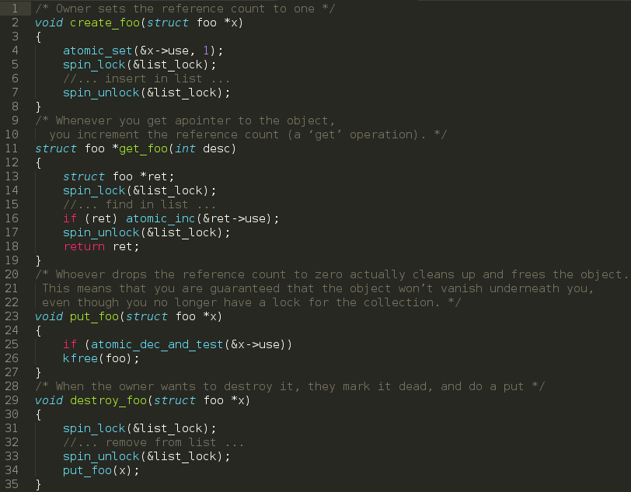
Reference Count Example

Slide 24
Sequential lock
Seqlocks work in situations where the resource to be protected is small, simple, and frequently accessed, and where write access is rare but can not be delayed.

Slide 25
Sequential lock
#include <linux/seqlock.h>
seqlock_t lock1 = SEQLOCK_UNLOCKED; seqlock_t lock2; seqlock_init (&lock2);
unsigned int seq;
do {
seq = read_seqbegin (&lock1);
/* Do what you need to do */
} while read_seqretry (&lock1, seq);

Slide 26
Sequential lock
Writers must obtain an exclusive lock to enter the critical section protected by a seqlock. To do so, call:
void write_seqlock (seqlock_t *lock);
The write lock is implemented with a spinlock, so all the usual constraints apply.
Make a call to:
void write_sequnlock (seqlock_t *lock);
to release the lock.

Slide 27
Sequential lock
static inline unsigned read_seqbegin (const seqlock_t *sl);
static inline unsigned read_seqretry (const seqlock_t *sl, unsigned start);
static inline void write_seqlock (seqlock_t *sl);
static inline void write_sequnlock (seqlock_t *sl);
static inline void write_seqlock_irq (seqlock_t *sl);
static inline void write_sequnlock_irq (seqlock_t *sl);

Slide 28
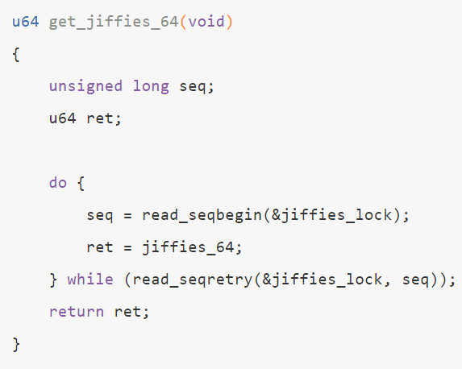
Sequential lock
The sequential lock is used to obtain value of jiffies at x86_64 architecture

Slide 29
Read-Copy-Update
Read-copy-update (RCU) is an advanced mutual exclusion scheme that can yield high performance in the right conditions. Its use in drivers is rare. Those who are interested in the full details of the RCU algorithm can find them in the white paper published by its creator
http://www.rdrop.com/users/paulmck/rclock/intro/rclock_intro.html

Slide 30
Homework
Add mutex in chardev driver on per-device node basis. Use scull driver as an example of creating and using file-specific custom data.
int scull_open(struct inode *inode, struct file *filp)
{
struct scull_dev *dev;
dev = container_of(inode->i_cdev, struct scull_dev, cdev);
filp->private_data = dev; /* for other methods */
}
return 0;
}
While the device is opened, the struct inode *inode representing the device is passed to scull_open. Then, the custom structure dev is extracted and passed to filp->private_data so that other methods such as scull_read can use it:
ssize_t scull_read(struct file *filp, char _ _user *buf, size_t count,
loff_t *f_pos)
{
struct scull_dev *dev = filp->private_data;
/* other codes that uses *dev */
}

Slide 31
Thank you!

