Slide 1
Time, Delays, and Deferred Work p.1
jiffies counter
Delaying execution, atomic context
Delaying execution, non-atomic context
Kernel Timers
Kernel High Resolution Timers

Slide 2
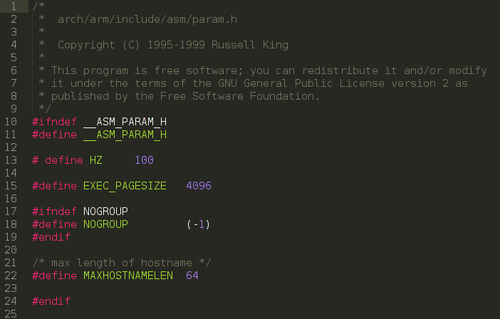
Using the jiffies Counter
HZ – constant defines timer interrupts per second.

Slide 3
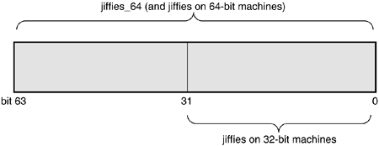
Using the jiffies Counter
#include <linux/jiffies.h>
unsigned long j, stamp_1, stamp_n;
j = jiffies; /* read the current value */
stamp_1 = j + HZ; /* 1 second in the future */
stamp_n = j + n * HZ / 1000; /* n milliseconds in the future */
If HZ = 100 jiffies wraps around every
0xFFFFFFFF / 100 /3600 / 24 = 497 days

Slide 4
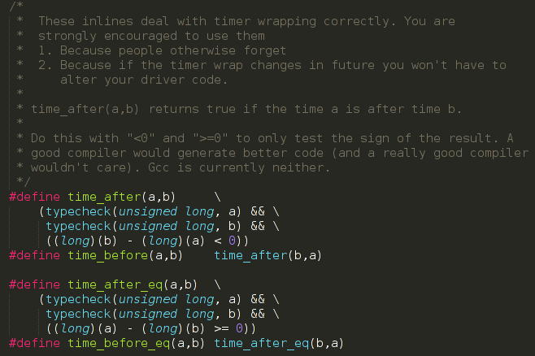
Using the jiffies Counter
Use macros to compare jiffies to avoid errors.

Slide 5
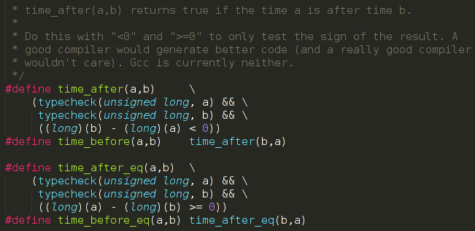
Using the jiffies Counter
To compare your cached value (like stamp_1 above) and the current value, you should use one of the following macros:
int time_after(unsigned long a, unsigned long b);
int time_before(unsigned long a, unsigned long b);
int time_after_eq(unsigned long a, unsigned long b);
int time_before_eq(unsigned long a, unsigned long b);
time_after(5, 1); > TRUE time_after(0xFFFFFFFF, 0xFFFFFFF0); > TRUE
time_after(5, 6); > FALSE time_after(0x00000005, 0xFFFFFFF0); > TRUE!!!

Slide 6
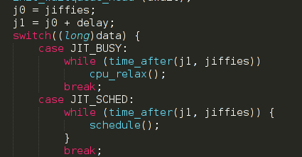
Using the jiffies Counter
time_after returns true if time a is after time b

Slide 7
Delaying Execution
Busy waiting in non-atomic context.
j1 = jiffies + delay;
a)
while (time_before(jiffies, j1))
{
cpu_relax( );
}
b)
while (time_before(jiffies, j1))
{
schedule( );
}
NOT GOOD!

Slide 8
Delaying Execution
How the process sleeps?
sleeping_task = current;
set_current_state(TASK_INTERRUPTIBLE);
schedule();
func1();
/* The rest of the code */
…….
To wake the process up:
wake_up_process(sleeping_task);
this sets the task state to TASK_RUNNING
or send signal (if interruptible)

Slide 9
Delaying Execution
Timeouts, Long delays 10ms+
Non-Atomic context
set_current_state(TASK_INTERRUPTIBLE); schedule_timeout (delay);
Sleep for delay ticks.
Behavior is nearly optimal, even under load.
Cause the process to sleep until the given time has passed.

Slide 10
Delaying Execution
Waitqueues Timeouts, Long delays 10ms+
Non-Atomic context
wait_queue_head_t wait;
init_waitqueue_head (&wait);
wait_event_interruptible_timeout(wait, 0, delay);
Relies on schedule_timeout internally.
Designed with a hardware driver in mind, where execution could be resumed in either of two ways: either somebody calls wake_up on the wait queue, or the timeout expires.

Slide 11
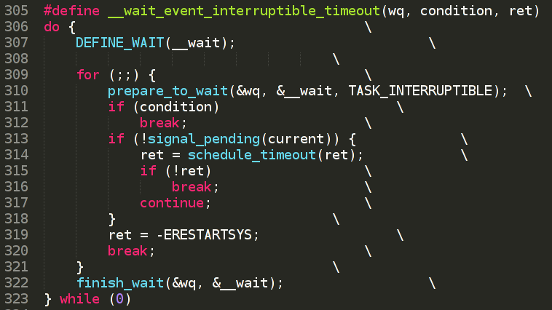
Delaying Execution
Waitqueue internals
Sets process state to
TASK_INTERRUPTIBLE
Must have this to prevent
races.
wake_up_interruptible could be called before
wait_event_interruptible
Always set the condition to true before calling wake_up to prevent races!!!

Slide 12
Delaying Execution
Timeouts, Long delays 10ms+
Non-Atomic context
msleep(delay);
msleep_interruptible(delay);
Backed by jiffies / legacy_timers

Slide 13
Delaying Execution
Timeouts 10us - 20ms
Non-Atomic context
usleep_range(unsigned long min, unsigned long max);
Backed by hrtimers – result could be very precise.
The larger a range you supply, the greater a chance that you will not trigger an interrupt; this should be balanced with what is an acceptable upper bound on delay / performance for your specific code path.

Slide 14
Delaying Execution
Timeouts few us
Non-Atomic context
void udelay(unsigned long usecs);
Busy-waiting loop.

Slide 15
Delaying Execution
Timeouts, Short delays,
Atomic context.
void ndelay(unsigned long nsecs);
void udelay(unsigned long usecs);
void mdelay(unsigned long msecs);
These functions are busy-waiting. Must be called in atomic context (when sleeping is not allowed. hardware and software interrupts, or spinlock is aquired).

Slide 16
Kernel Timers
Needed to schedule an action to happen later, without blocking the current process until that time arrives.

Slide 17
Kernel Timers
Needed to schedule an action to happen later, without blocking the current process until that time arrives.
Timer function:
• No access to user space is allowed. Because there is no process context, there is no path to the user space associated with any particular process.

Slide 18
Kernel Timers
Needed to schedule an action to happen later, without blocking the current process until that time arrives.
Timer function:
• No access to user space is allowed. Because there is no process context, there is no path to the user space associated with any particular process.
• The current pointer is not meaningful in atomic mode and cannot be used since the relevant code has no connection with the process that has been interrupted.

Slide 19
Kernel Timers
Needed to schedule an action to happen later, without blocking the current process until that time arrives.
Timer function:
• No access to user space is allowed. Because there is no process context, there is no path to the user space associated with any particular process.
• The current pointer is not meaningful in atomic mode and cannot be used since the relevant code has no connection with the process that has been interrupted.
• No sleeping or scheduling may be performed. Atomic code may not call schedule or a form of wait_event, nor may it call any other function that could sleep. For example, calling kmalloc(..., GFP_KERNEL) is against the rules. Semaphores also must not be used since they can sleep.

Slide 20
Kernel Timers
#include <linux/timer.h>
struct timer_list
{
/* ... */
unsigned long expires;
void (*function)(unsigned long);
unsigned long data;
};
void init_timer(struct timer_list *timer);
struct timer_list TIMER_INITIALIZER(_function, _expires, _data);
void add_timer(struct timer_list * timer);
int del_timer(struct timer_list * timer);

Slide 21
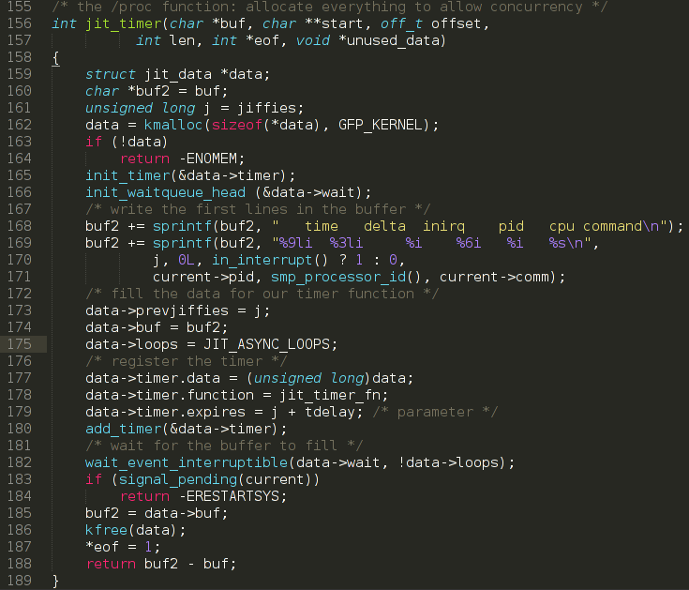
Kernel Timers

Slide 22
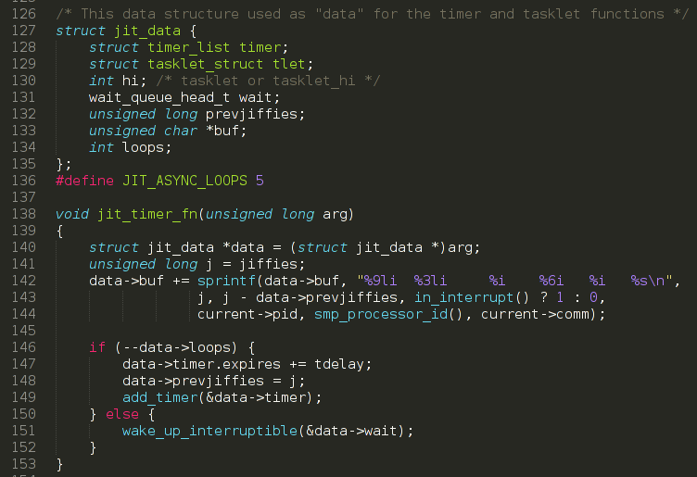
Kernel Timers

Slide 23
Kernel High Resolution Timers
High-resolution timers (or hrtimers) provide a high-precision framework for timer management independent of the previously discussed timer framework. Although timers operate on the granularity of jiffies, hrtimers operate at the granularity of nanoseconds.
Initialization and start
void hrtimer_init( struct hrtimer *time, clockid_t which_clock,
enum hrtimer_mode mode );
int hrtimer_start(struct hrtimer *timer, ktime_t time, const
enum hrtimer_mode mode);
Once an hrtimer has started, it can be cancelled
int hrtimer_cancel(struct hrtimer *timer);
int hrtimer_try_to_cancel(struct hrtimer *timer);
Check to see if the hrtimer has activated its callback
int hrtimer_callback_running(struct hrtimer *timer);

Slide 24

Kernel High Resolution Timers
Every hrtimer is bound to a specific clock. The system currently supports two clocks, being:
CLOCK_MONOTONIC: a clock which is guaranteed always to move forward CLOCK_REALTIME which matches the current real-world time.
Which clock should be used will depend mainly on whether the timer needs to be tied to time as the rest of the world sees it or not. The call to hrtimer_init() will tie an hrtimer to a specific clock.
The mode parameter describes how the time parameter should be interpreted. A mode of HRTIMER_ABS indicates that time is an absolute value, while HRTIMER_REL indicates that time should be interpreted relative to the current time.

Slide 25
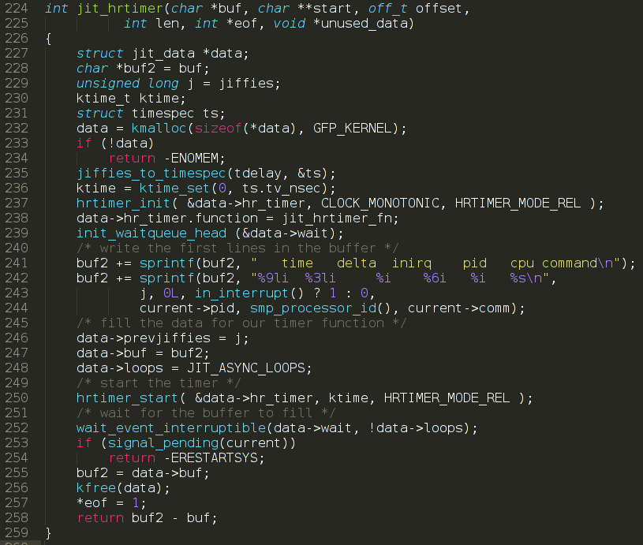
Kernel High Resolution Timers

Slide 26
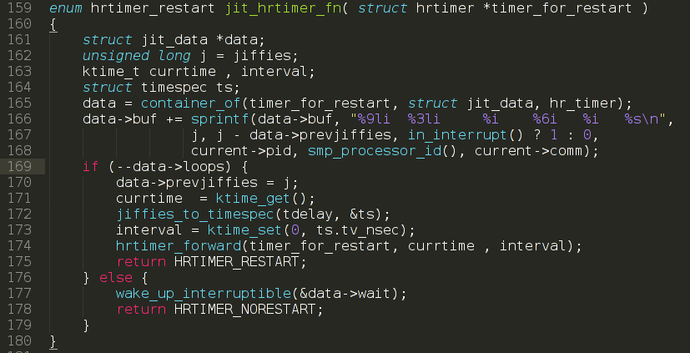
Kernel High Resolution Timers

Slide 27
Thank you!

