Slide 1
Time, Delays, and Deferred Work p.2
Tasklets
Workqueues
Shared Queue

Slide 2
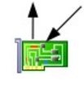
Tasklets
HW interrupt handler runs with interrupts from current line disabled.
Schedule tasklet and rise software IRQ .
Restore interrupt as soon as possible and exit.
Soft. IRQ
Interrupt context
HW int. handler
Other HW int. handlers
Bottom half (tasklet)
Process context tasks
Schedule bottom half rise soft. IRQ and exit
Handle int. data and wake up waiting tasks
Process context tasks
HW IRQ
ACK
NB: Remember spin_lock_bh() which disables bottom halves (tasklets) on current CPU!!!

Slide 3
Tasklets
• A tasklet can be disabled and re-enabled later; it won’t be executed until it is enabled as many times as it has been disabled.

Slide 4
Tasklets
• A tasklet can be disabled and re-enabled later; it won’t be executed until it is enabled as many times as it has been disabled.
• Just like timers, a tasklet can reregister itself.

Slide 5
Tasklets
• A tasklet can be disabled and re-enabled later; it won’t be executed until it is enabled as many times as it has been disabled.
• Just like timers, a tasklet can reregister itself.
• A tasklet can be scheduled to execute at normal priority or high priority. The latter group is always executed first.

Slide 6
Tasklets
• A tasklet can be disabled and re-enabled later; it won’t be executed until it is enabled as many times as it has been disabled.
• Just like timers, a tasklet can reregister itself.
• A tasklet can be scheduled to execute at normal priority or high priority. The latter group is always executed first.
• Tasklets may be run immediately if the system is not under heavy load but never later than the next timer tick.

Slide 7
Tasklets
• A tasklet can be disabled and re-enabled later; it won’t be executed until it is enabled as many times as it has been disabled.
• Just like timers, a tasklet can reregister itself.
• A tasklet can be scheduled to execute at normal priority or high priority. The latter group is always executed first.
• Tasklets may be run immediately if the system is not under heavy load but never later than the next timer tick.
• A tasklets can be concurrent with other tasklets but is strictly serialized with respect to itself—the same tasklet never runs simultaneously on more than one processor. A tasklet always runs on the same CPU that schedules it.

Slide 8
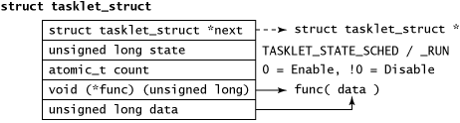
Tasklets
Tasklets are represented by the tasklet_struct structure

Slide 9
Tasklets
Declaring and scheduling a tasklet
/* Declare a Tasklet (the Bottom-Half) */
void tasklet_function( unsigned long data );
DECLARE_TASKLET( tasklet_example, tasklet_function, tasklet_data );
...
/* Schedule the Bottom-Half */
tasklet_schedule( &tasklet_example );

Slide 10
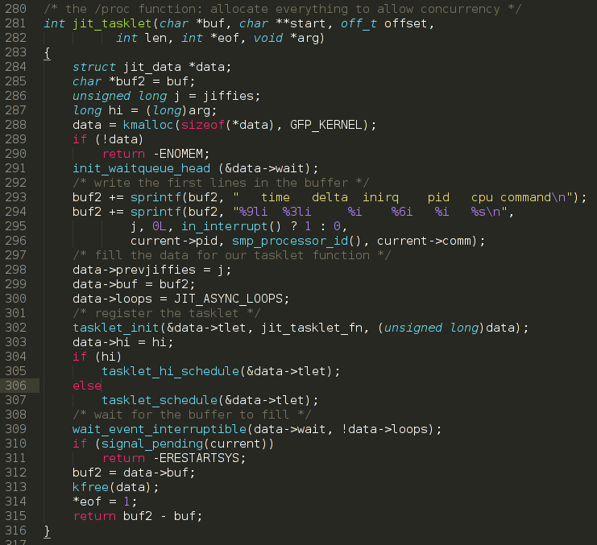
Tasklets

Slide 11
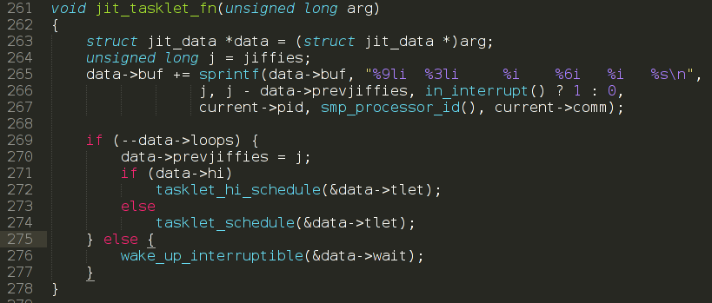
Tasklets

Slide 12
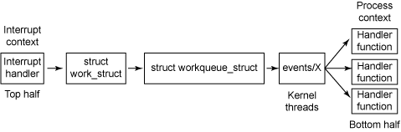
Workqueues
The process behind work queues

Slide 13
Workqueues API
Work initialization macros
INIT_WORK( work, func );
INIT_DELAYED_WORK( work, func );
INIT_DELAYED_WORK_DEFERRABLE( work, func );
Work queue functions
int queue_work( struct workqueue_struct *wq, struct work_struct *work );
int queue_work_on( int cpu, struct workqueue_struct *wq,
struct work_struct *work );
int queue_delayed_work( struct workqueue_struct *wq,
struct delayed_work *dwork, unsigned long delay );
int queue_delayed_work_on( int cpu, struct workqueue_struct *wq,
struct delayed_work *dwork, unsigned long delay );

Slide 14
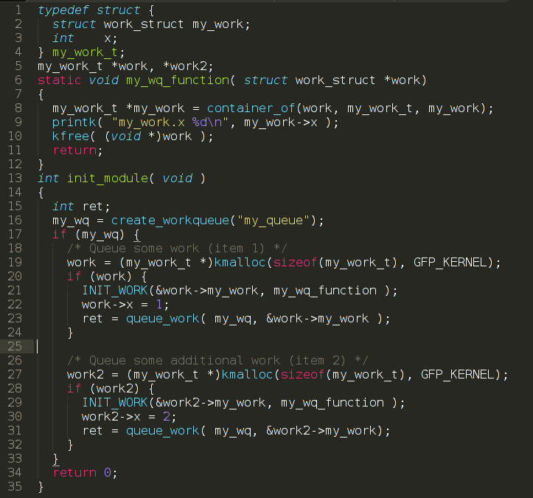
Workqueues API

Slide 15
Shared Queue
Work queue functions
You can use a kernel-global workqueue, with four functions that address
this work queue. These functions mimic those from previous slide except that you
don't need to define the work queue structure.
int schedule_work( struct work_struct *work );
int schedule_work_on( int cpu, struct work_struct *work );
int scheduled_delayed_work( struct delayed_work *dwork, unsigned long delay );
int scheduled_delayed_work_on(
int cpu, struct delayed_work *dwork, unsigned long delay );

Slide 16
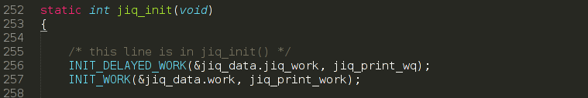
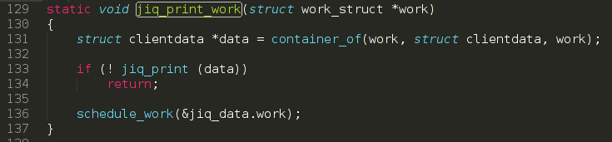
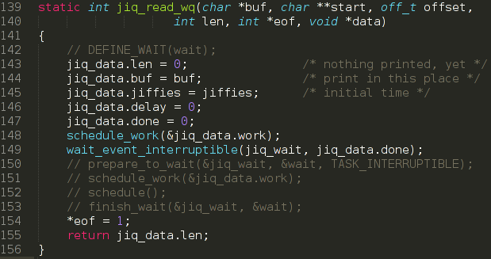
Shared Queue
If preempted in TASK_INTERRUPTIBLE stat (just after prepare_to_wait) the task does not sleep. Only sleep after calling schedule().

Slide 17
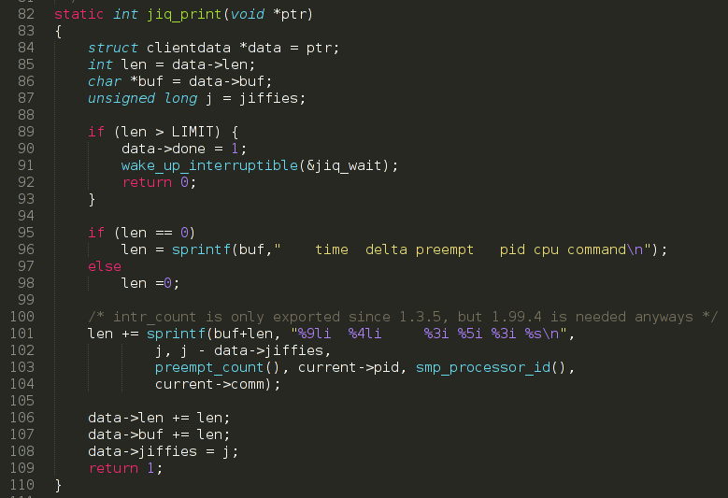
Shared Queue

Slide 18
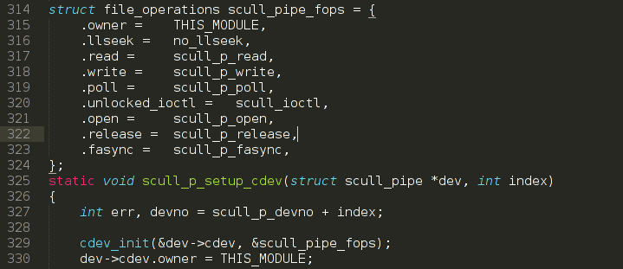
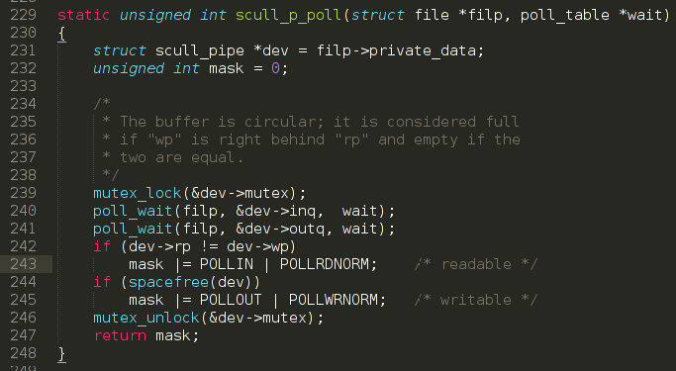
Poll & Select

Slide 19
Homework
Read and learn “6 Advanced Char Driver Operations” about “poll” system call.
Write a driver which:
On write creates 2 tasks in shared kernel workqueue
1) Sorting the array.
2) Find arithmetic mean value of the array.
Supports poll & select to check if data is ready.
On read – return max, min and arithmetic mean value.
Write a test application that writes 10’000 random words buffer to driver, waits using poll until ready and reads max, min and arithmetic mean values.

Slide 20
Thank you!

