Slide 1
Overview
What is Linux Kernel? Linux Kernel creation history.
Processes and scheduler. Memory management and virtual memory. Filesystems. System calls.
Examples of embedded, Linux Kernel related projects Global Logic’s teams have been working on.

Slide 2
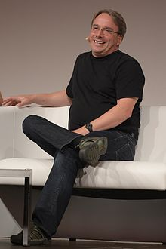
Linux Kernel History
Linus Benedict Torvalds
Born:
December 28, 1969 (age 45)
Helsinki, Finland
Residence:
Dunthorpe, Oregon, United States

Slide 3
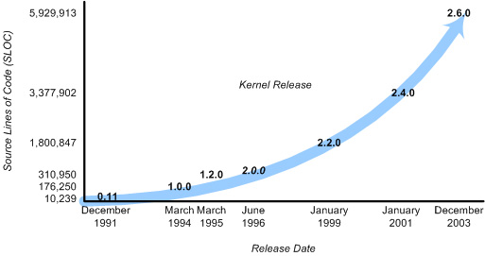
Linux Kernel History

Slide 4
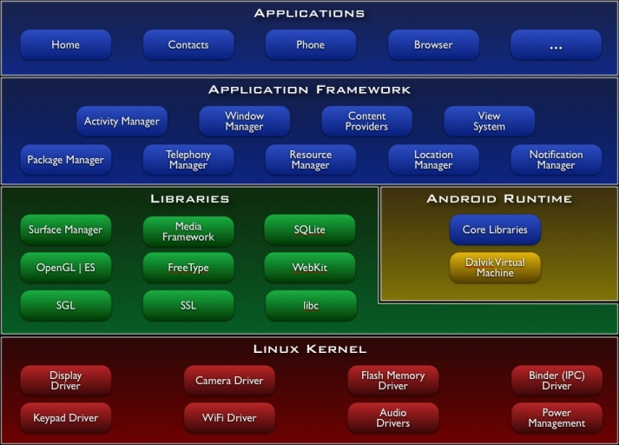

Linux Kernel History

Slide 5
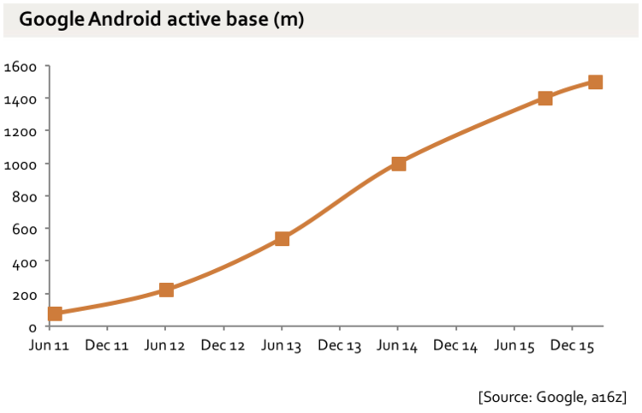
Linux Kernel History
1.3-1.4bn Google Android phones, and 150-200m Google Android tablets.
Maybe 450m additional Android phones and 200m Android tablets in China, not connected to Google services

Slide 6
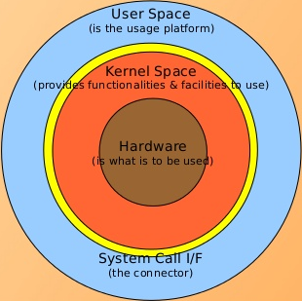
What is a kernel?

Slide 7
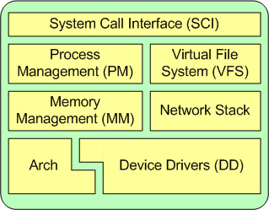
What is a kernel?
Kernel is a resource manager

Slide 8
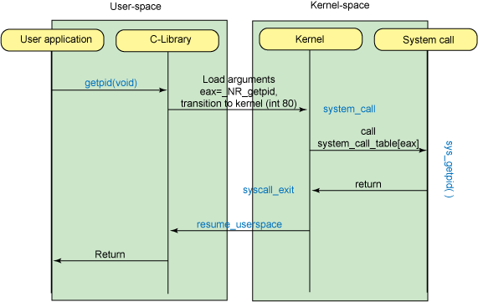
System Call Interface (SCI)

Slide 9
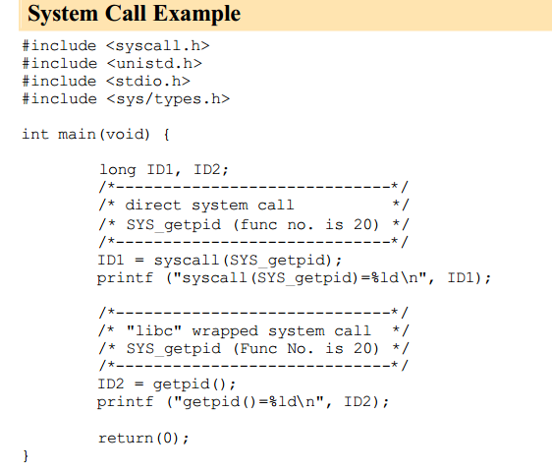
System Call Interface (SCI)

Slide 10
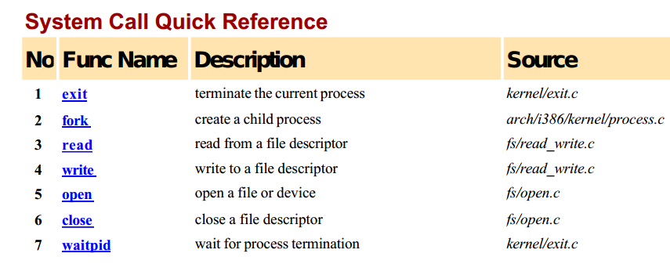
System Call Interface (SCI)

Slide 11
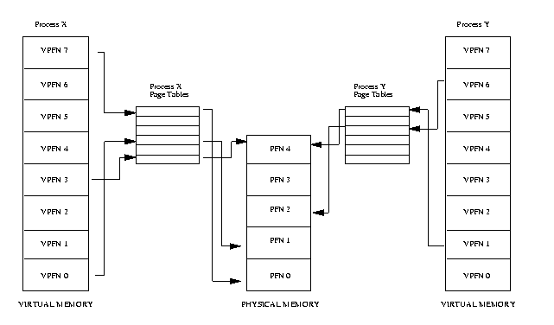
Memory Management

Slide 12
Memory Management

Slide 13

Memory Management
Do you have 3 free cells in a raw?

Slide 14
Memory Management
Do you have 3 free cells in a raw?
-YES!

Slide 15
Memory Management

Slide 16

Memory Management

Slide 17

Memory Management

Slide 18
Memory Management
What did you see?
I saw 3 green cells in a raw.
I saw 4 blue cells in a raw.
I saw 3 blue cells in a row.

Slide 19
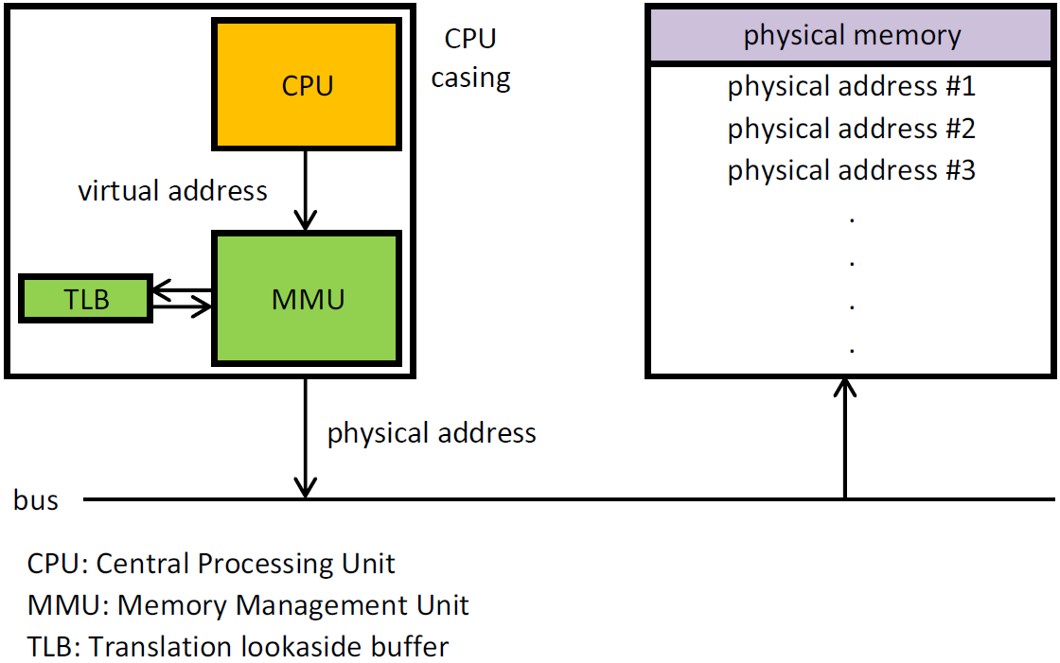
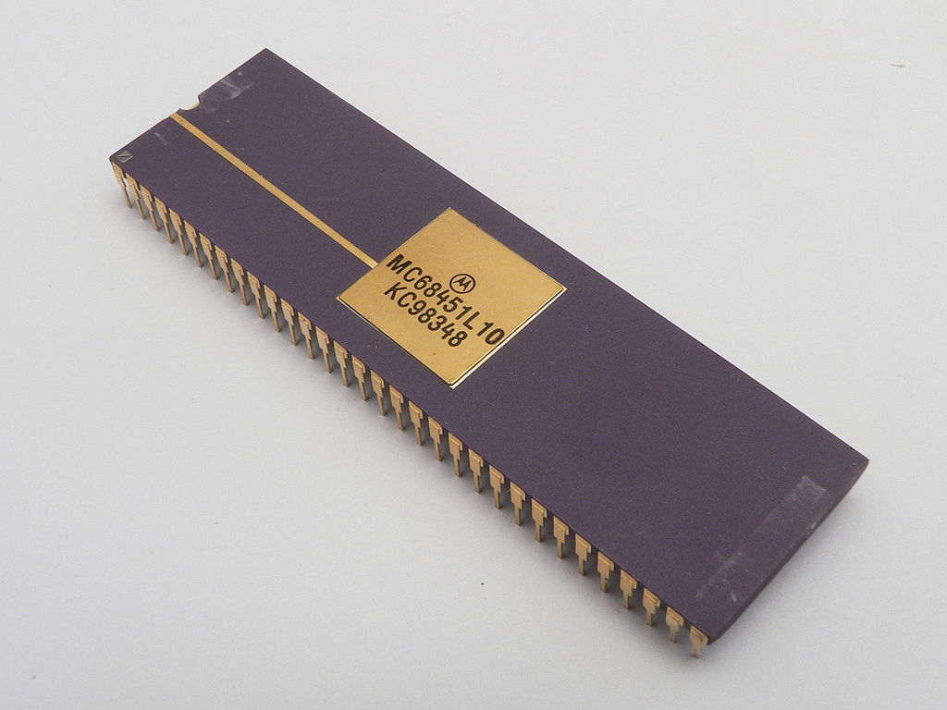
Memory Management
68451 MMU Chip

Slide 20
Process Management
Listing 1. A small portion of task_struct
struct task_struct {
volatile long state;
void *stack;
unsigned int flags;
int prio, static_prio;
struct list_head tasks;
struct mm_struct *mm, *active_mm;
pid_t pid;
pid_t tgid;
struct task_struct *real_parent;
char comm[TASK_COMM_LEN];
struct thread_struct thread;
struct files_struct *files;
...
};

Slide 21
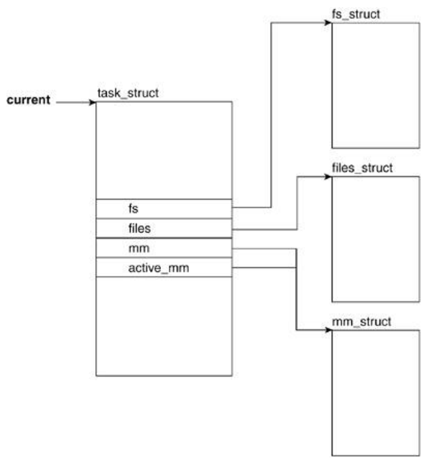
Process Management
Filesystem- and Address Space- Related Fields

Slide 22
Process Management
Filesystem- and Address Space Related Fields
files
The files field holds a pointer to the file descriptor table for the task. This file descriptor holds pointers to files (more specifically, to their descriptors) that the task has open.
mm
mm points to address-space and memory-management related information.
active_mm
active_mm is a pointer to the most recently accessed address space. Both the mm and active_mm fields start pointing at the same mm_struct.

Slide 23
Process Management
Filesystem- and Address SpaceRelated Fields
…
Each process a pointer (mm_struct→pgd) to its own Page Global Directory (PGD) which is a physical page frame.
…
On the x86, the process page table is loaded by copying mm_struct→pgd into the cr3 register
…
https://www.kernel.org/doc/gorman/html/understand/understand006.html#text10

Slide 24
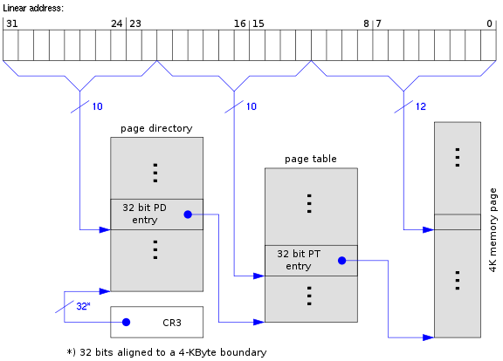
Process Management
CR3
CR3 enables the processor to translate linear addresses into physical addresses by locating the page directory and page tables for the current task. Typically, the upper 20 bits of CR3 become the page directory base register (PDBR), which stores the physical address of the first page directory entry.

Slide 25
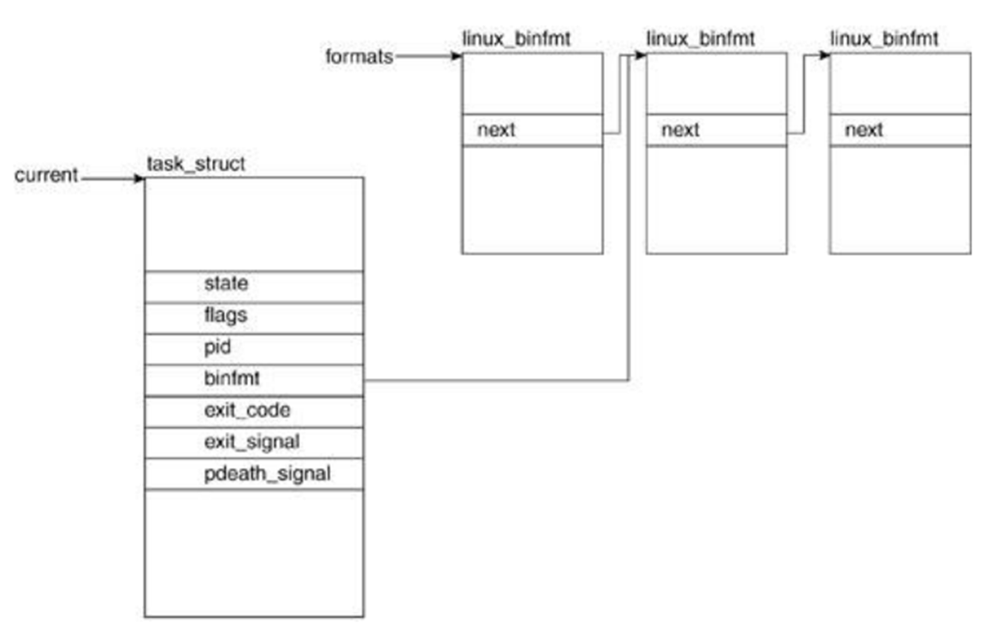
Process Management
Process Attribute Related Fields

Slide 26
Process Management
Process Attribute Related Fields
state
The state field keeps track of the state a process finds itself in during its execution lifecycle. Possible values it can hold are TASK_RUNNING, TASK_INTERRUPTIBLE, TASK_UNINTERRUPTIBLE, TASK_ZOMBIE, TASK_STOPPED, and TASK_DEAD
pid
In Linux, each process has a unique process identifier (pid). This pid is stored in the task_struct as a type pid_t. Although this type can be traced back to an integer.
binfmt
Linux supports a number of executable formats. An executable format is what defines the structure of how your program code is to be loaded into memory.

Slide 27
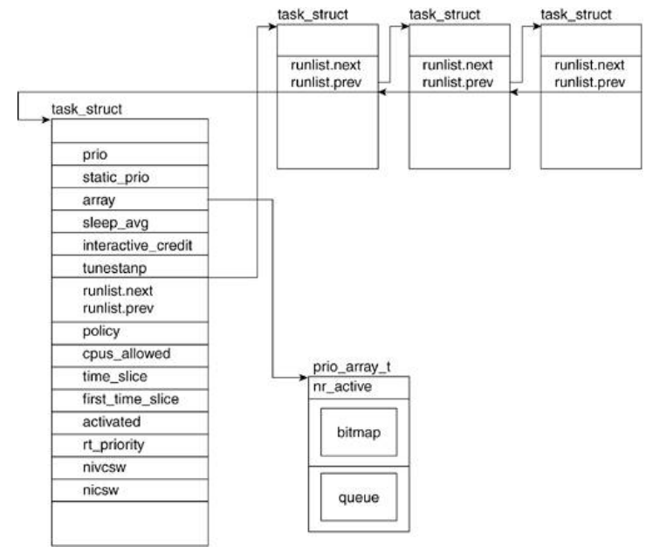
Process Management
Scheduling Related Fields

Slide 28
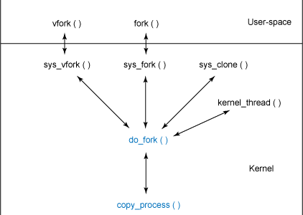
Process Management
Process Creation

Slide 29
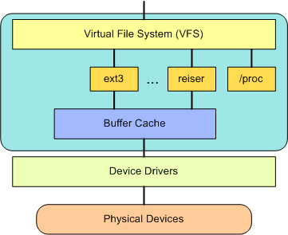
Virtual File System
At the top of the VFS is a common API abstraction of functions such as open,
close, read, and write. At the bottom of the VFS are the file system abstractions
that define how the upper-layer functions are implemented. These are plug-ins
for the given file system (of which over 50 exist).
You can find the file system sources in ./linux/fs.

Slide 30
Linux Kernel related projects in GL
Texas Instruments OMAP CPU BSP
GoNet
WebTuner
Hirschmann Car Communications

Slide 31
Home work
Make a copy of Linux virtual machine.

Slide 32
Thank you!

