Slide 1
Memory allocation p.2
ioremap
Lookaside caches
per-CPU Variables
Acquiring a Large Buffer at Boot Time

Slide 2
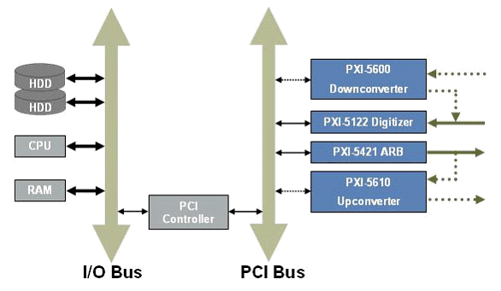
ioremap

Slide 3
ioremap
#include <linux/vmalloc.h>
void *ioremap(unsigned long offset,
unsigned long size);
void iounmap(void * addr);
ioremap is for mapping the “device memory” physical address to virtual kernel space.
Don’t use ioremap for “normal memory”.

Slide 4
ioremap
The mapping not only translates a virtual address into a physical address, but it also controls how the processor will access that memory.

Slide 5
ioremap
The mapping not only translates a virtual address into a physical address, but it also controls how the processor will access that memory.
"normal memory" is subject to reordering of reads and writes, while "device memory" is not;

Slide 6
ioremap
The mapping not only translates a virtual address into a physical address, but it also controls how the processor will access that memory.
"normal memory" is subject to reordering of reads and writes, while "device memory" is not;
"device memory" can’t be shared between processors;

Slide 7
ioremap
The mapping not only translates a virtual address into a physical address, but it also controls how the processor will access that memory.
"normal memory" is subject to reordering of reads and writes, while "device memory" is not;
"device memory" can’t be shared between processors;
RAM might be mapped with writeback caching enabled, while device memory is uncached.

Slide 8
ioremap
The mapping not only translates a virtual address into a physical address, but it also controls how the processor will access that memory.
"normal memory" is subject to reordering of reads and writes, while "device memory" is not;
"device memory" can’t be shared between processors;
RAM might be mapped with writeback caching enabled, while device memory is uncached.
One should not directly access addresses returned by ioremap as if they were pointers to memory. Rather, readb and writeb should always be used.

Slide 9
Lookaside Caches
Kernel maintains a set of memory pools of objects that are all the same size.
Kernel implements a facility to create this sort of pool, which is often called a lookaside cache
Examples:
struct task_struct
Each process or task in the system has task_struct data structure.
struct page
Each physical page in the system has a struct page associated with it to keep track of whatever it is we are using the page for at the moment.

Slide 10
Lookaside Caches
kmem_cache_t *kmem_cache_create (const char *name, size_t size,
size_t offset,
unsigned long flags,
void (*constructor)(void *, kmem_cache_t *,
unsigned long flags),
void (*destructor)(void *, kmem_cache_t *,
unsigned long flags));
The function creates a new cache object that can host any number of memory areas all of the same size, specified by the size argument.

Slide 11
Lookaside Caches
Once a cache of objects is created, you can allocate objects from it by calling kmem_cache_alloc:
void *kmem_cache_alloc (kmem_cache_t *cache, int flags);
To free an object, use kmem_cache_free:
void kmem_cache_free (kmem_cache_t *cache, const void *obj);
When driver code is finished with the cache, typically when the module is unloaded, it should free its cache as follows:
int kmem_cache_destroy (kmem_cache_t *cache);

Slide 12
per-CPU Variables
Cross processor data sharing is expensive because of locking
Sometimes per-CPU variables could be used.
Examples:
Network statistics
Scheduler run queues
Things to be aware of:
Cross-processor access requires explicit locking
Be aware of preemption, use get_cpu_var(), put_cpu_var()
Total space for per-CPU variables could be limited.

Slide 13
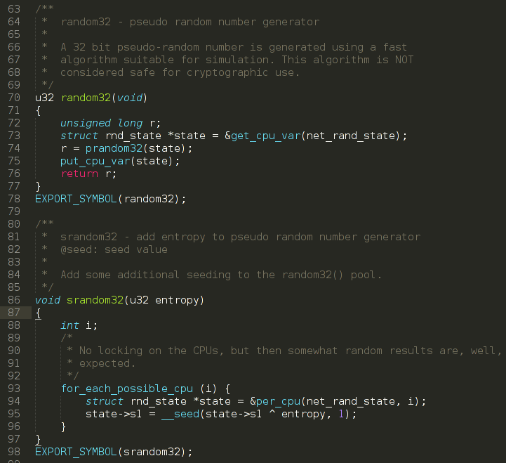
per-CPU Variables

Slide 14
Acquiring a Large Buffer at Boot Time
Boot-time memory allocation is performed by calling one of these functions:
#include <linux/bootmem.h>
void *alloc_bootmem (unsigned long size);
void *alloc_bootmem_low (unsigned long size);
void *alloc_bootmem_pages (unsigned long size);
void *alloc_bootmem_low_pages (unsigned long size);
This mechanism is available only for code linked in the kernel image.

Slide 15
Homework
The same as for previous week.

Slide 16
Thank you!

