Slide 1
Interrupts handling p.1
Abstraction layers
Highlevel IRQ API
Chiplevel hardware encapsulation
IRQ flow handlers

Slide 2
Abstraction layers
There are three main levels of abstraction in the interrupt code:
1. Highlevel driver API
2. Highlevel IRQ flow handlers
3. Chiplevel hardware encapsulation

Slide 3
Highlevel IRQ API
int request_irq (unsigned int irq,
irqreturn_t (*handler)(int, void *),
unsigned long flags,
const char *dev_name,
void *dev_id);
void free_irq (unsigned int irq, void *dev_id);
void disable_irq (int irq);
void disable_irq_nosync (int irq);
void enable_irq (int irq);

Slide 4

Chiplevel hardware encapsulation
hardware
arch-asm-level
arch-c-level
HW interrupt
asm_do_IRQ()
handle_IRQ()
Assembler code has to be designed so that every HW interrupt invokes asm_do_IRQ() function call.

Slide 5
IRQ flow handlers
arch-c-level
flow-handle
Driver handler
asm_do_IRQ()
handle_IRQ()
generic_handle_irq()
desc->handle_irq()
handle_simple_irq()
or
handle_level_irq()
or
handle_edge_irq()
handle_irq_event()
action->handler()
my_gpio_irq()
Use irq_set_chip_and_handler function to set the handle_irq field of struct irq_desc
Use request_irq function from high level IRQ API to set the handler field of struct irqaction

Slide 6
IRQ flow handlers
struct irq_chip {
const char *name;
void (*irq_enable)(struct irq_data *data);
void (*irq_disable)(struct irq_data *data);
int (*irq_set_type)(struct irq_data *data, unsigned int flow_type);
…
unsigned long flags;
};
This function sets the custom data to be passed to functions registered with struct itq_chip.
int irq_set_chip_data (unsigned int irq, void *data)
The data could later be extracted using:
void *irq_data_get_irq_chip_data (struct irq_data *d);
This function sets the handle_irq field of struct irq_desc to handle
void irq_set_chip_and_handler (unsigned int irq, struct irq_chip *chip,
irq_flow_handler_t handle)
handle could be set to:
• handle_level_irq
• handle_edge_irq
• handle_simple_irq
• handle_percpu_irq

Slide 7
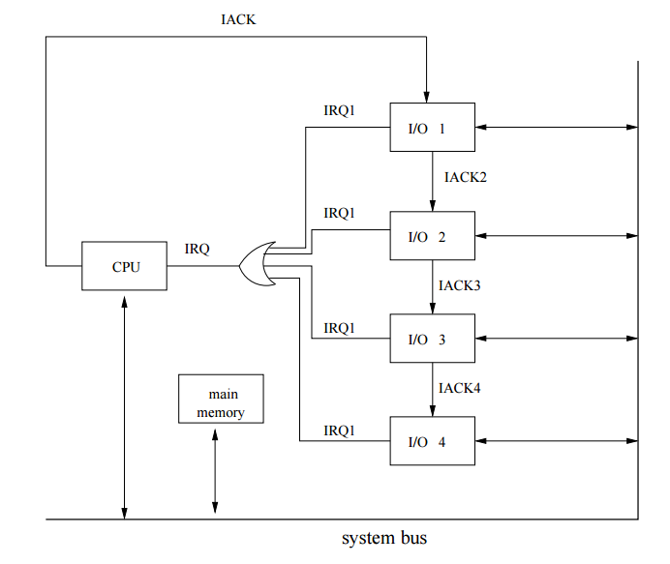
IRQ flow handlers
Interrupts daisy chaining.

Slide 8
IRQ flow handlers
arch-c-level
flow-handle
Driver handler
asm_do_IRQ()
handle_IRQ()
generic_handle_irq()
desc->handle_irq()
handle_irq_event()
handle_simple_irq()
action->handler()
my_gpio_irq()
We can call generic_handle_irq() to emulate interrupts. This is useful for chained interrupts.

Slide 9
IRQ flow handlers
arch-c-level
flow-handle
pl061
Driver handler
asm_do_IRQ()
handle_IRQ()
generic_handle_irq()
desc->handle_irq()
pl061_irq_handle()
generic_handle_irq()
desc->handle_irq()
handle_irq_event()
handle_simple_irq()
action->handler()
my_gpio_irq()
For chained interrupts:
1. Register HW interrupt handler using irq_set_chained_handler
2. Invoke non-hardware interrupt handlers for chained devices using generic_handle_irq

Slide 10
IRQ flow handlers
Register HW interrupt handler:
void irq_set_chained_handler (unsigned int irq, irq_flow_handler_t handle)
Don’t forget about custom data that might needed in handler
int irq_set_handler_data (unsigned int irq, void *data)
Invoke non-hardware interrupt handlers for chained devices using
int generic_handle_irq (unsigned int irq)

Slide 11
Thank you!

