Slide 1
Interrupts handling p.2
request_irq
request_irq params
Top & Bottom Halves (Tasklets)
Top & Bottom Halves (Workqueues)
Moving IRQs to threads (request_threaded_irq)
request_threaded_irq() params
Implementing a Handler
Enabling and Disabling Interrupts
Interrupt Sharing (Driver API Level)
The /proc interface

Slide 2
request_irq
int request_irq (unsigned int irq,
irqreturn_t (*handler)(int, void *),
unsigned long flags,
const char *dev_name,
void *dev_id);

Slide 3
request_irq params
unsigned int irq - The interrupt number being requested.
irqreturn_t (*handler)(int, void *) - The pointer to the handling function being installed.
unsigned long flags - A bit mask of options related to interrupt management.
const char *dev_name - The string passed to request_irq is used in /proc/interrupts to show the owner of the interrupt
void *dev_id - a sort of client data; a void * argument is passed to request_irq(), and this same pointer is then passed back as an argument to the handler when the interrupt happens.

Slide 4
flags bitmasks
IRQF_DISABLED - In ancient versions of the Linux kernel, there were two types of main interrupt handlers. Fast handlers, which ran with interrupts disabled (i.e., with IRQF DISABLED set), and slow handlers that remained interruptible. Running IRQ handlers with interrupts enabled can cause stack overflows which is an undesirable situation, especially in an OS kernel. Note that this flag has been removed since Linux v4.1 (August 2015).
IRQF_SHARED - Allow an interrupt line to be shared among several devices. Handlers that share an interrupt line need to check first if the passed device identifier belongs to them (i.e., they check if the arriving interrupt was issued by their device) and must return IRQ_NONE in case not.
IRQF_ONESHOT – The interrupt is not re-enabled after the IRQ handler finishes. This flag is required for threaded interrupts which need to keep the interrupt line disabled until the threaded handler has run. Specifying this flag is mandatory if the primary handler is set to NULL. If the IRQF_ONESHOT flag is not specified, some handlers will end up in stack overflows since the interrupt of the issuing device is still active. Hence the kernel rejects such requests and throws an error message.
Read about the rest of flags in “Kernel_interrupts_report.pdf” shared on Google drive.

Slide 5
Unregister Interrupt Handlers
void free_irq (unsigned int irq,
void *dev_id);
free_irq will also disable the interrupt line if it is no longer used by handlers. The function waits for running IRQ handlers to finish, and should consequently never be called from any interrupt context to avoid potential deadlocks.

Slide 6
Implementing a Handler
Remember about ATOMIC context: don’t do anything that would sleep, don’t call wait_event, don’t allocate memory with anything other than GFP_ATOMIC, don’t lock a semaphore, don’t call schedule().

Slide 7
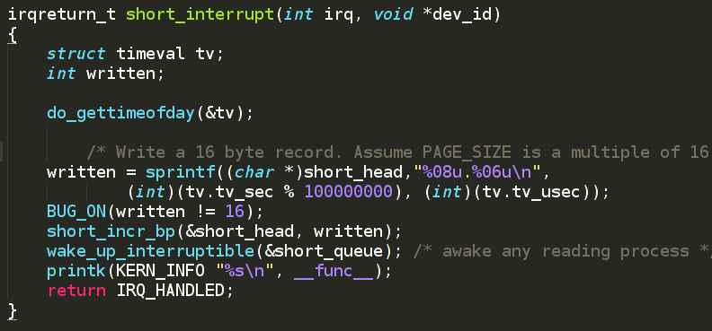
Implementing a Handler
Simple interrupt handler.

Slide 8
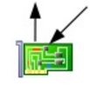
Top & Bottom Halves (tasklets)
HW interrupt handler runs with interrupts from current line disabled.
Schedule tasklet and rise software IRQ .
Restore interrupt as soon as possible and exit.
Soft. IRQ
Interrupt context
HW int. handler
Other HW int. handlers
Bottom half (tasklet)
Process context tasks
Schedule bottom half rise soft. IRQ and exit
Handle int. data and wake up waiting tasks
Process context tasks
HW IRQ
ACK

Slide 9
Top & Bottom Halves (tasklets)
Declaring and scheduling a tasklet
/* Declare a Tasklet (the Bottom-Half) */
void tasklet_function( unsigned long data );
DECLARE_TASKLET( tasklet_example, tasklet_function, tasklet_data );
...
/* Schedule the Bottom-Half */
tasklet_schedule( &tasklet_example );

Slide 10
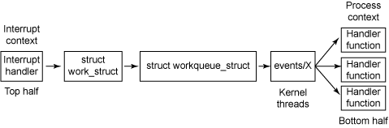
Top & Bottom Halves (Workqueues)
The process behind work queues
Scheduling Work Items
static inline bool queue_work (struct workqueue_struct *wq, struct work_struct *work);
Synchronize with hard-IRQ
Call wake_up_interruptible from interrupt handler, use wait_event_interruptible from work function.

Slide 11
Moving IRQs to threads (request_threaded_irq)
int request_threaded_irq (unsigned int irq,
irq_handler_t handler,
irq_handler_t thread_fn,
unsigned long irqflags,
const char *devname,
void *dev_id);
Defer as much work to the kernel thread as possible – preferably all work, get rid of sync. issues between hard-IRQ and thread in process context.
The concept originates from the real-time kernel tree. As a consequence, threaded interrupts meet many requirements of a real-time system, most importantly reducing interrupt latency in the kernel and allowing a fine-grained priority model.

Slide 12
request_threaded_irq() params
The handler function (could be NULL in this case IRQF_ONESHOT flag must be passed). This is hard-IRQ handler which would ideally read the interrupt-cause or interrupt-status register of the device that raised the interrupt and determine if the processing for the interrupt can finish within few microseconds (e.g. out-of-band interrupts on a network card like buffer-overrun, DMA-overrun and so on). If it could finish interrupt processing fast for some set of interrupt causes, it would return IRQ_HANDLED after processing and acknowledging the interrupts. But, if the interrupt processing needs 100s of microseconds or more than a jiffy, it could simply acknowledge the interrupt to the device and return IRQ_WAKE_THREAD. Returning this value makes sense only when the thread_fn is also registered.

Slide 13
request_threaded_irq() params
The thread_fn function. When the hard-IRQ handler function returns IRQ_WAKE_THREAD, the associated kthread with this interrupt handler is added to the scheduler run-queue. When this kthread is scheduled, it would invoke the thread_fn function which can perform bottom-half interrupt processing fully in process context. Note that the thread_fn runs competing for CPU along with other processes on the runqueue, but it can run for longer duration without hurting the overall system responsiveness as it does not run in high-priority by default unlike SoftIRQs. When the thread_fn completes, the associated kthread would take itself out of the runqueue and remain in blocked state until woken up again by the hard-IRQ function.

Slide 14
Enabling and Disabling Interrupts
Disabling a single interrupt
void disable_irq (int irq);
void disable_irq_nosync (int irq);
void enable_irq (int irq);
Remember that somebody has prepared respective h/w communication functions, added them to struct irq_chip and registered this structure with irq_set_chip_and_handler

Slide 15
Enabling and Disabling Interrupts
Disabling all interrupts
void local_irq_save (unsigned long flags);
void local_irq_disable(void); - unconditionally
void local_irq_restore (unsigned long flags);
void local_irq_enable (void); - unconditionally

Slide 16
Interrupt Sharing (Driver API Level)
SoC
Device #1
GPIO 0
GPIO controller
GPIO 1
ARM CPU
GPIO IRQ
GPIO 2
GPIO N
Device #2
internal bus
We have already discussed interrupts chaining in Kernel IRQ subsystem.
How can we share interrupts on Driver API Level?

Slide 17
Interrupt Sharing (Driver API Level)
Set IRQF_SHARED flag while for request_irq
The dev_id argument must be unique and specific to each driver. (Passing NULL could cause kernel oops at unload time.)
Return IRQ_NONE whenever your handler is called and finds that the device is not interrupting.

Slide 18
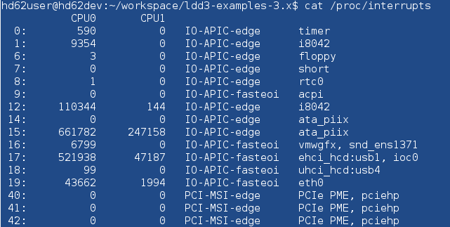
The /proc interface
Whenever a hardware interrupt reaches the processor, an internal counter is incremented, providing a way to check whether the device is working as expected. Reported interrupts are shown in /proc/interrupts.

Slide 19
Thank you!

