Slide 1
USB Drivers p.2 usb-skeleton driver.
USB Logical Function
USB Descriptors
Enumeration Flow
Register USB Driver
USB SysFs
USB Device Probe
USB Urbs
Write/Read to USB Device

Slide 2
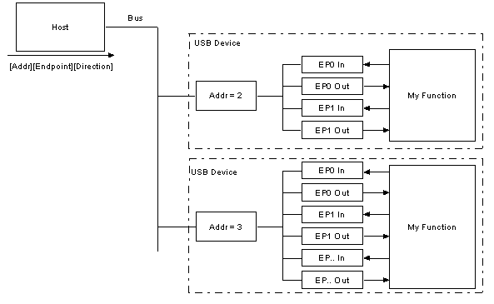
USB Logical Function
Most functions will have a series of buffers, typically 8 bytes long. Each buffer will belong to an endpoint - EP0 IN, EP0 OUT etc.

Slide 3
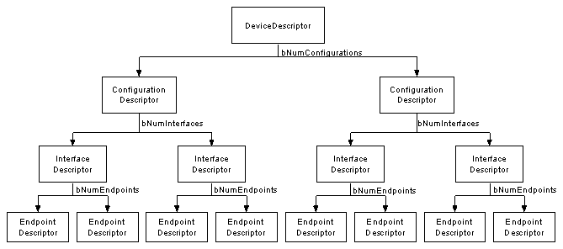
USB Descriptors
USB devices can only have one device descriptor. The device descriptor includes information such as what USB revision the device complies to, the Product and Vendor IDs used to load the appropriate drivers and the number of possible configurations the device can have. The number of configurations indicate how many configuration descriptors branches are to follow.

Slide 4
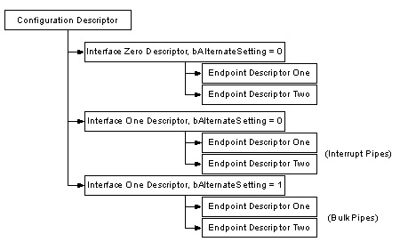
USB Descriptors
The configuration descriptor specifies values such as the amount of power this particular configuration uses, if the device is self or bus powered and the number of interfaces it has. When a device is enumerated, the host reads the device descriptors and can make a decision of which configuration to enable.
It can only enable one configuration at a time.

Slide 5
USB Descriptors
The interface descriptor could be seen as a header or grouping of the endpoints into a functional group performing a single feature of the device. For example you could have a multi-function scanner/printer device. Interface descriptor one could describe the endpoints of the scanner function and Interface descriptor two the printer function. Unlike the configuration descriptor, there is no limitation as to having only one interface enabled at a time. A device could have 1 or many interface descriptors enabled at once.

Slide 6
Enumeration Flow
Plug in Device to Host
Detect Device
Identify Speed of Device
Get Device Descriptors
Reset Device and Assign Address
Get Config Descriptors
Get Interface Descriptors
Load Drivers
Device Ready to Use

Slide 7
Enumeration Flow
Plug in Device to Host
Detect Device
Identify Speed of Device
Get Device Descriptors
Reset Device and Assign Address
Get Config Descriptors
Get Interface Descriptors
Load Drivers
Device Ready to Use

Slide 8
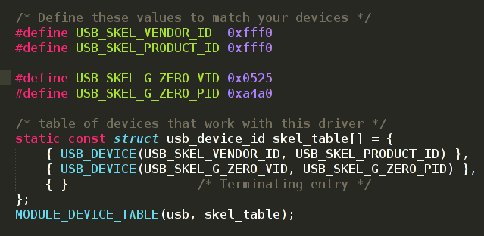
Register USB Driver

Slide 9
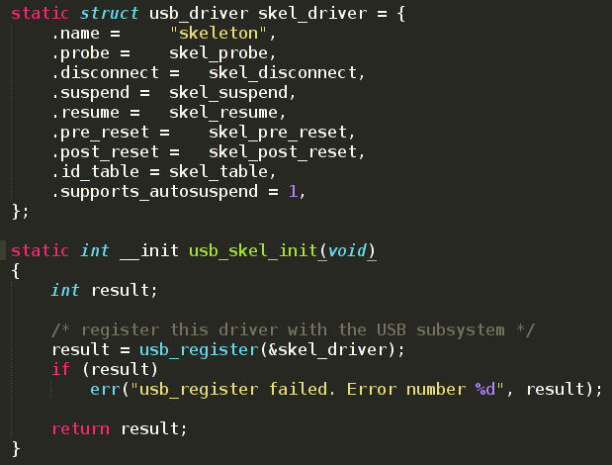
Register USB Driver

Slide 10
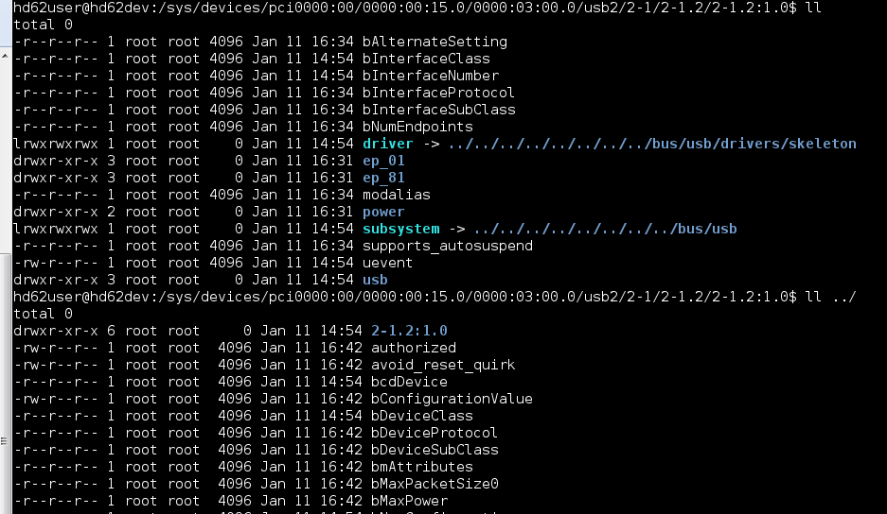
USB SysFs

Slide 11
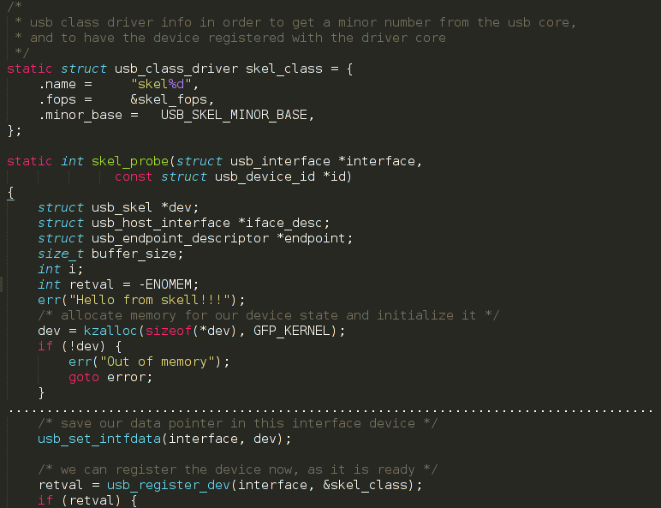
USB Device Probe
1
2
3

Slide 12
USB Urbs
The USB code in the Linux kernel communicates with all USB devices using something called a urb (USB request block). This request block is described with the struct urb structure and can be found in the include/linux/usb.h file.
The typical lifecycle of a urb:
• Created by a USB device driver.
• Assigned to a specific endpoint of a specific USB device.
• Submitted to the USB core, by the USB device driver.
• Submitted to the specific USB host controller driver for the specified device by the USB core.
• Processed by the USB host controller driver that makes a USB transfer to the device.
• When the urb is completed, the USB host controller driver notifies the USB device driver.

Slide 13
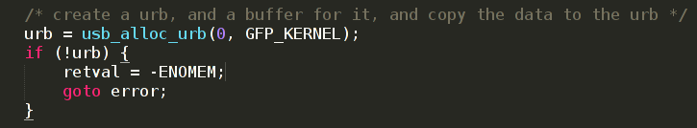
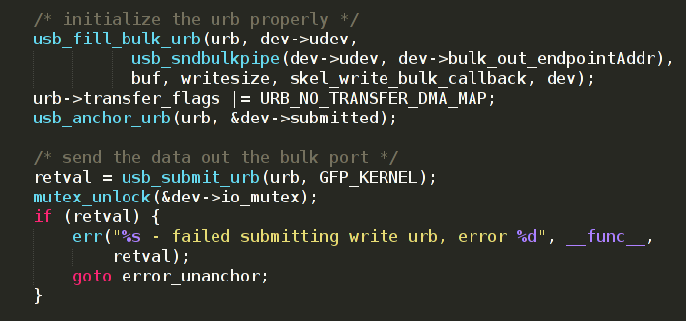
Write/Read to USB Device
1

Slide 14
Further Reading
Writing Linux Kernel Driver for Unknown USB Device: http://matthias.vallentin.net/blog/2007/04/writing-a-linux-kernel-driver-for-an-unknown-usb-device/
Demo STM32 Toggle LED source code: git@github.com:oshevchenko/stm32_tft.git (branch workshop_usb)
Миникомпьютер из роутера с OpenWRT: пишем USB class-driver под Linux https://habrahabr.ru/post/163861/

Slide 15
Thank you!

