Slide 1
Network Drivers p.2
How snull Is Designed
Device Registration
Interface Information
The Device Methods
Packet Transmission
Controlling Transmission Concurrency
Packet Reception
Overriding ARP

Slide 2
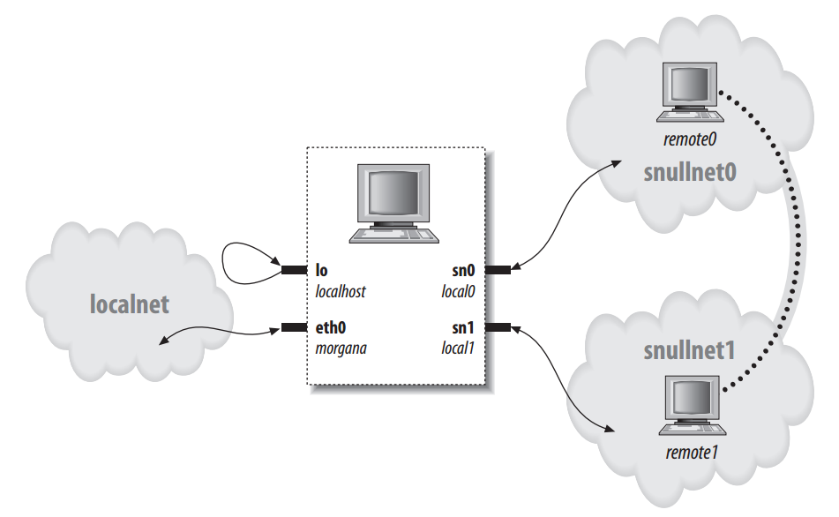
How snull Is Designed
Version
192.168.0.2
192.168.0.1
192.168.1.2
192.168.1.1

Slide 3
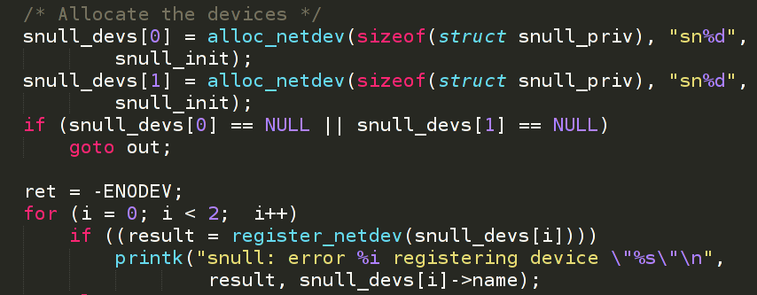
Device Registration
The net_device structure, like many other kernel structures, contains a kobject and is, therefore, reference-counted and exported via sysfs.

Slide 4
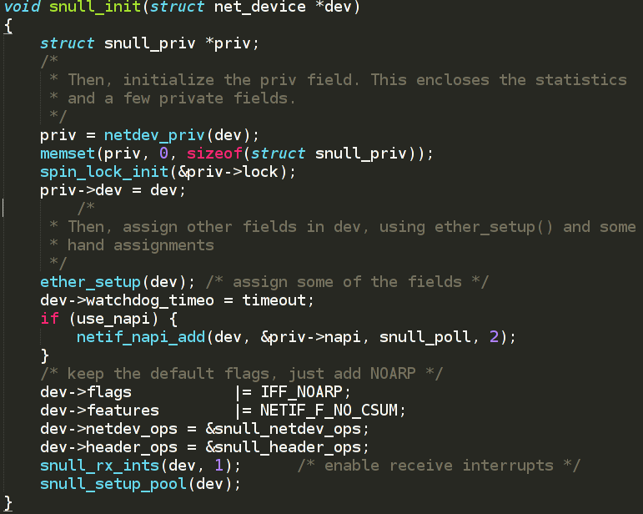
Device Registration

Slide 5
Interface information
Version
net_device fields filled by ether_setup
unsigned short hard_header_len;
The hardware header length, that is, the number of octets that lead the transmitted
packet before the IP header, or other protocol information. The value of
hard_header_len is 14 (ETH_HLEN) for Ethernet interfaces.
unsigned mtu;
The maximum transfer unit (MTU). This field is used by the network layer to
drive packet transmission. Ethernet has an MTU of 1500 octets (ETH_DATA_LEN).
This value can be changed with ifconfig.
unsigned long tx_queue_len;
The maximum number of frames that can be queued on the device’s transmission
queue. This value is set to 1000 by ether_setup, but you can change it. For
example, plip uses 10 to avoid wasting system memory (plip has a lower
throughput than a real Ethernet interface).
unsigned short type;
The hardware type of the interface. The type field is used by ARP to determine
what kind of hardware address the interface supports. The proper value for
Ethernet interfaces is ARPHRD_ETHER, and that is the value set by ether_setup. The
recognized types are defined in <linux/if_arp.h>.

Slide 6
Interface information
Version
Some other net_device fields
unsigned long rmem_end;
unsigned long rmem_start;
unsigned long mem_end;
unsigned long mem_start;
Device memory information. These fields hold the beginning and ending
addresses of the shared memory used by the device. If the device has different
receive and transmit memories, the mem fields are used for transmit memory and
the rmem fields for receive memory. The rmem fields are never referenced outside
unsigned char addr_len;
unsigned char broadcast[MAX_ADDR_LEN];
unsigned char dev_addr[MAX_ADDR_LEN];
Hardware (MAC) address length and device hardware addresses. The Ethernet
address length is six octets (we are referring to the hardware ID of the interface
board), and the broadcast address is made up of six 0xff octets; ether_setup
arranges for these values to be correct. The device address, on the other hand,
must be read from the interface board in a device-specific way, and the driver
should copy it to dev_addr.
unsigned short flags; Interface flags (detailed next).

Slide 7
Interface information
Version
Flags
IFF_PROMISC
This flag is set (by the networking code) to activate promiscuous operation. By
default, Ethernet interfaces use a hardware filter to ensure that they receive
broadcast packets and packets directed to that interface’s hardware address
only. Packet sniffers such as tcpdump set promiscuous mode on the interface in
order to retrieve all packets that travel on the interface’s transmission medium.
IFF_MULTICAST
This flag is set by drivers to mark interfaces that are capable of multicast transmission.
ether_setup sets IFF_MULTICAST by default, so if your driver does not
support multicast, it must clear the flag at initialization time.
IFF_BROADCAST
This flag (maintained by the networking code) states that the interface allows
broadcasting. Ethernet boards do.
IFF_DEBUG
This marks debug mode. The flag can be used to control the verbosity of your
printk calls or for other debugging purposes. Although no in-tree driver currently
uses this flag, it can be set and reset by user programs via ioctl, and your
driver can use it. The misc-progs/netifdebug program can be used to turn the flag
on and off.

Slide 8
Interface information
Version
Flags
IFF_LOOPBACK
This flag should be set only in the loopback interface. The kernel checks for
IFF_LOOPBACK instead of hardwiring the lo name as a special interface.
IFF_POINTOPOINT
This flag signals that the interface is connected to a point-to-point link. It is set
by the driver or, sometimes, by ifconfig. For example, plip and the PPP driver
have it set.
IFF_NOARP
This means that the interface can’t perform ARP. For example, point-to-point
interfaces don’t need to run ARP, which would only impose additional traffic
without retrieving useful information. snull runs without ARP capabilities, so it
sets the flag.

Slide 9
The Device Methods
Version
int (*ndo_open)(struct net_device *dev); Opens the interface. The interface is opened whenever ifconfig activates it. The open method should register any system resource it needs (I/O ports, IRQ, DMA, etc.), turn on the hardware, and perform any other setup your device
requires.
int (*ndo_stop)(struct net_device *dev);
Stops the interface. The interface is stopped when it is brought down. This function
should reverse operations performed at open time.
int (*ndo_start_xmit) (struct sk_buff *skb, struct net_device *dev);
Method that initiates the transmission of a packet. The full packet (protocol
headers and all) is contained in a socket buffer (sk_buff) structure. Socket buffers
are introduced later in this chapter.
int (*ndo_set_config)(struct net_device *dev, struct ifmap *map);
Changes the interface configuration. This method is the entry point for configuring
the driver. The I/O address for the device and its interrupt number can be
changed at runtime using set_config. This capability can be used by the system
administrator if the interface cannot be probed for. Drivers for modern hardware
normally do not need to implement this method.

Slide 10
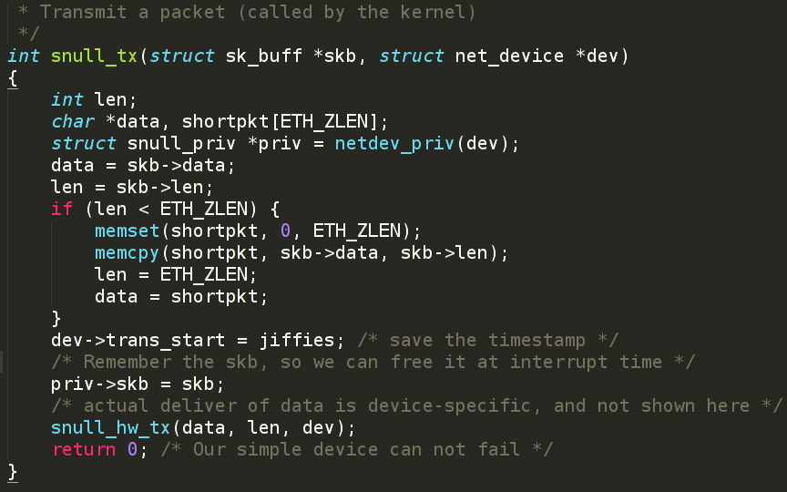
Packet Transmission
Whenever the kernel needs to transmit a data packet, it calls the driver’s ndo_start_xmit
method to put the data on an outgoing queue. Each packet handled by the kernel is contained in a socket buffer structure (struct sk_buff).

Slide 11
Controlling Transmission Concurrency
Real hardware interfaces, transmit packets asynchronously and have a limited amount of memory available to store outgoing packets. When that memory is exhausted (which, for some hardware, happens with a single outstanding packet to transmit), the driver needs to tell the networking system not to start any more transmissions until the hardware is ready to accept new data.
void netif_stop_queue(struct net_device *dev);
void netif_wake_queue(struct net_device *dev);

Slide 12
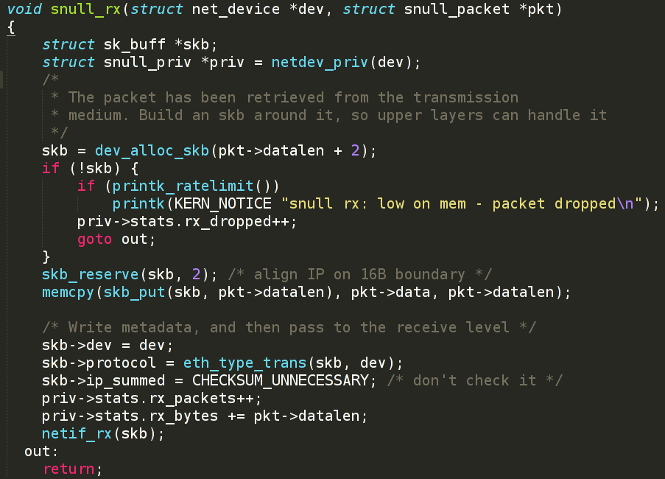
Packet Reception

Slide 13
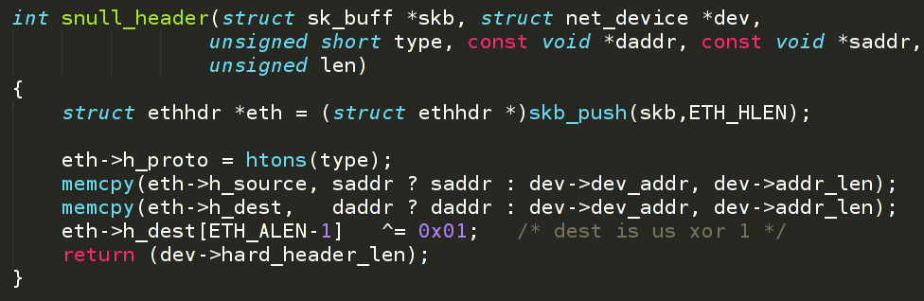
Overriding ARP
Function (called before ndo_start_xmit) that builds the hardware header from
the source and destination hardware addresses that were previously retrieved; its
job is to organize the information passed to it as arguments into an appropriate,
device-specific hardware header. eth_header is the default function for Ethernet-like
interfaces, and ether_setup assigns this field accordingly

Slide 14
Homework
Add ARP support to snull driver.

Slide 15
Thank you!

