Slide 1
Device model p.1
Device model
Kobjects, Ksets, and Subsystems
Low-Level Sysfs Operations
Default and Nondefault Attributes
Symbolic Links
Hotplug Operations

Slide 2
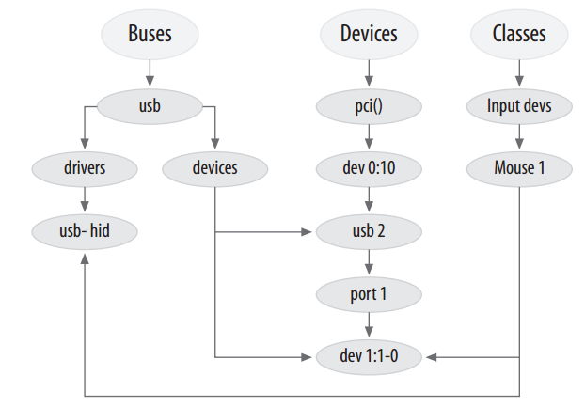
A small piece of the device model
Version

Slide 3
Kobjects, Ksets, and Subsystems
Version
Reference counting of objects
Often, when a kernel object is created, there is no way to know just how long it
will exist. One way of tracking the lifecycle of such objects is through reference
counting. When no code in the kernel holds a reference to a given object, that
object has finished its useful life and can be deleted.
Sysfs representation
Every object that shows up in sysfs has underneath it a kobject that interacts
with the kernel to create its visible representation.
Data structure glue
The device model is in its entirety a fiendishly complicated data structure made
up of multiple hierarchies with numerous links between them. The kobject
implements this structure and holds it together.
Hotplug event handling
The kobject subsystem handles the generation of events that notify user space
about the comings and goings of hardware on the system.

Slide 4
Embedding kobjects
Version
struct cdev {
struct kobject kobj;
struct module *owner;
struct file_operations *ops;
struct list_head list;
dev_t dev;
unsigned int count;
};
The way to convert a pointer to a struct kobject called kp embedded within a
struct cdev would be:
struct cdev *device = container_of (kp, struct cdev, kobj);

Slide 5
Kobject initialization
Version
void kobject_init (struct kobject *kobj);
int kobject_set_name (struct kobject *kobj, const char *format, ...);

Slide 6
Reference count manipulation
Version
One of the key functions of a kobject is to serve as a reference counter for the object in which it is embedded.
struct kobject *kobject_get (struct kobject *kobj);
void kobject_put (struct kobject *kobj);
struct kobj_type {
void (*release)(struct kobject *);
struct sysfs_ops *sysfs_ops;
struct attribute **default_attrs;
};
Every kobject needs to have an associated kobj_type structure.
void my_object_release (struct kobject *kobj)
{
struct my_object *mine = container_of (kobj, struct my_object, kobj);
/* Perform any additional cleanup on this object, then... */
kfree(mine);
}

Slide 7
Kobject Hierarchies
Version
Adding a kobject to a kset is usually done when the object is created; it is a two-step
process. The kobject’s kset field must be pointed at the kset of interest; then the
kobject should be passed to:
int kobject_add (struct kobject *kobj);
At some point the kobject will probably have to be removed from the kset to clear that reference; that is done with:
void kobject_del (struct kobject *kobj);

Slide 8
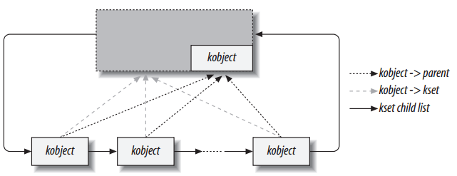
Kobject Hierarchies
Version
• All of the contained kobjects in the diagram are actually embedded within some
other type, possibly even other ksets.
• It is not required that a kobject’s parent be the containing kset (although any
other organization would be strange and rare).

Slide 9
Subsystems
Version
A subsystem is a representation for a high-level portion of the kernel as a whole. Subsystems usually (but not always) show up at the top of the sysfs hierarchy. Some
example subsystems in the kernel include block_subsys (/sys/block for block
devices), devices_subsys (/sys/devices the core device hierarchy), and a specific subsystem for every bus type known to the kernel.
struct subsystem {
struct kset kset;
struct rw_semaphore rwsem;
};
A subsystem is really just a wrapper around a kset, with a semaphore thrown in.

Slide 10
Low-Level Sysfs Operations
• Sysfs entries for kobjects are always directories
• The name assigned to the kobject (with kobject_set_name) is the name used for the sysfs directory.
• The sysfs entry is located in the directory corresponding to the kobject’s parent pointer.

Slide 11
Default Attributes
struct kobj_type {
void (*release)(struct kobject *);
struct sysfs_ops *sysfs_ops;
struct attribute **default_attrs;
};
The default_attrs field lists the attributes to be created for every kobject of this type, and sysfs_ops provides the methods to implement those attributes. We start with default_attrs, which points to an array of pointers to attribute structures:
struct attribute {
char *name;
struct module *owner;
mode_t mode;
};

Slide 12
Default Attributes
The default_attrs array says what the attributes are but does not tell sysfs how to actually implement those attributes. That task falls to the
kobj_type->sysfs_ops field, which points to a structure defined as:
struct sysfs_ops {
ssize_t (*show)(struct kobject *kobj, struct attribute *attr,
char *buffer);
ssize_t (*store)(struct kobject *kobj, struct attribute *attr,
const char *buffer, size_t size);
};

Slide 13
Nondefault Attributes
If you wish to add a new attribute to a kobject’s sysfs directory, simply fill in an attribute structure and pass it to:
int sysfs_create_file (struct kobject *kobj, struct attribute *attr);
To remove an attribute, call:
int sysfs_remove_file (struct kobject *kobj, struct attribute *attr);

Slide 14
Binary Attributes
Binary attributes are described with a bin_attribute structure:
struct bin_attribute {
struct attribute attr;
size_t size;
ssize_t (*read)(struct kobject *kobj, char *buffer, loff_t pos, size_t size);
ssize_t (*write)(struct kobject *kobj, char *buffer, loff_t pos, size_t size);
};
Binary attributes must be created explicitly; they cannot be set up as default attributes. To create a binary attribute, call:
int sysfs_create_bin_file (struct kobject *kobj, struct bin_attribute *attr);
Binary attributes can be removed with:
int sysfs_remove_bin_file (struct kobject *kobj, struct bin_attribute *attr);

Slide 15
Symbolic Links
Creating a symbolic link within sysfs is easy:
int sysfs_create_link (struct kobject *kobj, struct kobject *target, char *name);
Symbolic links can be removed with:
void sysfs_remove_link (struct kobject *kobj, char *name);

Slide 16
Hotplug Event Generation
The actual event generation takes place when a kobject is passed to kobject_add or kobject_del. Before the event is handed to user space,code associated with the kobject (or, more specifically, the kset to which it belongs) has the opportunity to add information for user space or to disable event generation entirely.

Slide 17
Hotplug Operations
Actual control of hotplug events is exercised by way of a set of methods stored in the kset_hotplug_ops structure:
struct kset_hotplug_ops {
int (*filter)(struct kset *kset, struct kobject *kobj);
char *(*name)(struct kset *kset, struct kobject *kobj);
int (*hotplug)(struct kset *kset, struct kobject *kobj,
char **envp, int num_envp, char *buffer, int buffer_size);
};

Slide 18
Hotplug Operations
When the user-space hotplug program is invoked, it is passed to the name of the relevant subsystem as its one and only parameter. The name hotplug method is charged with providing that name. It should return a simple string suitable for passing to user space.
Everything else that the hotplug script might want to know is passed in the environment. The final hotplug method (hotplug) gives an opportunity to add useful environment variables prior to the invocation of that script.
(*hotplug)(struct kset *kset, struct kobject *kobj, char **envp,
int num_envp, char *buffer, int buffer_size);

Slide 19
Thank you!

