Slide 1
Device Model p.2
Buses
Bus registration
Devices
Device Drivers
Classes
Device-creation process
Hotplug
Dealing with Firmware

Slide 2
Buses
Version
struct bus_type {
char *name;
struct subsystem subsys;
struct kset drivers;
struct kset devices;
int (*match)(struct device *dev, struct device_driver *drv);
struct device *(*add)(struct device * parent, char * bus_id);
int (*hotplug) (struct device *dev, char **envp,
int num_envp, char *buffer, int buffer_size);
/* Some fields omitted */
};
A bus is a channel between the processor and one or more devices. For the purposes of the device model, all devices are connected via a bus.
The bus code serves as an intermediary between the device core and individual drivers

Slide 3
Bus registration
Version
struct bus_type ldd_bus_type = {
.name = "ldd",
.match = ldd_match,
.hotplug = ldd_hotplug,
};
A new bus must be registered with the system via a call to bus_register.
ret = bus_register (&ldd_bus_type);
if (ret)
return ret;

Slide 4
Devices
Version
At the lowest level,every device in a Linux system is represented by an instance of
struct device:
struct device {
struct device *parent;
struct kobject kobj;
char bus_id[BUS_ID_SIZE];
struct bus_type *bus;
struct device_driver *driver;
void *driver_data;
void (*release)(struct device *dev);
/* Several fields omitted */
};
The usual set of registration and unregistration functions exists:
int device_register(struct device *dev);
void device_unregister(struct device *dev);

Slide 5
Device Drivers
Version
Drivers are defined by the following structure:
struct device_driver {
char *name;
struct bus_type *bus;
struct kobject kobj;
struct list_head devices;
int (*probe)(struct device *dev);
int (*remove)(struct device *dev);
void (*shutdown) (struct device *dev);
};
The registration functions are:
int driver_register(struct device_driver *drv);
void driver_unregister(struct device_driver *drv);

Slide 6
Classes
Version
The first step is to create the class itself. That is accomplished with a call to class_simple_create:
struct class_simple *class_simple_create (struct module *owner, char *name);
The real purpose of creating a simple class is to add devices to it; that task is achieved with:
struct class_device *class_simple_device_add(struct class_simple *cs,
dev_t devnum,
struct device *device,
const char *fmt, ...);

Slide 7
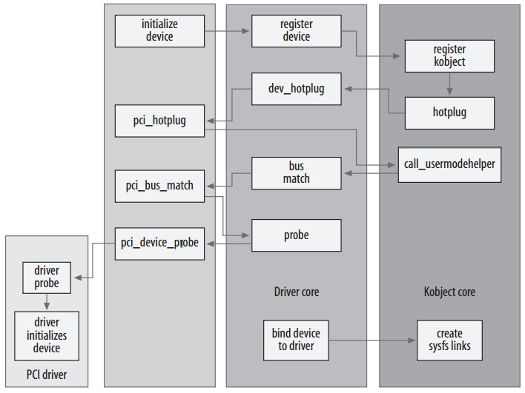
Device-creation process
Version
The steps of a PCI device’s lifecycle within the kernel.

Slide 8
Hotplug
Version
/sbin/hotplug is typically a very small bash script that merely passes execution on to a list of other programs that are placed in the /etc/hotplug.d/ directory tree.
DIR="/etc/hotplug.d"
for I in "${DIR}/$1/"*.hotplug "${DIR}/"default/*.hotplug ; do
if [ -f $I ]; then
test -x $I && $I $1 ;
fi
done
exit 1

Slide 9
Hotplug
Version
udev looks for a file called dev in the /class/ tree of sysfs
If your driver handles getting a major and minor number on its own, through a call to the cdev_init function or the older register_chrdev
To use class_simple interface is usually the easiest way to do this:
static struct class_simple *foo_class;
...
foo_class = class_simple_create (THIS_MODULE, "foo");
if (IS_ERR(foo_class)) {
printk(KERN_ERR "Error creating foo class.\n");
goto error;
}
class_simple_device_add (foo_class, MKDEV(FOO_MAJOR, minor), NULL, "foo%d", minor);

Slide 10
Hotplug
Version
create the structure containing the information needed to register a miscellaneous device with the kernel.
static struct miscdevice hello_dev = {
MISC_DYNAMIC_MINOR,
/*
* Name ourselves /dev/hello.
*/
"hello",
/*
* What functions to call when a program performs file
* operations on the device.
*/
&hello_fops
};

Slide 11
Hotplug
Version
register the device in the module's initialization function.
static int __init hello_init(void)
{
int ret;
/*Create the "hello" device in the /sys/class/misc directory.
* Udev will automatically create the /dev/hello device using
* the default rules.*/
ret = misc_register (&hello_dev);
if (ret)
printk(KERN_ERR
"Unable to register \"Hello, world!\" misc device\n");
return ret;
}
module_init(hello_init);

Slide 12
Hotplug
Version
The hello device appeared when we called misc_register() with a structure containing the device name "hello".
$ ls -d /sys/class/misc/hello/
/sys/class/misc/hello/
$ cat /sys/class/misc/hello/ dev
10:61
Create udev rule
$ cat /etc/udev/rules.d/010_hello.rules
KERNEL=="hello", SYMLINK+="hello_world", MODE="0444“
$ sudo insmod ./hello_dev.ko
$ ls -l /dev/hello*
cr--r--r-- 1 root root 10, 61 2007-06-19 21:21 /dev/hello
lrwxrwxrwx 1 root root 5 2007-06-19 21:21 /dev/hello_world -> hello

Slide 13
Dealing with Firmware
Version
#include <linux/firmware.h>
int request_firmware(const struct firmware **fw, char *name,
struct device *device);
When a call is made to request_firmware,a new directory is created under /sys/class/firmware using your device’s name. That directory contains three attributes:
loading - This attribute should be set to one by the user-space process that is loading the firmware. When the load process is complete,it should be set to 0.
data - a binary attribute that receives the firmware data itself. After setting
loading, the user-space process should write the firmware to this attribute.
device - This attribute is a symbolic link to the associated entry under /sys/devices

Slide 14
Dealing with Firmware
Version
The environment passed to the hotplug handler includes a variable
FIRMWARE, which is set to the name provided to request_firmware. The handler should locate the firmware file, and copy it into the kernel using the attributes provided.
udev rule:
$ cat /lib/udev/rules.d/50-firmware.rules
# firmware-class requests, copies files into the kernel
SUBSYSTEM=="firmware", ACTION=="add", RUN+=“/bin/firmware --firmware=$env{FIRMWARE} --devpath=$env{DEVPATH}"
when a firmware load request is received from kernel space, udev will execute the program /bin/firmware

Slide 15
Thank you!

