Slide 1
USB Frame Buffer Driver
Linux Video Subsystem
FB Programming interface
struct fb_ops
Build and run Frame Buffer Driver
fbcon and shell configuration.

Slide 2
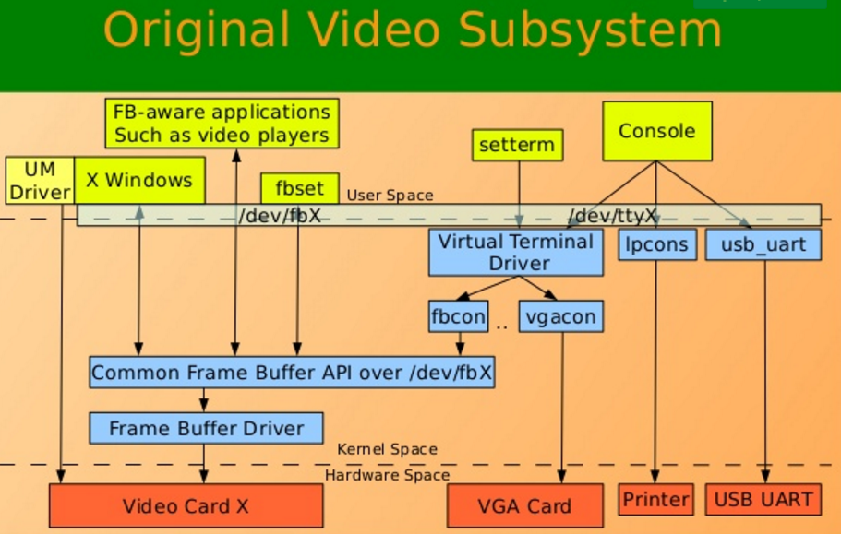
USB Descriptors
qqq

Slide 3
Data Path
User Space
Shell (ash, bash, dash)
/dev/tty0
Kernel Space
fbcon
/dev/fb0
TFT display
Hardware

Slide 4
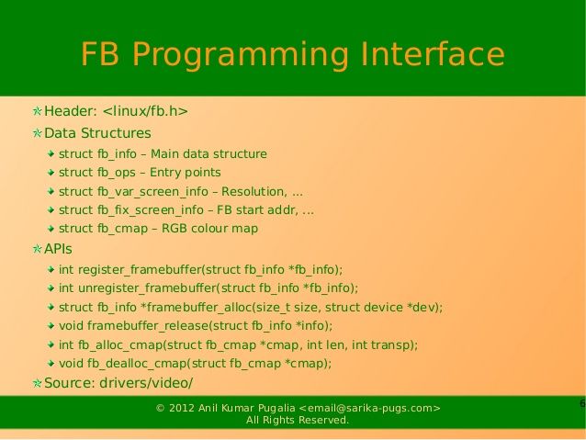
USB Descriptors

Slide 5
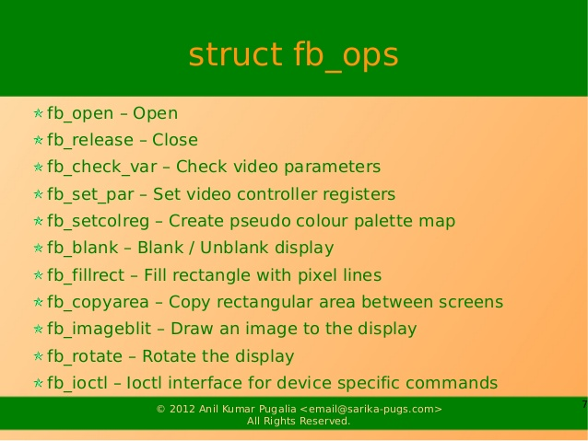
USB Descriptors

Slide 6
Inittab
Start userspace shell (ash) application on /dev/tty0
root@OpenWrt:~# cat /etc/inittab
::sysinit:/etc/init.d/rcS S boot
::shutdown:/etc/init.d/rcS K shutdown
::askconsole:/usr/libexec/login.sh
tty0::respawn:/bin/ash –login
Configure Linux Kernel command line to use tty0 for console output. Provide font parameter for “fbcon” driver.
root@OpenWrt:~# cat /proc/cmdline
board=TL-MR3020 console=ttyATH0,115200 rootfstype=squashfs,jffs2 noinitrd console=tty0 fbcon=font:ProFont6x11

Slide 7
Inject commands
User Space
Shell (ash, bash, dash)
SSH client
/dev/tty0
ioctl TIOCSTI
Kernel Space
fbcon
/dev/fb0
TFT display
Hardware

Slide 8
Inject commands
User Space
Shell (ash, bash, dash)
/dev/tty0
Kernel Space
fbcon
/dev/fb0
Keyboard driver
TFT display
Keyboard
Hardware

Slide 9
Further Reading
Framebuffer driver: git@github.com:oshevchenko/stm32_tft.git (branch frame_buffer)
Миникомпьютер из роутера с OpenWRT: пишем драйвер фреймбуфера
https://habrahabr.ru/post/164635/
3. http://tldp.org/HOWTO/pdf/Keyboard-and-Console-HOWTO.pdf
4. http://www.humbug.in/2010/utility-to-send-commands-or-data-to-other-terminals-ttypts/

Slide 10
Thank you!

