Slide 1
Source code and development tools
Kernel Build System.
Building Root filesystem.
Bootloaders and Kernel Booting process.

Slide 2
Source code
Visit to get the latest source code: www.kernel.org
Browse on-line:
http://lxr.free-electrons.com/source/drivers/?v=3.19
Subscribe for newbies mailing list:
http://lists.kernelnewbies.org/mailman/listinfo/kernelnewbies

Slide 3
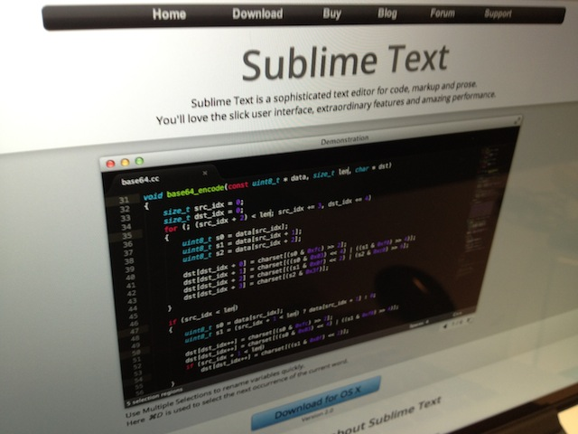
Source code
Editor
Sublime
+
cscope
plugin

Slide 4
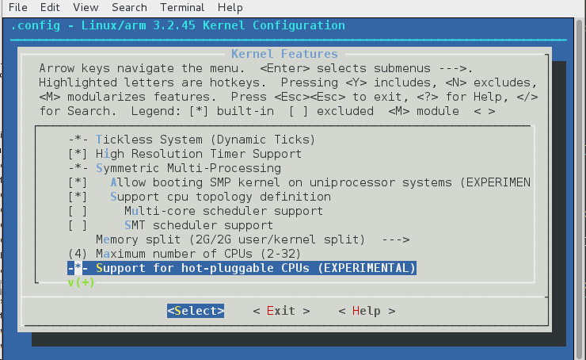
Configure Kernel
Command: ext/fujitsu/external/fujitsu/rtos/linux/3.2.x$ make menuconfig
Input: ./src/..../Kconfig
Input/output: ./src/build/M-arm-linux-gcc/.config
Output: ./src/build/M-arm-linux-gcc/include/generated/autoconf.h

Slide 5
Configure Kernel
ext/fujitsu/external/fujitsu/rtos/linux/3.2.x/arch/arm/Kconfig
…
source "arch/arm/mach-ep93xx/Kconfig"
source "arch/arm/mach-footbridge/Kconfig"
source "arch/arm/mach-fujitsu/Kconfig"
source "arch/arm/mach-gemini/Kconfig"
...
ext/fujitsu/external/fujitsu/rtos/linux/3.2.x/drivers/usb/musb/Kconfig
…
config MUSB_PIO_ONLY
bool 'Disable DMA (always use PIO)'
depends on USB_MUSB_HDRC
default USB_MUSB_TUSB6010 || USB_MUSB_DA8XX || USB_MUSB_AM35X
help
All data is copied between memory and FIFO by the CPU.
DMA controllers are ignored....

Slide 6
Configure Kernel
Linux Kernel Makefiles
The Makefiles have five parts:
Makefile the top Makefile.
.config the kernel configuration file.
arch/$(ARCH)/Makefile the arch Makefile.
scripts/Makefile.* common rules etc. for all kbuild Makefiles.
kbuild Makefiles there are about 500 of these.

Slide 7
Configure Kernel
Built-in object goals - $(obj-y)
The kbuild Makefile specifies object files for vmlinux in the $(obj-y) lists. These lists depend on the kernel configuration.
Kbuild compiles all the $(obj-y) files. It then calls "$(LD) -r" to merge these files into one built-in.o file. built-in.o is later linked into vmlinux by the parent Makefile.

Slide 8
Configure Kernel
Built-in object goals - $(obj-y)
/build/M-arm-linux-gcc/.config:
#
# Automatically generated file; DO NOT EDIT.
# Linux/arm 3.2.45 Kernel Configuration
#
CONFIG_ARM=y
CONFIG_SYS_SUPPORTS_APM_EMULATION=y
CONFIG_GENERIC_GPIO=y
# CONFIG_ARCH_USES_GETTIMEOFFSET is not set
CONFIG_HAVE_PROC_CPU=y
CONFIG_NR_CPUS=4
CONFIG_HOTPLUG_CPU=y

Slide 9
Configure Kernel
Built-in object goals - $(obj-y)
arch/arm/mach-fujitsu/Makefile:
obj-y += common.o
obj-$(CONFIG_MACH_FUJITSU_DEVKIT) += irq-hd62x.o
obj-$(CONFIG_MACH_FUJITSU_DEVKIT) += timer-hd62x.o
obj-y += gpio.o
obj-y += clock.o
obj-$(CONFIG_MACH_FUJITSU_DEVKIT) += clock-hd62x.o
obj-$(CONFIG_MACH_FUJITSU_DEVKIT) += fseu-devkit-setup.o
obj-$(CONFIG_HOTPLUG_CPU) += hotplug.o
obj-$(CONFIG_SMP) += headsmp.o smp-hd62x.o
obj-$(CONFIG_CPU_IDLE) += cpuidle.o

Slide 10
Building Kernel
ext/fujitsu/external/fujitsu/rtos/linux/3.2.x$ make all
make SHELL="sh -x" all
/usr/bin/make --no-print-directory TARGET=arm-linux-gcc REPORT=0 MISRA=0 DEPEND=0
ARCH=arm
CROSS_COMPILE=/home/hd62user/arm-fujitsu-linux-uclibcgnueabi/bin/arm-fujitsu-linux-uclibcgnueabi-
'COMPILER_FLAGS=-I. -Isrc
….. -DMEMORY1_LINUX_START=0x20C00000 …...
Output:
2036279 ./src/build/M-arm-linux-gcc/arch/arm/boot/compressed/vmlinux
46848242 ./src/build/M-arm-linux-gcc/vmlinux

Slide 11
Building Kernel
Important!!!
If cross-compiling from Linux does not set environmental variables on system level.
Prepare a script that do it for current terminal session.
TERMPROG=gnome-terminal
TERMARGS="\
--title='${TITLE}' \
--working-directory=`pwd` \
--geometry=${GEOMETRY} \
--show-menubar \
--active \
--profile=HD62Shell
"
function create_env_file()
{
cat << __EOT__ > "${ENVFILE}"
export KERNEL=kernel7
export PATH=/home/hd62user/workspace/tools/arm-bcm2708/gcc-linaro-arm-linux-gnueabihf-raspbian/bin:\${PATH}
export ARCH=arm
export CROSS_COMPILE=arm-linux-gnueabihf-
__EOT__
}
################################################################################
# loop thru all configured terminals an execute first found
# HCC changes: do not open terminal window when called for release build
################################################################################
create_env_file
if [ -f ${ENVFILE} ]
then
. ${ENVFILE}
fi
eval ${TERMPROG} ${TERMARGS}
exit 0

Slide 12
Building Kernel
vmlinux is a statically linked executable file that contains the Linux kernel
$ readelf -h ./src/build/M-arm-linux-gcc/vmlinux
ELF Header:
Magic: 7f 45 4c 46 01 01 01 00 00 00 00 00 00 00 00 00
Class: ELF32
Data: 2's complement, little endian
Version: 1 (current)
OS/ABI: UNIX - System V
ABI Version: 0
Type: EXEC (Executable file)
Machine: ARM
Version: 0x1
Entry point address: 0x80008000
Start of program headers: 52 (bytes into file)
...

Slide 13
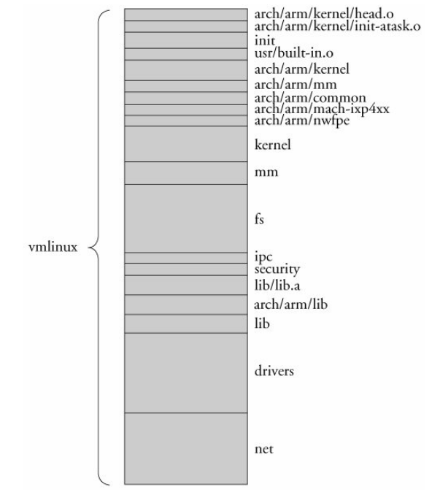
Building Kernel
vmlinux image components

Slide 14
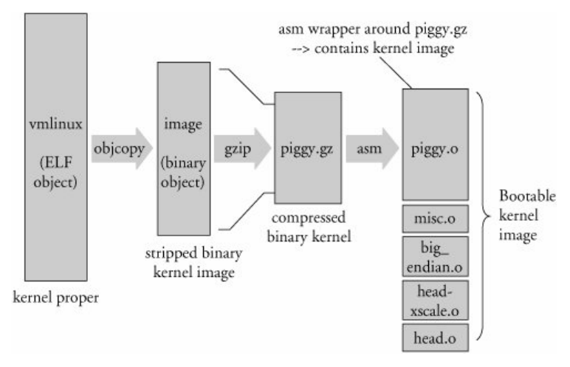
Building Kernel
zImage – bootable kernel image preparation

Slide 15
Building root filesystem
Minimum set of directories:
/dev -- Device files, required to perform I/O
/proc -- Directory stub required by the proc filesystem
/etc -- System configuration files
/bin -- Essential binaries considered part of the system
/lib -- Shared libraries to provide run-time support
/mnt -- A mount point for maintenance on other disks
/usr -- Additional utilities and applications
Basic set of utilities: sh, ls, cp, mv (Busybox)
Minimum set of config files: rc, inittab, fstab, etc.,
Devices: /dev/hd*, /dev/tty*, /dev/fd0, etc.,
Runtime library to provide basic functions used by utilities.

Slide 16
Building root filesystem
For Fujitsu build system:
make rootfs
make rootfs-full
Run make SHELL="sh -x" rootfs to know the details.
Manual rootfs creation example
1. dd if=/dev/zero of=DEVICE bs=1k count=4096
2. mke2fs -m 0 -N 2000 DEVICE
3. mount -t ext2 DEVICE /mnt
4. Create directories and populate them
/dev -- Device files, required to perform I/O
/proc -- Directory stub required by the proc filesystem
/etc -- System configuration files
/bin -- Essential binaries considered part of the system
/lib -- Shared libraries to provide run-time support
/mnt -- A mount point for maintenance on other disks
/usr -- Additional utilities and applications
5. umount /mnt
6. dd if=DEVICE bs=1k | gzip -v9 > rootfs.gz
More: http://www.ibm.com/developerworks/library/l-initrd/

Slide 17
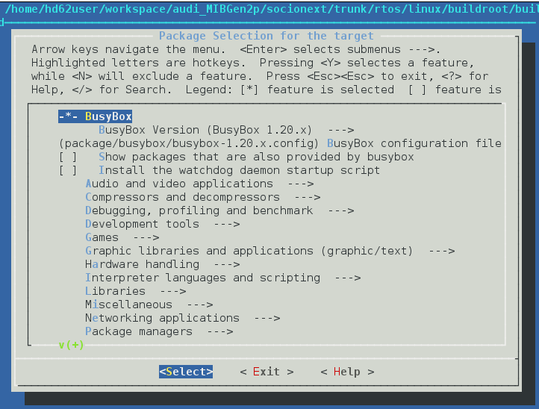
Building root filesystem
Tools for generating root filesystem.
Buildroot https://buildroot.org/

Slide 18
Kernel booting
Bootloader
U-Boot
http://www.denx.de/wiki/view/DULG/UBoot
U-Boot implements tftp command to download the kernel and filesystem (in case of ramdisk) images to SDRAM. You can then choose to directly boot the newly downloaded images or write them to non-volatile memory using U-Boot commands and then copy the the images to SDRAM from this memory for subsequent boots.

Slide 19
Kernel booting
Boot Sequence
RAM
NOR Flash
ATAGS
U-Boot
Linux Kernel (zImage)
RootFS (rootfs.cpio.gz)

Slide 20
Kernel booting
Boot Sequence
RAM
U-Boot
By Hardware Microprogram
NOR Flash
ATAGS
U-Boot
Linux Kernel (zImage)
RootFS (rootfs.cpio.gz)

Slide 21
Kernel booting
Boot Sequence
Boot Sequence
RAM
ATAGS
U-Boot
Linux Kernel (zImage)
RootFS (rootfs.cpio.gz)
By U-Boot
NOR Flash
ATAGS
U-Boot
Linux Kernel (zImage)
RootFS (rootfs.cpio.gz)

Slide 22
Kernel booting
Boot Sequence
Boot Sequence
Boot Sequence
Uncompress and mount by Linux Kernel
RAM
ATAGS
Linux Kernel
RootFS
Linux Kernel (zImage)
RootFS (rootfs.cpio.gz)
Uncompressed by itself
NOR Flash
ATAGS
U-Boot
Linux Kernel (zImage)
RootFS (rootfs.cpio.gz)

Slide 23
Kernel booting
Boot Sequence
Boot Sequence
Boot Sequence
RAM
User Space
Linux Kernel
RootFS
Services and applications (hcc_app)
NOR Flash
ATAGS
U-Boot
Linux Kernel (zImage)
RootFS (rootfs.cpio.gz)

Slide 24
Kernel booting
zImage decompression
arch/arm/boot/compressed/head.S: start
ARM-specific kernel code
arch/arm/kernel/head.S: stext
Processor-independent kernel code (first C-function)
init/main.c: start_kernel

Slide 25
Kernel booting
Initrd load and mount
init/main.c:kernel_init
init/do_mounts.c:prepare_namespace
…
lib/inflate.c:gunzip
init/init_post
init/main.c:run_init_process
if (execute_command) {
run_init_process(execute_command);
printk(KERN_WARNING "Failed to execute %s. Attempting "
"defaults...\n", execute_command);
}
run_init_process("/sbin/init");
run_init_process("/etc/init");
run_init_process("/bin/init");
run_init_process("/bin/sh");

Slide 26
Kernel booting
Busybox init
ext/fujitsu/external/fujitsu/rtos/linux/buildroot/buildroot-2012.08/output/build/busybox-1.20.2/init/init.c
/* Default sysinit script. */
#ifndef INIT_SCRIPT
#define INIT_SCRIPT "/etc/init.d/rcS"
#endif
…
new_init_action(ASKFIRST, bb_default_login_shell, "");
//TODO: VC_1 instead of ""? "" is console -> ctty problems -> angry users
new_init_action(ASKFIRST, bb_default_login_shell, VC_2);
new_init_action(ASKFIRST, bb_default_login_shell, VC_3);
new_init_action(ASKFIRST, bb_default_login_shell, VC_4);
/* sysinit */
new_init_action(SYSINIT, INIT_SCRIPT, "");
return;
}

Slide 27
Kernel booting
Start scripts
ext/fujitsu/external/fujitsu/rtos/linux/buildroot/rootfs/directories/etc/init.d/rcS
SCRIPT_LIST_NORMAL=`echo /etc/init.d/S??*`
…
SCRIPT_LIST="${SCRIPT_LIST_NORMAL}"
…
for script in ${SCRIPT_LIST}
do
# ignore dangling symlinks (if any).
[ ! -f "${script}" ] && continue
# ignore non executable scripts (if any).
[ ! -x "${script}" ] && continue
status=0
echo "executing \"${script} ${SCRIPT_ARGUMENT}\""
# ( trap - INT QUIT TSTP; set ${SCRIPT_ARGUMENT}; . ${script} )
${script} ${SCRIPT_ARGUMENT}

Slide 28
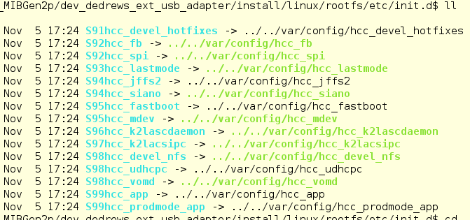
Kernel booting
Scripts to start

Slide 29
Kernel booting
Additional reading:
Chistopher Hallinan “Embedded Linux Primer”
http://www.mosaic-industries.com/embedded-systems/_media/pdfs/white-papers/embedded-linux-primer.pdf

Slide 30
Home work
1. Get Linux Kernel source code for TP-Link TL-MR3020
https://wiki.openwrt.org/toh/tp-link/tl-mr3020
2. Get examples for the book Linux Device Drivers 3.
https://github.com/duxing2007/ldd3-examples-3.x
3. Add “misc-modules” to TP-Link TL-MR3020’s kernel drivers directory “src/drivers”.
4. Modify Kernel build system so that after running commands
make kernel_menuconfig
make
It would be possible to add drivers from misc-modules to vmlinux.

Slide 31
Thank you!

