Slide 1
Debug Techniques
Pitfalls from Experience
Debug support in Kernel
printk
/proc filesystem
ioctl method
Debugging by watching (strace)
Oops messages
Asserting bugs and dumping information
Postmortem core dump analysis with GDB

Slide 2
Pitfalls from Experience
C language syntax pitfalls
Remember about concurrency, kernel code is preemptive.
Beware NULL or garbage pointers
Zero-out memory before using
Do not re-invent the wheel, use functions already available (e.g. linked list, strings)
Beware of any warnings in compilation
Minimize complexity

Slide 3
Debugging Support in the Kernel
CONFIG_DEBUG_KERNEL
This option just makes other debugging options available; it should be turned on but does not, by itself, enable any features.
CONFIG_DEBUG_INFO
This option causes the kernel to be built with full debugging information included. You’ll need that information if you want to debug the kernel with gdb..

Slide 4
Debugging Support in the Kernel
CONFIG_DEBUG_SLAB
Each byte of allocated memory is set to 0xa5 before being handed to the caller and then set to 0x6b when it is freed.
CONFIG_DEBUG_SPINLOCK
With this option enabled, the kernel catches operations on uninitialized spinlocks and various other errors (such as unlocking a lock twice).

Slide 5
Debugging Support in the Kernel
CONFIG_DEBUG_KMEMLEAK has to be enabled.
A kernel thread scans the memory every 10 minutes (by default) and prints the number of new unreferenced objects found. To display the details of all the possible memory leaks:
# mount -t debugfs nodev /sys/kernel/debug/
# cat /sys/kernel/debug/kmemleak
To trigger an intermediate memory scan:
# echo scan > /sys/kernel/debug/kmemleak
To clear the list of all current possible memory leaks:
# echo clear > /sys/kernel/debug/kmemleak

Slide 6
Debugging Support in the Kernel
CONFIG_DEBUG_DRIVER
Under “Device drivers.” Turns on debugging information in the driver core, which can be useful for tracking down problems in the low-level support code.
etc…

Slide 7
printk (vs. printf)
Lets one classify messages according to their priority by associating with different loglevels
printk(KERN_DEBUG “Here I am: %s:%i\n”, __FILE__, __LINE__);
Eight possible loglevels (0 - 7), defined in <linux/kernel.h>

Slide 8
printk (vs. printf)
KERN_EMERG
For emergency messages
KERN_ALERT
For a situation requiring immediate action
KERN_CRIT
Critical conditions, related to serious hardware or software failures
KERN_ERR
Used to report error conditions; device drivers often use it to report hardware difficulties
KERN_WARNING
Warnings for less serious problems

Slide 9
printk (vs. printf)
KERN_NOTICE
Normal situations worthy of note (e.g., security-related)
KERN_INFO
Informational messages
KERN_DEBUG
Used for debugging messages

Slide 10
printk (vs. printf)
Without specified priority
DEFAULT_MESSAGE_LOGLEVEL = KERNEL_WARNING
console_loglevel initialized to DEFAULT_CONSOLE_LOGLEVEL
If current priority < console_loglevel message is printed to the console one line at a time

Slide 11
printk (vs. printf)
console_loglevel can be modified using /proc/sys/kernel/printk
Contains 4 values
Current loglevel
Default log level
Minimum allowed loglevel
Boot-timed default loglevel
echo 6 > /proc/sys/kernel/printk

Slide 12
printk (vs. printf)
printk writes messages into a circular buffer that is __LOG_BUF_LEN bytes
If the buffer fills up, printk wraps around and overwrite the beginning of the buffer
Cyclic buffer length:
#define CONFIG_LOG_BUF_SHIFT 17
#define __LOG_BUF_LEN (1 << CONFIG_LOG_BUF_SHIFT) = 128Kb
Can specify the –f <file> option to klogd to save messages to a specific file

Slide 13
printk (vs. printf)
Get the data from cyclic buffer:
syslog system call
Userspace command
dmesg
If both klogd and syslogd are running messages are appended to /var/log/messages
klog daemon doesn’t save consecutive identical lines, only the first line + the number of repetitions
Data path:
/proc/kmsg > klogd > syslogd > /var/log/messages

Slide 14
printk (vs. printf)
Too many messages may overwhelm the console
To reduce repeated messages, use
int printk_ratelimit(void);
Example
if (printk_ratelimit()) {
printk(KERN_NOTICE “kernel notice!”);
}

Slide 15
printk (vs. printf)
To modify the behavior of printk_ratelimit
/proc/sys/kernel/printk_ratelimit
Number of seconds before re-enabling messages
/proc/sys/kernel/printk_ratelimit_burst
Number of messages accepted before rate limiting

Slide 16
Using the /proc filesystem
Exports Kernel information
Example:
/proc/modules which provides the list of modules
/proc/meminfo stats memory usage statistics
/proc/cpuinfo number, type and other information about CPU cores.

Slide 17
Add support for /proc fs to the module
a proc_dir_entry structure is created with all the information needed for the /proc file, including pointers to any handler functions (in our case there is only one, the one called when somebody attempts to read from the /proc file).
Then init_module registers the structure with the kernel and cleanup_module unregisters it.

Slide 18
Add support for /proc fs to the module
struct proc_dir_entry {
unsigned short low_ino;
unsigned short namelen;
const char *name;
mode_t mode;
nlink_t nlink;
uid_t uid;
gid_t gid;
unsigned long size;
struct inode_operations * proc_iops;
struct file_operations * proc_fops;
get_info_t *get_info;
struct proc_dir_entry *next, *parent, *subdir;
void *data;
read_proc_t *read_proc; - Read handler of the proc file.
write_proc_t *write_proc;
atomic_t count; /* use count */
int deleted; /* delete flag */
kdev_t rdev;
};

Slide 19
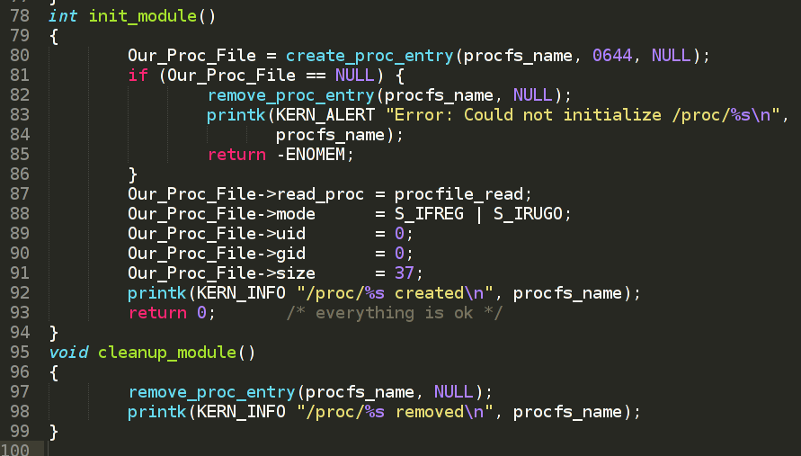
Add support for /proc fs to the module

Slide 20
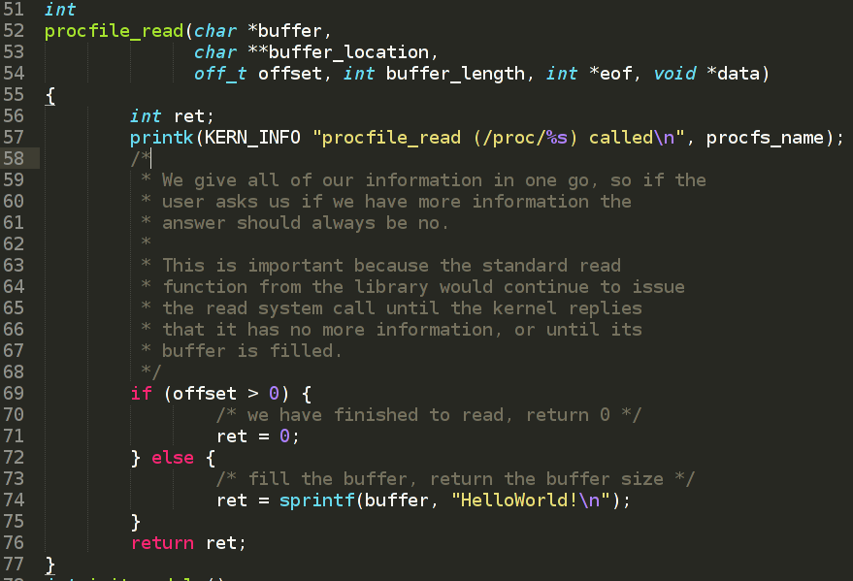
Add support for /proc fs to the module

Slide 21
Add support for /proc fs to the module
Write to /proc file
copy_from_user — Copy a block of data from user space.
unsigned long copy_from_user (void * to, const void __user * from, unsigned long n);
Arguments
to - Destination address, in kernel space.
from - Source address, in user space.
n - Number of bytes to copy.

Slide 22
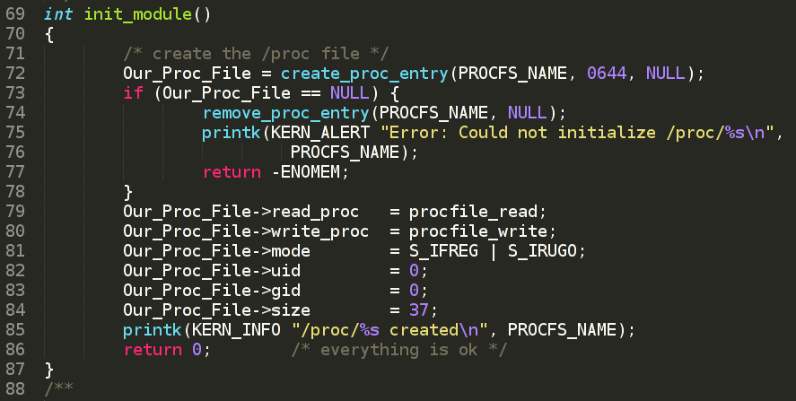
Add support for /proc fs to the module

Slide 23
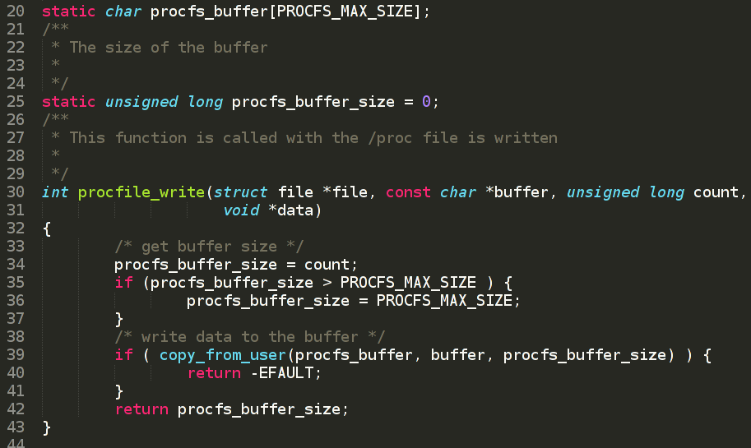
Add support for /proc fs to the module

Slide 24
The ioctl method
Implement additional commands to return debugging information
Advantages
Faster than reading /proc file.
Can be left in the driver unnoticed
Drawbacks
Requires additional userspace application to issue ioctl syscall and parse the response.

Slide 25
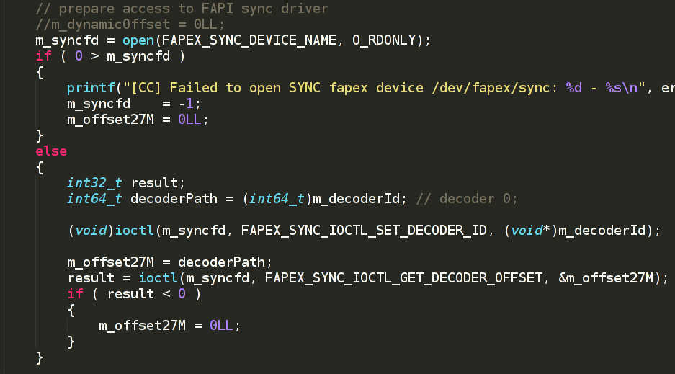
The ioctl method (userspace code)

Slide 26
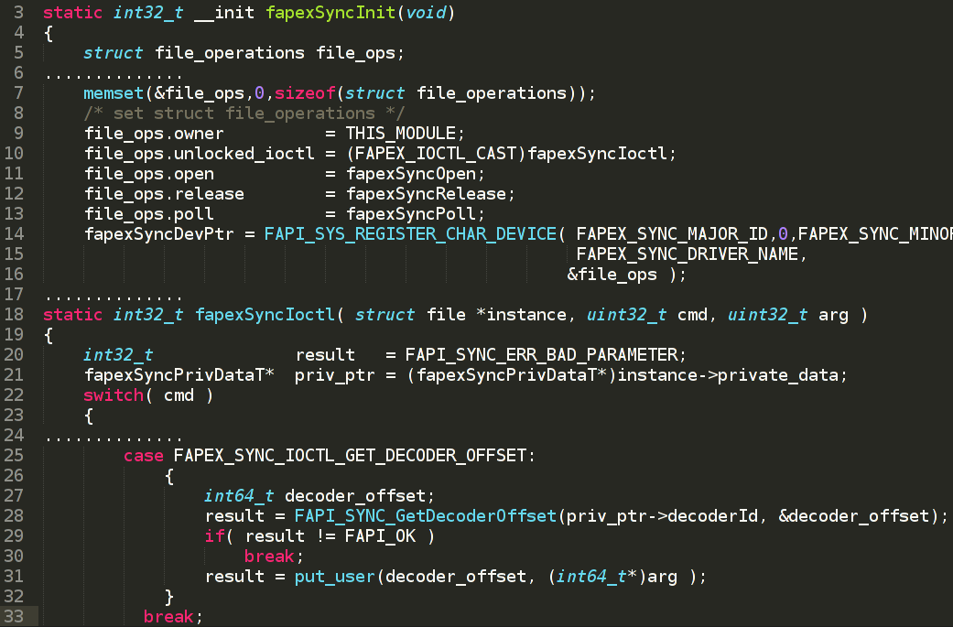
The ioctl method (Kernel code)

Slide 27
Debugging by watching
strace command
Shows system calls, arguments, and return values
No need to compile a program with the –g option
-t to display when each call is executed
-T to display the time spent in the call
-e to limit the types of calls
-o to redirect the output to a file

Slide 28
Debugging by watching
# strace console -o
execve("/usr/local/bin/console", ["console", "-o"], [/* 17 vars */]) = 0
stat("/etc/ld.so.cache", {st_mode=S_IFREG|0644, st_size=2753, ...}) = 0
open("/etc/ld.so.cache", O_RDONLY|O_CLOEXEC) = 3
open("/usr/local/lib/libpthread.so.0", O_RDONLY) = -1 ENOENT (No such file or directory)
open("/lib/libpthread.so.0", O_RDONLY) = 3
....
open("/tmp/testTS.ts", O_RDONLY|O_LARGEFILE) = 3
....
open("/dev/cimax0", O_RDWR|O_LARGEFILE) = 4
....
ioctl(4, CHIOGPARAMS, 0x7ef4fab8) = 0

Slide 29
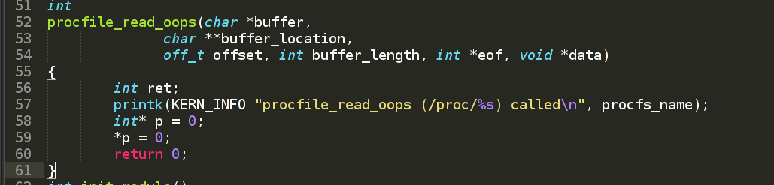
Oops messages
Dereferencing invalid pointers often results in oops messages

Slide 30
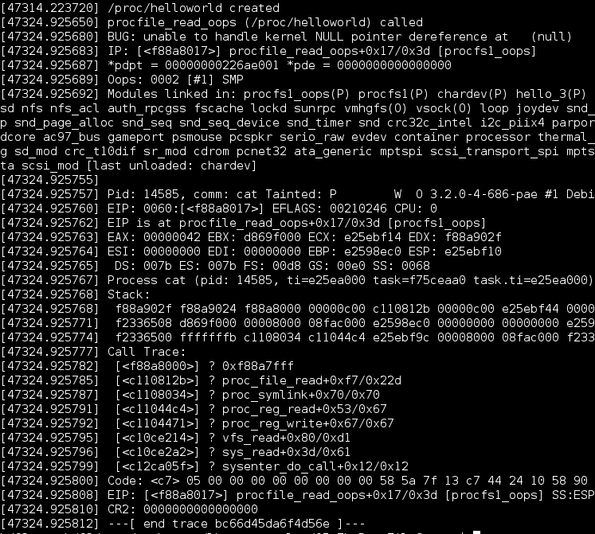
Oops messages
Error message
Call stack
Function name, kernel module name

Slide 31
Asserting bugs and dumping information
BUG() and BUG_ON(conditional)
Cause an oops, which results in a stack trace and an error message
panic()
Causes an oops and halts the kernel
if (terrible_thing)
panic(“terrible_thing is %ld!\n”, terrible_thing);

Slide 32
Core dump analysis with GDB
1. Enable core dump creation:
# ulimit -c unlimited
2. Copy core dump to your PC
3. Run GDB:
./arm-fujitsu-linux-uclibcgnueabi-gdb /home/hd62user/…/hcc_app
--core=/home/hd62user/…/your_core_dump.core

Slide 33
Core dump analysis with GDB
bt
Backtrace: display the thread stack.
thread apply all bt
Backtrace: display the all threads’ stacks.
info register
Reristers content
info sharedlibrary
Show .so libraries used.
p VAR
Print variable

Slide 34
Homework
Read http://www.tldp.org/LDP/lkmpg/2.6/lkmpg.pdf get examples from https://github.com/hamjam/lkmpg-examples
Learn how to manage /proc file with standard filesystem and with seq_file.
Add support to “chardev.c” for writing. Currently there is a stub:
static ssize_t device_write(struct file *filp, const char *buff, size_t len, loff_t * off)
{
printk("<1>Sorry, this operation isn't supported.\n");
return -EINVAL;
}
Add to support “chardev.c” for /proc file so that it could be possible to read from /proc/chardev the last value written to /dev/chardev
Example:
$ echo 123 > /dev/chardev
$ cat /proc/chardev
$ 123

Slide 35
Thank you!

