Slide 1
Concurrency and race conditions p.1
Overview
Semaphores and Mutexes
Reader/Writer Semaphores
Completions

Slide 2
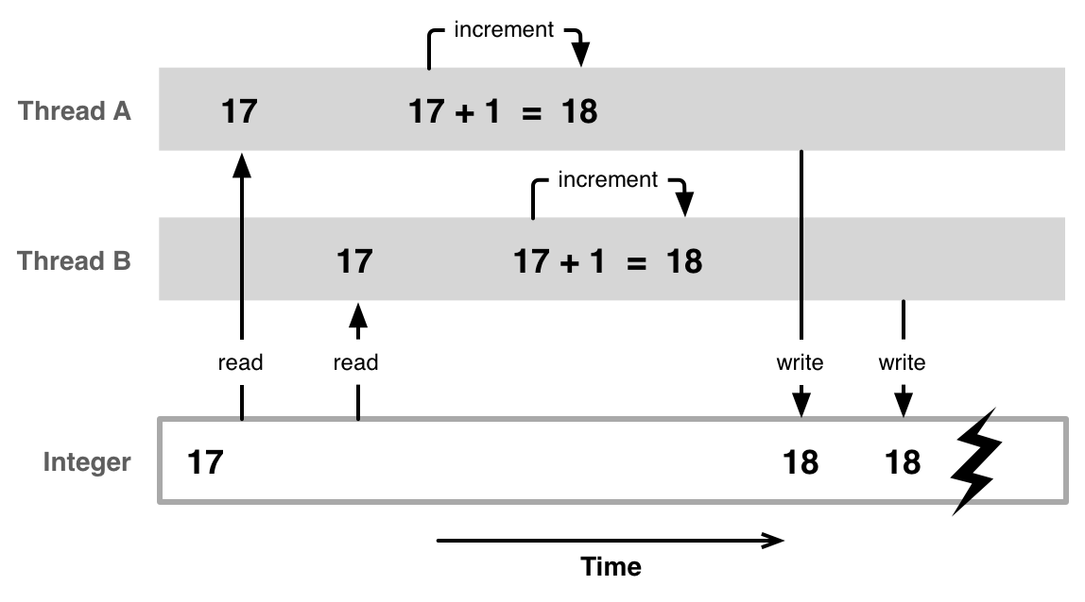
Overview
Race condition

Slide 3
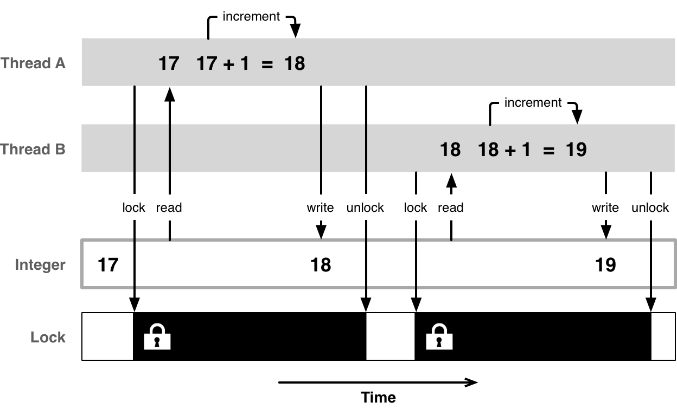
Overview
Mutual exclusive access

Slide 4
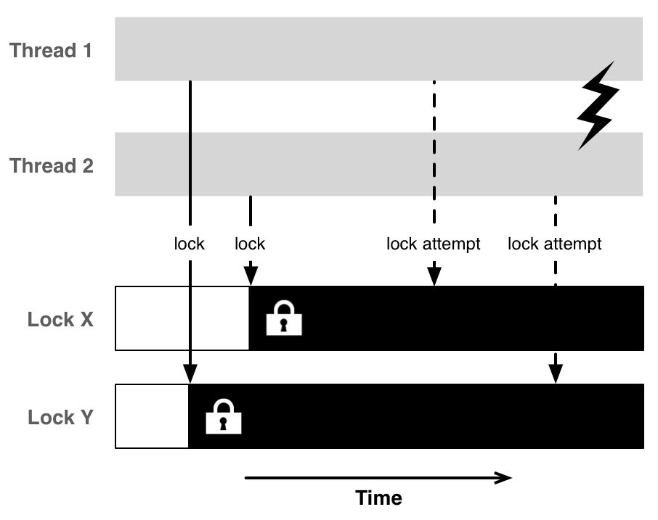
Overview
Dead lock

Slide 5
Semaphores and Mutexes
#include <linux/semaphore.h>
Static declaration
DEFINE_SEMAPHORE(name);
DEFINE_MUTEX(name);
These are macros:
#define DEFINE_SEMAPHORE(name) \
struct semaphore name = __SEMAPHORE_INITIALIZER(name, 1)
#define DEFINE_MUTEX(mutexname) \
struct mutex mutexname = __MUTEX_INITIALIZER(mutexname)

Slide 6
Semaphores and Mutexes
#include <linux/semaphore.h>
Runtime initialization
void sema_init(struct semaphore *sem, int val);
void mutex_init(struct mutex *mutex);
These are functions.
initialize already allocated mutex/semaphore. It is used for per-object mutexes/semaphores, when it is just a field in a heap-allocated object.

Slide 7
Semaphores and Mutexes
Enter critical section:
int down_interruptible(struct semaphore *sem);
void down(struct semaphore *sem);
int down_trylock(struct semaphore *sem);
Exit critical section:
void up(struct semaphore *sem);

Slide 8
Semaphores and Mutexes
Enter critical section:
int down_interruptible(struct semaphore *sem);
void down(struct semaphore *sem);
int down_trylock(struct semaphore *sem);
Exit critical section:
void up(struct semaphore *sem);
Remember error paths!!!

Slide 9
Semaphores and Mutexes
Enter critical section:
int mutex_lock_interruptible(struct mutex *lock);
void mutex_lock(struct mutex *lock);
int mutex_trylock (struct mutex *lock);
Exit critical section:
void mutex_unlock(struct mutex *lock);

Slide 10
Semaphores and Mutexes
Enter critical section:
int mutex_lock_interruptible(struct mutex *lock);
void mutex_lock(struct mutex *lock);
int mutex_trylock (struct mutex *lock);
Exit critical section:
void mutex_unlock(struct mutex *lock);
Remember error paths!!!

Slide 11
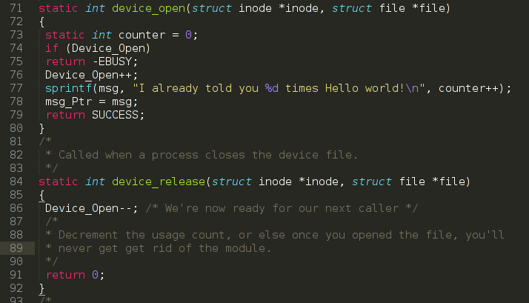
Add Mutex to Chardev.c
In current implementation the driver returns –EBUSY error if device is already open

Slide 12
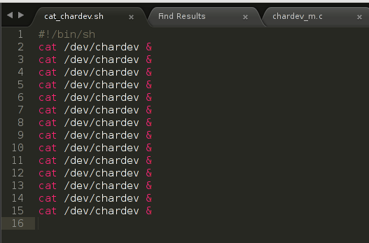
Add Mutex to Chardev.c
Test script

Slide 13
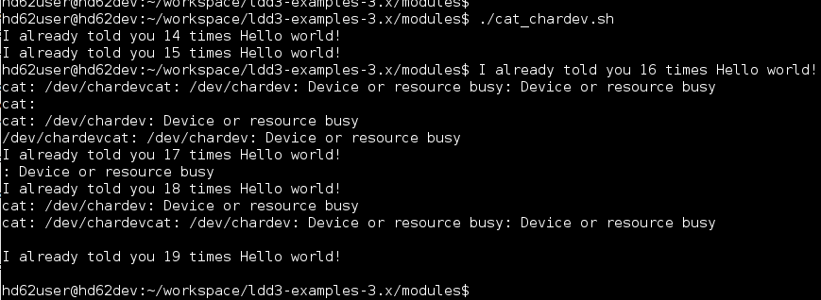
Add Mutex to Chardev.c
“Device or resource busy” errors observed!

Slide 14
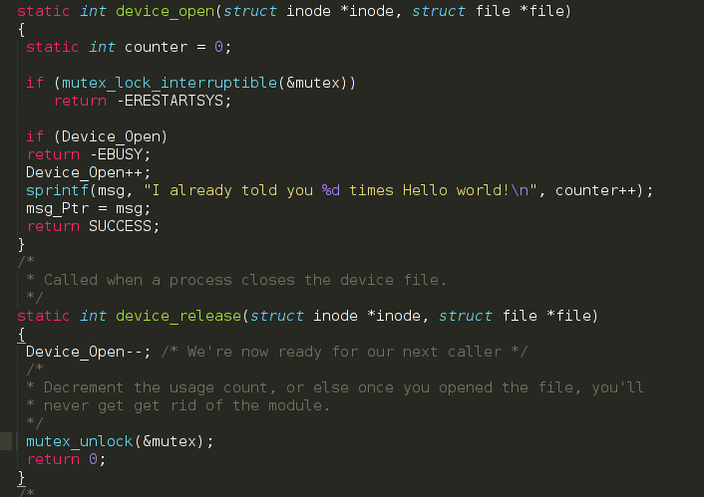
Add Mutex to Chardev.c

Slide 15
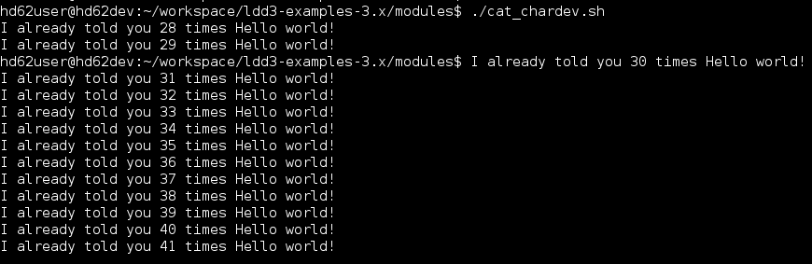
Add Mutex to Chardev.c
No error is returned!

Slide 16
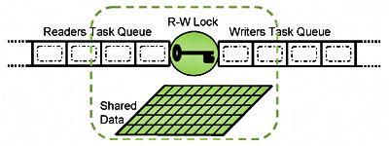
Reader/Writer Semaphores
An rwsem allows either one writer OR an unlimited number of readers to hold the semaphore.

Slide 17


Reader/Writer Semaphores
No writers – all readers get access immediately.
Writers get priority.

Slide 18
Reader/Writer Semaphores
#include <linux/rwsem.h>
void init_rwsem (struct rw_semaphore *sem);
The interface for code needing read-only access is:
void down_read (struct rw_semaphore *sem);
int down_read_trylock (struct rw_semaphore *sem);
void up_read (struct rw_semaphore *sem);

Slide 19
Reader/Writer Semaphores
#include <linux/rwsem.h>
void init_rwsem (struct rw_semaphore *sem);
The interface for writers is similar:
void down_write (struct rw_semaphore *sem);
int down_write_trylock (struct rw_semaphore *sem);
void up_write (struct rw_semaphore *sem);

Slide 20
Completions
DEFINE_MUTEX(mutex);
mutex_lock(&mutex);
start_external_task(&mutex);
mutex_lock(&mutex);
External task
<DO THE JOB>
……
mutex_unlock(pMutex);
Not good!!!

Slide 21
Completions
DECLARE_COMPLETION(my_completion);
start_external_task(&my_completion);
wait_for_completion(&my_completion);
External task
<DO THE JOB>
……
complete(pCompletion);
OK!!!

Slide 22
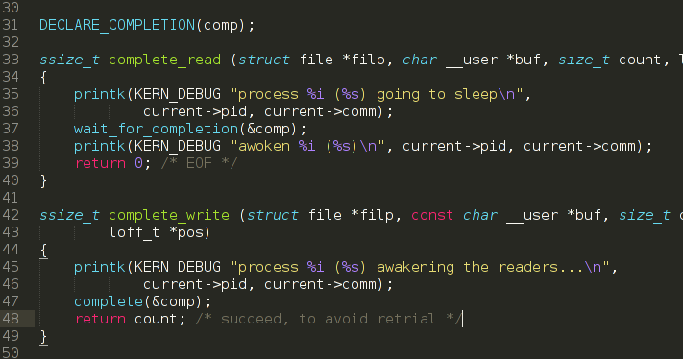
Completions
Check “complete” module behaviour.

Slide 23
Homework
Read LDD3 ch5 https://static.lwn.net/images/pdf/LDD3/ch05.pdf till spinlocks.

Slide 24
Thank you!

