Slide 1
Memory allocation p.1
MMU+Pagetables
kmalloc
vmalloc
get_free_pages and friends.

Slide 2
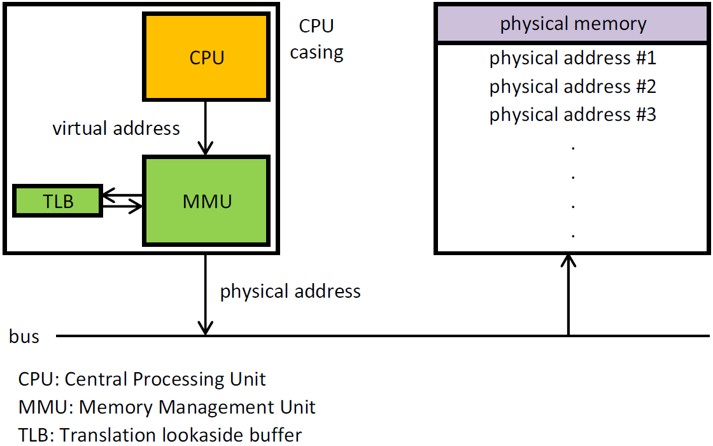
MMU+Pagetables

Slide 3
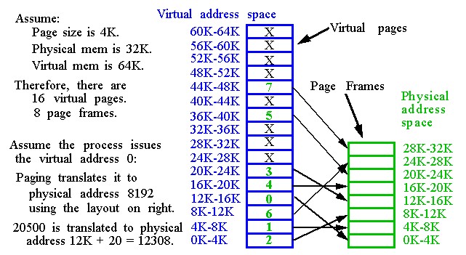
Virtual to physical address
Virtual and physical address space is divided into pages.
Page size is 512 – 64K bytes (4K)
Fragmentation problem is solved.

Slide 4
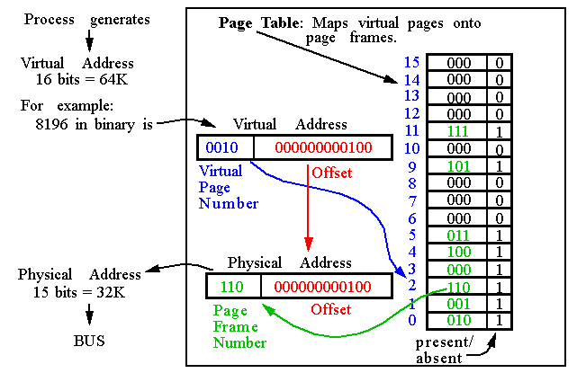
Page tables
Page table is stored in main memory.

Slide 5
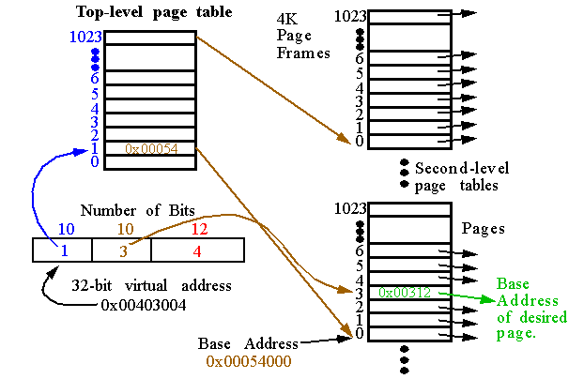
Multi-level page tables
Linux has 3 level page tables.

Slide 6
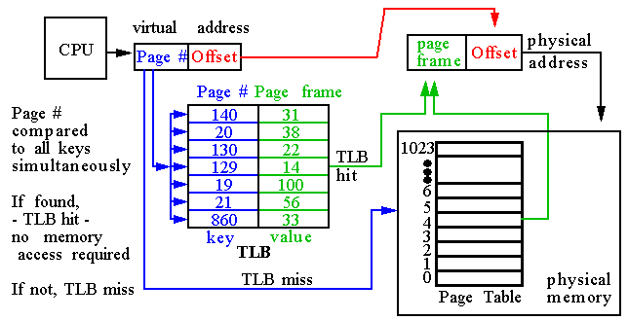
Translation Lookaside Buffers (TLBs)
With two-level paging, one memory reference could require three memory accesses!
In order to reduce the number of times this occurs, a fast lookup table called a TLB is added as a hardware cache in the microprocessor.

Slide 7
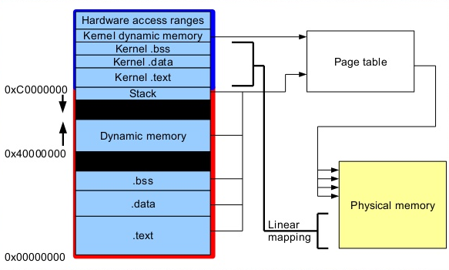
Memory map
Process memory map on typical Linux system

Slide 8
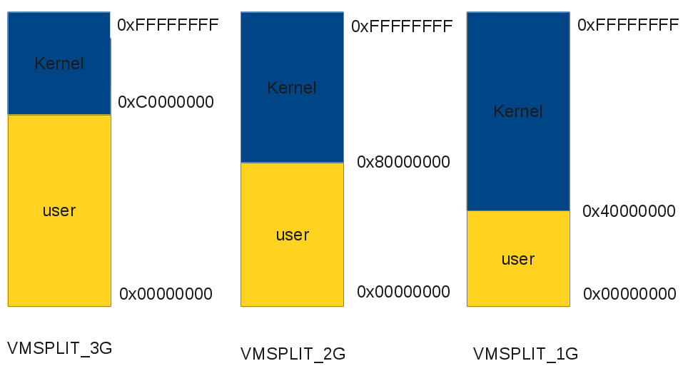
Memory map
Linux virtual address space options

Slide 9
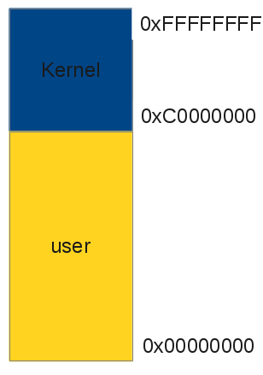
Memory map
256 PD entries Common for ALL Tasks
Other
Kernel Data
1GB
256 PD entries
0x1FFFFFFF
Kernel Space
Real Other Kernel Data
3GB
768 page directory entries
Real Tasks Space
Tasks
Real Other Kernel Data
Real Tasks Space
Real Kernel Space
0x00000000
Physical Memory (512 Mb)
Virtual Memory
Linux virtual address space options

Slide 10
kmalloc
#include <linux/slab.h>
void *kmalloc(size_t size, int flags);
void kfree(const void *ptr)
GFP_ATOMIC
Used to allocate memory from interrupt handlers and other code outside of a
process context. Never sleeps.
GFP_KERNEL
Normal allocation of kernel memory. May sleep.
GFP_DMA
This is an allocation from ZONE_DMA. Device drivers that need DMA-able memory use this flag

Slide 11
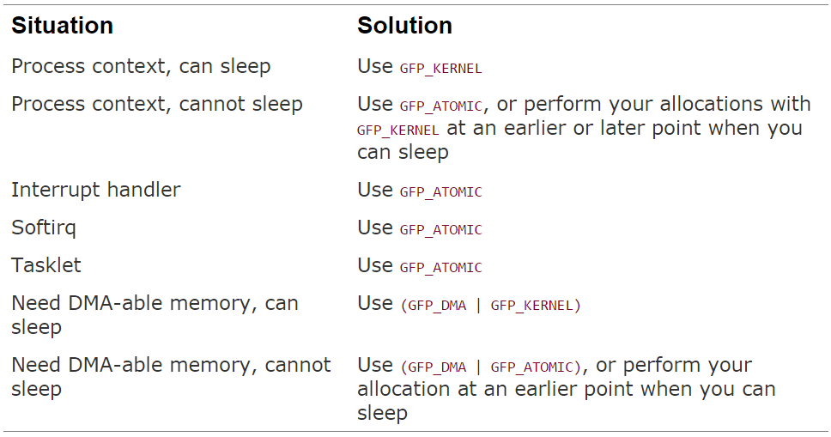
kmalloc

Slide 12
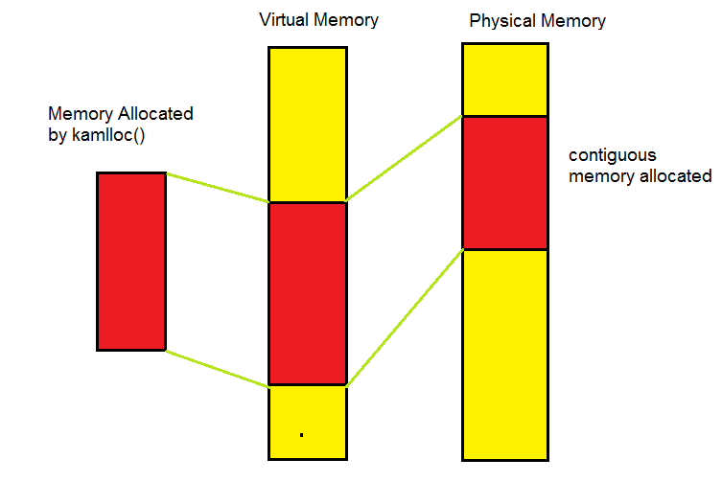
kmalloc
kmalloc allocates contiguous memory in physical memory as well as virtual memory.

Slide 13
kmalloc
Q: Is memory allocated by kmalloc physically contiguous?

Slide 14
kmalloc
Q: Is memory allocated by kmalloc physically contiguous?
A: Yes.

Slide 15
kmalloc
Q: Is memory allocated by kmalloc physically contiguous?
A: Yes.
Q: Is memory allocated by kmalloc page aligned?

Slide 16
kmalloc
Q: Is memory allocated by kmalloc physically contiguous?
A: Yes.
Q: Is memory allocated by kmalloc page aligned?
A: Yes, if you allocate a page or more. (At least in the current implementation.)

Slide 17
kmalloc
Q: Is memory allocated by kmalloc physically contiguous?
A: Yes.
Q: Is memory allocated by kmalloc page aligned?
A: Yes, if you allocate a page or more. (At least in the current implementation.)
Q: How big could be the memory area allocated by kmalloc?

Slide 18
kmalloc
Q: Is memory allocated by kmalloc physically contiguous?
A: Yes.
Q: Is memory allocated by kmalloc page aligned?
A: Yes, if you allocate a page or more. (At least in the current implementation.)
Q: How big could be the memory area allocated by kmalloc?
A: Do not use kmalloc for sizes larger than few Kbytes. Use get_free_page and friends instead.

Slide 19
kmalloc
Q: Are memory addresses returned by kmalloc physical addresses?

Slide 20
kmalloc
Q: Are memory addresses returned by kmalloc physical addresses?
A: No, But the (virtual) address range used by kmalloc features a one-to-one mapping to physical memory, possibly shifted by a constant PAGE_OFFSET value; the functions don’t need to modify the page tables for that address range. Check virt_to_phys and phys_to_virt macro for implementation details on your target platform.

Slide 21
vmalloc
#include <linux/vmalloc.h>
void *vmalloc(unsigned long size);
void vfree(void * addr);
vmalloc() is used only when absolutely necessary. Typically, to obtain very large regions of memory

Slide 22
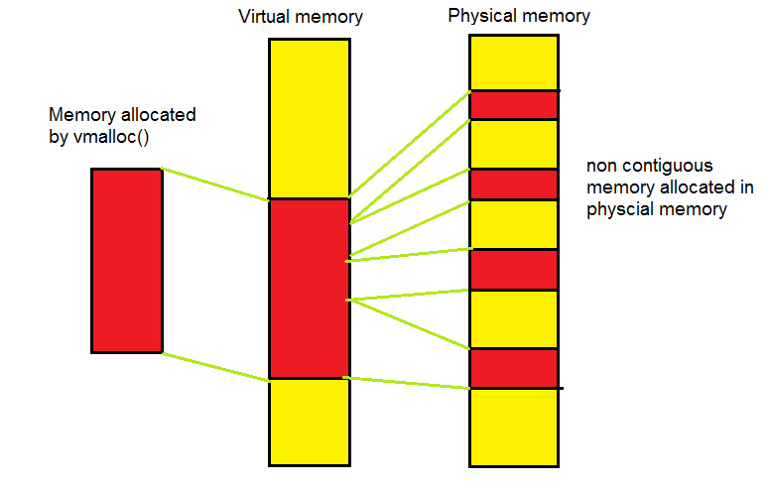
vmalloc
vmalloc() function must specifically set up the page table entries to make non-physically contiguous pages contiguous in the virtual address space.

Slide 23
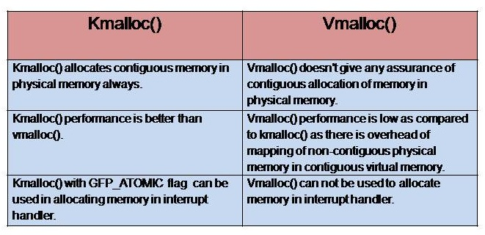
kmalloc vs. vmalloc

Slide 24
get_free_page and friends
get_zeroed_page(unsigned int flags);
Returns a pointer to a new page and fills the page with zeros.
__get_free_page(unsigned int flags);
Similar to get_zeroed_page, but doesn’t clear the page.
__get_free_pages(unsigned int flags, unsigned int order);
Allocates 2^order physically contiguous pages long
E.g. order=0 – one page, order=3 – 8 pages.
The maximum allowed value for order is 10 or 11.
void free_page(unsigned long addr);
void free_pages(unsigned long addr, unsigned long order);

Slide 25
get_free_page and friends
Q: What are the advantages compared to kmalloc?

Slide 26
get_free_page and friends
Q: What are the advantages compared to kmalloc?
A: The performance improvement is not dramatic.
The main advantage of page-level allocation isn’t actually speed, but rather more efficient memory usage.

Slide 27
get_free_page and friends
Q: What are the advantages compared to kmalloc?
A: The performance improvement is not dramatic.
The main advantage of page-level allocation isn’t actually speed, but rather more efficient memory usage.
Q: Could kmalloc or __get_free_pages fail?

Slide 28
get_free_page and friends
Q: What are the advantages compared to kmalloc?
A: The performance improvement is not dramatic.
The main advantage of page-level allocation isn’t actually speed, but rather more efficient memory usage.
Q: Could kmalloc or __get_free_pages fail?
A: The functions can fail to allocate memory in certain circumstances. Although they sometimes fail when there is no available memory, the kernel does its best to fulfill allocation requests. Therefore, it’s easy to degrade system responsiveness by allocating too much memory

Slide 29
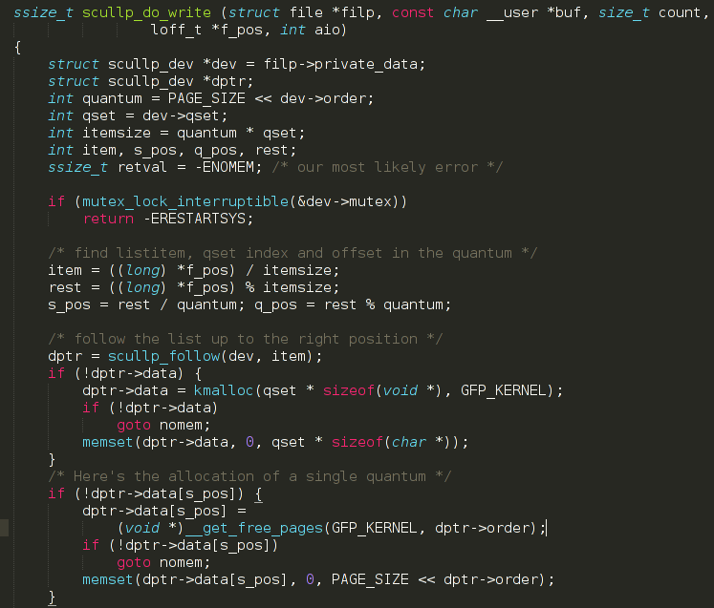
get_free_page and friends

Slide 30
Thank you!

