Slide 1
Device Driver Basics
Kernel Module Concepts
Minimal Module examples
Modules vs Programs
Device Drivers
Major and Minor numbers
Character Device Drivers

Slide 2
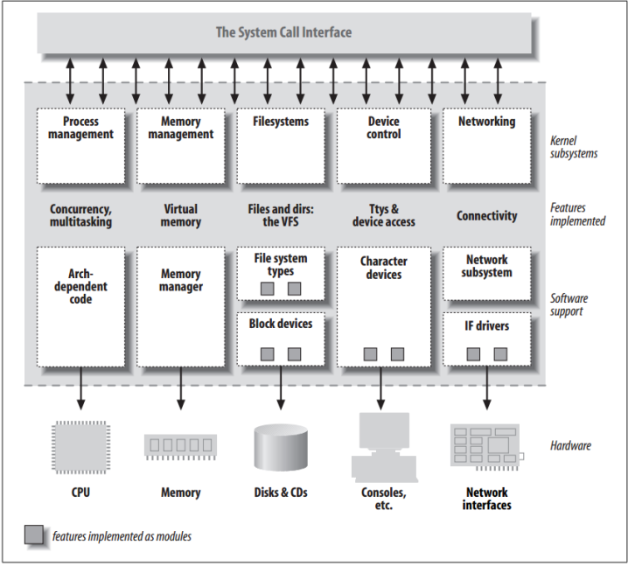
Kernel Modules Concepts
Modules are pieces of code that can be loaded and unloaded into the kernel upon demand.
They extend the functionality of the kernel without the need to reboot the system.

Slide 3
Kernel Modules Concepts
Check the modules already present in the system:
lsmod
it gets its information by reading the file /proc/modules.
$ lsmod
Module Size Used by
hmac 12715 0
nls_utf8 12416 0
cifs 219143 0
bnep 17288 2

Slide 4
Kernel Modules Concepts
Insert module
insmod
or
modprobe
modprobe looks through the file /lib/modules/version/modules.dep, to see if other modules must be loaded before the requested module may be loaded.

Slide 5
Minimal Module
To build kernel modules on Ubuntu (Debian) virtual machine we need to install respective kernel headers first.
sudo apt-get install linux-headers-$(uname -r)

Slide 6
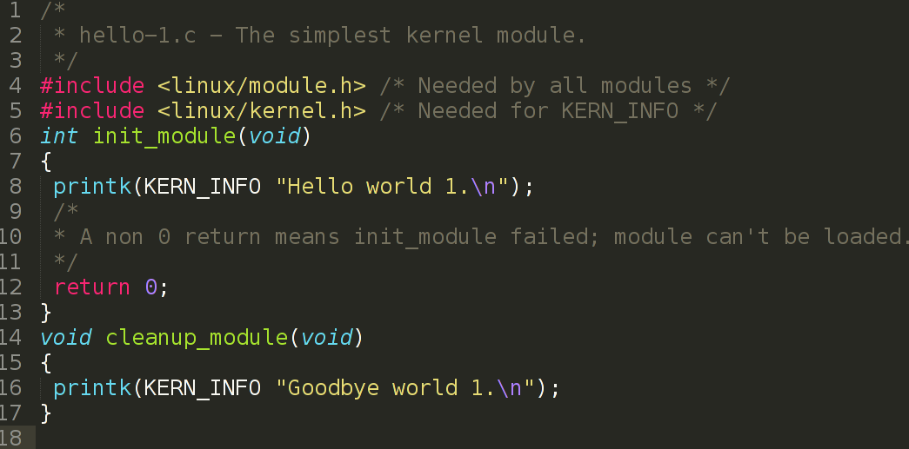
Minimal Module

Slide 7
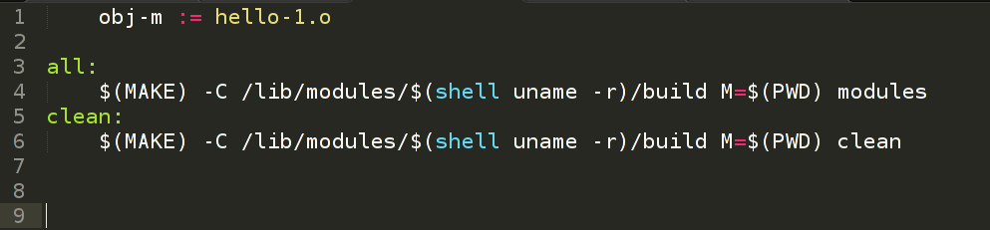
Minimal Module Makefile

Slide 8
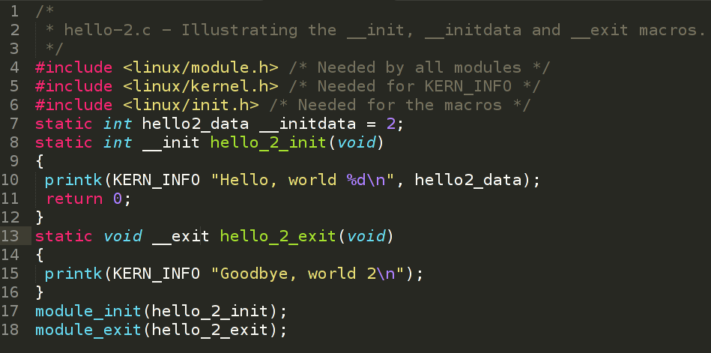
Minimal Module 2
For built−in drivers the __init macro causes the init function to be discarded and its memory freed once the init function finishes the __exit macro causes the omission of the function.
No effect on loadable modules.

Slide 9
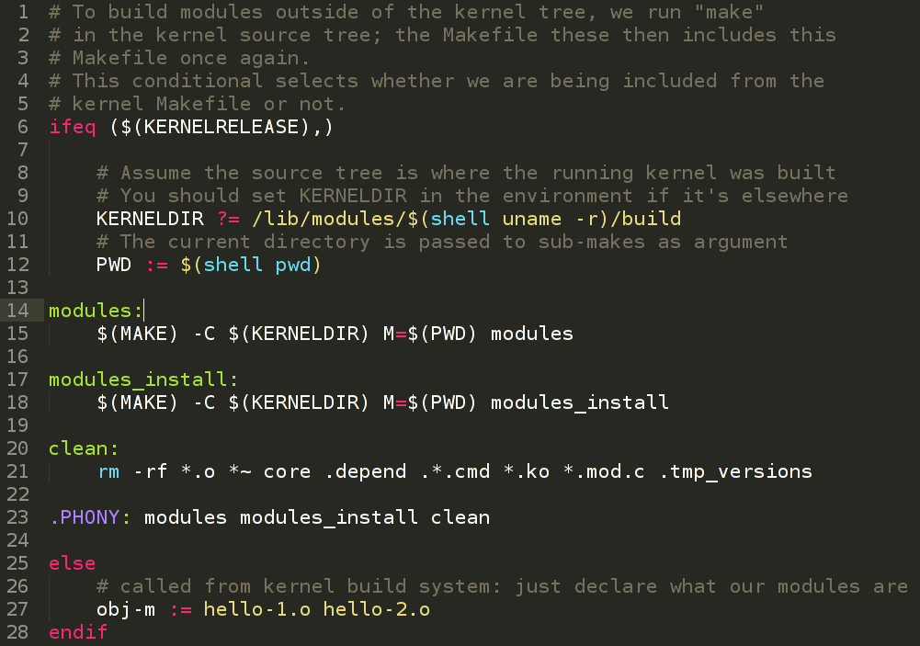
Minimal Module 2 Makefile

Slide 10
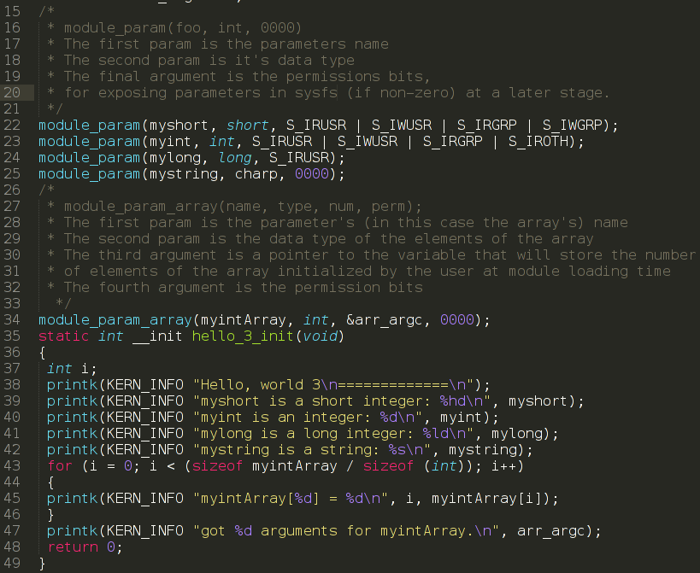
Module Command Line Args
insmod hello-3.ko mystring=“teststring” myshort=256 myint=1024 myintArray=1,2

Slide 11
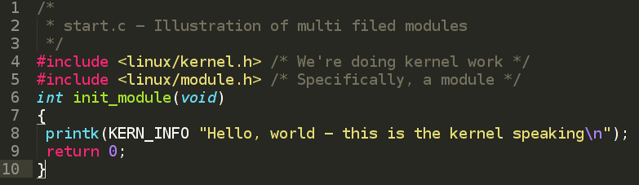
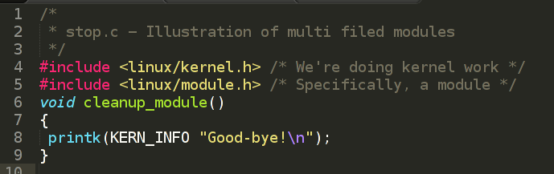
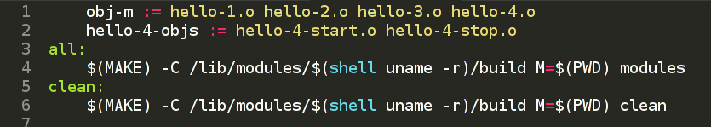
Module Multiple files
Makefile:

Slide 12
Modules vs Programs
Modules are Event-driven
Kernel code executing a system call is working in the context of a process. Kernel code can refer to the current process by accessing the global item current, which yields a pointer to struct task_struct
Keep concurrency in mind, code should be reentrant.
Kernel has a very small stack; it can be as small as a single, 4096-byte page. Kernel driver functions share that stack with the entire kernel-space call chain
No floating point arithmetic
No standard I/O library. Modules are object files whose symbols get resolved upon insmod'ing. The only external functions you can use are the ones provided by the kernel. Check /proc/kallsyms for functions exported by your kernel.
Name space. Declare all your variables as static and to use a well−defined prefix for your symbols. By convention, all kernel prefixes are lowercase. If you don't want to declare everything as static, another option is to declare a symbol table and register it with a kernel.

Slide 13
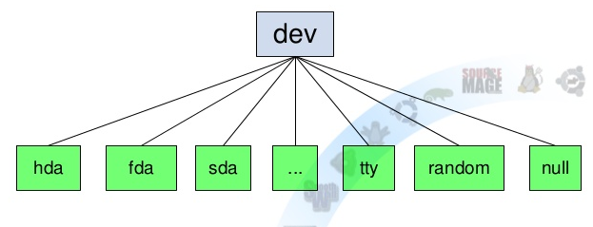
Device Drivers
Class of module which provides functionality for hardware, each piece of hardware is represented by a file located in /dev

Slide 14
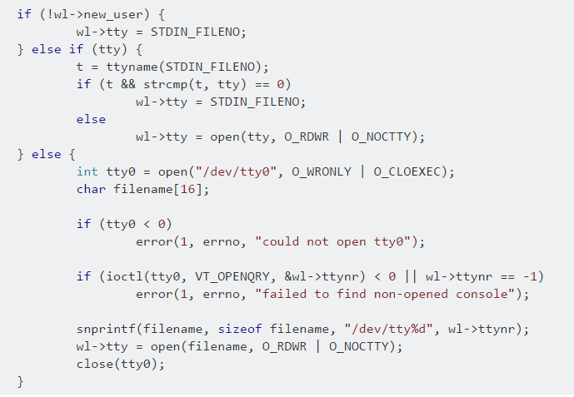
Device Drivers
Class of module which provides functionality for hardware, each piece of hardware is represented by a file located in /dev
Make it transparent for User space application!

Slide 15
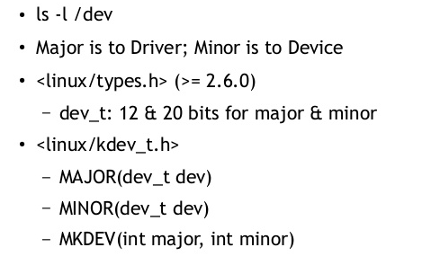
Major and Minor numbers

Slide 16
Major and Minor numbers
ls -lA /dev/tty*
…
crw------- 1 root root 4, 0 Nov 19 16:28 /dev/tty0
crw-rw---- 1 root tty 4, 1 Nov 19 16:28 /dev/tty1
…

Slide 17
Major and Minor numbers
ls -lA /dev/tty*
…
crw------- 1 root root 4, 0 Nov 19 16:28 /dev/tty0
crw-rw---- 1 root tty 4, 1 Nov 19 16:28 /dev/tty1
…
Device node “c” is for “char”

Slide 18
Major and Minor numbers
Major – 4 – tty device driver.
ls -lA /dev/tty*
…
crw------- 1 root root 4, 0 Nov 19 16:28 /dev/tty0
crw-rw---- 1 root tty 4, 1 Nov 19 16:28 /dev/tty1
…
Device node “c” is for “char”

Slide 19
Major and Minor numbers
Major – 4 – tty device driver.
ls -lA /dev/tty*
…
crw------- 1 root root 4, 0 Nov 19 16:28 /dev/tty0
crw-rw---- 1 root tty 4, 1 Nov 19 16:28 /dev/tty1
…
Device node “c” is for “char”
Minor 0, 1 – the number of physical device. Used only by “tty” driver, to distinguish between the different devices of the same type. No other parts of Kernel use Minor numbers.

Slide 20
Major and Minor numbers
All device files are created by the mknod command.
mknod /dev/coffee c 12 2

Slide 21
Major and Minor numbers
All device files are created by the mknod command.
mknod /dev/coffee c 12 2
Device node “c” is for “char”
Major “12”
Minor “2”

Slide 22
Character Device Driver
Fill the file_operation structure.
The file_operations structure is defined in linux/fs.h, and holds pointers to functions defined by the driver that perform various operations on the device.
struct file_operations fops = {
.read = device_read,
.write = device_write,
.open = device_open,
.release = device_release
};

Slide 23
Character Device Driver
Register a Device in Kernel
int register_chrdev(
unsigned int major,
const char *name,
struct file_operations *fops
);

Slide 24
Character Device Driver
Register a Device in Kernel
int register_chrdev(
unsigned int major,
const char *name,
struct file_operations *fops
);
unsigned int major is the major number you want to request,
const char *name is the name of the device as it'll appear in /proc/devices
struct file_operations *fops is a pointer to the file_operations table for your driver.

Slide 25
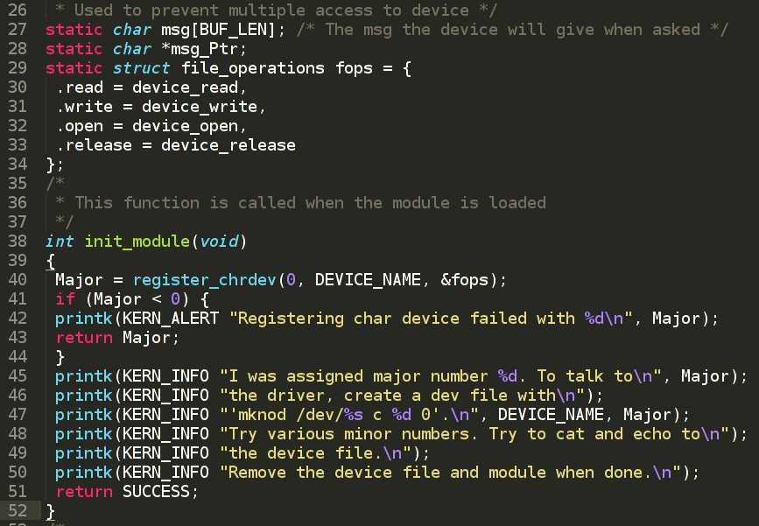
Character Device Driver
Check the chardev.c source code.

Slide 26
Homework
Read about and add to Hello module information:
MODULE_LICENSE("GPL");
MODULE_AUTHOR(DRIVER_AUTHOR);
MODULE_DESCRIPTION(DRIVER_DESC);
MODULE_PARM_DESC(xxx, “yyy");
MODULE_SUPPORTED_DEVICE(“xxx");
2. Learn about Unregistering A Device

Slide 27
Thank you!

