Slide 1
Live Shipment Tracker
Team Optimus
Arnab Paul Choudhury, Mtech IIT Guwahati
Aryan Yadav, Mtech IIT Guwahati
Manas Ranjan Jena, PhD NIT Rourkela

Slide 2
Challenge:
#1
Develop a low-cost light weight tracker with real-time information on High value Items
Key Players and Current scenario:
Third-party Logistic Support
Seller
Customer
location?
High Value Package
E-commerce Marketplace

Slide 3
Problems Faced:
#2
Total dependence on logistic partner for tracking package location
No real-time visibility
Items are sometimes lost in Transit
Some items are marked as “Return to Origin” without attempting delivery
Seller has no idea whom to trust in the case of a dispute

Slide 4
Solution:
#3
The major components of the solution:
Tracking hardware device
Collect location information from satellites/network
Transmit location information
Private and Permissioned Blockchain Network
Ensures immutability of data
Enhanced security
Application Server
Receive data
Visualize data
Process data

Slide 5




Architecture Diagram:
#4
Satellite
GPS/GNSS Module
Server
Application Server
Internet
GPRS/LTEModule
Blockchain network
Client Device Application
Microcontroller
Cloud
Persistence Storage
Legend
Wireless connection
Wired connection
Tracker Device
Connection

Slide 6
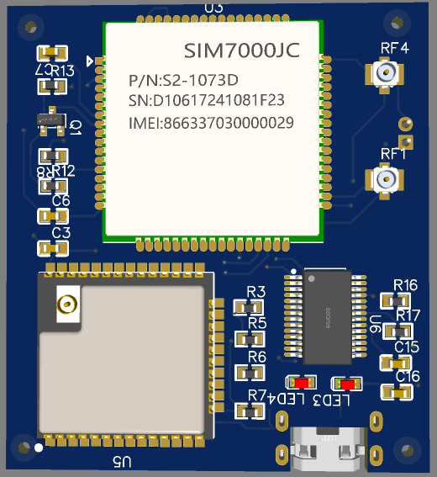
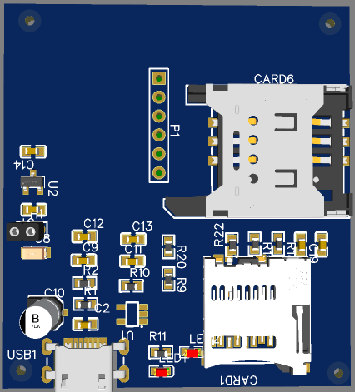
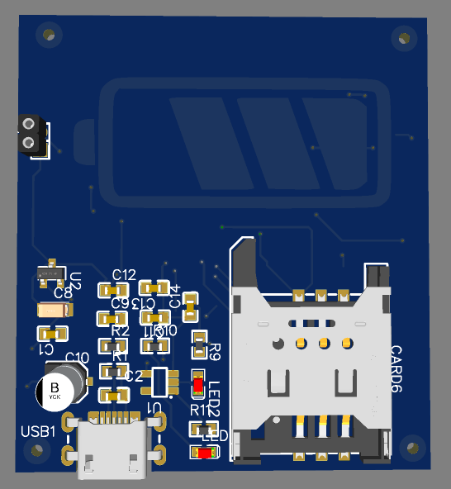
Tracker Device:
5.3 cm
#5
Form factor: 5.3x4.7x3 cm
Lifetime: 1 month
Power source: 2000 mAh batteries
Frequency of Transmission: 1 per 15 minutes
Major Components Used:
SIM7000JC: GPRS/LTE/GPS
ESP-12e: Microcontroller with SPIFFS
SD card (optional, for more persistent storage)
Dual use Antenna for GPS and LTE
Major constraints to form factor and lifetime:
Frequency of transmission
Energy density of Battery
Type of Technology used for Transmission
3 cm
4.7 cm
Fig: Dimensions of tracking device
Fig: PCB with SD card
(bottom view)
Fig: PCB top view
Fig: PCB without SD card (Bottom view)

Slide 7
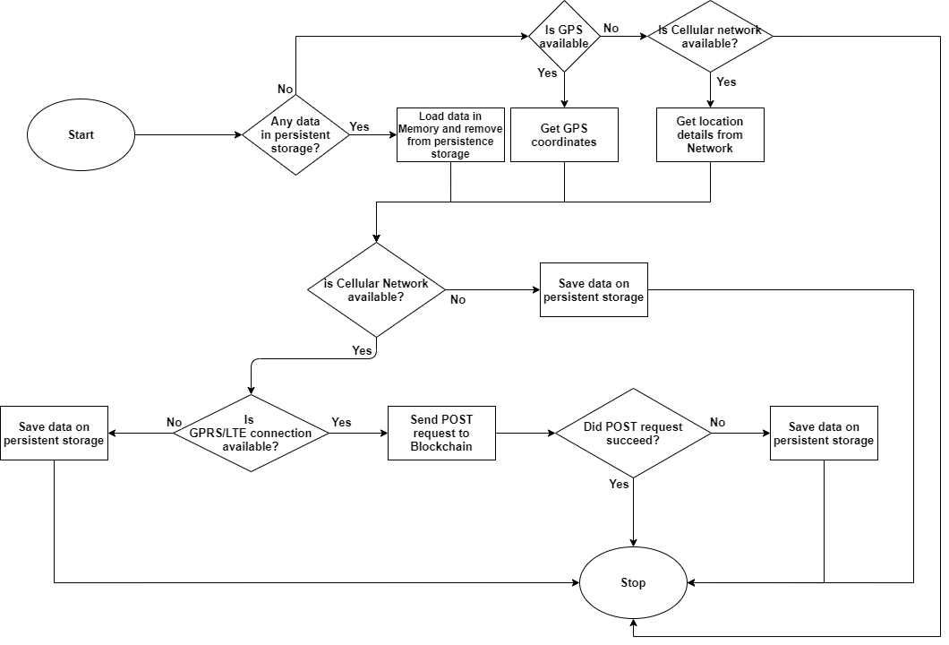
Flowchart:
#6

Slide 8


Blockchain Network:
#7
Type of Blockchain network:
Permissioned Private Blockchain
Benefits:
Immutability
Security
Faster transactions; better performance
Validating peer
Seller
Logistic Partner 1
Customer 1
Logistic Partner 2
Customer 2
Customer 3

Slide 9
Prototype Demonstration:
#10
Components and technologies used:
Tracker:
SIM900A, development board
Internet connectivity(GPRS connection): SIM
Microcontroller: NodeMCU, ESP-12e development board
GPS module: Neo-6m
Server:
Http tunnel for localhost: ngrok
Python flask
Blockchain:
Python
Application Server:
Python Flask
HTML/Css
Javascript
Mapbox
SIM900A development board
NodeMCU
Tracker
Neo-6m GPS Module
SIM
Internet
ngrok
Data Server
Local Machine
Blockchain
Application Server

Slide 10
Estimated Costs:
#9
Per unit Tracker Cost:
Serial No. | Component | Unit cost | Units required | Cost
1 | SIM7000JC | 1500 | 1 | 1200
2 | ESP-12e | 200 | 1 | 200
3 | Battery(2000 mAh) |  |  | 400
4 | Dual Antenna |  |  | 200
5 | Passive elements |  | As per requirement | 100
6 | Active elements |  | As per requirement | 100
7 | Fabrication |  |  | 300
8 | Transistors, USB, regulators and other components |  |  | 300
9 | Tracker frame |  |  | 200
 |  |  | Total | 3000
Data Charges: Depends upon service provider, however it is minimal
Server, Blockchain: multiple low cost and “pay as you go” cloud options available with initial cost almost nil and charges are correlated with the amount of active usage, like API calls etc.
To sum up, the entire solution can be deployed within Rs 4000

Slide 11
Benefits and Advantages:
#10
No human intervention required once embedded in package
Cost effective, small form factor
Blockchain ensures immutability and security
Data is Decentralized, yet private and permissioned
Customer satisfaction

Slide 12
Future Work:
#11
Make use of technologies like Nb-IoT/LoRa/5G
Optimized use of microcontroller
Implement industry grade Blockchain framework like Hyperledger framework etc.
Unique visualization for providing information at a glance.

Slide 13
Questions…

