Slide 1


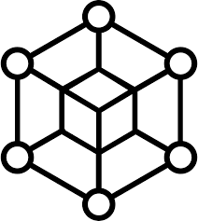

Architecture Diagram:
GPS Satellite
GPS Module
Application Server
Internet
GSM/GPRS Module
Blockchain network
Client Device Application
Microcontroller
Cloud
Persistence Storage
Legend
Wireless connection
Wired connection
Tracker Device
Connection

Slide 2
Data Flow: Case 1 - when Internet connection available
*GPS/location and time data streamed in real time through GPRS/GSM Module in to the blockchain network
GPS Satellite
GPS Module
Application Server
Internet
GSM/GPRS Module
Blockchain network
Client Device Application
Microcontroller
Cloud
Persistence Storage
Legend
Wireless connection
Wired connection
Tracker Device
Connection

Slide 3
Data Flow: Case 2 - when Internet connection not available
*GPS/location and time stored in local persistence storage
GPS Satellite
GPS Module
Application Server
Internet
GSM/GPRS Module
Blockchain network
Client Device Application
Microcontroller
Cloud
Persistence Storage
Legend
Wireless connection
Wired connection
Tracker Device
Connection

Slide 4
Data Flow: Case 2 – After regaining Internet connection
*GPS/location and time data stored in persistence storage is synched back into the blockchain network and subsequently real-time GPS data is streamed thereby maintaining continuity
GPS Satellite
GPS Module
Application Server
Internet
GSM/GPRS Module
Blockchain network
Client Device Application
Microcontroller
Cloud
Persistence Storage
Legend
Wireless connection
Wired connection
Tracker Device
Connection

