Slide 1
Week 1: Lab

Slide 2
PLINK
A software package for manipulating and analyzing processed genome wide SNP data
Can perform quality control, GWAS, population genetics
https://www.cog-genomics.org/plink/
Lindgren et al. 2011

Slide 3
PLINK Input Files
PED file
One sample per row
Contains pedigree and genotype information
MAP file
One SNP per row
Contains information on each SNP
We won’t typically use ped/map files but helpful to get started with the format

Slide 4
PED file
First six fields give pedigree information
Family ID
Individual ID
Paternal ID
Maternal ID
(0=unknown) (0=unknown)
Sex (1=male; 2=female; other=unknown)
Phenotype (0=unknown)
Each subsequent two fields contains the genotype at subsequent SNPs
Missing data indicated by 0 0

Slide 5
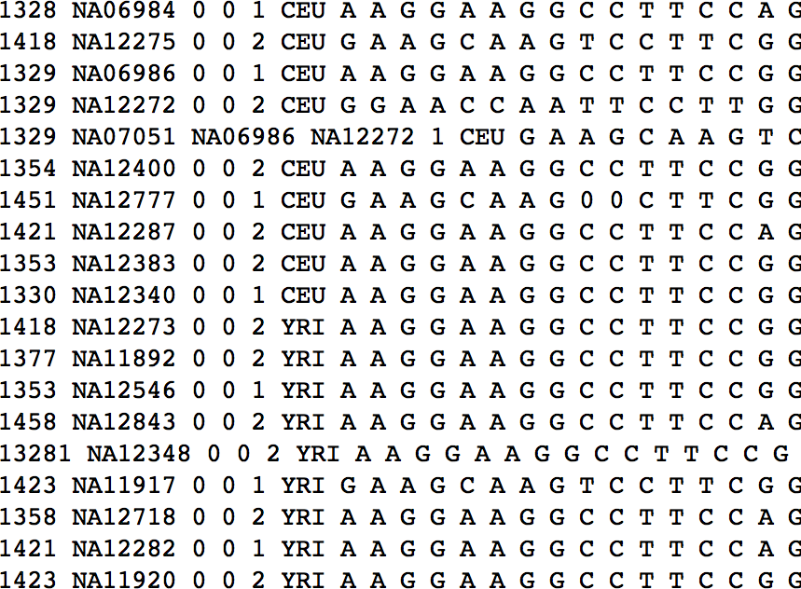

Slide 6
Family ID

Slide 7
Sample name

Slide 8
SAME FAMILY

Slide 9
Sex

Slide 10
Phenotype

Slide 11
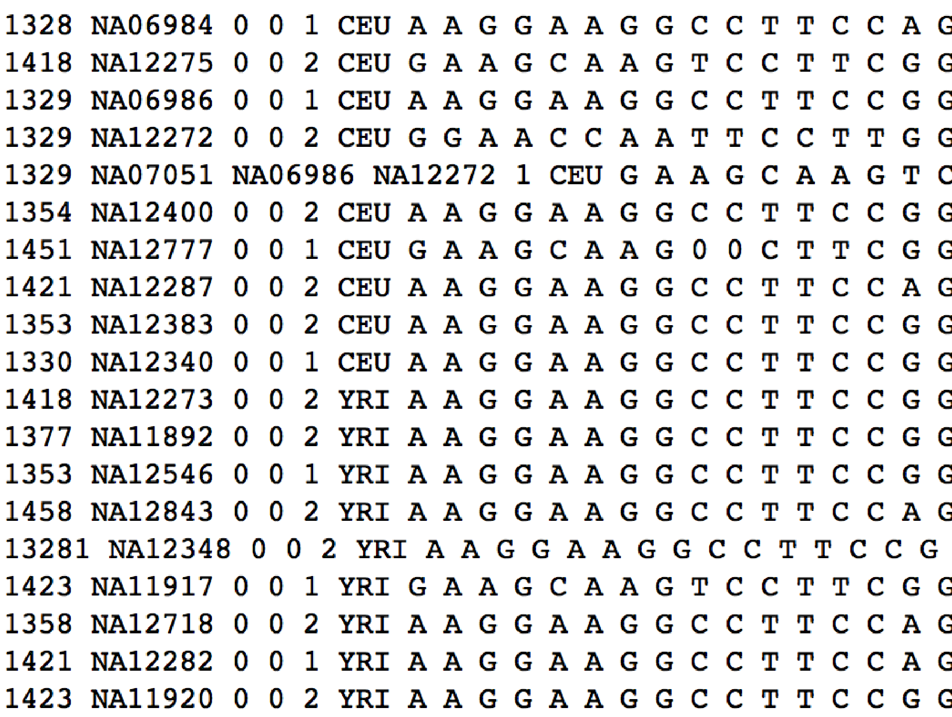
Genotype of first SNP
Genotype of second

Slide 12
Missing genotype

Slide 13
Loading a PLINK file
Filenames of the PED and MAP file should be consistent:
myfile.ped myfile.map
Myfile.ped myfile.map
myfile.ped filemy.map
First load the plink module (you only have to do this once per session)
$ module load plink2/1.90p
$ plink --file myfile --command

Slide 14
Loading a PLINK file
Filenames of the .bed, .bim and .fam file should be consistent:
myfile.bed myfile.bim myfile.fam
Myfile.bed myfile.bim myfile.map
myfile.bed filemy.bim filemy.fam
First load the plink module (you only have to do this once per session)
$ module load plink2/1.90p
$ plink --file myfile --command

Slide 15
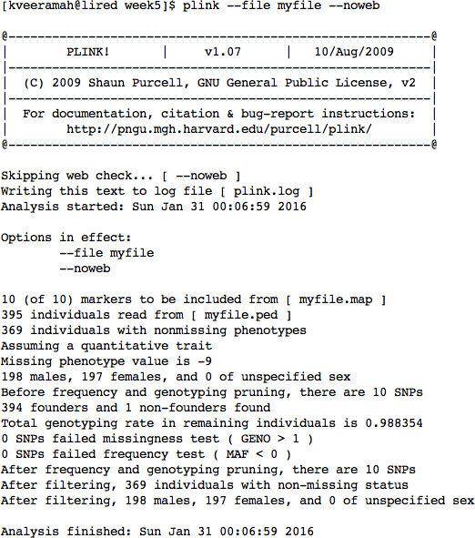

Slide 16
PLINK Binary files
PLINK can convert human-readable files to a much smaller binary format that is quicker to analyze
$
plink --file myfile --make-bed –-out newfilename
This command creates 3 new files with extension:
bed, bim, fam
$ plink --bfile mybinaryfile --commands

Slide 17
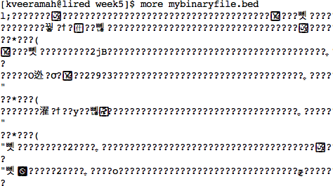
bed file

Slide 18
bim file
Contains six fields
Chromosome
SNP name (arbitrary, normally: rsid####)
Recombination map position (can be set to 0)
Genomic coordinate
Major allele
Minor allele
Number of rows matches the number of SNPs in the dataset
Can be broken up by chromosome

Slide 19
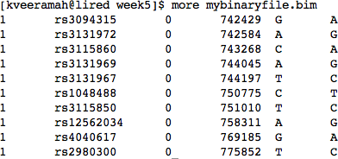
bim file
Chromosome
SNP position
Alleles

Slide 20
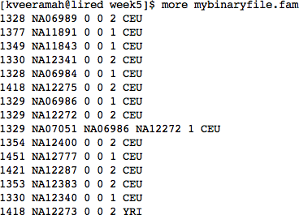
fam file

Slide 21
General PLINK notation Manipulating Data
$ plink --bfile mybinaryfile <DO_STUFF>
--make-bed --out <OUT_PLINK FILE>
Tells plink to make
a new binary ped file
Tells plink the name of the new file
e.g. make a new file with a subset of SNPs
$ plink --bfile mybinaryfile --extract SNPlist
--make-bed --out mybinaryfile_specsnps

Slide 22
General PLINK notation
$ plink --bfile mybinaryfile <DO_STUFF> --out <OUT_ANALYSIS_FILE>
Each command will generate a .log file
e.g. calculate allele frequencies
$ plink --bfile mybinaryfile -–freq
--out mybinaryfile_AF

Slide 23
Remove Individuals from a dataset
Pull out certain individuals using --keep
$ touch Chabu.txt
$ grep CHABU Ethiopians_All.fam > Chabu.txt
$ plink --bfile Ethiopians_All --keep Chabu.txt --make-bed --out Chabu_only
$ head Chabu_only.fam

