Slide 1
Exploring the Peruvian Domestic Flight Network
Alessandra Oshiro
Data and Network Visualization // Winter 2022
April 6th, 2022

Slide 2
Research Question and Data
Explore the air connectivity within Peru
How well connected are the regions?
Which is the most important airport?
Data:
OpenFlights: Airport Database, and Routes Database [only Peruvian commercial flights and airports]
ESPG.io: Map coordinates
Geo GPS Perú: Shapefiles for Peru’s national and regional borders
Packages: pandas, graph-tool, matplotlib, basemap, PIL

Slide 3
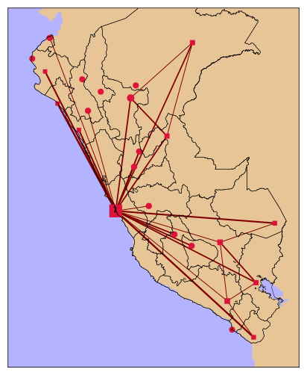
Network of all the airports and flights
Vertices: airports
Size: degree
Shape: international
Position: coordinates
Edges: routes
Width: number of flights
Simple map color for readability
Only relevant borders drawn

Slide 4
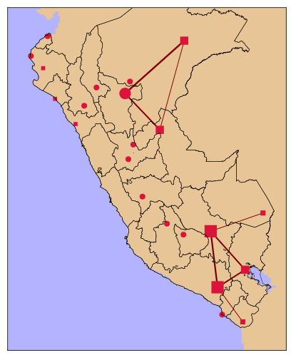
Network without Lima
Vertices: airports
Size: degree
Shape: international
Position: coordinates
Edges: routes
Width: number of flights
Simple map color for readability
Only relevant borders drawn

Slide 5
