Slide 1

Name: OSHITHA GARBHAPU ADMISSION NO:AP22110010174 INTERNSHIP COMPANY:EDUNET STREAM:AIML
PROJECT TITLE:EMPLOYEE BURNOUT PREDICTION

Slide 2
AGENDA
PROBLEM STATEMENT
PROJECT OVERWIEW
END USERS
MY SOLUTION
MODELING
RESULT
CONCLUSION
REFERENCES

Slide 3

PROJECT TITLE : EMPLOYEE BURNOUT PREDICTION problem statement:
Develop a predictive model to anticipate employee burnout based on historical performance metrics, personal factors, and organizational indicators, aiming to identify early warning signs and implement proactive intervention strategies

Slide 4
PROJECT OVERVIEW
Employee burnout is a condition characterized by:
1. Emotional Exhaustion: Feeling drained, depleted, and lacking energy
2. Physical Symptoms: Manifesting in headaches, fatigue, and sleep disturbances Prolonged or excessive stress leads to this state, negatively impacting both individual well-being and organizational productivity
3. Reduced Personal Accomplishment: Experiencing feelings of inadequacy and failure in one's work.
4. . Depersonalization: Adopting a cynical and detached attitude towards work and colleagues

Slide 5
WHO ARE THE END USERS of this project?
Human Resources (HR) Departments of the organizations
Managers and Team Leaders
Employees Themselves
Health and Wellness Programs

Slide 6
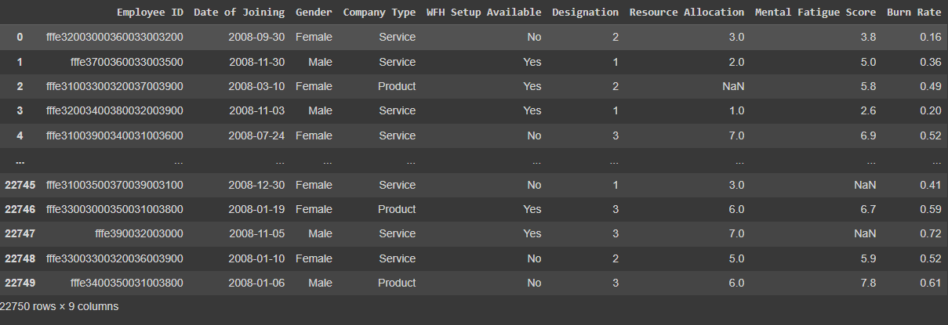

YOUR SOLUTION AND ITS VALUE PROPOSITION
MY SOLUTION IS LINEAR REGRESSION
Linear regression analysis is used to predict the value of a variable based on the value of another variable. The variable you want to predict is called the dependent variable. The variable you are using to predict the other variable's value is called the independent variable.
Here in our project , burn rate is the independent variable ,and remaining columns like joining time etc are dependent variables

Slide 7
How did you customize the project and make it your own
Along with linear regression I also used:
Support vector Machine(Linear Kernel)
Random forest regressor
Decision tree regressor
But, linear regression is the best since it has the lowest mean squared error, root mean squared error, and mean absolute error, indicating better accuracy and precision in its predictions.

Slide 8
MODELLING
Importing libraries
Handling missing values
Analyzing categorical data
Encoding categorical data
Fitting into linear regression model
Support Vector machine(linear kernel)
Random forest regressor
Decision tree regressor
Result

Slide 9
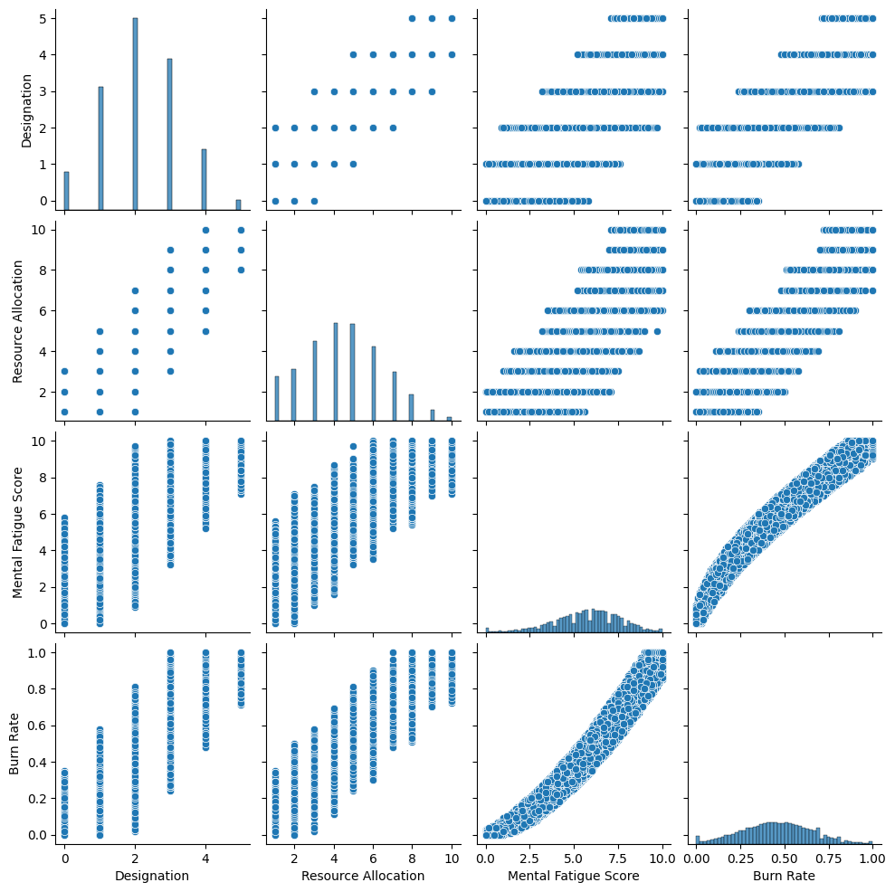
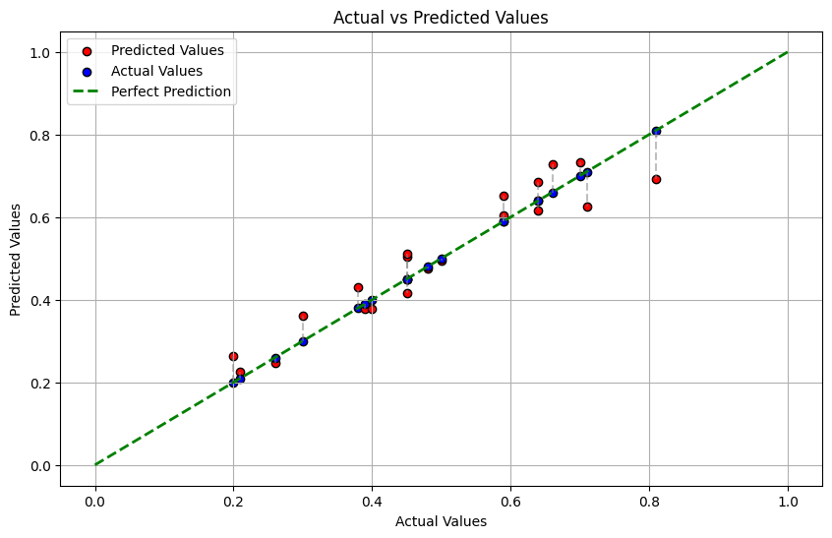
Results
Correlation analysis
Output:

Slide 10
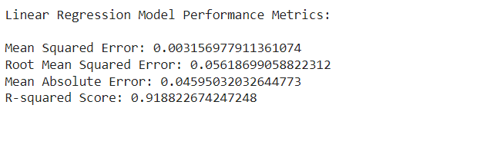
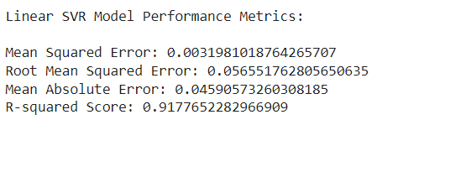
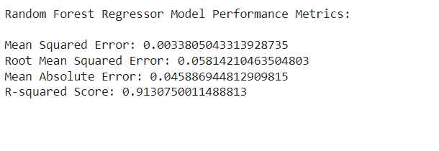
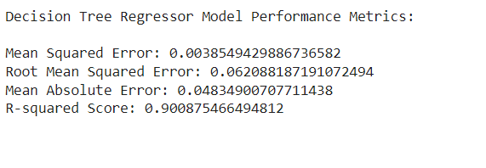
Conclusion:
Developed machine learning models to predict the Burn Rate based on factors like Resource Allocation and other variables.
Used regression techniques to model the relationship between predictors and burnout levels
Based on the evaluation metrics, the Linear Regression model appears to be the best model for predicting burnout analysis.
It has the lowest mean squared error, root mean squared error, and mean absolute error, indicating better accuracy and precision in its predictions. Additionally, it has the highest R-squared score, indicating a good fit to the data and explaining a higher proportion of the variance in the target variable.
So we are choosing this model for deployment.

Slide 11
links
Reference :
Colab link- https://colab.research.google.com/drive/11GsdcEEMQPFoZ6VyTh5i_UjN8LFzhaL3?usp=sharing
Data set link:"/content/employee_burnout_analysis-AI.xlsx "

Slide 12
THANK YOU FOR YOUR ATTENTION.
-Oshitha Garbhapu
AP22110010174

