Slide 1

High Capability Multidimensional Data Compression on GPUs
S5455, GPTC 2015
Sergio E. Zarantonello
szarantonello@scu.edu
Ed Karrels
ed.karrels@gmail.com
School of Engineering, Santa Clara University

Slide 2
Part 1: Theory and Applications
Challenge
Massive amounts of multidimensional data generated by petascale scientific simulations, monitoring devices, and high-end imaging applications.
Growing inability of current networks, computer hardware and software to transmit, store, and analyze this data.
Solution
Fast and effective lossy data compression.
Optimized compression ratios subject to a priori specified error tolerances.
GPUs to make the above feasible.

Slide 3
Part 1: Theory and Applications
Our goal
A multidimensional wavelet-based CODEC for large data.
A discrete optimization procedure to provide best compression ratios subject to error tolerance and error metric specified by user
A high performance CUDA implementation for large data, exploiting parallelism at various levels.
A flexible design allowing for future enhancements (redundant bases, adaptive dictionaries, compressive sensing, sparse representations, etc.)
An initial focus on medical Computed Tomography, Seismic Imaging, and Non-Destructive Testing of Materials.

Slide 4
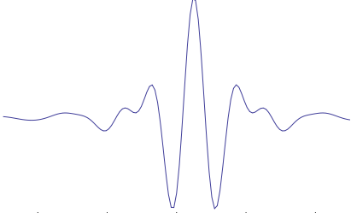
Part 1: Theory and Applications
Why wavelets ?
Wavelets are “short” waves “localized” in
both, spatial and frequency domains.
Can be used as basis functions for sparse
representations of data.
Give compact representations of well-behaved data and point singularities.
Multidimensional wavelets take advantage of data correlation along all coordinate axes.
Wavelet encoding/decoding can be implemented with fast algorithms.

Slide 5

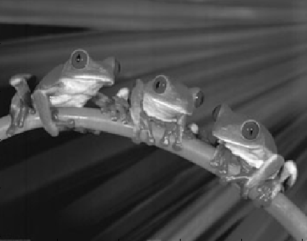
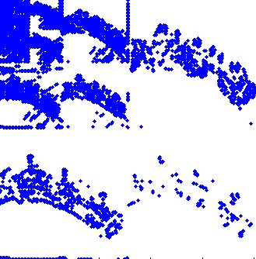
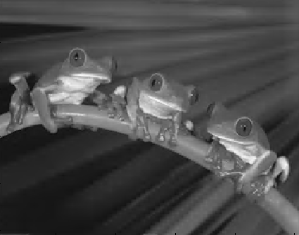
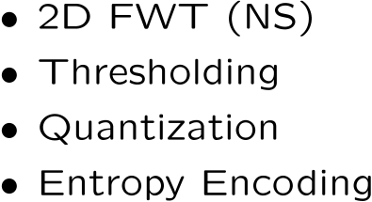
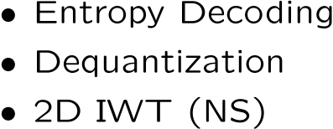

Part 1: Theory and Applications
Conventional 2d procedure

Slide 6
Part 1: Theory and Applications
Our approach
Data is decomposed into overlapping cubelets.
Cubelets are processed independently.
Cubelets are encoded via biorthogonal wavelet filters along each coordinate axis.
Wavelet coefficients are thresholded, then quantized
Quantized cubelets are Huffman encoded.
Process is “reversed” to reconstruct the data.
“Hill Climbing” algorithm is implemented to deliver highest compression possible subject to error constraint(s).

Slide 7
Part 1: Theory and Applications
2d (frame-by-frame) versus 3d procedure
X-Ray CT scan
10 steps of the cardiac cycle
512 x 512 x 96 cube
http://www.osirix-viewer.com
Error: 2d procedure
Error: 3d procedure
Compression Ratio=6.6
PSNR=46.1 (3d volume)
Cutoff=88% Bins=1106
Max Error= 9.45
Compression Ratio=10.2
PSNR=46.2 (3d volume)
Cutoff=92% Bins=850
Max Error = 5.68

Slide 8

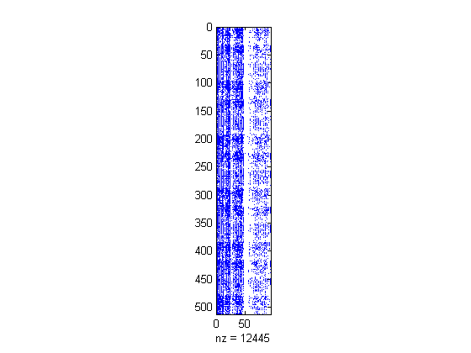
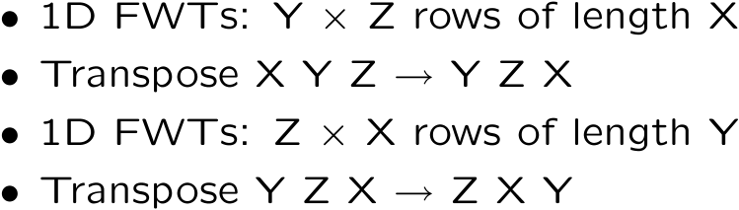
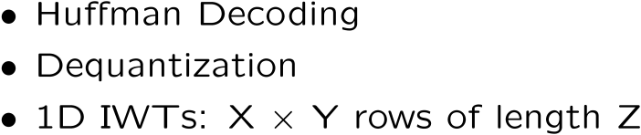
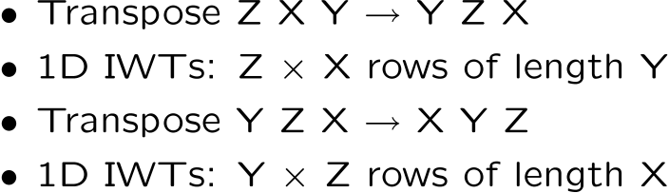
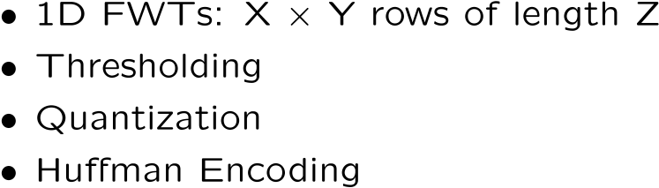
Part 1: Theory and Applications
Outline of 3d procedure
y
y
x
z
x
z
x
z
y

Slide 9


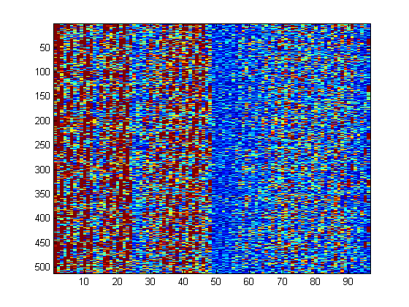

Part 1: Theory and Applications
Optimized compression for given error tolerance
1. Obtain wavelet coefficients
2. Find starting compression parameters
3. Calculate reconstruction error
4. Calculate compression Ratio
5. “Hill Climbing” iterations to find maximum compression ratio subject to error tolerance
Error Check

Slide 10
Part 1: Theory and Applications
Optimized compression for given error tolerance
Quantization Bins
Compression Ratio
PSNR
% Cutoff
Quantization Bins
% Cutoff
Begin
End
Cutoff
Bins
PSNR
Ratio
76 %
1850
52.4
3.6 X
92 %
850
46.2
10.2 X

Slide 11




Part 1: Theory and Applications
Applications: Optical Coherence Tomography
Objective: efficient transfer over the internet of
high-resolution 3d images of retina for diagnosis.
Dataset courtesy of Quinglin Wang
Carl Zeiss Meditec Inc.

Slide 12
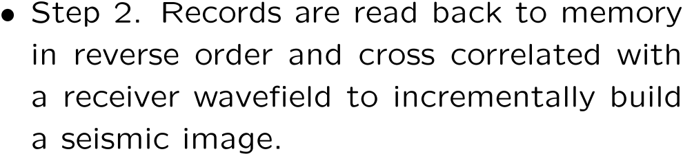



Part 1: Theory and Applications
Applications: Reverse Time Migration

Slide 13
Part 2: Implementation
Stages of compression
Wavelet transform
Threshold
Quantization
Huffman coding
Overall speedup

Slide 14
Wavelet Transform on GPU
Part 2: Implementation
Each row of data is independent
Within each row, multiple read / write passes
Before
…
After
odds
evens
1 row == 1 thread block
Synchronize between read & write

Slide 15
3d Wavelet Transform
Part 2: Implementation
Thread block 0,2
Thread block 0,1
Thread block 0,0
Thread block 1,0
Thread block 2,0
Thread block 3,0
Height × depth rows, each one is an independent thread block.

Slide 16
Transform Along Each Axis
Part 2: Implementation
X
Transpose XYZ → YZX
Y
Transpose YZX → ZXY
Z

Slide 17
GPU Transpose
Part 2: Implementation
Access global memory in contiguous order
read
write
(thread indices)
0 | 1 | 2 | 3
4 | 5 | 6 | 7
8 | 9 | 10 | 11
12 | 13 | 14 | 15
Contiguous
write to global
memory
0 | 1 | 2 | 3
4 | 5 | 6 | 7
8 | 9 | 10 | 11
12 | 13 | 14 | 15
Global
memory
Shared
memory
write
read
Noncontiguous
read from shared
memory
0 | 1 | 2 | 3
4 | 5 | 6 | 7
8 | 9 | 10 | 11
12 | 13 | 14 | 15
0 | 4 | 8 | 12
1 | 5 | 9 | 13
2 | 6 | 10 | 14
3 | 7 | 11 | 15

Slide 18
Optimizations
Part 2: Implementation
Global memory
Shared memory
2.5× speedup
Change constant factors double → float
1.6× speedup
Speedup over CPU version: 100x
(860ms → 8.6ms for 256x256x256 cubelet,
8 levels of transforms along each axis)
Notes:
shmem: 334.3 ms -> 134.7 ms
double -> float:
CPU (alcatraz): 865.71ms
GPU, k20: 17.375ms
GPU, GTX980: 8.618ms

Slide 19
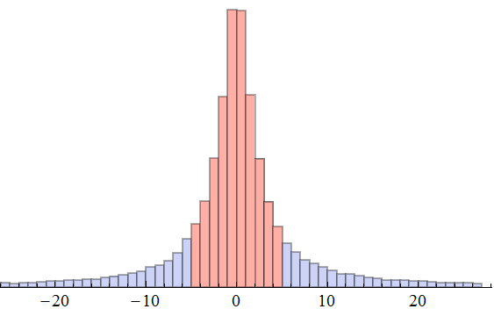
Threshold
Part 2: Implementation
Trim smallest x% of values – round to 0
Just sort absolute values using Thrust library
Speedup over CPU sort: 100× (7.0 toolkit is 35% faster than 6.5)
[-5 .. +5]
Notes:
CPU (alcatraz) 1232.48ms, GPU (gtx980): 12.42ms

Slide 20
Quantization
Part 2: Implementation
Map floating point values to small set of integers
Log : bin size near x proportional to x
Matches data distribution well
Simple function; fast
Lloyd's algorithm
Given starting bins, fine-tune to minimize overall error
Start with log quantization bins
Multiple passes over full data set, time-consuming

Slide 21
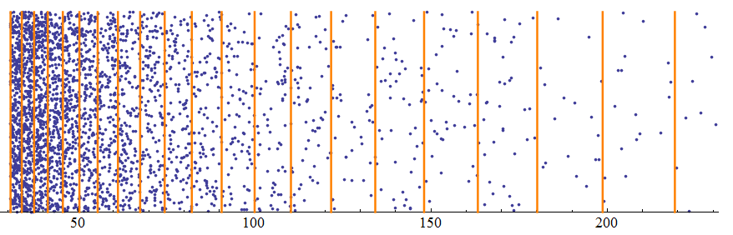
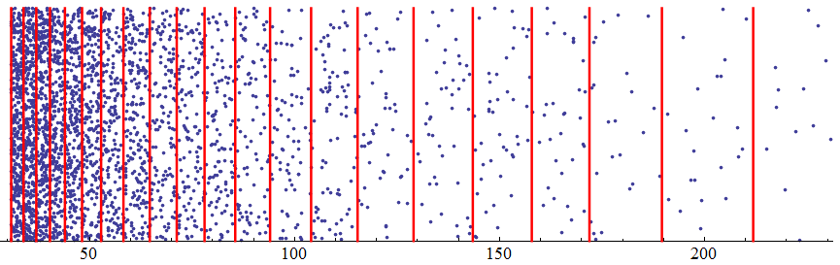
Log / Lloyd Quantization
Part 2: Implementation
Log quantization, pSNR 38.269
GPU speedup: 75× (thrust::transform())
Lloyd quantization, pSNR 45.974
GPU speedup: create 280×, apply 49×
Notes:
Log
cpu: 96.41
gpu: 1.293
./test_compress_cpu -err -thresh .9 -qalg lloyd around.cube out.cube
CPU Lloyd 500 iters, 107905.40 ms
Quantize lloyd: 215.61 ms
GPU lloyd 37 iterations, 384.099
Quantize: 4.424 ms

Slide 22
Huffman Encoding
Part 2: Implementation
Optimal bit encoding based on value frequencies
Compute histogram on CPU
Copy data GPU → CPU: 26ms
Compute on CPU: 25ms
Compute histogram on GPU
No copy needed
Compute: .62ms
Optimization: per-thread counter for common value
Value | Count | Encoding
9 | 16609445 | 1
8 | 46198 | 011
10 | 42896 | 001
11 | 32594 | 000
7 | 30831 | 0101
12 | 6942 | 01000
6 | 5388 | 010011

Slide 23
Overall CPU → GPU speedup
Part 2: Implementation
GPU: GTX 980
CPU: Intel Core i7 3.5GHz
 | MATLAB | CPU | GPU
Compress | 43000 | 2300 | 23
Error control | 39000 | 1400 | 18
time to process 256³ cubelet, in milliseconds
Notes:
./test_compress_cpu -noz -thresh .9 ~/Data/around1.cube out.cube
400 error control iterations in 7.135s

Slide 24
Future Directions
Part 2: Implementation
Improve performance
Use subsample for training Lloyd's
Use Quickselect to find threshold value
Multiple GPUs
Improve accuracy
Weighted values in Lloyd's algorithm
Normalize values in each quadrant

Slide 25

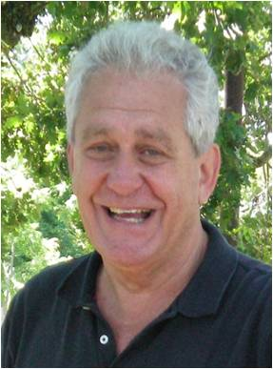
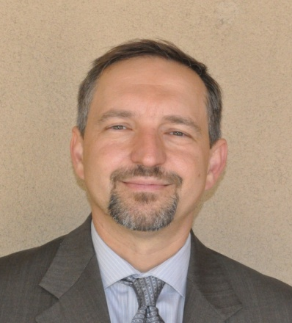
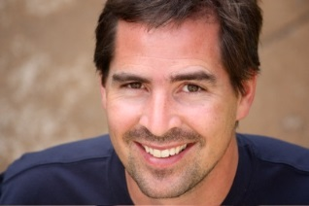


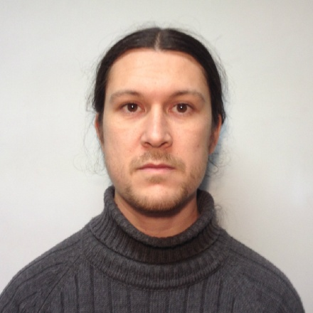
Our Team
Ed Karrels Santa Clara University, ed.karrels@gmail.com
Drazen Fabris
Santa Clara University
dfabris@scu.edu
Sergio Zarantonello
Santa Clara University
szarantonello@scu.edu
David Concha
Universidad Rey Juan Carlos, Spain
david.concha@urjc.es
Bonnie Smithson
Santa Clara University
Bonnie@DejaThoris.com
Anupam Goyal
Algorithmica LLC
anupam@rithmica.com

Slide 26
use nsi dataset
2d vs 3d – round to psnr 46
performance 2d vs 3d

