Slide 1
Fastest Finger First Test

Slide 2
GROUP MEMBERS
SHASHANK PATHAK (15BCE1287)
OSHO AGYEYA (15BCE1326)

Slide 3
AIM
To design a fastest finger first circuit to find which player pressed the switch first by utilization of basic gates and flip flops made by these gates itself.

Slide 4
ABSTRACT
Quiz competitions are held in schools, colleges and also in Television channels as they carry out special programs, various other organizations. The process of identifying a participant whose option button pressed is very critical in timings as they might differ in seconds or milliseconds.
This process of carrying the tedious work is made simple by this Circuit. This Electronic Quiz buzzer enables to identify a particular participant as whom have pressed first amongst all. This Circuit is made up of a simple AND gate IC’s and a couple of D type flip Flop IC’s are used in order to set and reset the device. An LED for Each participant is provided such that, it will indicate the person who has pressed the option switch first amongst all and also a beep sound indicator is made available when any switch is pressed. This is made of simple components using an AND gate , Flip Flop IC , LED’s and buzzer hence the circuit is cost effective.

Slide 5
COMPONENTS REQUIRED
Bread board
Wires
Switches
AND,NAND,NOT gates
Battery 9V
Winner indicators LED’s
Buzzer
SR Flip Flop using basic gates
Resistors 1k ohm

Slide 6
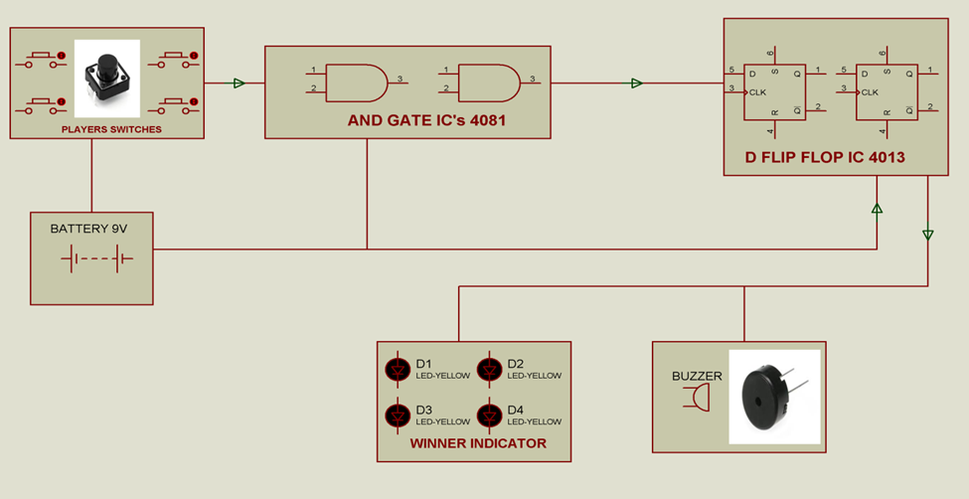
BLOCK DIAGRAM

Slide 7
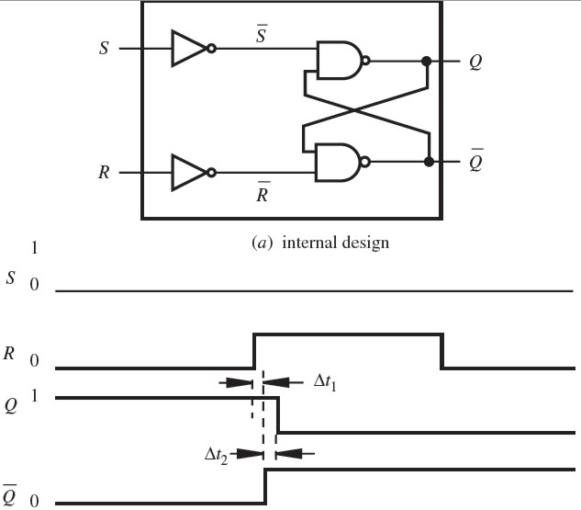
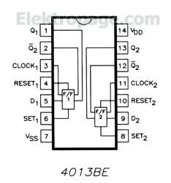
S-R FLIP FLOP IC USING BASIC GATES

Slide 8
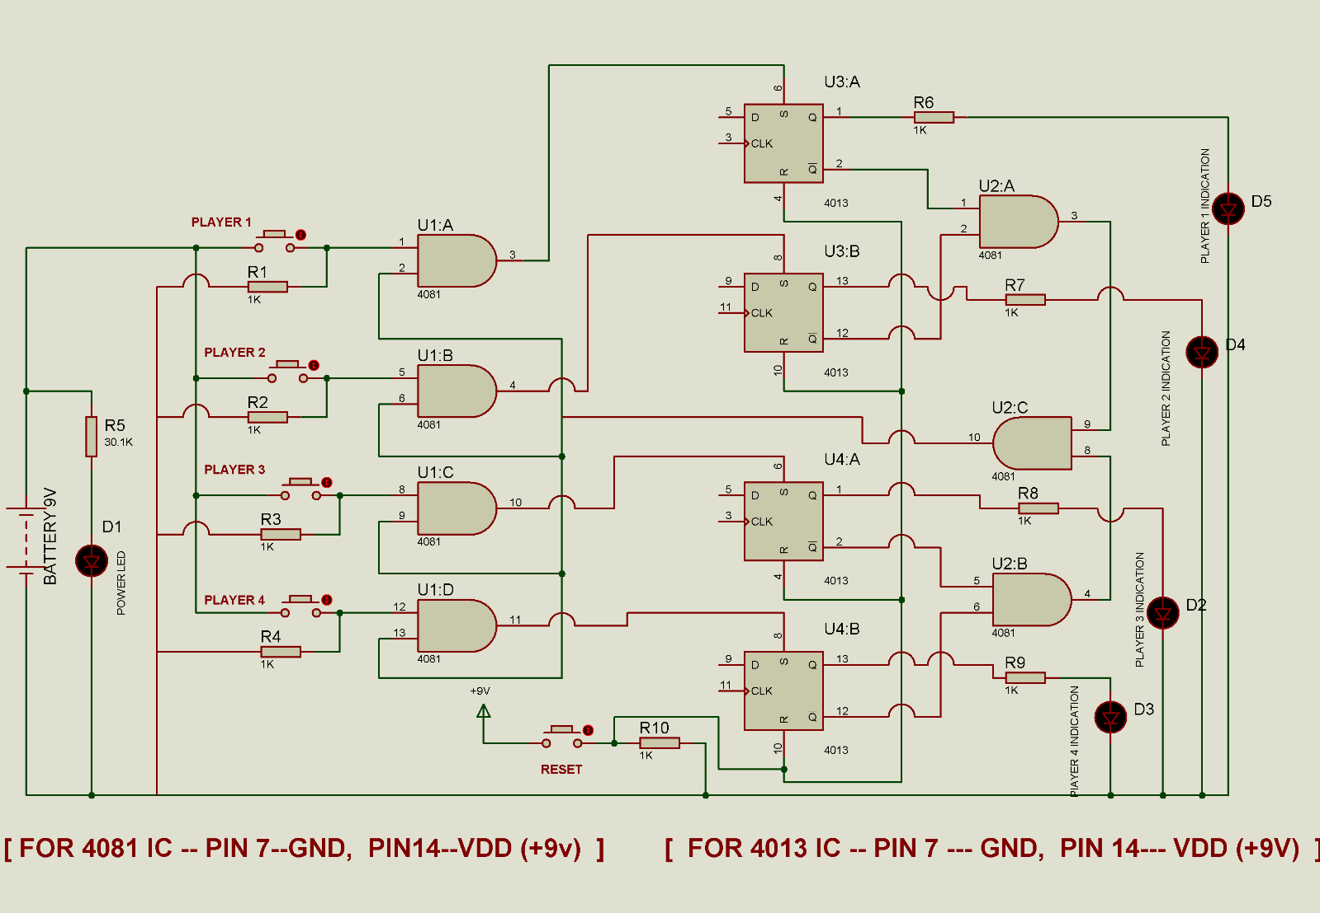
CIRCUIT DIAGRAM

Slide 9
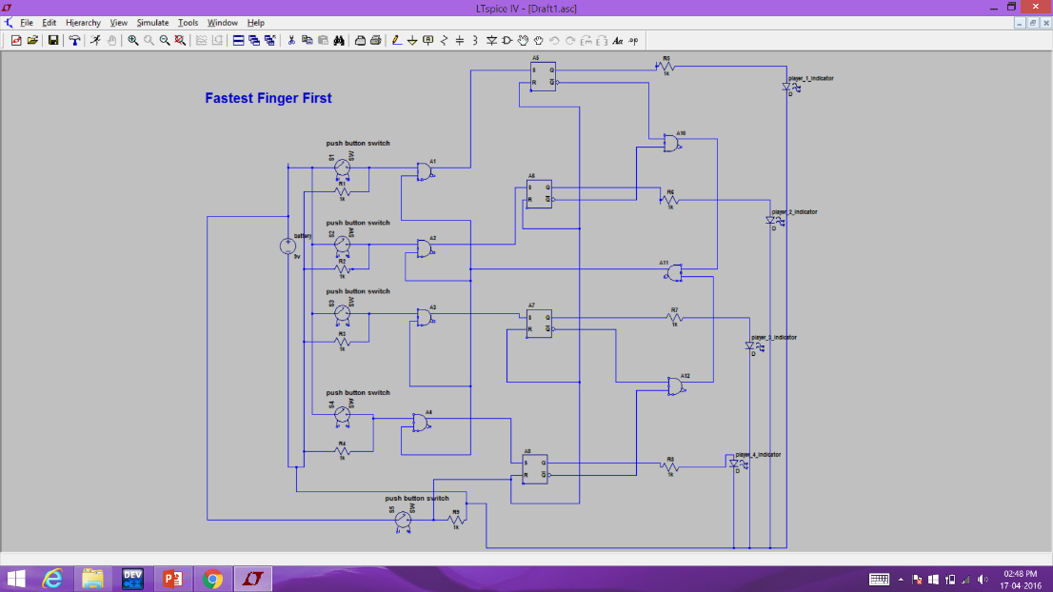
LTSpice DIAGRAM

Slide 10
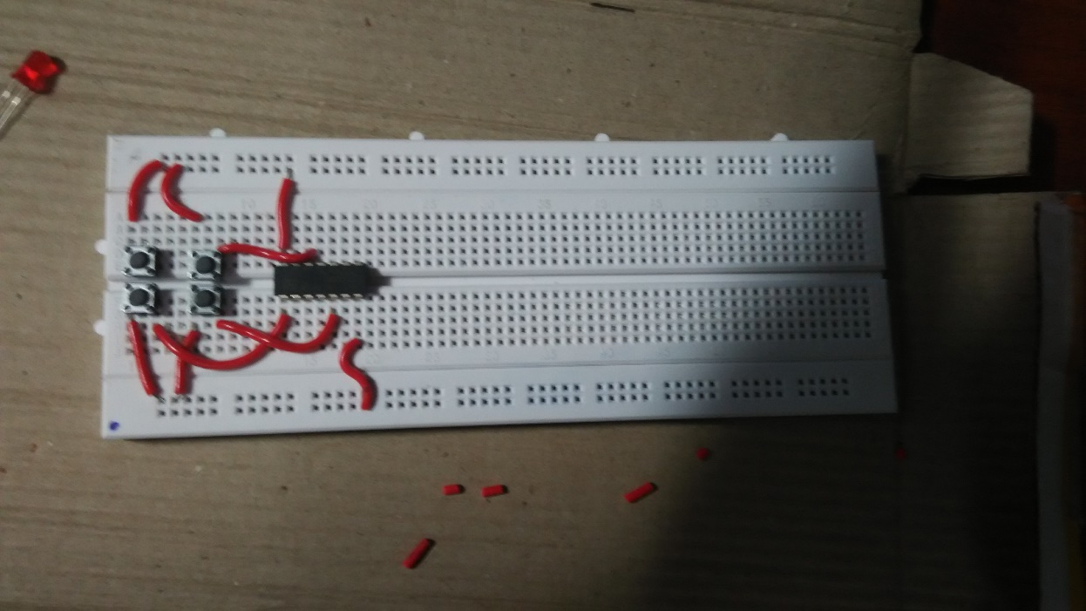
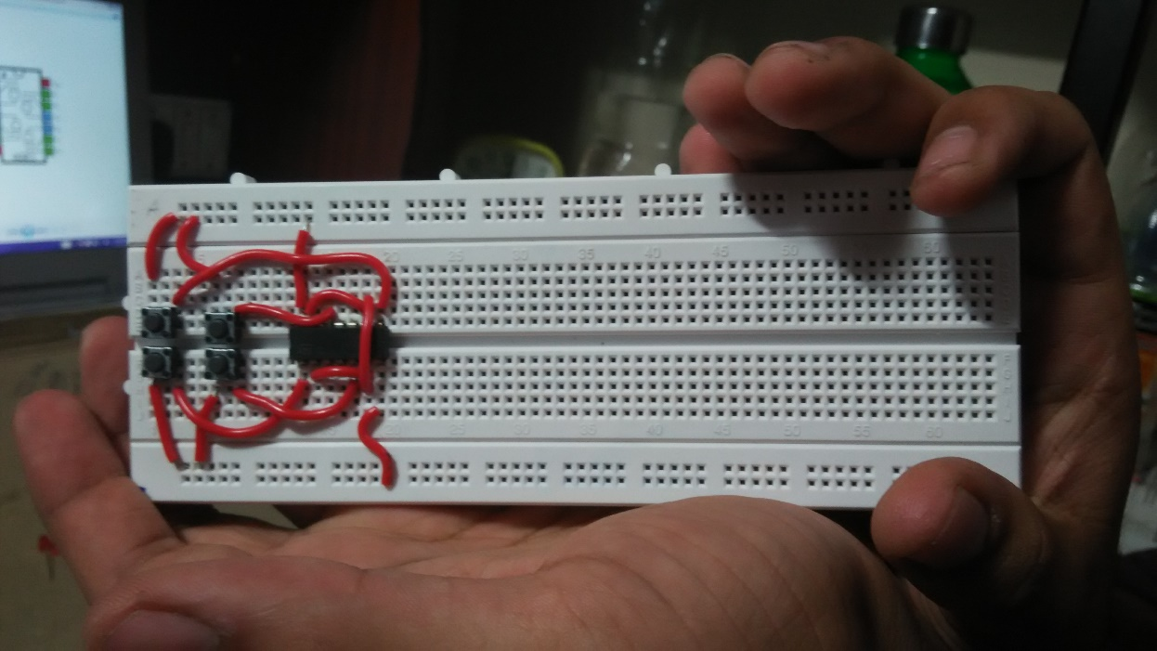
CIRCUIT UNDER CONSTRUCTION:

Slide 11
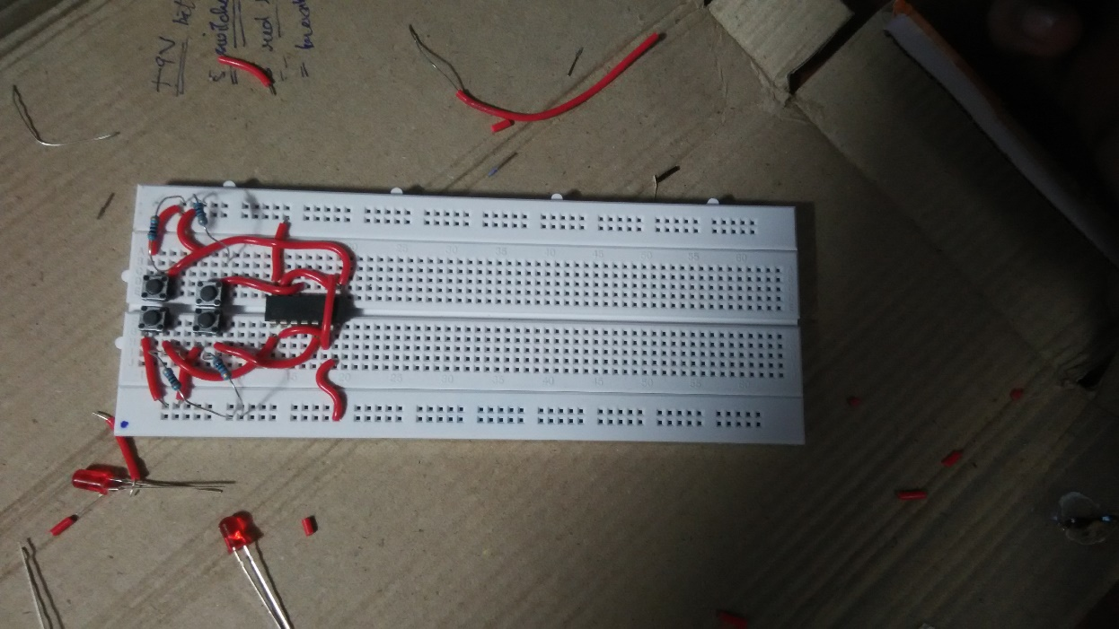
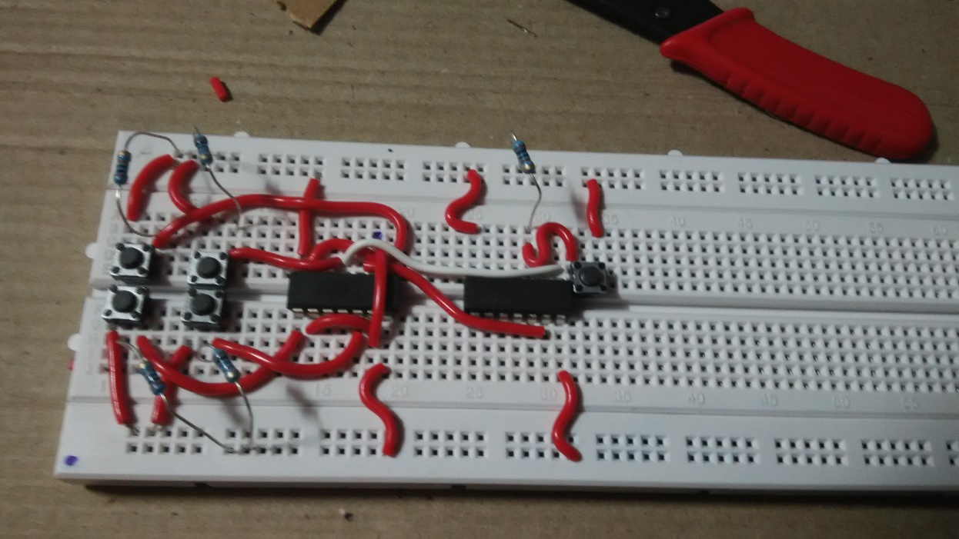
CIRCUIT UNDER CONSTRUCTION:

Slide 12
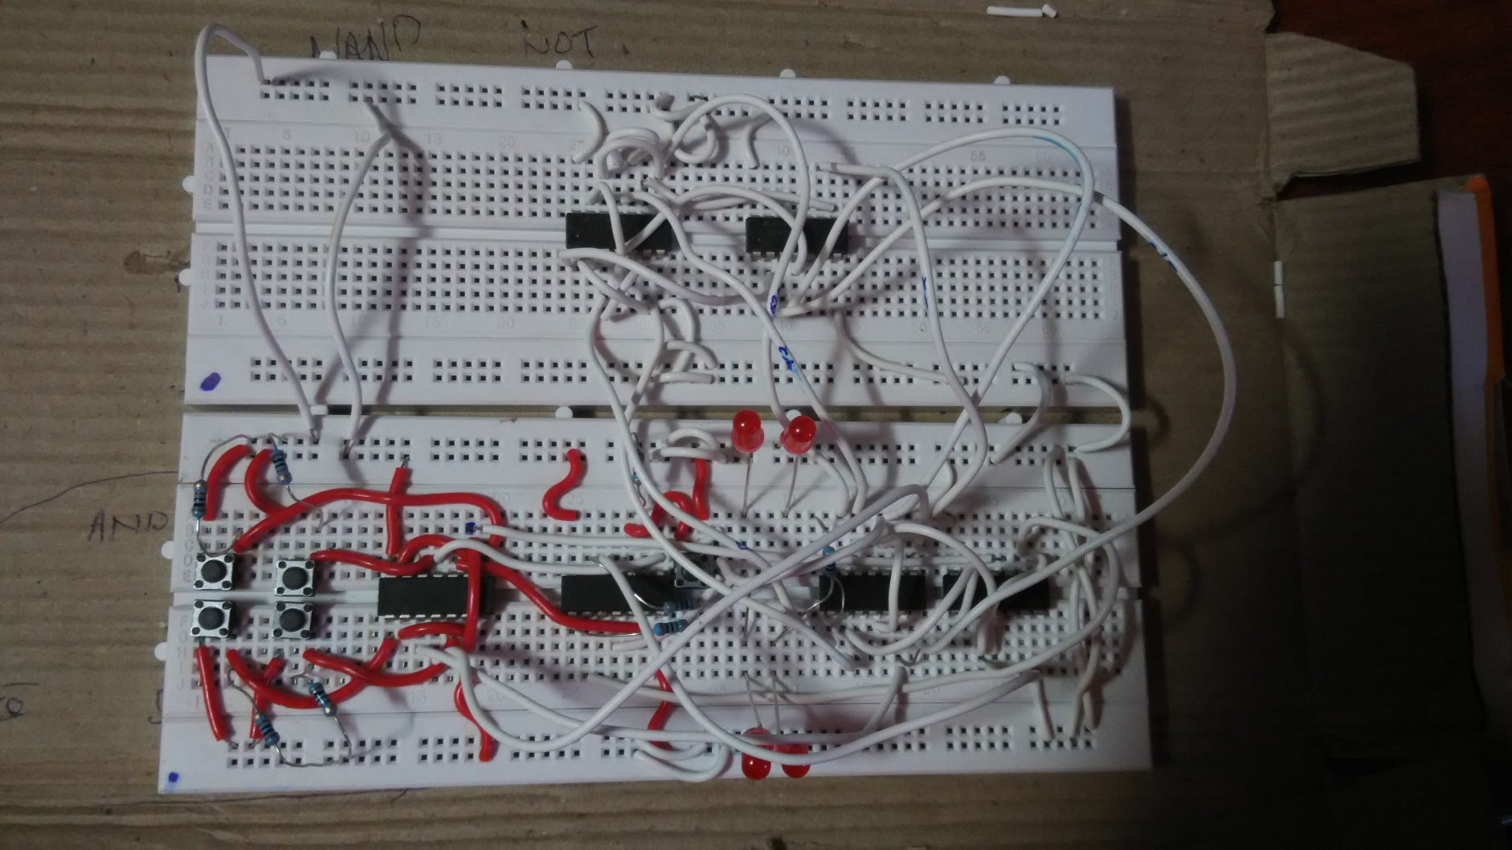
FINAL:

Slide 13
THANK YOU

