Slide 1
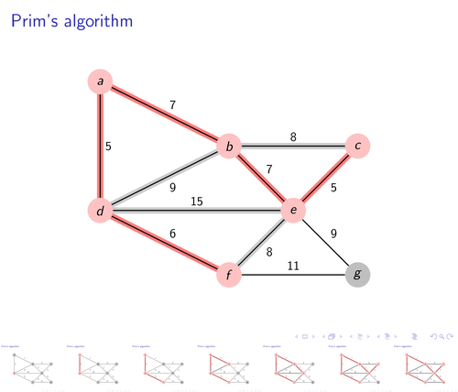
NETWORKS AND COMMUNICATION
PROJECT
Osho Agyeya
15BCE1326

Slide 2
USES OF PRIM’S ALGORITHM
MAIN PURPOSE: FINDING MINIMUM SPANNING TREE
1.Distances between the cities for the minimum route calculation
for transportation.
2.For Establishing the network cables these play important role in finding
the minimum cables required to cover the whole region.
3. Prim Algorithm Approach to Improving Local Access Network in Rural Areas
4. AI (Artificial Intelligence)
5. Game Development
6. Cognitive Science

Slide 3
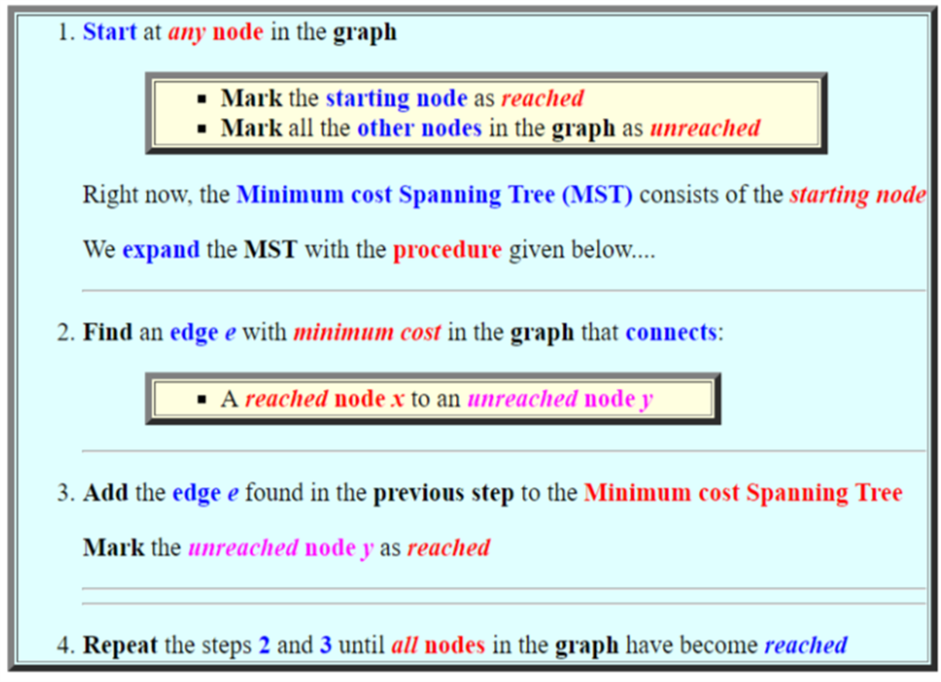
ALGORITHM

Slide 4
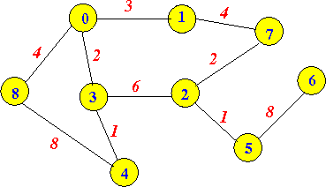
Find a Minimum cost Spanning Tree for this graph

Slide 5
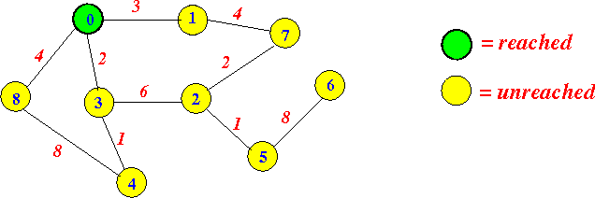
We pick the starting node: node 0 and mark it as reached. All other nodes are marked a unreached

Slide 6

Find an edge with minimum cost that connects a reached node to an unreached node.

Slide 7
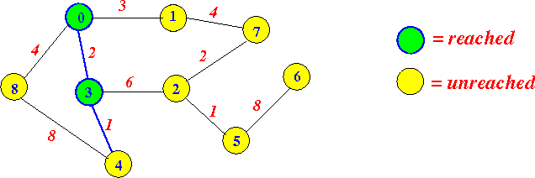
This edge is: (0,3)
Add the edge (0,3) to the MST and mark the node 3 as reached:

Slide 8
Find an edge with minimum cost that connects a reached node to an unreached node:

Slide 9
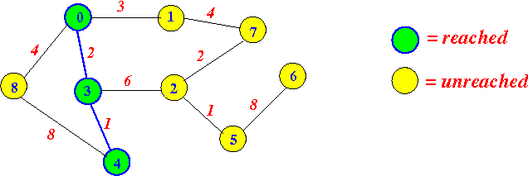
This edge is: (3,4).
Add the edge (3,4) to the MST and mark the node 4 as reached:

Slide 10

Find an edge with minimum cost that connects a reached node to an unreached node:

Slide 11
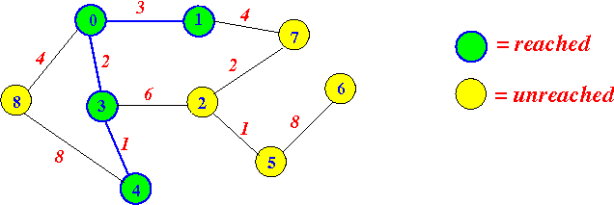
This edge is: (0,1).
Add the edge (0,1) to the MST and mark the node 1 as reached:

Slide 12
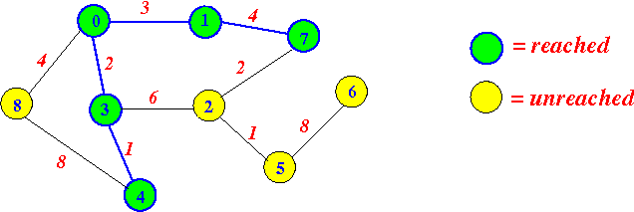
I think you get the "drift" by now.... So I will speed things up a little.
Next edge added is: (1,7):

Slide 13
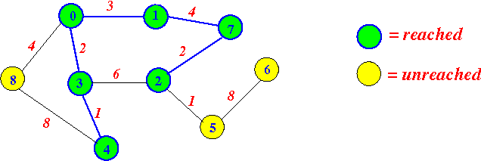
Next edge added is: (7,2):

Slide 14
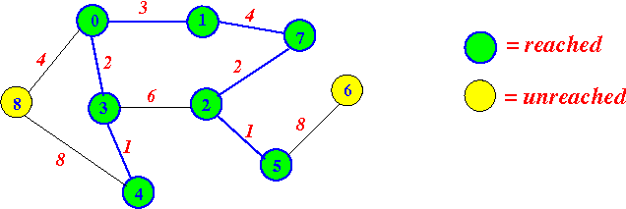
Next edge added is: (2,5):

Slide 15
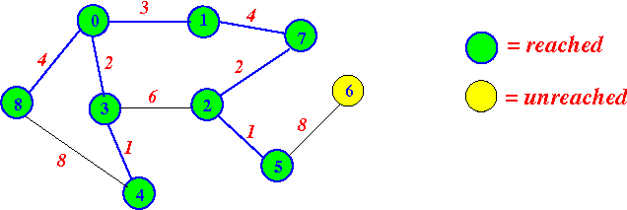
Next edge added is: (0,8):

Slide 16
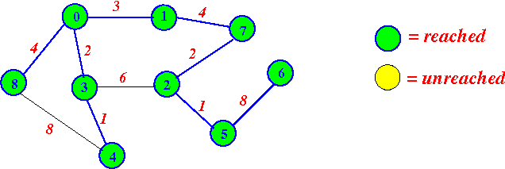
Next edge added is: (5,6):

Slide 17
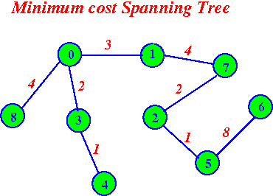
Now all nodes of the graph are reached
Done !!!
The Minimum cost Spanning Tree is:

Slide 18
PSEUDO CODE
ReachSet = {0};
UnReachSet = {1, 2, ..., N-1};
SpanningTree = {};
while ( UnReachSet ≠ empty )
{
Find edge e = (x, y) such that:
1. x ∈ ReachSet
2. y ∈ UnReachSet
3. e has smallest cost
SpanningTree = SpanningTree ∪ {e};
ReachSet = ReachSet ∪ {y};
UnReachSet = UnReachSet - {y};
}

Slide 19
SUBSEQUENT WORK
Optimization
Implementation in Java
Implementation in SCILAB
Simulation on SCILAB

