Slide 1
PRODUCT DESIGN, MANAGEMENT TECHNIQUES AND ENTREPRENEURSHIP PROJECT
FALL SEMESTER 2016-2017

Slide 2
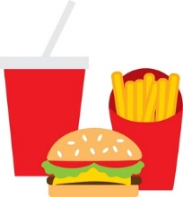
SNAGGER SNACK WITH SWAGGER!
Shubham Parashar(15BCE1318)
Shriansh Srivastava(15BCE1314)
Osho Agyeya(15BCE1326)
Animesh Sen Gupta(15BCE1198)
Har Shobhit Dayal(15BCE1192)

Slide 3
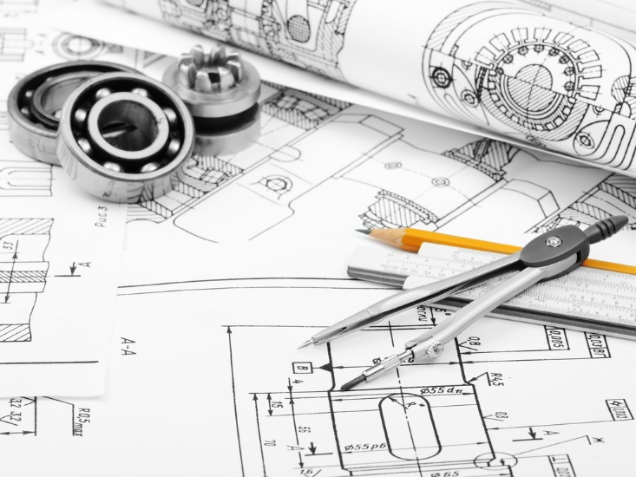
PROJECT SUMMARY:
The project is aimed at the design and construction of product “Snagger”. This shall be used at cinema halls and movie theatres for ergonomic placement and accessibility of food items to maximize movie enjoyment while catering to the food needs of the audience by helping them to keep all their food stuff in a single tumbler.

Slide 4
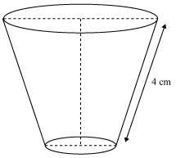
PROJECT DESIGN SPECIFICATION:
BASIC STRUCTURE:
The basic structure of the bucket is inverted frustrum (actual dimensions of the product are different from those mentioned in the diagram).

Slide 5
MATERIAL:
Plastic is an appropriate material since it is easily washable.
HEIGHT:
The proposed height of the structure is 26 cm.
BASE:
The base of the frustum has a radius of 7.5 cm.
The base is circular.

Slide 6

LAYERS:
The estimated no. of layers are 3.
Layer 1 is for storing soft drinks.
Layer 2 is for storing popcorns.
Layer 3 shall be used to storing nachos, dips, samosas, burgers and sandwiches.

Slide 7
BOTTOM COMPARTMENT:
The bottom most compartment is meant for storing soft drinks.
The bottom surface is inclined at an angle of (5-10) degrees. This is done so that the soft drink slides down the incline to eventually collect at one point.
The height of the bottom-most compartment is 7 cm.
The outer surface will have a radium sticker to denote the level of soft drink that has been consumed.

Slide 8
MIDDLE COMPARTMENT:
SIDE WALLS:
This layer shall be used for storing popcorns.
This layer shall have the maximum volume.
The side wall is cylindrical. The side wall will have a joined straw which shall open at the top.

Slide 9
INTENDED FUTURE WORK :
The fundamental designing shall be done on software Sketchup.
The top layer for storing nachos,dips,samosas and sandwiches shall be further modified. The middle compartment to be used for storing pop-corn shall be designed to increase volume. Further specifications shall be posted after this.

