Slide 1
TCP/IP
Transmission Control Protocol / Internet Protocol
It is a standard method for computers to communicate with each other, regulated by the Internet Engineering Task Force (IETF)
It consists of 4 layers:
Link layer
Internet layer
Transport layer
Application layer

Slide 2
Link layer
This is the lowest layer of the internet.
It handles:
Bitwise error detection
Packet switching: grouping data into “packets” to be sent as a bunch
Physical addresses (typically “media access control”, or MAC address)

Slide 3
Internet layer
Uses the Internet Protocol (IP) to transmit data from source to destination
This requires 2 parts:
Host identification and addressing (this is what an IP address is)
Packet routing – finding the best path for packets to take to get from source to destination
This is a “connectionless” protocol; it does not require a direct connection between 2 computers

Slide 4
Transport layer
Uses the Transmission Control Protocol for connection-oriented communication
This protocol directs the outgoing traffic through an Internet socket or port number, and aggregates incoming traffic through another socket.
These port numbers are associate with applications, and have standard values: FTP (20 & 21), SSH(22), SSL (443), HTTP (80), etc.

Slide 5
Application layer
There are many applications that use TCPIP:
Remote connections:
Telnet
File transfer:
File Transfer Protocol (FTP)
Email:
Simple Mail Transfer Protocol (SMTP)
Internet Message Access Protocol (IMAP)
Post Office Protocol (POP)
Support Services:
Domain Name System (DNS)
Simple Network Management Protocol (SNMP)
Web:
Hypertext Transfer Protocol (HTTP)
Secure Shell (SSH)

Slide 6
IP Addressing
Every computer connected to the internet has a unique IP address, made up of 4 numbers
Each number is from 0-255 = 1 byte
A Domain Name Service (DNS) translates a hostname, formatted as a Uniform Resource Locator (URL; e.g., www.google.com) into its IP address so it can be located by an IP router

Slide 7
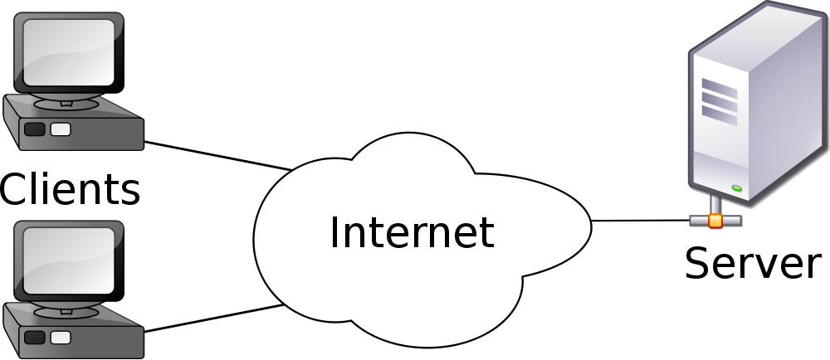
Client / Server model

Slide 8
Client / Server model
Request
From: IP x.x.x.x
For: Page 1
Page 1
x.x.x.x
Page 3
y.y.y.y
Request
From: IP y.y.y.y
For: Page 3

Slide 9
HTTP
Hypertext Transfer Protocol (HTTP)
Clients submit an HTTP request:
GET, POST, PUT, CONNECT…
Header information (who is making the request)
Optional content
Servers return an HTTP response:
Status line (e.g., HTTP/1.1 404 ERROR)
Header information (about the server)
Optional content

Slide 10
XML
eXtensible Markup Language
It describes a schema that is intended to be both human-readable and machine-readable
Every XML document is plain (Unicode) text
XML documents are divided into two parts:
Markup
Content

Slide 11
Markup in XML
Tags begin with < and end with >
Start tag: <section>
End tag: </section>
Empty-element tag: <line-break />
Elements are bookcased by start-tags and end-tags:
<section>Content</section>

Slide 12
Markup in XML
Elements can be nested:
<section>
<subsection> Content 1 </subsection>
<subsection> Content 2 </subsection>
</section>
Elements can have attributes:
<step number=“3”>Magic happens</step>

Slide 13
Escapes and comments
To allow tag characters to be parsed correctly, there must be a way to create them. This is done by escaping a character with & and ;
&lt; is parsed as <
&gt; is parsed as >
&amp; is parsed as &
To add a comment (that will not be parsed):
<!-- This is a comment & won’t be parsed -->

Slide 14
HTML and Browsers
Hypertext Markup Language (HTML) is a subset of XML, with certain tags with predefined meanings
Every browser is just an HTML parser!
(Ok, not just an HTML parser. Also a parser of CSS, Javascript…)

Slide 15
Cascading Style Sheets
Provides a standard form for describing the style of elements in an HTML document
Selectors
identifies single elements or groups of elements
Properties
Which aspects of the element(s) should be formatted
Values
How the property of the element(s) should be formatted

