Slide 1
graftM

Slide 2
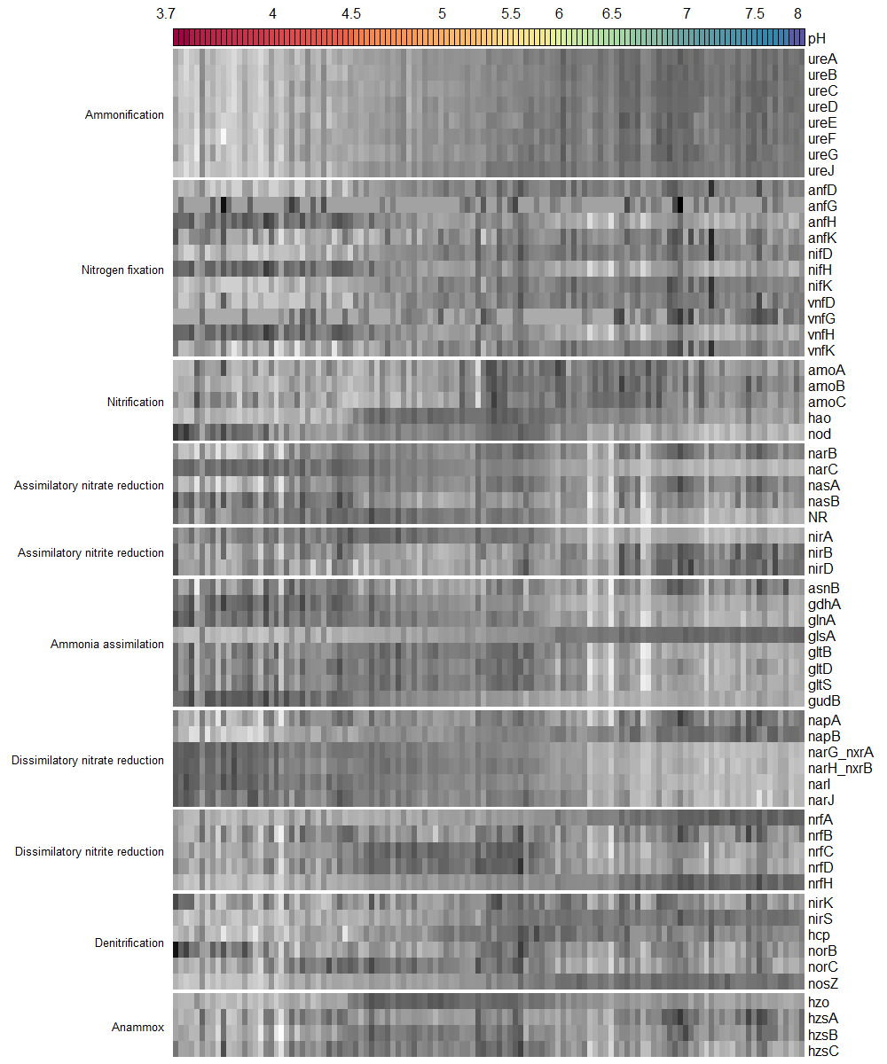
Relative abundance
Data | F_value | p_value | Signif
ureA | 421.63 | 0.0000 | ***
ureB | 452.27 | 0.0000 | ***
ureC | 444.15 | 0.0000 | ***
ureD | 320.68 | 0.0000 | ***
ureE | 242.76 | 0.0000 | ***
ureF | 230.72 | 0.0000 | ***
ureG | 206.85 | 0.0000 | ***
ureJ | 229.16 | 0.0000 | ***
anfD | 58.42 | 0.0000 | ***
anfG | 0.05 | 0.8321
anfH | 97.20 | 0.0000 | ***
anfK | 12.26 | 0.0007 | ***
nifD | 55.29 | 0.0000 | ***
nifH | 103.45 | 0.0000 | ***
nifK | 88.42 | 0.0000 | ***
vnfD | 47.33 | 0.0000 | ***
vnfG | 18.76 | 0.0000 | ***
vnfH | 109.56 | 0.0000 | ***
vnfK | 33.80 | 0.0000 | ***
amoA | 11.60 | 0.0009 | ***
amoB | 54.37 | 0.0000 | ***
amoC | 15.12 | 0.0002 | ***
hao | 3.19 | 0.0765
nod | 77.93 | 0.0000 | ***
narB | 20.82 | 0.0000 | ***
narC | 581.44 | 0.0000 | ***
nasA | 16.82 | 0.0001 | ***
nasB | 16.61 | 0.0001 | ***
NR | 91.95 | 0.0000 | ***
nirA | 110.31 | 0.0000 | ***
nirB | 19.40 | 0.0000 | ***
nirD | 37.55 | 0.0000 | ***
asnB | 0.44 | 0.5073
gdhA | 141.00 | 0.0000 | ***
glnA | 164.30 | 0.0000 | ***
glsA | 827.29 | 0.0000 | ***
gltB | 44.32 | 0.0000 | ***
gltD | 37.31 | 0.0000 | ***
gltS | 44.81 | 0.0000 | ***
gudB | 225.47 | 0.0000 | ***
napA | 14.46 | 0.0002 | ***
napB | 222.85 | 0.0000 | ***
narG_nxrA | 677.71 | 0.0000 | ***
narH_nxrB | 346.81 | 0.0000 | ***
narI | 551.96 | 0.0000 | ***
narJ | 178.71 | 0.0000 | ***
nrfA | 430.66 | 0.0000 | ***
nrfB | 4.68 | 0.0325 | *
nrfC | 3.85 | 0.0521
nrfD | 6.74 | 0.0106 | *
nrfH | 472.19 | 0.0000 | ***
nirK | 1.52 | 0.2206
nirS | 319.23 | 0.0000 | ***
hcp | 37.69 | 0.0000 | ***
norB | 1.45 | 0.2303
norC | 4.79 | 0.0307 | *
nosZ | 441.27 | 0.0000 | ***
hzo | 0.05 | 0.8199
hzsA | 19.34 | 0.0000 | ***
hzsB | 6.89 | 0.0098 | **
hzsC | 3.54 | 0.0625
ANOVA results

Slide 3
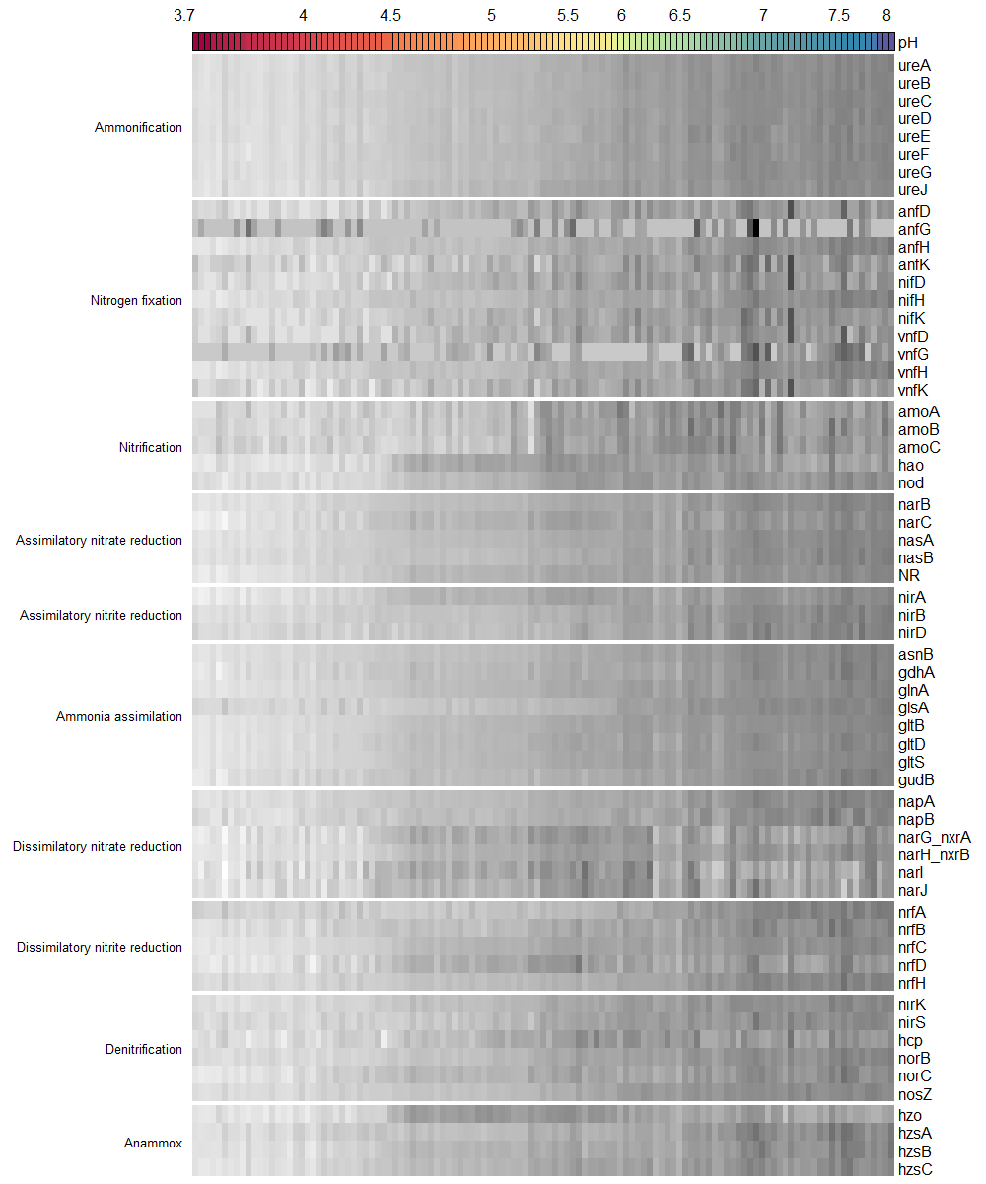
Absolute abundance
qPCR
Data | F_value | p_value | Signif
ureA | 0.93 | 0.3367
ureB | 1.23 | 0.2691
ureC | 5.31 | 0.0230 | *
ureD | 2.34 | 0.1291
ureE | 1.30 | 0.2565
ureF | 2.27 | 0.1348
ureG | 12.47 | 0.0006 | ***
ureJ | 1.85 | 0.1764
anfD | 104.07 | 0.0000 | ***
anfG | 2.19 | 0.1414
anfH | 66.18 | 0.0000 | ***
anfK | 58.39 | 0.0000 | ***
nifD | 7.04 | 0.0091 | **
nifH | 19.51 | 0.0000 | ***
nifK | 10.24 | 0.0018 | **
vnfD | 1.49 | 0.2240
vnfG | 1.79 | 0.1836
vnfH | 99.58 | 0.0000 | ***
vnfK | 0.10 | 0.7508
amoA | 109.08 | 0.0000 | ***
amoB | 112.01 | 0.0000 | ***
amoC | 101.29 | 0.0000 | ***
hao | 6.43 | 0.0125 | *
nod | 26.69 | 0.0000 | ***
narB | 2.34 | 0.1286
narC | 10.87 | 0.0013 | **
nasA | 0.58 | 0.4473
nasB | 5.32 | 0.0228 | *
NR | 603.51 | 0.0000 | ***
nirA | 20.69 | 0.0000 | ***
nirB | 5.65 | 0.0191 | *
nirD | 1.10 | 0.2974
asnB | 75.54 | 0.0000 | ***
gdhA | 28.31 | 0.0000 | ***
glnA | 30.91 | 0.0000 | ***
glsA | 138.84 | 0.0000 | ***
gltB | 22.70 | 0.0000 | ***
gltD | 15.79 | 0.0001 | ***
gltS | 14.14 | 0.0003 | ***
gudB | 1.91 | 0.1699
napA | 3.96 | 0.0491 | *
napB | 27.10 | 0.0000 | ***
narG_nxrA | 30.45 | 0.0000 | ***
narH_nxrB | 11.27 | 0.0011 | **
narI | 50.17 | 0.0000 | ***
narJ | 16.89 | 0.0001 | ***
nrfA | 58.04 | 0.0000 | ***
nrfB | 18.84 | 0.0000 | ***
nrfC | 25.66 | 0.0000 | ***
nrfD | 22.00 | 0.0000 | ***
nrfH | 0.87 | 0.3533
nirK | 7.10 | 0.0088 | **
nirS | 11.66 | 0.0009 | ***
hcp | 17.37 | 0.0001 | ***
norB | 17.36 | 0.0001 | ***
norC | 19.20 | 0.0000 | ***
nosZ | 0.60 | 0.4408
hzo | 0.57 | 0.4519
hzsA | 12.13 | 0.0007 | ***
hzsB | 4.90 | 0.0287 | *
hzsC | 1.02 | 0.3135
ANOVA results

Slide 4
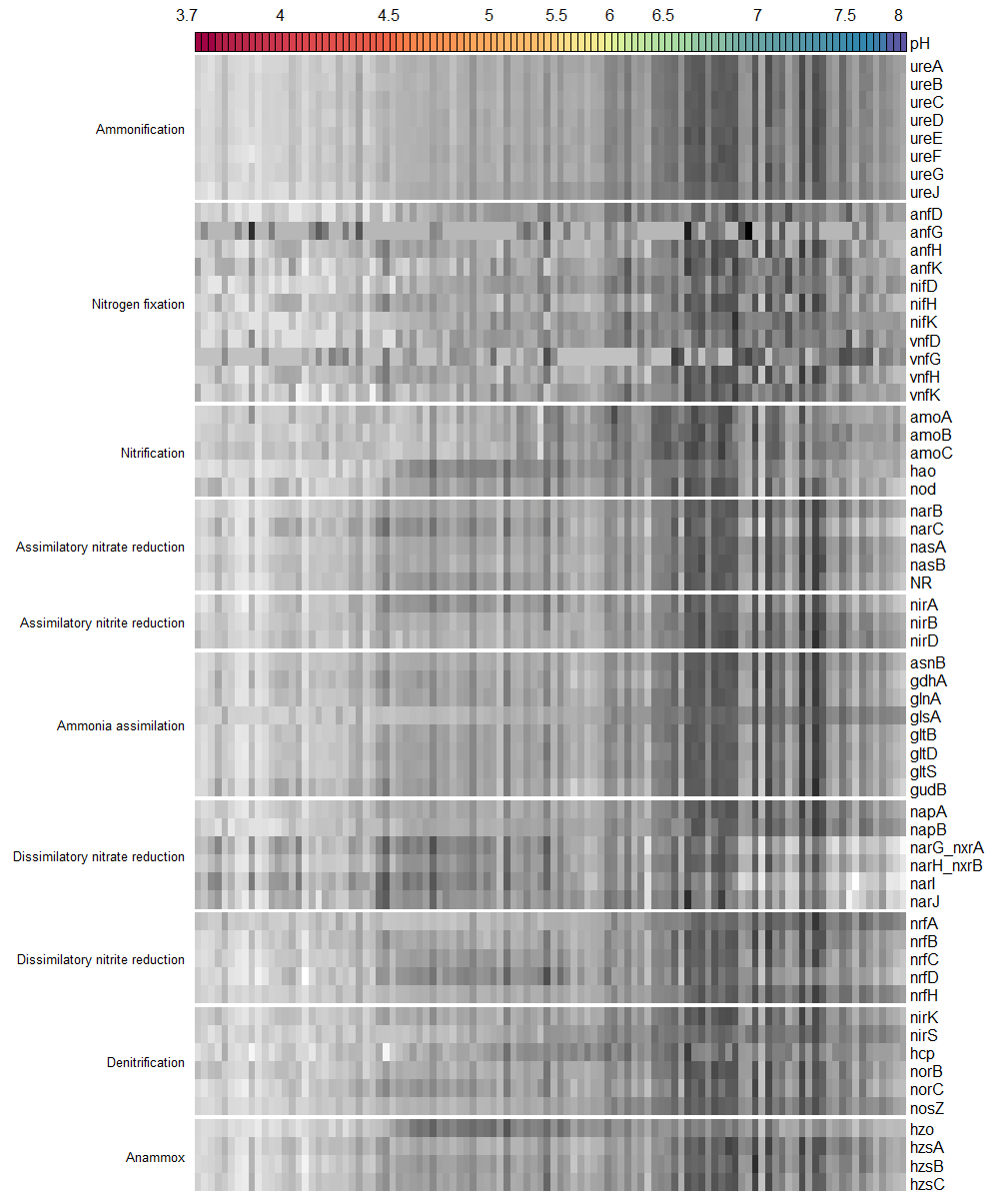
Absolute abundance
PLFA
Data | F_value | p_value | Signif
ureA | 140.44 | 0.0000 | ***
ureB | 129.52 | 0.0000 | ***
ureC | 125.25 | 0.0000 | ***
ureD | 128.01 | 0.0000 | ***
ureE | 118.78 | 0.0000 | ***
ureF | 120.56 | 0.0000 | ***
ureG | 103.97 | 0.0000 | ***
ureJ | 151.34 | 0.0000 | ***
anfD | 89.80 | 0.0000 | ***
anfG | 1.20 | 0.2758
anfH | 39.35 | 0.0000 | ***
anfK | 57.10 | 0.0000 | ***
nifD | 92.94 | 0.0000 | ***
nifH | 40.72 | 0.0000 | ***
nifK | 93.65 | 0.0000 | ***
vnfD | 79.77 | 0.0000 | ***
vnfG | 27.08 | 0.0000 | ***
vnfH | 37.40 | 0.0000 | ***
vnfK | 72.62 | 0.0000 | ***
amoA | 44.18 | 0.0000 | ***
amoB | 72.15 | 0.0000 | ***
amoC | 58.85 | 0.0000 | ***
hao | 27.77 | 0.0000 | ***
nod | 31.63 | 0.0000 | ***
narB | 83.82 | 0.0000 | ***
narC | 9.02 | 0.0033 | **
nasA | 82.84 | 0.0000 | ***
nasB | 60.15 | 0.0000 | ***
NR | 35.85 | 0.0000 | ***
nirA | 25.09 | 0.0000 | ***
nirB | 82.41 | 0.0000 | ***
nirD | 99.11 | 0.0000 | ***
asnB | 77.90 | 0.0000 | ***
gdhA | 35.18 | 0.0000 | ***
glnA | 49.26 | 0.0000 | ***
glsA | 181.27 | 0.0000 | ***
gltB | 57.05 | 0.0000 | ***
gltD | 50.81 | 0.0000 | ***
gltS | 55.29 | 0.0000 | ***
gudB | 28.21 | 0.0000 | ***
napA | 83.20 | 0.0000 | ***
napB | 121.43 | 0.0000 | ***
narG_nxrA | 0.29 | 0.5935
narH_nxrB | 13.99 | 0.0003 | ***
narI | 4.43 | 0.0377 | *
narJ | 3.09 | 0.0816
nrfA | 172.48 | 0.0000 | ***
nrfB | 71.23 | 0.0000 | ***
nrfC | 57.34 | 0.0000 | ***
nrfD | 22.60 | 0.0000 | ***
nrfH | 165.01 | 0.0000 | ***
nirK | 70.63 | 0.0000 | ***
nirS | 214.37 | 0.0000 | ***
hcp | 69.13 | 0.0000 | ***
norB | 71.29 | 0.0000 | ***
norC | 45.07 | 0.0000 | ***
nosZ | 152.03 | 0.0000 | ***
hzo | 8.71 | 0.0039 | **
hzsA | 80.61 | 0.0000 | ***
hzsB | 69.54 | 0.0000 | ***
hzsC | 48.43 | 0.0000 | ***
ANOVA results

Slide 5
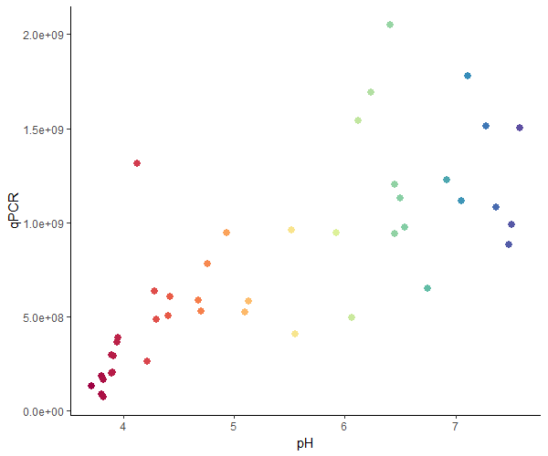
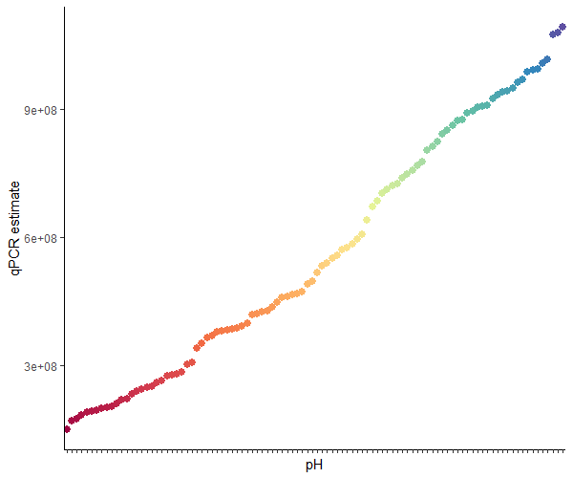
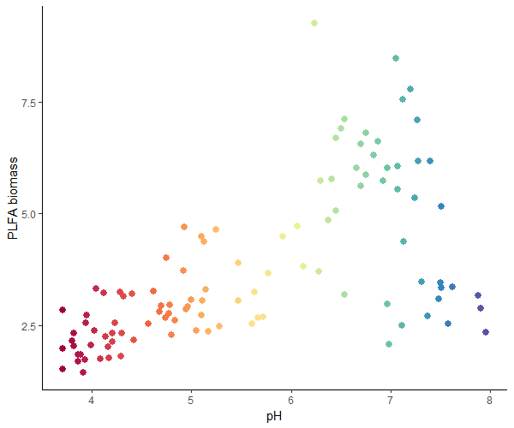
Biomass estimations

Slide 6
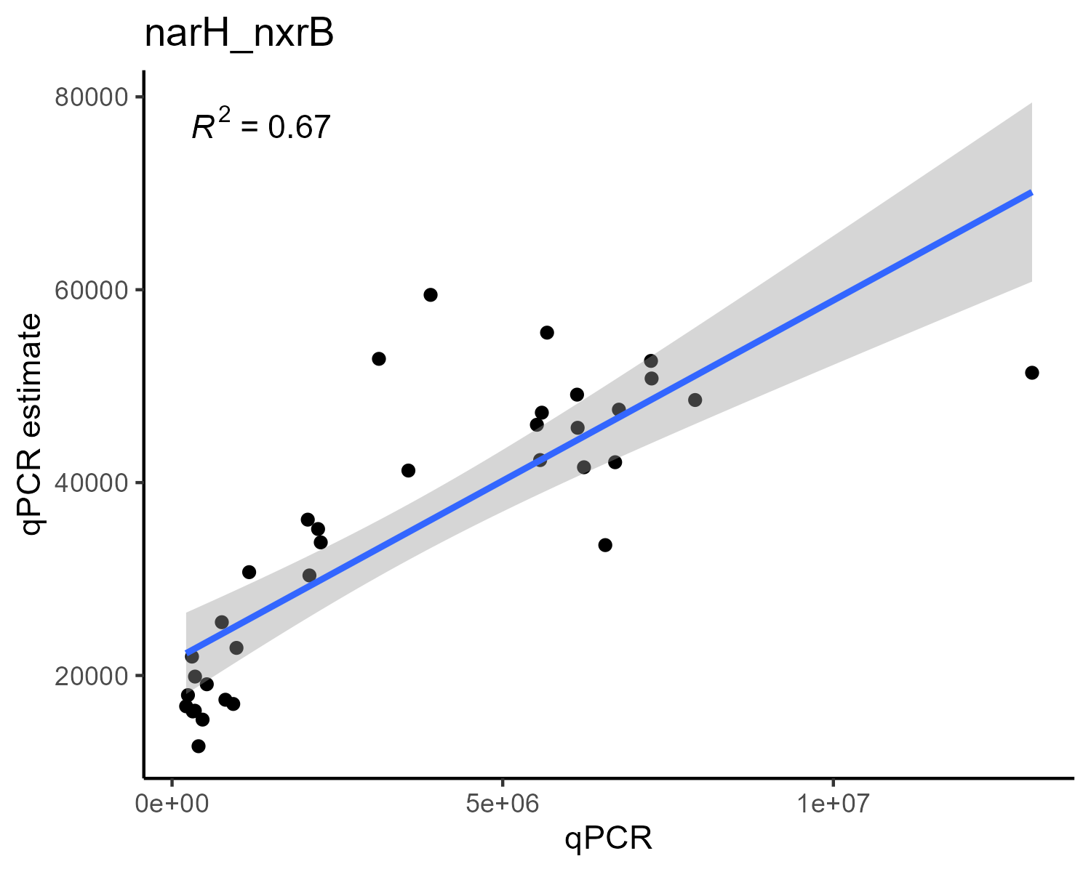
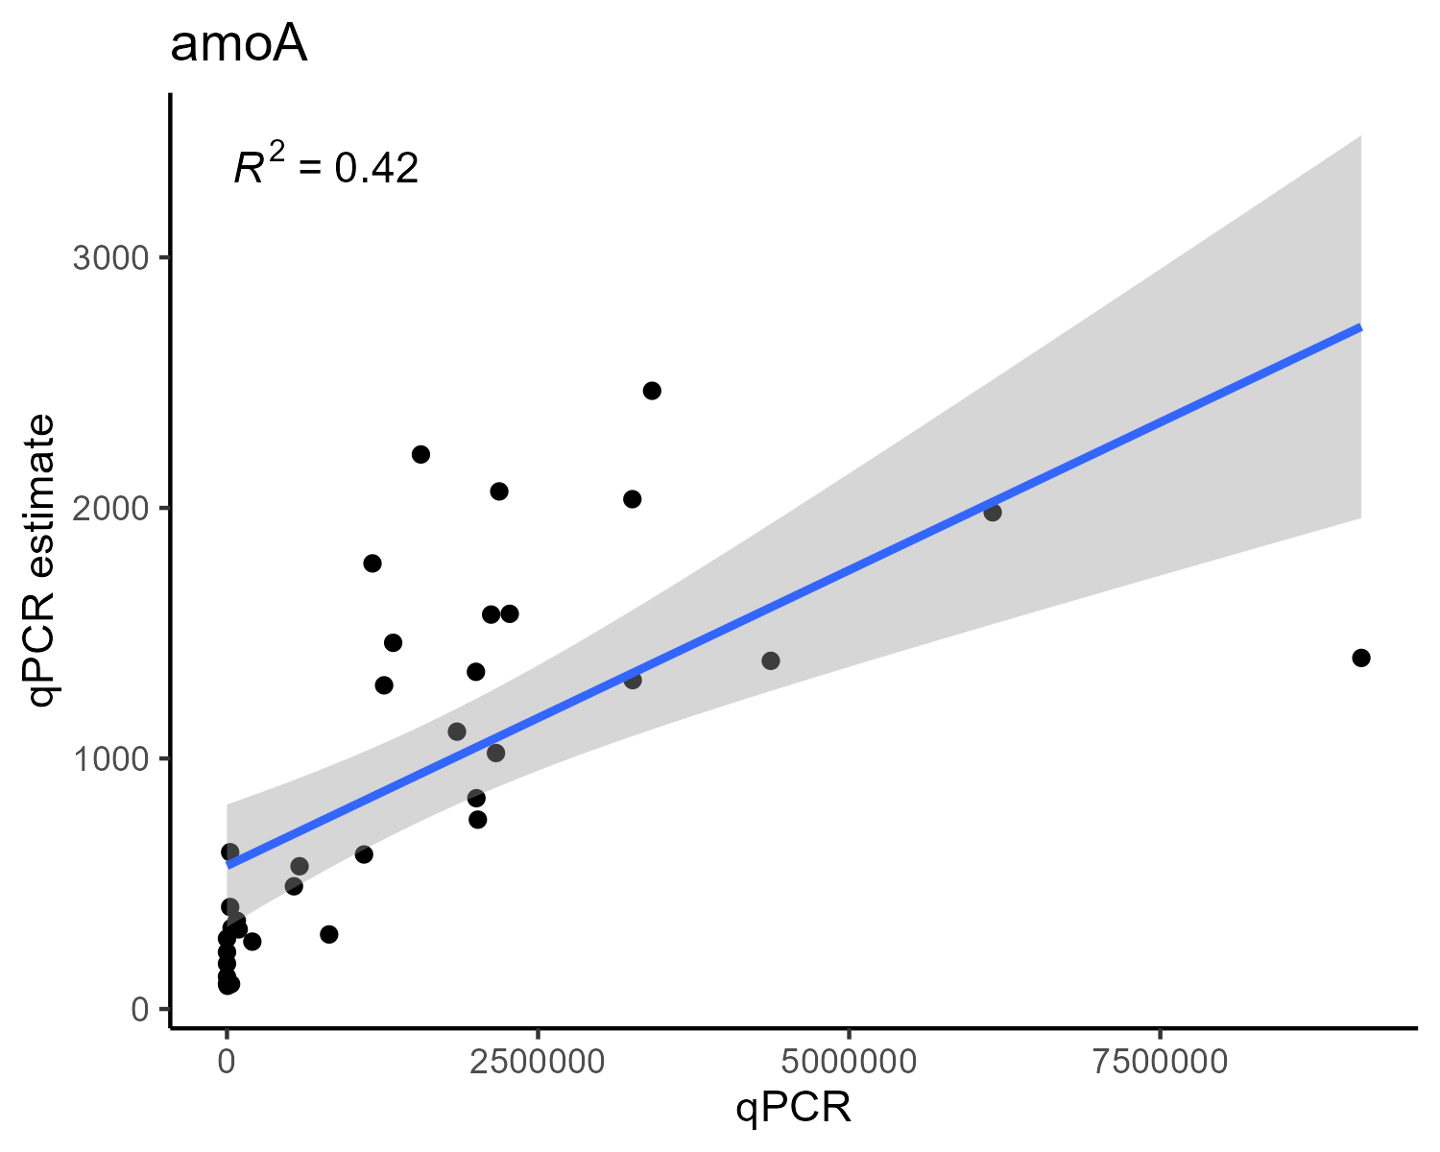
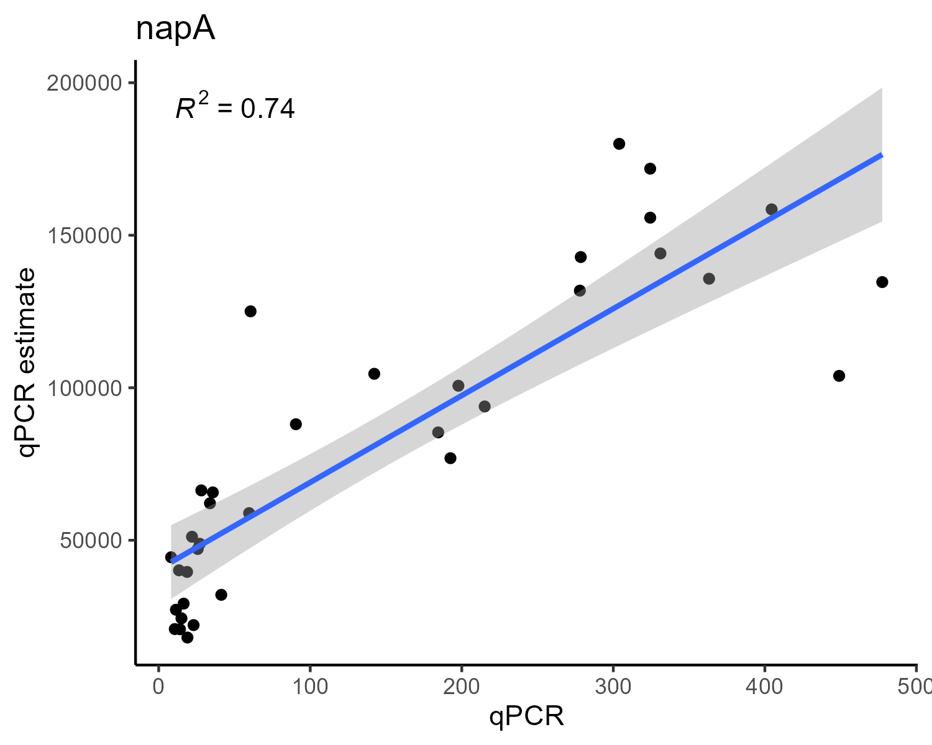
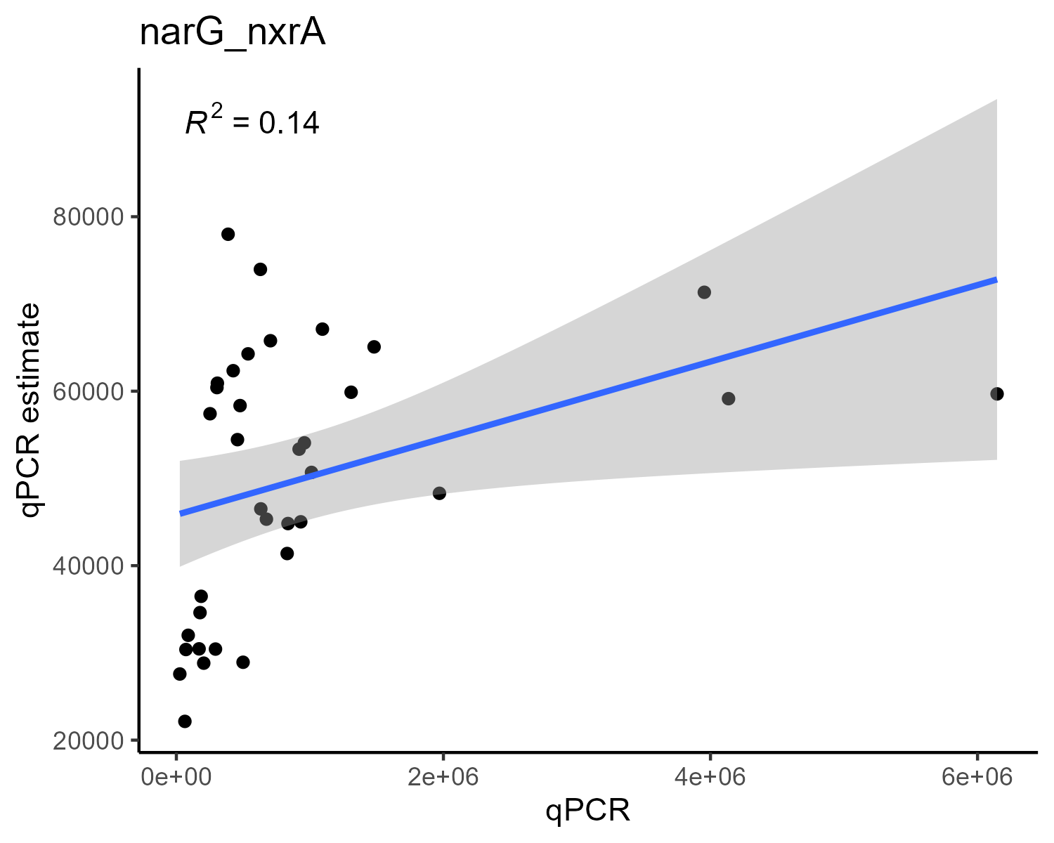
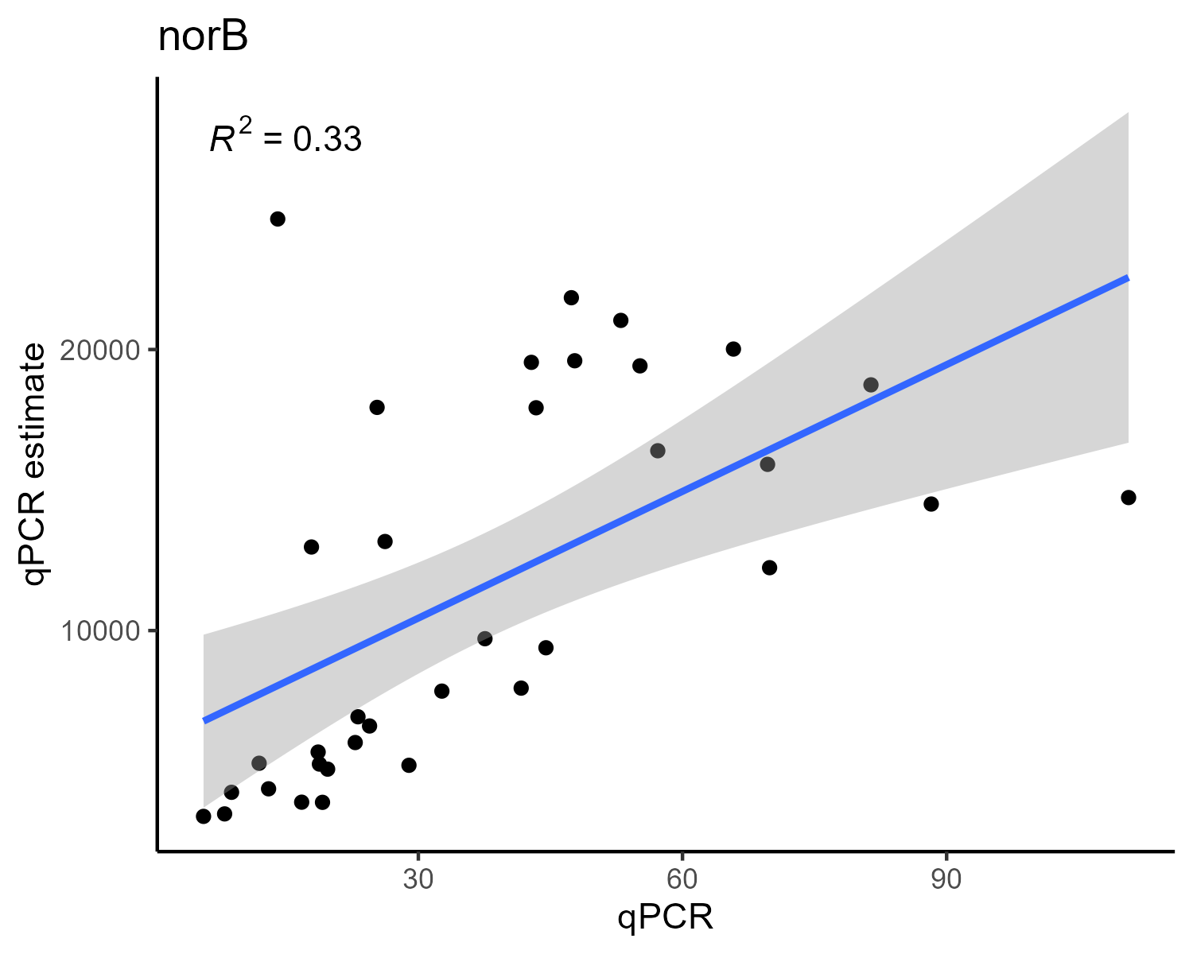
qPCR results vs qPCR estimation

Slide 7
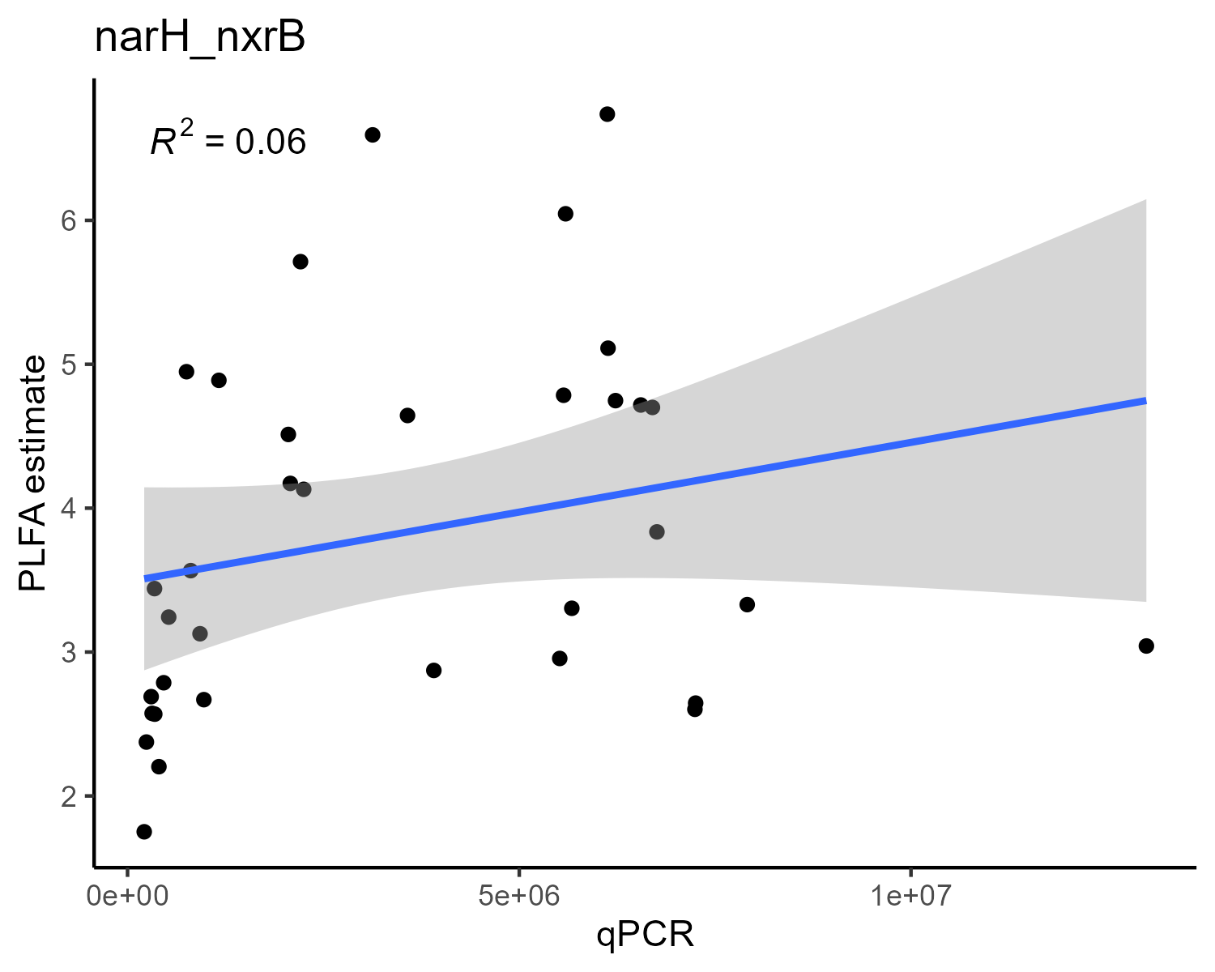
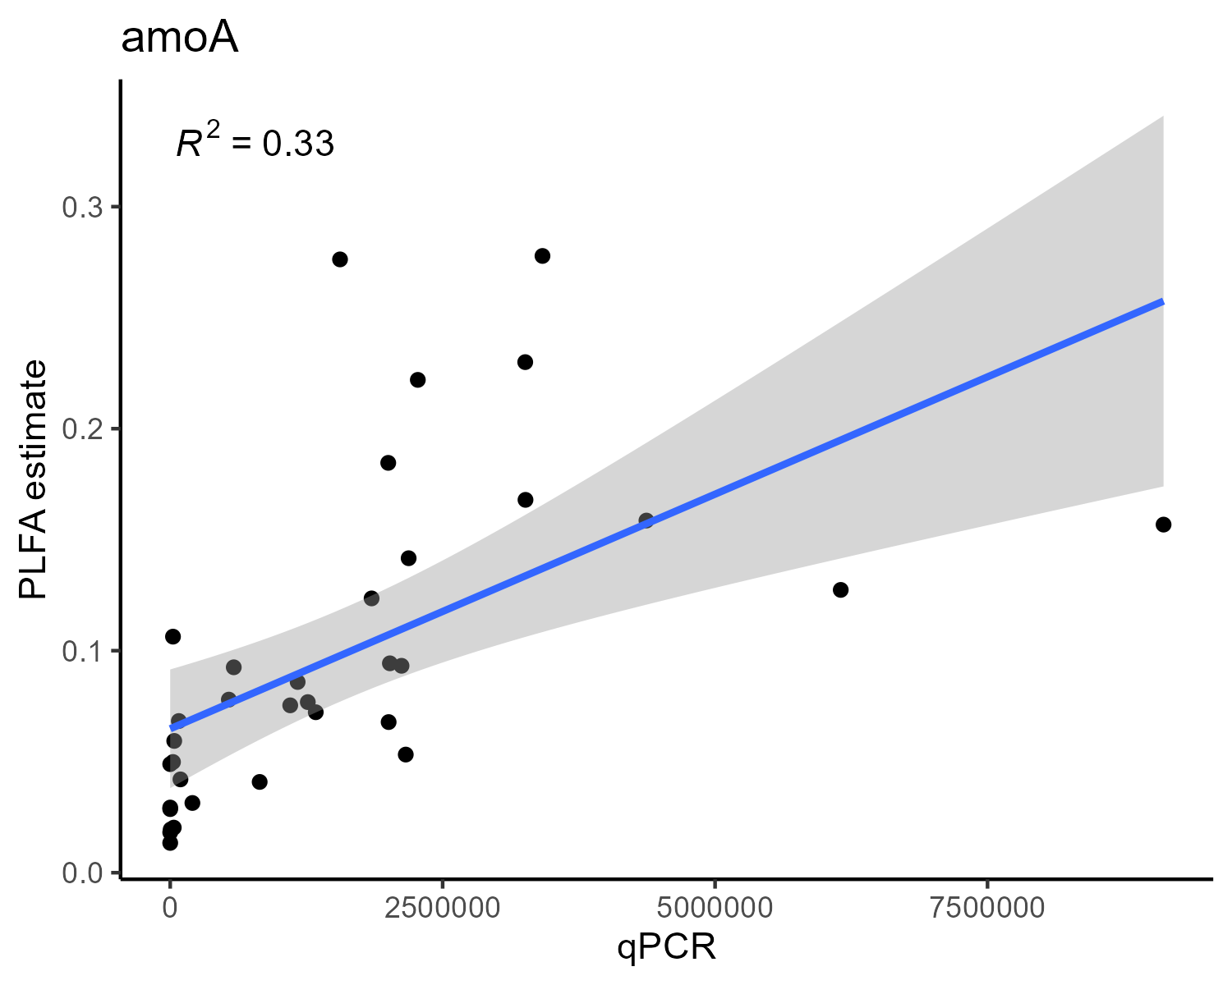
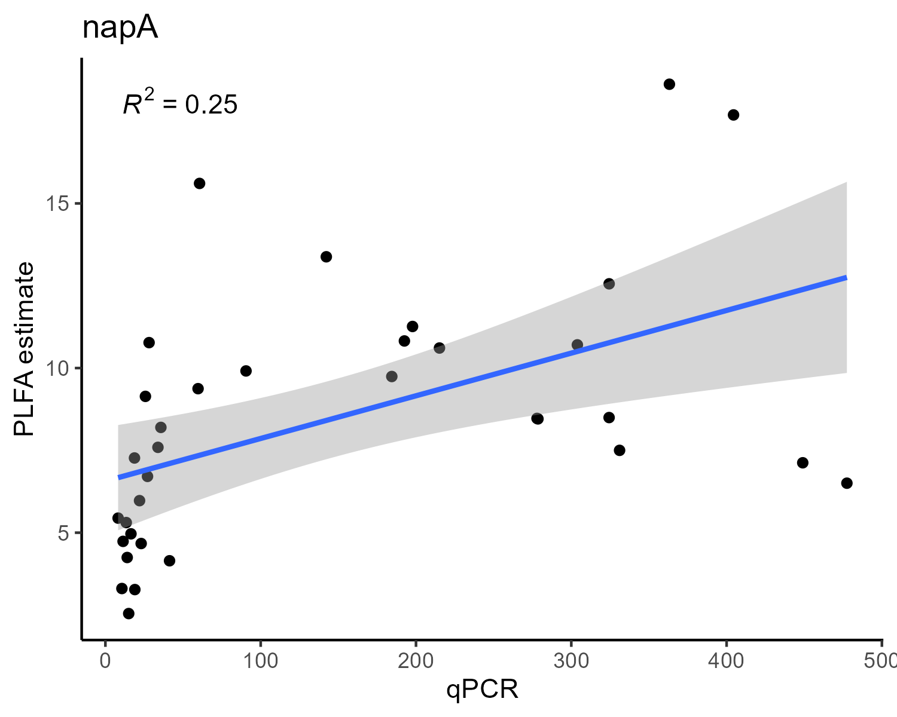
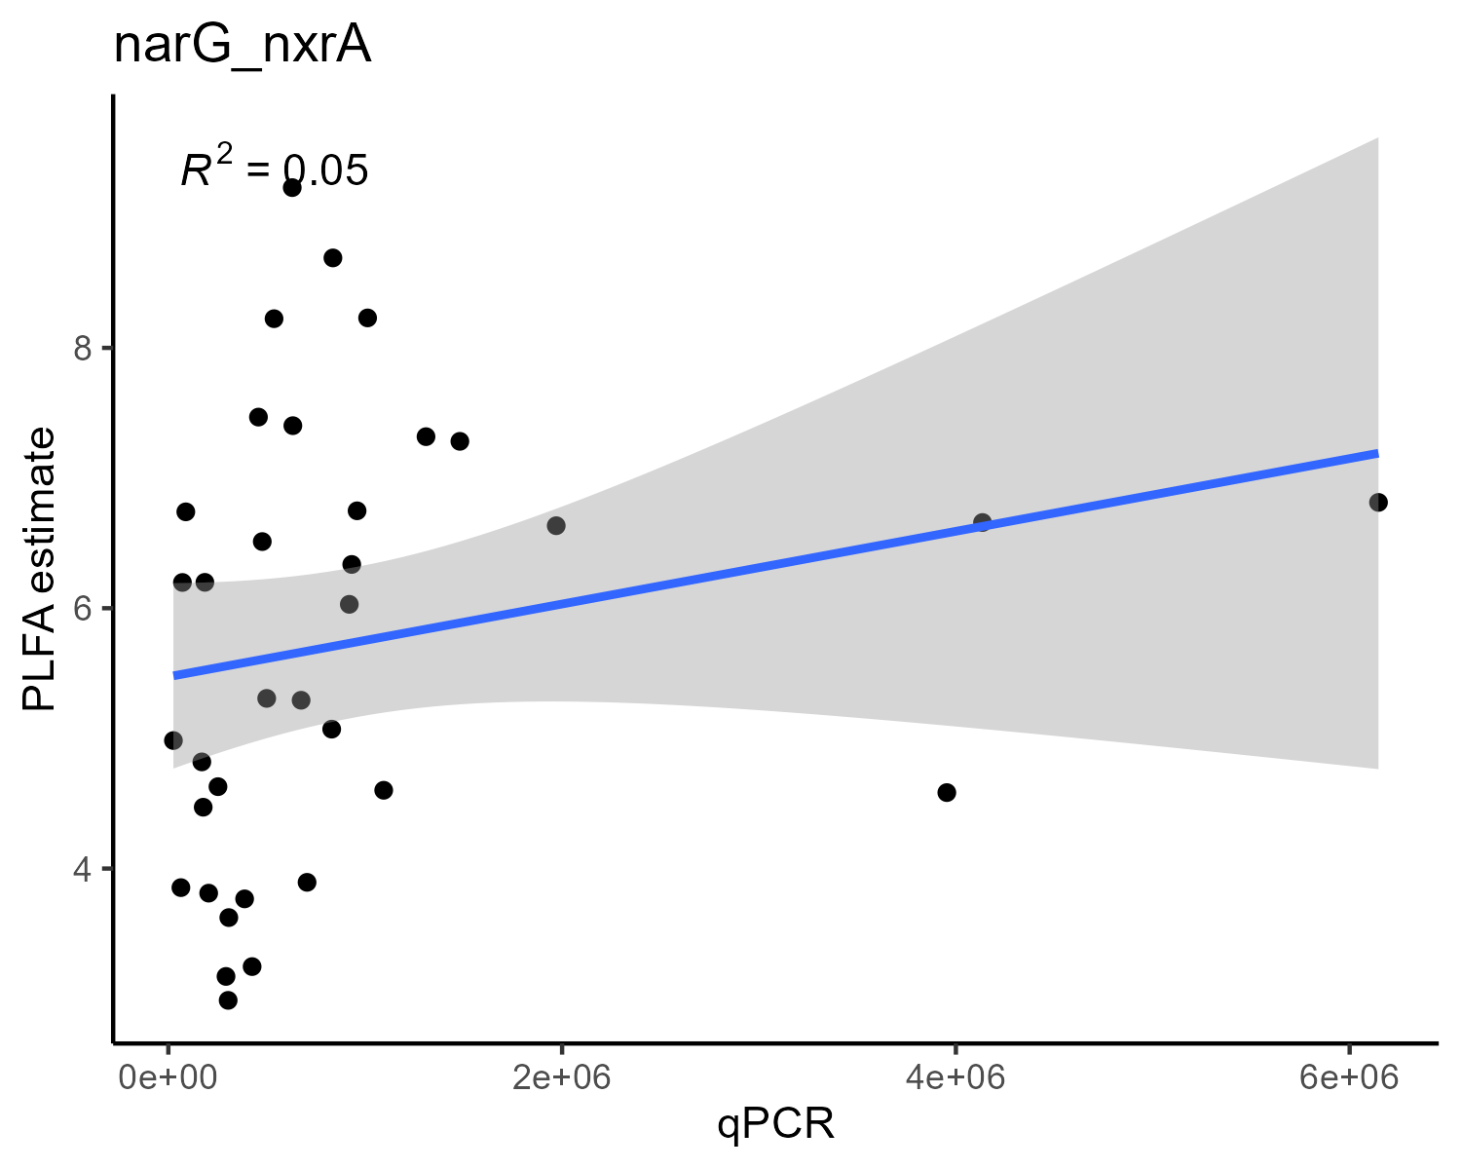
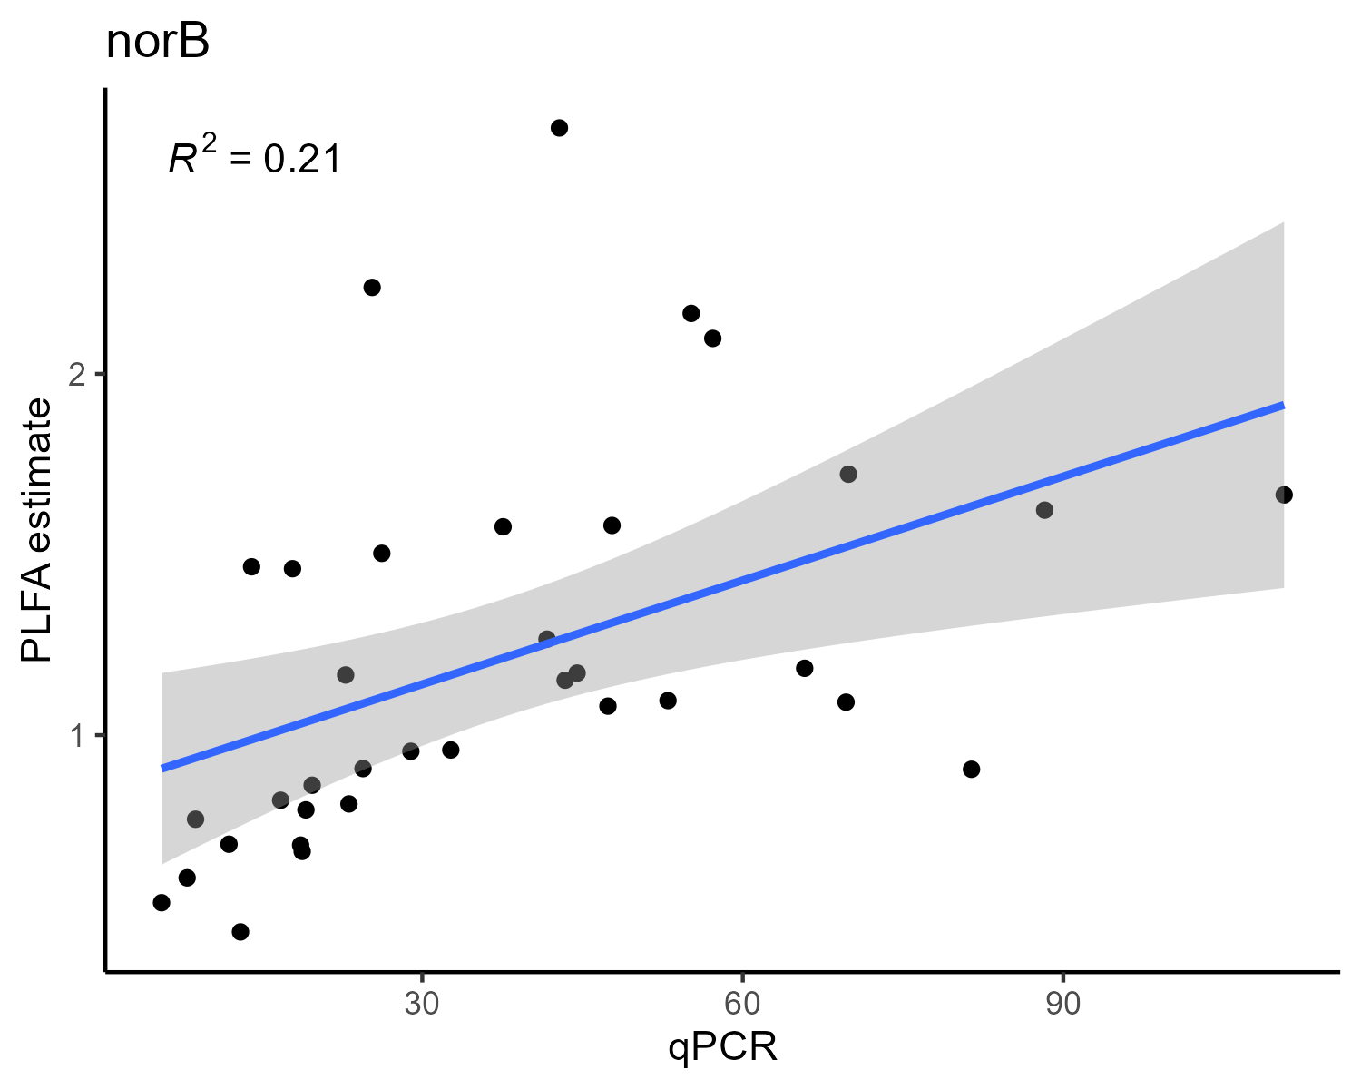
qPCR results vs PLFA estimation

Slide 8
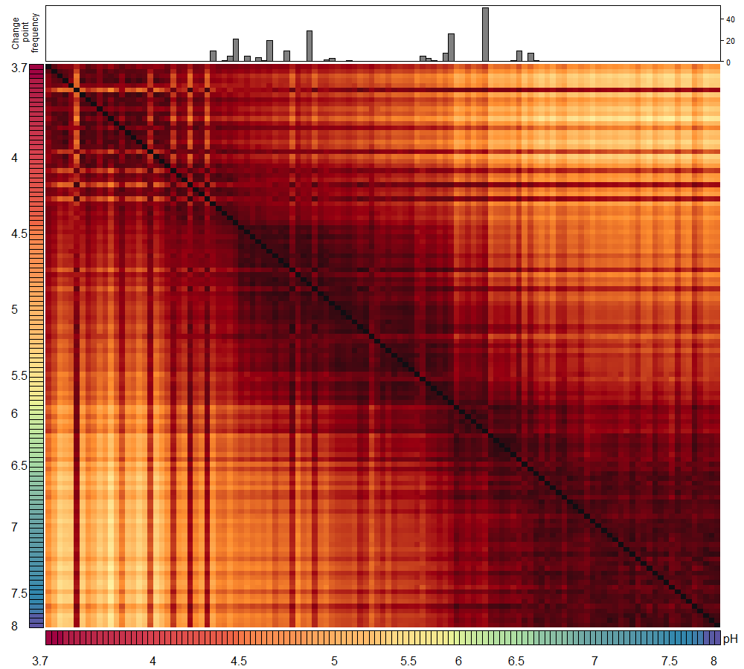
Hellinger distances
PERMANOVA results
Df | SumOfSqs | R2 | F | Pr(>F)
1 | 0.2535 | 0.47195 | 104.573 | 0.001
117 | 0.2836 | 0.52804 | NA | NA
118 | 0.5371 | 1.00000 | NA | NA

Slide 9
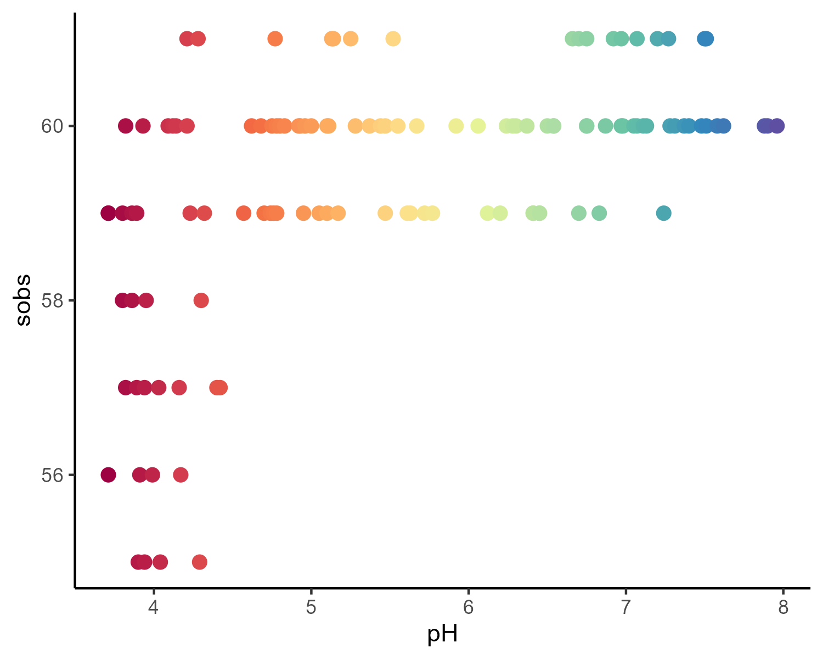
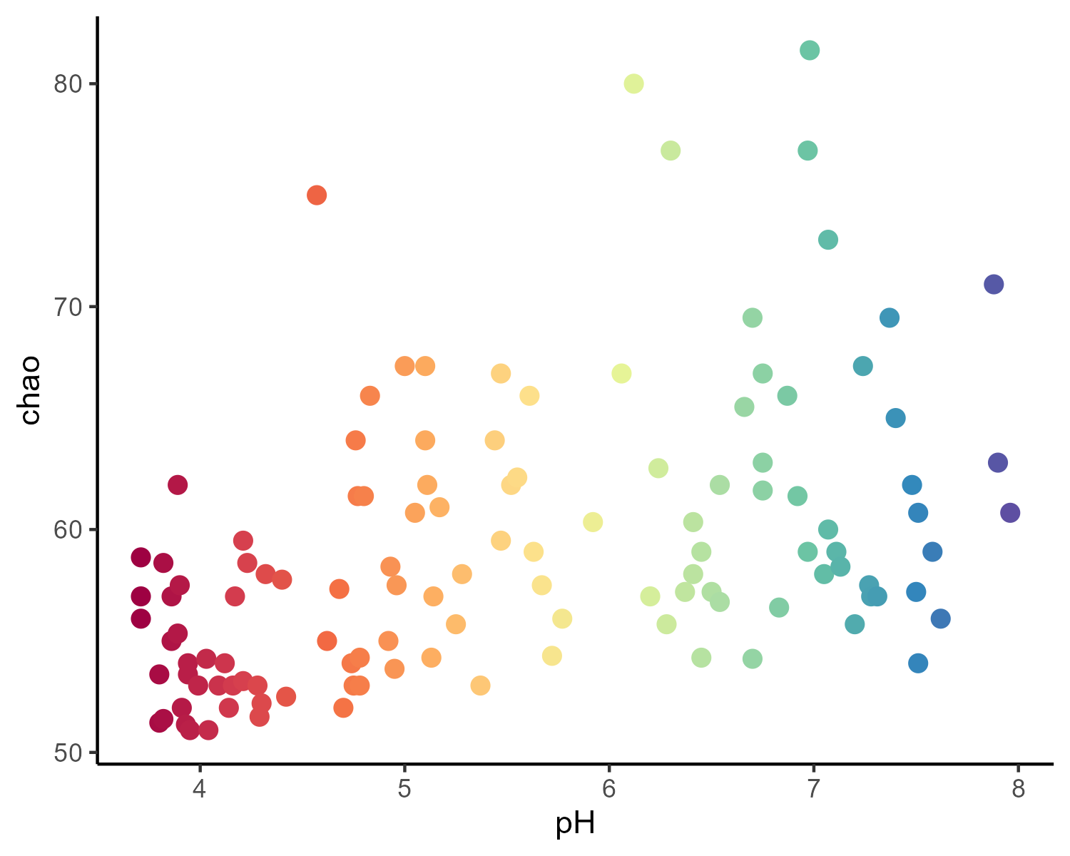
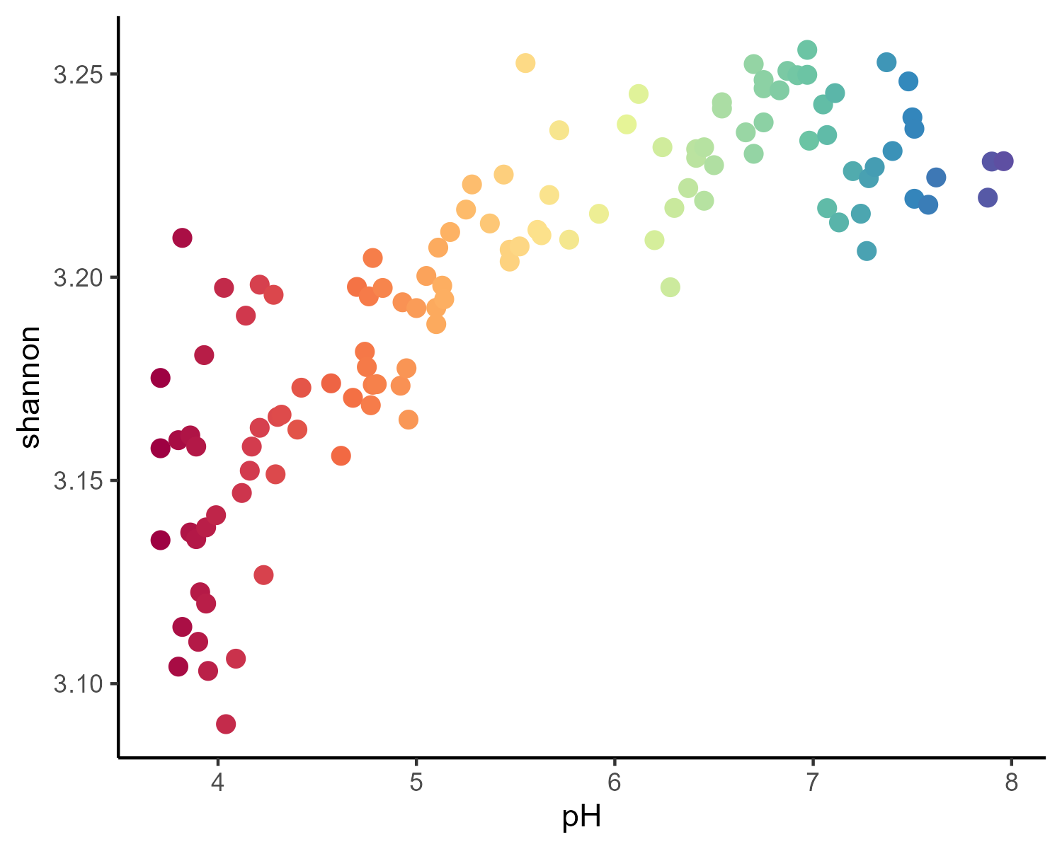
Alpha diversity
ANOVA results
Data | F_value | p_value | Signif
shannon | 246.32 | 0 | ***
sobs | 47.76 | 0 | ***
chao | 28.61 | 0 | ***

Slide 10
SingleM genes

Slide 11
Best cluster identification
Calculated stats for each gene*clustering level combination:
ANOVA for Sobs, Shannon and Chao1 alpha-diversity
PERMANOVA for singleM GSV composition
Best cluster identified as:
Has all 4 p-values lower than 0.01 (0.05 for chao1)
Has the highest combinations of all R2 (sum of R2)
Out of 5 highest R2 value combinations has a max F-values combinations (sum of F)
cluster | Gene | R2_ perm | F_ perm | p_ perm | F_value_sobs | p_value_sobs | R2_sobs | F_value_ shannon | p_value_ shannon | R2_ shannon | F_value_chao1 | p_value_chao1 | R2_ chao1 | sum_r2 | sum_F
73 | anfH | 0.16 | 22.08 | 0.00 | 415.56 | 0.00 | 0.78 | 332.91 | 0.00 | 0.74 | 96.94 | 0.00 | 0.45 | 2.13 | 867.49
67 | asnB | 0.14 | 19.02 | 0.00 | 324.10 | 0.00 | 0.73 | 262.07 | 0.00 | 0.69 | 225.86 | 0.00 | 0.66 | 2.22 | 831.05
86 | gdhA | 0.18 | 24.97 | 0.00 | 439.82 | 0.00 | 0.79 | 381.90 | 0.00 | 0.77 | 106.68 | 0.00 | 0.48 | 2.21 | 953.36
51 | glnA | 0.56 | 150.91 | 0.00 | 46.95 | 0.00 | 0.29 | 305.55 | 0.00 | 0.72 | 21.59 | 0.00 | 0.16 | 1.73 | 524.99
99 | glsA | 0.03 | 2.52 | 0.00 | 92.82 | 0.00 | 0.52 | 84.31 | 0.00 | 0.50 | 61.81 | 0.00 | 0.42 | 1.48 | 241.45
96 | gltB | 0.07 | 8.16 | 0.00 | 154.06 | 0.00 | 0.57 | 103.84 | 0.00 | 0.47 | 80.32 | 0.00 | 0.41 | 1.51 | 346.39
70 | gltD | 0.14 | 18.40 | 0.00 | 359.17 | 0.00 | 0.75 | 338.61 | 0.00 | 0.74 | 204.16 | 0.00 | 0.64 | 2.27 | 920.34
86 | gltS | 0.08 | 10.54 | 0.00 | 158.68 | 0.00 | 0.58 | 148.67 | 0.00 | 0.56 | 19.08 | 0.00 | 0.14 | 1.36 | 336.97
72 | gudB | 0.32 | 54.48 | 0.00 | 488.18 | 0.00 | 0.81 | 485.58 | 0.00 | 0.81 | 83.60 | 0.00 | 0.42 | 2.35 | 1111.85

