Slide 1
Hoosfield N cycling genes
Olga Shopina

Slide 2
SingleM community profile

Slide 3
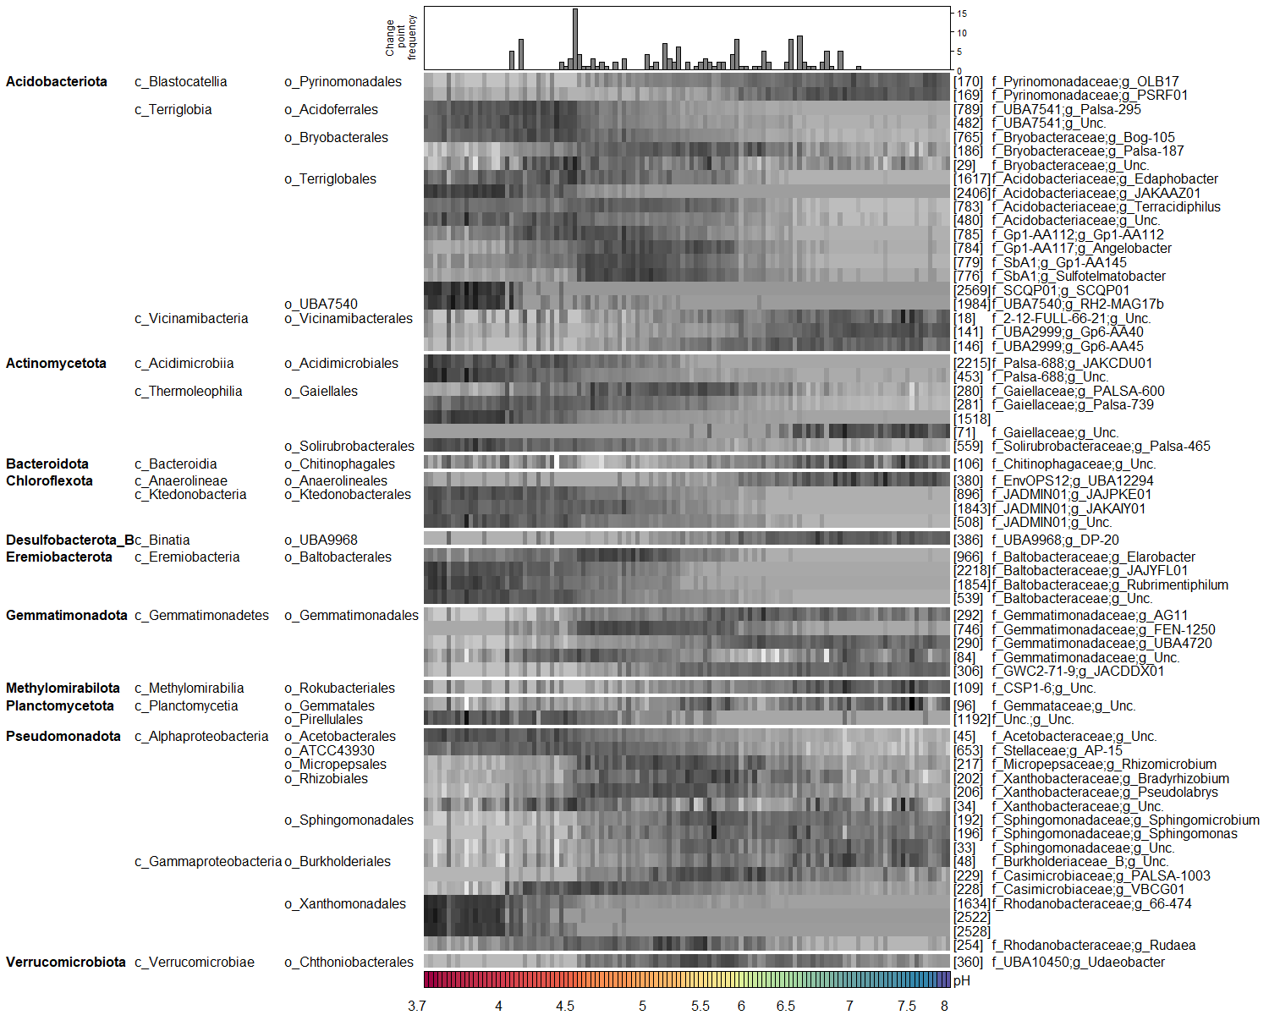
Relative abundance
Data | F_value | p_value | Signif
x170 | 532.97 | 0.0000 | ***
x169 | 292.80 | 0.0000 | ***
x789 | 165.94 | 0.0000 | ***
x482 | 186.46 | 0.0000 | ***
x765 | 279.32 | 0.0000 | ***
x186 | 0.63 | 0.4283
x29 | 7.86 | 0.0059 | **
x1617 | 131.52 | 0.0000 | ***
x2406 | 102.83 | 0.0000 | ***
x783 | 175.57 | 0.0000 | ***
x480 | 235.11 | 0.0000 | ***
x785 | 68.06 | 0.0000 | ***
x784 | 11.70 | 0.0009 | ***
x779 | 27.84 | 0.0000 | ***
x776 | 7.02 | 0.0092 | **
x2569 | 50.20 | 0.0000 | ***
x1984 | 56.12 | 0.0000 | ***
x18 | 77.05 | 0.0000 | ***
x141 | 328.16 | 0.0000 | ***
x146 | 237.19 | 0.0000 | ***
x2215 | 180.08 | 0.0000 | ***
x453 | 110.57 | 0.0000 | ***
x280 | 10.91 | 0.0013 | **
x281 | 428.22 | 0.0000 | ***
x1518 | 116.88 | 0.0000 | ***
x71 | 116.92 | 0.0000 | ***
x559 | 259.30 | 0.0000 | ***
x106 | 39.00 | 0.0000 | ***
x380 | 141.59 | 0.0000 | ***
x896 | 297.85 | 0.0000 | ***
x1843 | 346.73 | 0.0000 | ***
x508 | 233.28 | 0.0000 | ***
x386 | 241.09 | 0.0000 | ***
x966 | 43.64 | 0.0000 | ***
x2218 | 199.92 | 0.0000 | ***
x1854 | 146.05 | 0.0000 | ***
x539 | 240.53 | 0.0000 | ***
x292 | 66.32 | 0.0000 | ***
x746 | 7.76 | 0.0062 | **
x290 | 259.18 | 0.0000 | ***
x84 | 0.16 | 0.6904
x306 | 254.55 | 0.0000 | ***
x109 | 109.33 | 0.0000 | ***
x96 | 43.39 | 0.0000 | ***
x1192 | 100.81 | 0.0000 | ***
x45 | 416.90 | 0.0000 | ***
x653 | 369.23 | 0.0000 | ***
x217 | 1.18 | 0.2796
x202 | 0.31 | 0.5780
x206 | 2.61 | 0.1089
x34 | 2.81 | 0.0965
x192 | 57.07 | 0.0000 | ***
x196 | 42.24 | 0.0000 | ***
x33 | 138.71 | 0.0000 | ***
x48 | 99.28 | 0.0000 | ***
x229 | 7.93 | 0.0057 | **
x228 | 17.29 | 0.0001 | ***
x1634 | 83.40 | 0.0000 | ***
x2522 | 62.54 | 0.0000 | ***
x2528 | 74.63 | 0.0000 | ***
x254 | 15.01 | 0.0002 | ***
x360 | 6.41 | 0.0127 | *

Slide 4
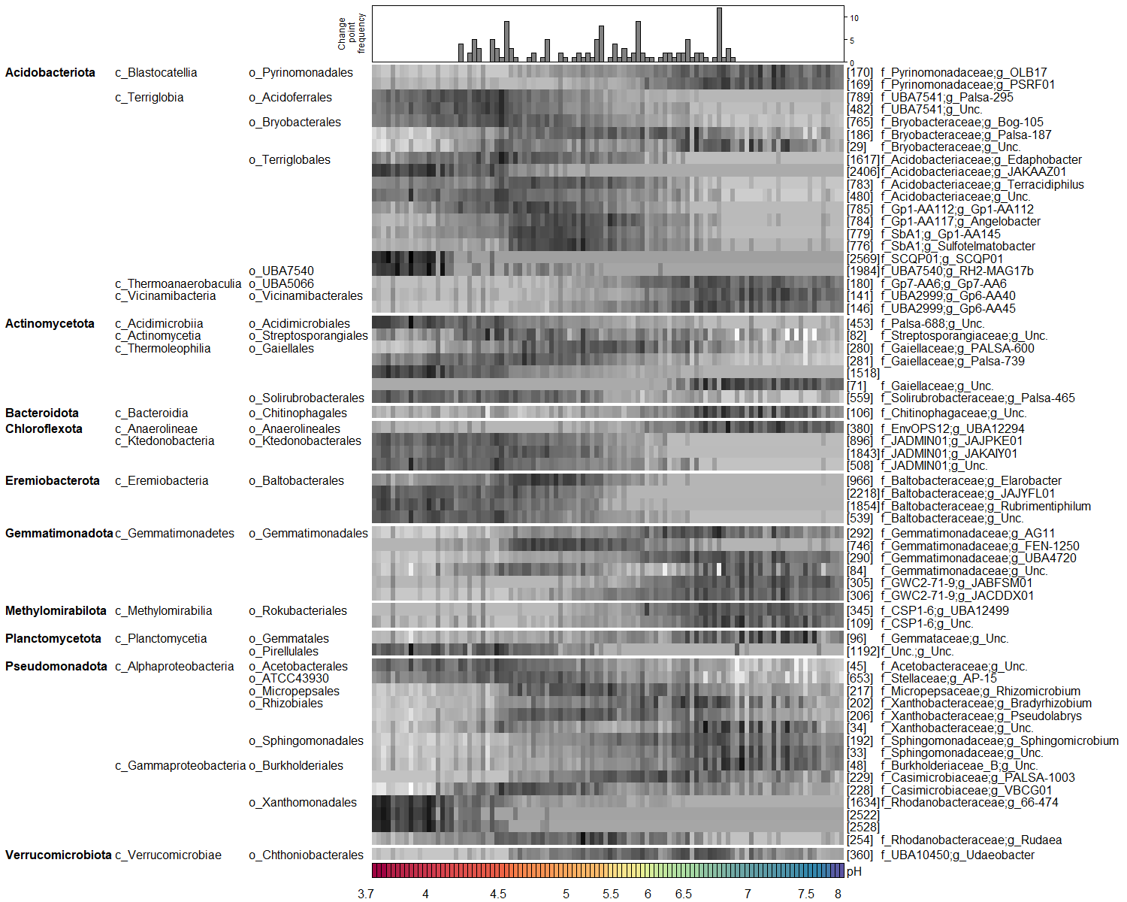
Absolute abundance
PLFA
Data | F_value | p_value | Signif
x170 | 175.28 | 0.0000 | ***
x169 | 139.63 | 0.0000 | ***
x789 | 137.22 | 0.0000 | ***
x482 | 137.22 | 0.0000 | ***
x765 | 144.86 | 0.0000 | ***
x186 | 0.45 | 0.5048
x29 | 19.49 | 0.0000 | ***
x1617 | 62.66 | 0.0000 | ***
x2406 | 82.31 | 0.0000 | ***
x783 | 58.21 | 0.0000 | ***
x480 | 133.10 | 0.0000 | ***
x785 | 44.64 | 0.0000 | ***
x784 | 9.31 | 0.0029 | **
x779 | 18.21 | 0.0000 | ***
x776 | 5.85 | 0.0173 | *
x2569 | 35.90 | 0.0000 | ***
x1984 | 44.22 | 0.0000 | ***
x141 | 150.39 | 0.0000 | ***
x146 | 116.98 | 0.0000 | ***
x2215 | 135.24 | 0.0000 | ***
x453 | 120.19 | 0.0000 | ***
x280 | 1.64 | 0.2031
x281 | 128.27 | 0.0000 | ***
x1518 | 107.69 | 0.0000 | ***
x71 | 82.21 | 0.0000 | ***
x559 | 256.91 | 0.0000 | ***
x106 | 76.52 | 0.0000 | ***
x380 | 107.72 | 0.0000 | ***
x896 | 290.78 | 0.0000 | ***
x1843 | 171.36 | 0.0000 | ***
x508 | 163.67 | 0.0000 | ***
x966 | 25.24 | 0.0000 | ***
x2218 | 213.43 | 0.0000 | ***
x1854 | 171.47 | 0.0000 | ***
x539 | 221.06 | 0.0000 | ***
x292 | 71.15 | 0.0000 | ***
x746 | 6.97 | 0.0096 | **
x290 | 145.98 | 0.0000 | ***
x84 | 13.15 | 0.0005 | ***
x306 | 159.06 | 0.0000 | ***
x109 | 107.09 | 0.0000 | ***
x96 | 80.68 | 0.0000 | ***
x90 | 91.42 | 0.0000 | ***
x1192 | 66.55 | 0.0000 | ***
x45 | 195.31 | 0.0000 | ***
x653 | 95.81 | 0.0000 | ***
x217 | 0.05 | 0.8180
x202 | 22.98 | 0.0000 | ***
x206 | 0.00 | 0.9912
x34 | 25.61 | 0.0000 | ***
x192 | 76.90 | 0.0000 | ***
x33 | 110.99 | 0.0000 | ***
x48 | 89.76 | 0.0000 | ***
x229 | 17.32 | 0.0001 | ***
x228 | 1.45 | 0.2320
x1634 | 71.61 | 0.0000 | ***
x2522 | 49.35 | 0.0000 | ***
x2528 | 57.72 | 0.0000 | ***
x254 | 9.60 | 0.0025 | **
x360 | 16.07 | 0.0001 | ***

Slide 5
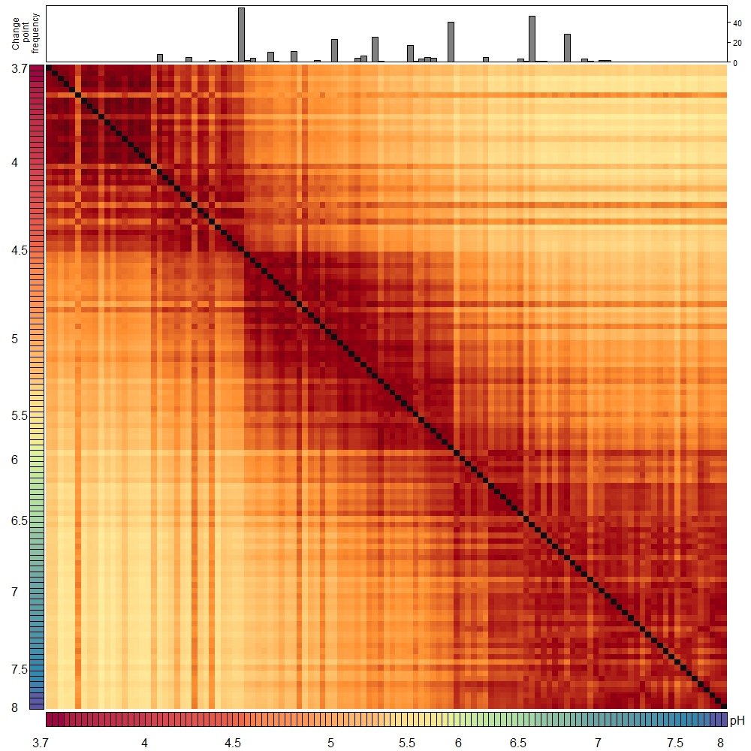
Hellinger distances
PERMANOVA results
Df | SumOfSqs | R2 | F | Pr(>F)
1 | 12.00515 | 0.5215472 | 125.3581 | 0.001
115 | 11.01319 | 0.4784528 | NA | NA
116 | 23.01834 | 1.0000000 | NA | NA

Slide 6
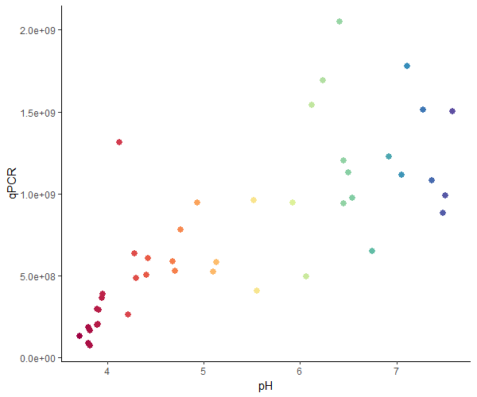
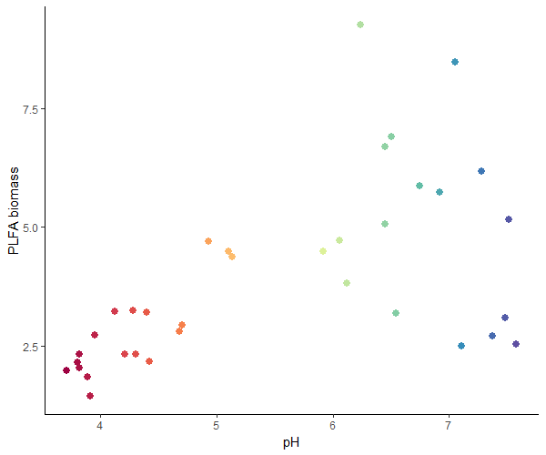
Biomass estimations
Coefficients:
Estimate Std. Error t value Pr(>|t|)
(Intercept) -784625220 213485248 -3.675 0.000682 ***
pH 290848745 38722912 7.511 3.16e-09 ***
---
Coefficients:
Estimate Std. Error t value Pr(>|t|)
(Intercept) -6631272 120955114 -0.055 0.957
I(pH^2) 25646957 3589678 7.145 1.03e-08 ***
---
Coefficients:
Estimate Std. Error t value Pr(>|t|)
(Intercept) -2.770e+09 1.208e+09 -2.293 0.0272 *
pH 1.052e+09 4.580e+08 2.298 0.0269 *
I(pH^2) -6.885e+07 4.127e+07 -1.668 0.1031
---
Coefficients:
Estimate Std. Error t value Pr(>|t|)
(Intercept) -0.23602 0.28857 -0.818 0.419
pH 0.25445 0.05098 4.992 1.89e-05 ***
---
Coefficients:
Estimate Std. Error t value Pr(>|t|)
(Intercept) 0.46766 0.16633 2.812 0.00823 **
I(pH^2) 0.02171 0.00470 4.620 5.63e-05 ***
---
Coefficients:
Estimate Std. Error t value Pr(>|t|)
(Intercept) -4.65673 1.54956 -3.005 0.00513 **
pH 1.93605 0.58285 3.322 0.00225 **
I(pH^2) -0.15065 0.05205 -2.894 0.00679 **
---

Slide 7
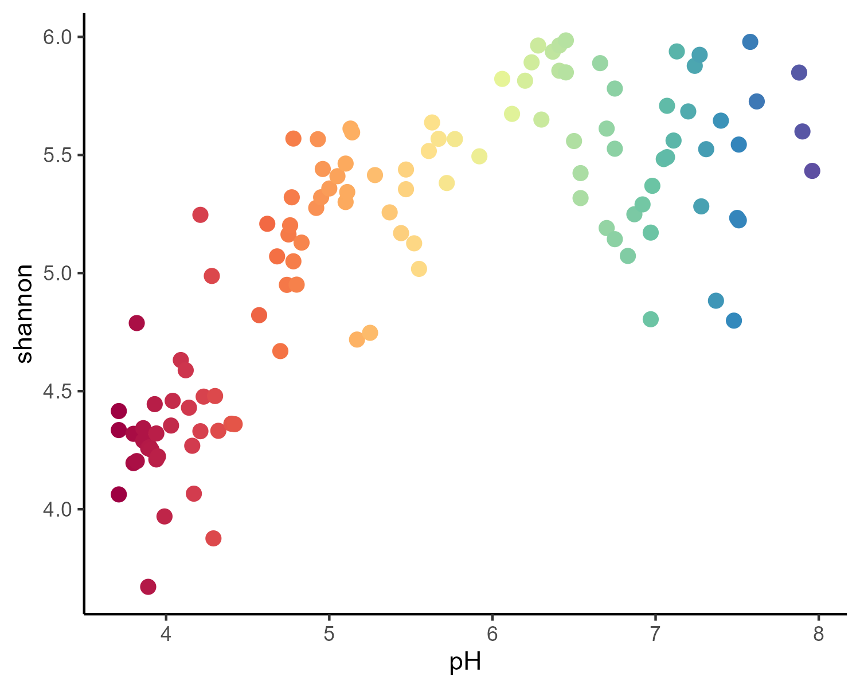
Alpha diversity
ANOVA results
Data | F_value | p_value | Signif
shannon | 148.85 | 0 | ***

Slide 8
graftM nitrogen genes

Slide 9
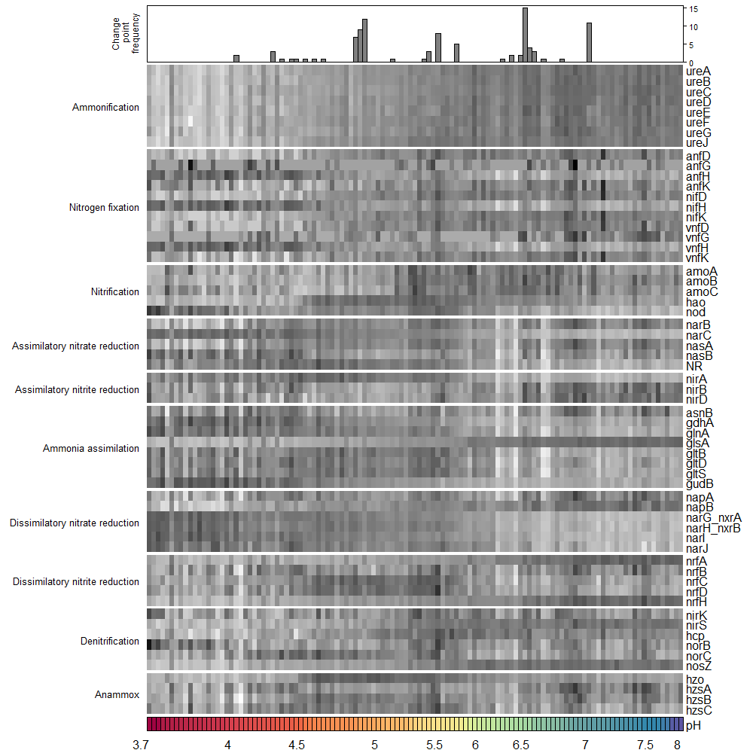
Relative abundance
ANOVA results
Data | F_value | p_value | Signif
ureA | 414.05275921 | 6.483028e-40 | ***
ureB | 446.77738542 | 2.039927e-41 | ***
ureC | 438.00911632 | 5.050350e-41 | ***
ureD | 317.42838509 | 7.269528e-35 | ***
ureE | 238.24299573 | 8.517182e-30 | ***
ureF | 228.02005854 | 4.642171e-29 | ***
ureG | 203.04848336 | 3.654057e-27 | ***
ureJ | 225.45192323 | 7.164603e-29 | ***
anfD | 61.91129475 | 2.168582e-12 | ***
anfG | 0.03944099 | 8.429282e-01
anfH | 95.73909289 | 8.173451e-17 | ***
anfK | 12.77946616 | 5.135335e-04 | ***
nifD | 59.09667614 | 5.533298e-12 | ***
nifH | 102.27769504 | 1.386563e-17 | ***
nifK | 90.31194503 | 3.721201e-16 | ***
vnfD | 48.28429562 | 2.358308e-10 | ***
vnfG | 19.75359429 | 2.040329e-05 | ***
vnfH | 108.33314634 | 2.813224e-18 | ***
vnfK | 35.11473249 | 3.314991e-08 | ***
amoA | 11.57190508 | 9.217159e-04 | ***
amoB | 53.93883410 | 3.211094e-11 | ***
amoC | 15.03674729 | 1.760287e-04 | ***
hao | 3.33918761 | 7.024093e-02
nod | 76.50999245 | 2.131023e-14 | ***
narB | 21.32232846 | 1.018345e-05 | ***
narC | 582.62785210 | 7.776610e-47 | ***
nasA | 17.06418837 | 6.883138e-05 | ***
nasB | 16.22733045 | 1.011692e-04 | ***
NR | 91.34640400 | 2.778739e-16 | ***
nirA | 110.56571616 | 1.579852e-18 | ***
nirB | 19.72089969 | 2.070320e-05 | ***
nirD | 37.27315805 | 1.428077e-08 | ***
asnB | 0.40227734 | 5.271751e-01
gdhA | 141.19170281 | 9.878396e-22 | ***
glnA | 163.08807340 | 8.581974e-24 | ***
glsA | 826.50702180 | 2.475663e-54 | ***
gltB | 43.42120165 | 1.390679e-09 | ***
gltD | 36.85460675 | 1.679674e-08 | ***
gltS | 43.91666440 | 1.157613e-09 | ***
gudB | 228.95851038 | 3.964641e-29 | ***
napA | 14.68592835 | 2.075199e-04 | ***
napB | 221.74421750 | 1.348447e-28 | ***
narG_nxrA | 676.16384092 | 5.545380e-50 | ***
narH_nxrB | 342.07284637 | 2.973756e-36 | ***
narI | 546.86503875 | 1.611378e-45 | ***
narJ | 177.93194628 | 4.242037e-25 | ***
nrfA | 430.97023070 | 1.056655e-40 | ***
nrfB | 4.88930021 | 2.900159e-02 | *
nrfC | 3.67913198 | 5.757713e-02
nrfD | 6.59108565 | 1.153192e-02 | *
nrfH | 463.76898596 | 3.663591e-42 | ***
nirK | 1.47451409 | 2.271225e-01
nirS | 318.75735501 | 6.090360e-35 | ***
hcp | 37.90157445 | 1.120315e-08 | ***
norB | 1.37576582 | 2.432475e-01
norC | 4.60942025 | 3.389689e-02 | *
nosZ | 433.28841103 | 8.277282e-41 | ***
hzo | 0.02956478 | 8.637837e-01
hzsA | 20.27232494 | 1.619624e-05 | ***
hzsB | 7.53490222 | 7.023929e-03 | **
hzsC | 3.35908965 | 6.942190e-02

Slide 10
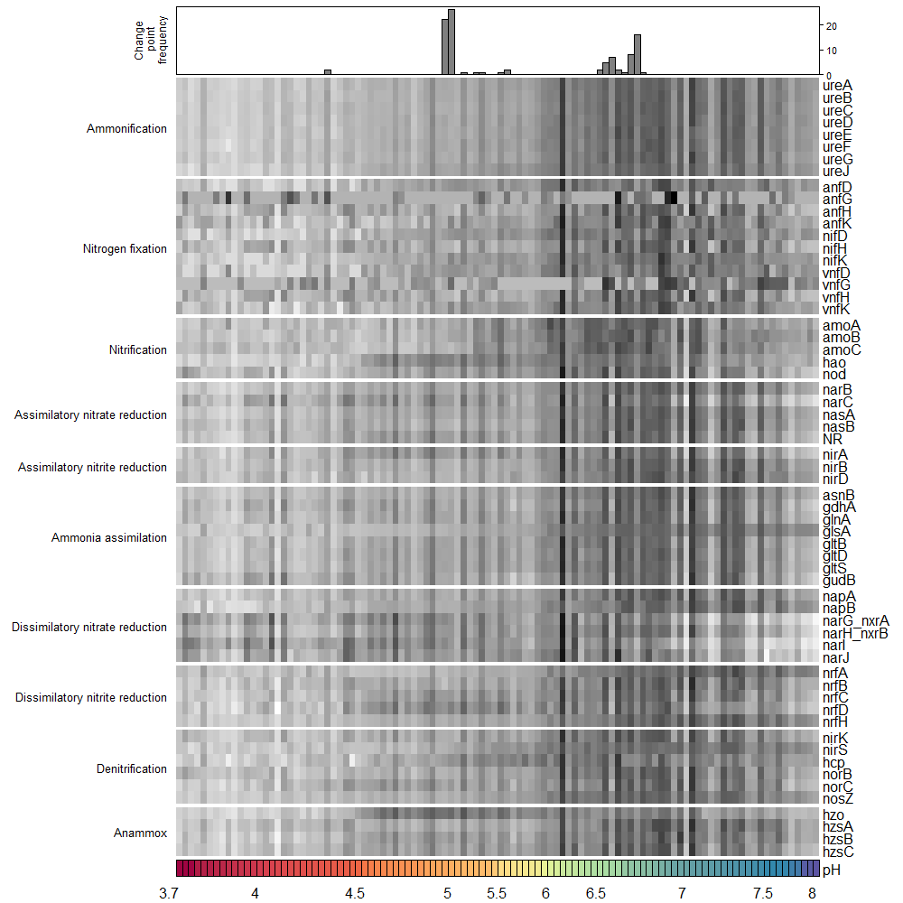
Absolute abundance
PLFA
ANOVA results
Data | F_value | p_value | Signif
ureA | 119.99 | 0.0000 | ***
ureB | 113.04 | 0.0000 | ***
ureC | 110.03 | 0.0000 | ***
ureD | 110.61 | 0.0000 | ***
ureE | 105.96 | 0.0000 | ***
ureF | 106.94 | 0.0000 | ***
ureG | 88.72 | 0.0000 | ***
ureJ | 122.67 | 0.0000 | ***
anfD | 63.74 | 0.0000 | ***
anfG | 1.14 | 0.2881
anfH | 26.00 | 0.0000 | ***
anfK | 40.40 | 0.0000 | ***
nifD | 65.13 | 0.0000 | ***
nifH | 26.97 | 0.0000 | ***
nifK | 66.38 | 0.0000 | ***
vnfD | 61.74 | 0.0000 | ***
vnfG | 26.28 | 0.0000 | ***
vnfH | 24.06 | 0.0000 | ***
vnfK | 54.12 | 0.0000 | ***
amoA | 40.63 | 0.0000 | ***
amoB | 66.53 | 0.0000 | ***
amoC | 49.73 | 0.0000 | ***
hao | 23.78 | 0.0000 | ***
nod | 18.11 | 0.0000 | ***
narB | 69.09 | 0.0000 | ***
narC | 3.02 | 0.0855
nasA | 68.01 | 0.0000 | ***
nasB | 44.72 | 0.0000 | ***
NR | 24.55 | 0.0000 | ***
nirA | 16.26 | 0.0001 | ***
nirB | 68.57 | 0.0000 | ***
nirD | 89.26 | 0.0000 | ***
asnB | 61.56 | 0.0000 | ***
gdhA | 22.61 | 0.0000 | ***
glnA | 34.19 | 0.0000 | ***
glsA | 181.06 | 0.0000 | ***
gltB | 41.49 | 0.0000 | ***
gltD | 37.07 | 0.0000 | ***
gltS | 39.78 | 0.0000 | ***
gudB | 15.84 | 0.0001 | ***
napA | 71.11 | 0.0000 | ***
napB | 126.63 | 0.0000 | ***
narG_nxrA | 3.06 | 0.0833
narH_nxrB | 5.77 | 0.0181 | *
narI | 10.52 | 0.0016 | **
narJ | 0.41 | 0.5239
nrfA | 197.29 | 0.0000 | ***
nrfB | 60.88 | 0.0000 | ***
nrfC | 43.76 | 0.0000 | ***
nrfD | 17.57 | 0.0001 | ***
nrfH | 173.26 | 0.0000 | ***
nirK | 52.94 | 0.0000 | ***
nirS | 188.11 | 0.0000 | ***
hcp | 50.33 | 0.0000 | ***
norB | 52.90 | 0.0000 | ***
norC | 36.60 | 0.0000 | ***
nosZ | 126.97 | 0.0000 | ***
hzo | 7.97 | 0.0057 | **
hzsA | 70.50 | 0.0000 | ***
hzsB | 65.06 | 0.0000 | ***
hzsC | 38.77 | 0.0000 | ***

Slide 11
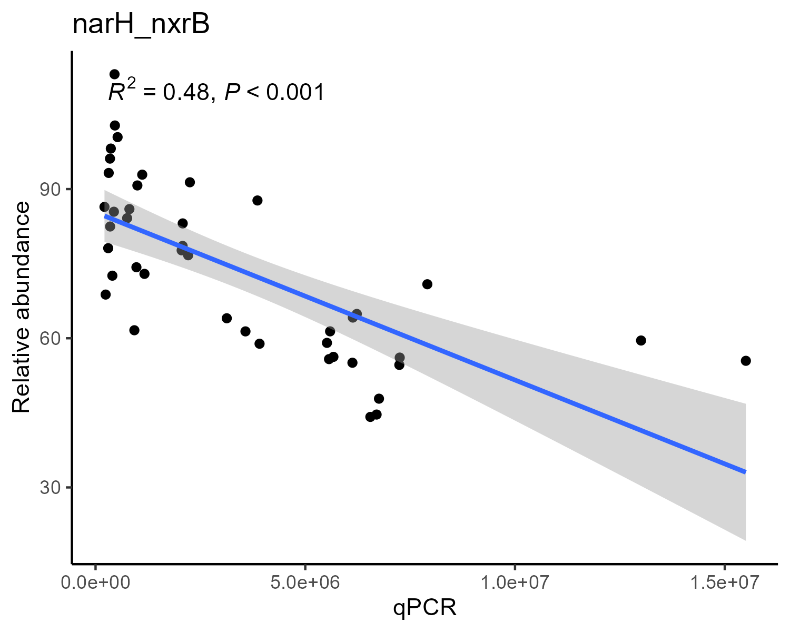
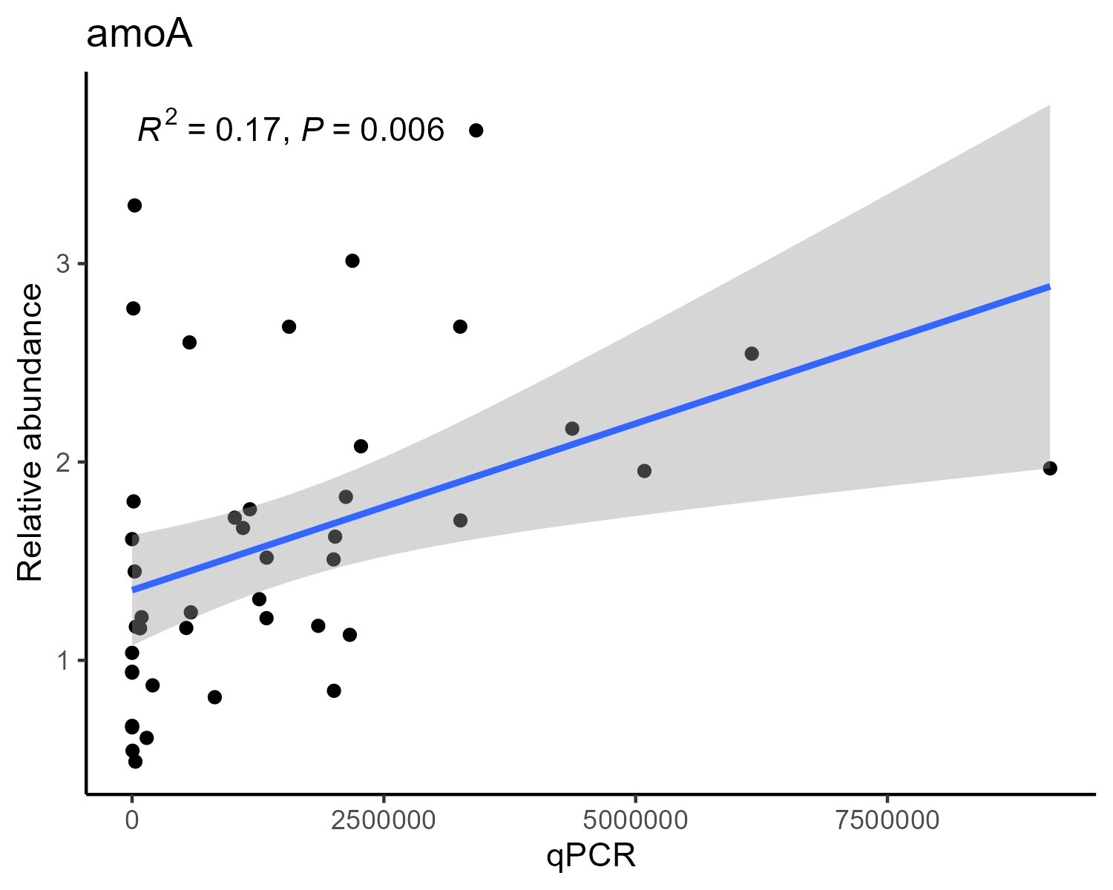
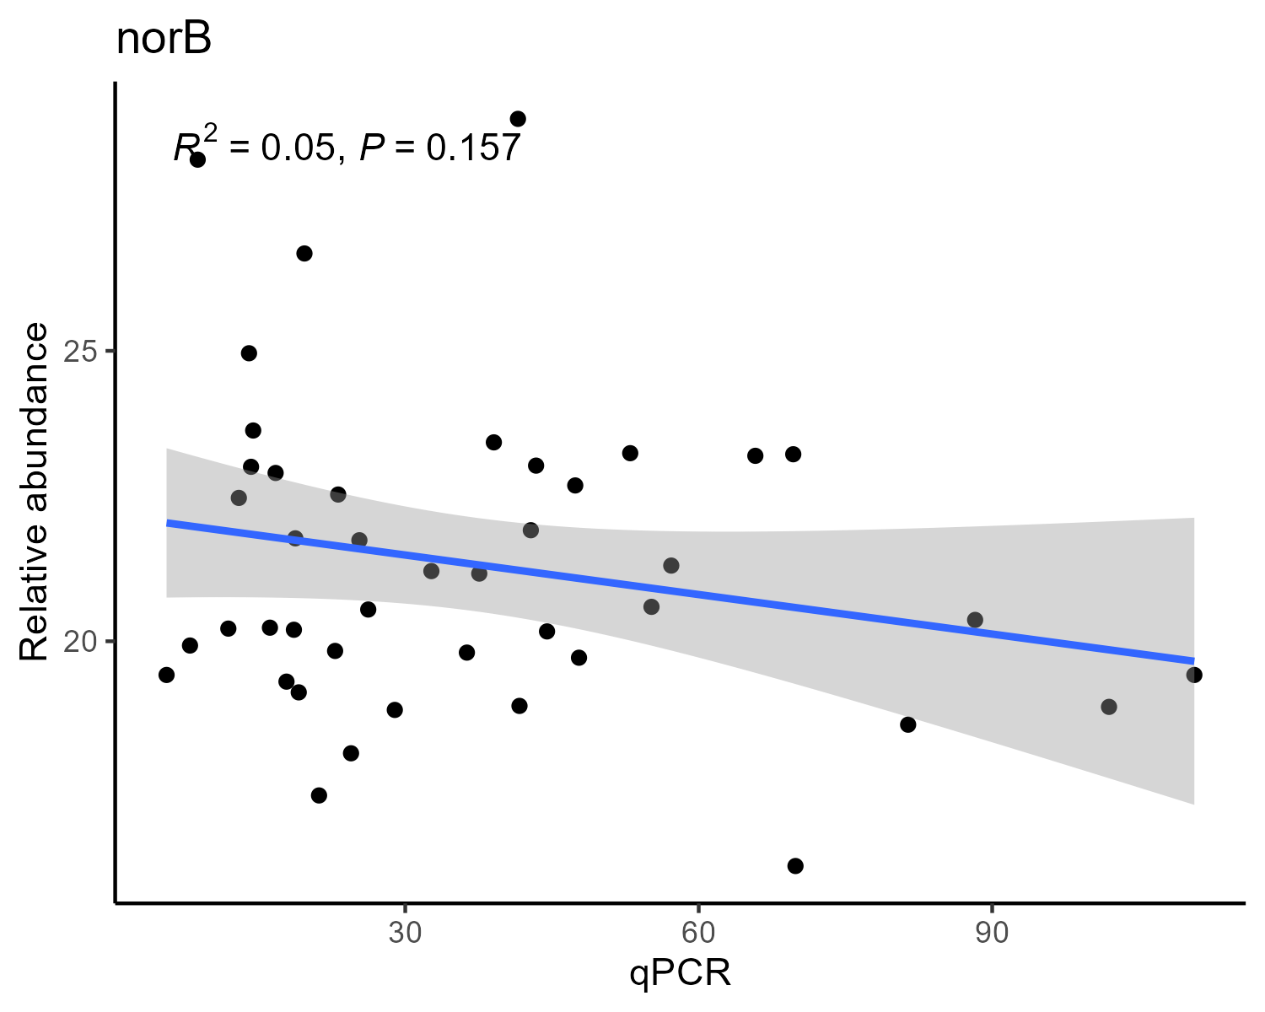
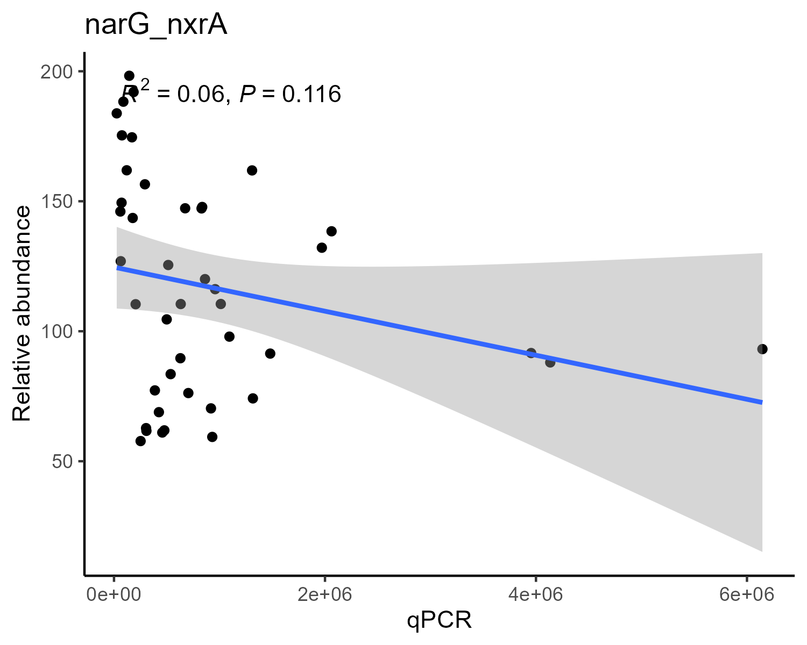
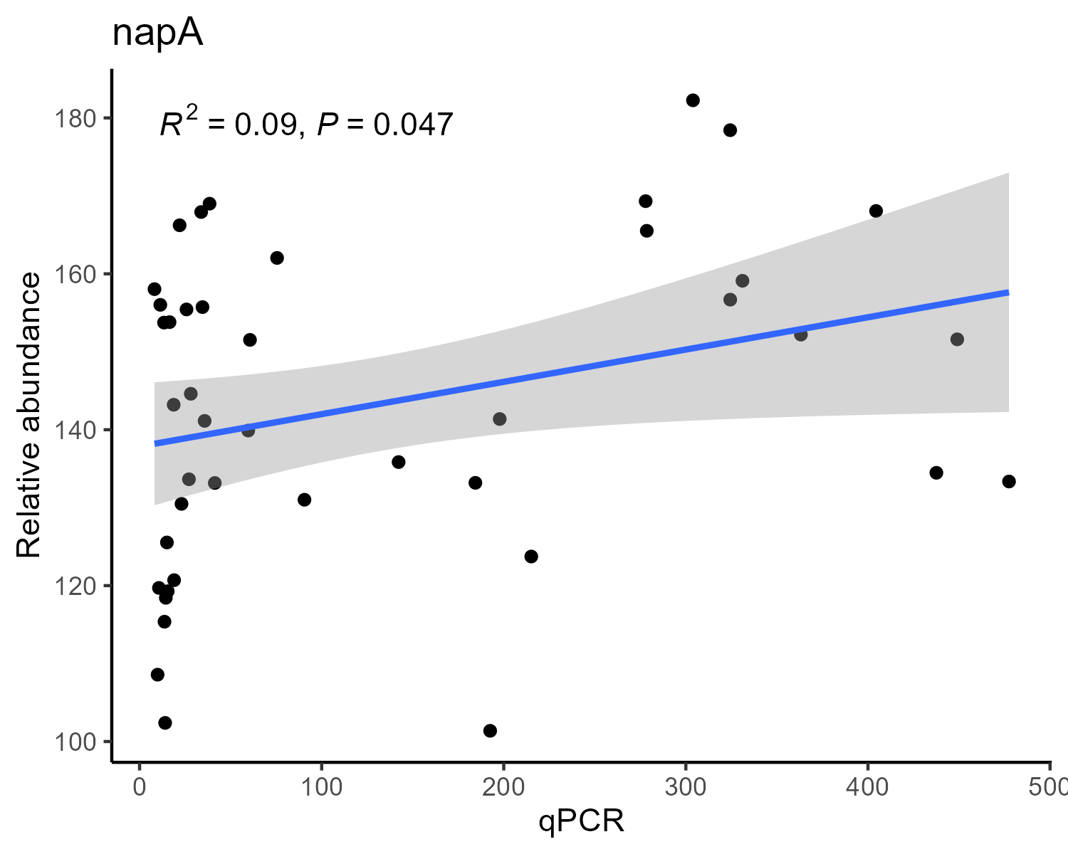
qPCR results vs Relative abundance

Slide 12
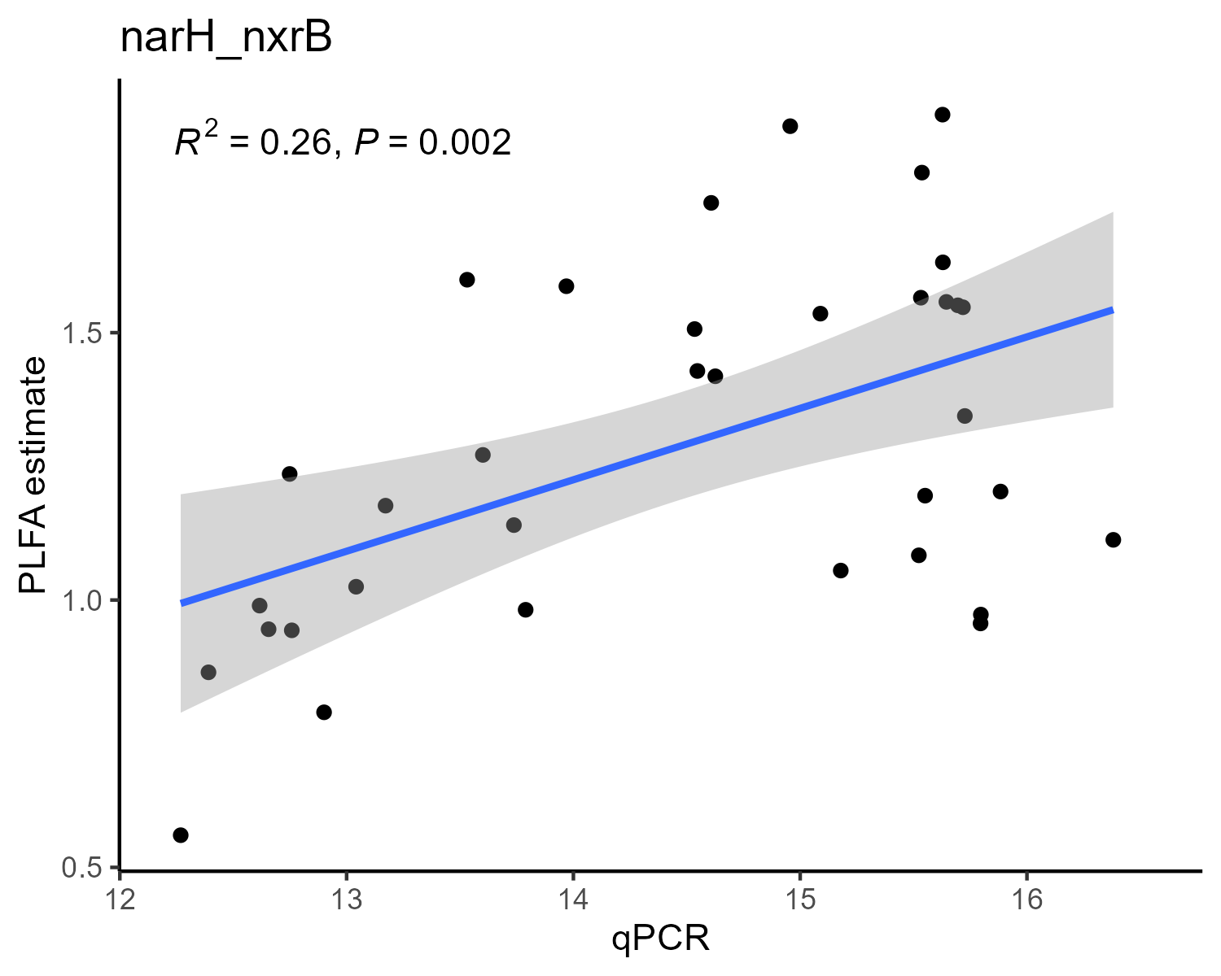
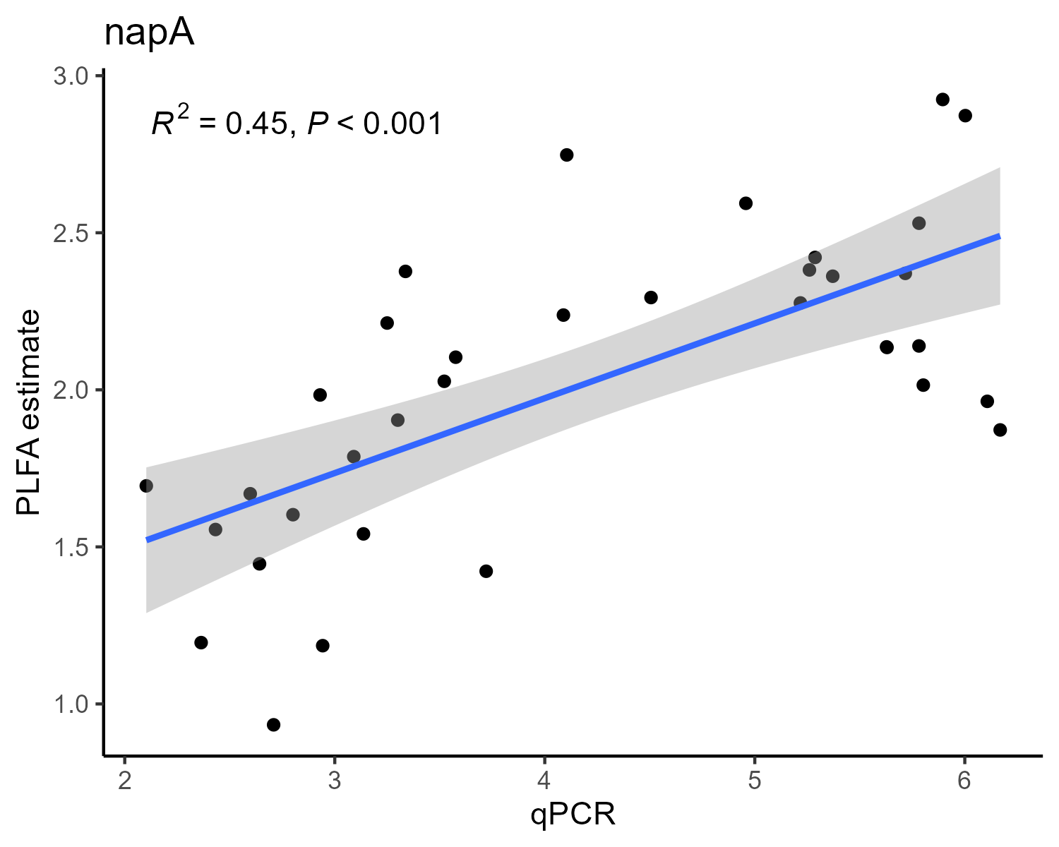
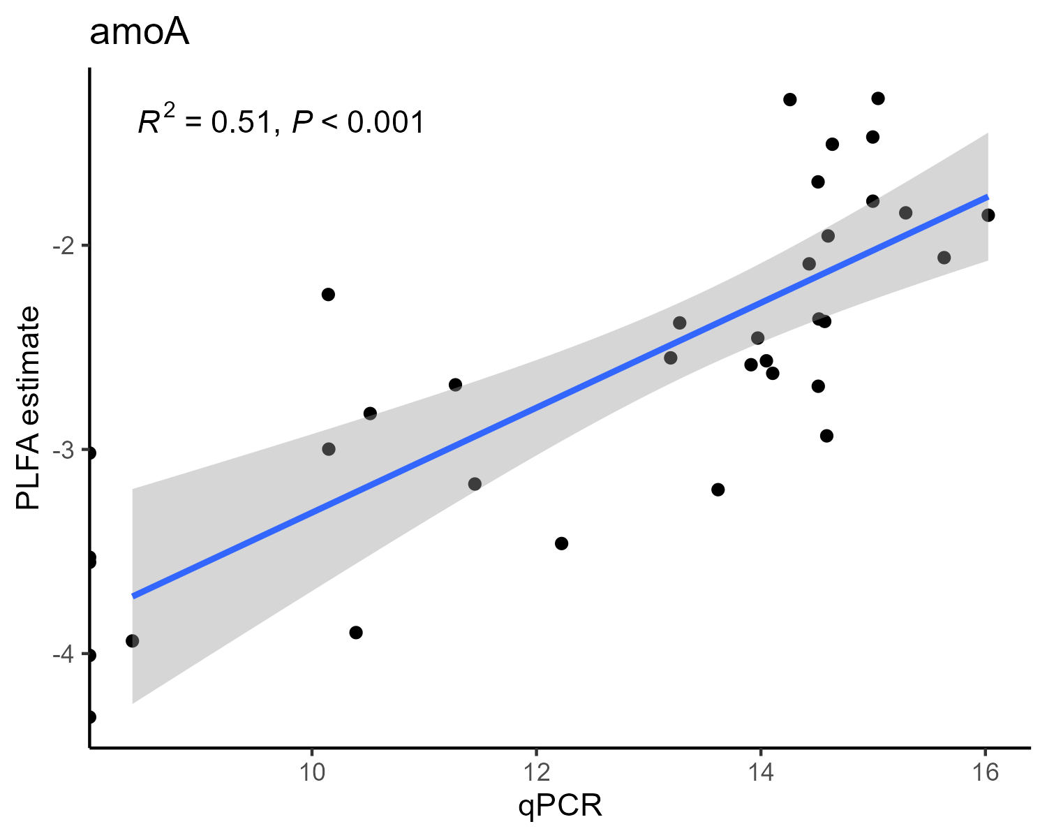
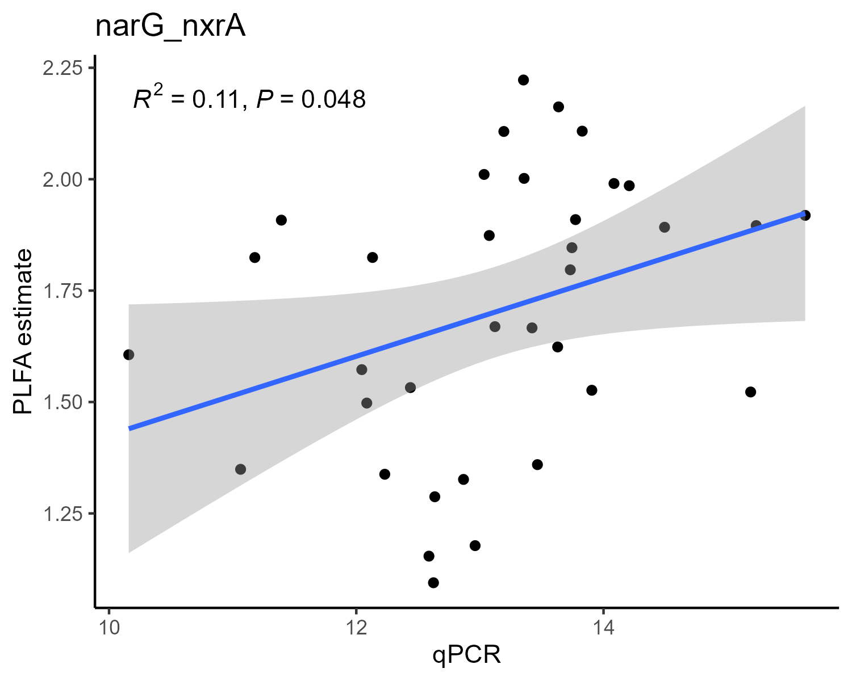
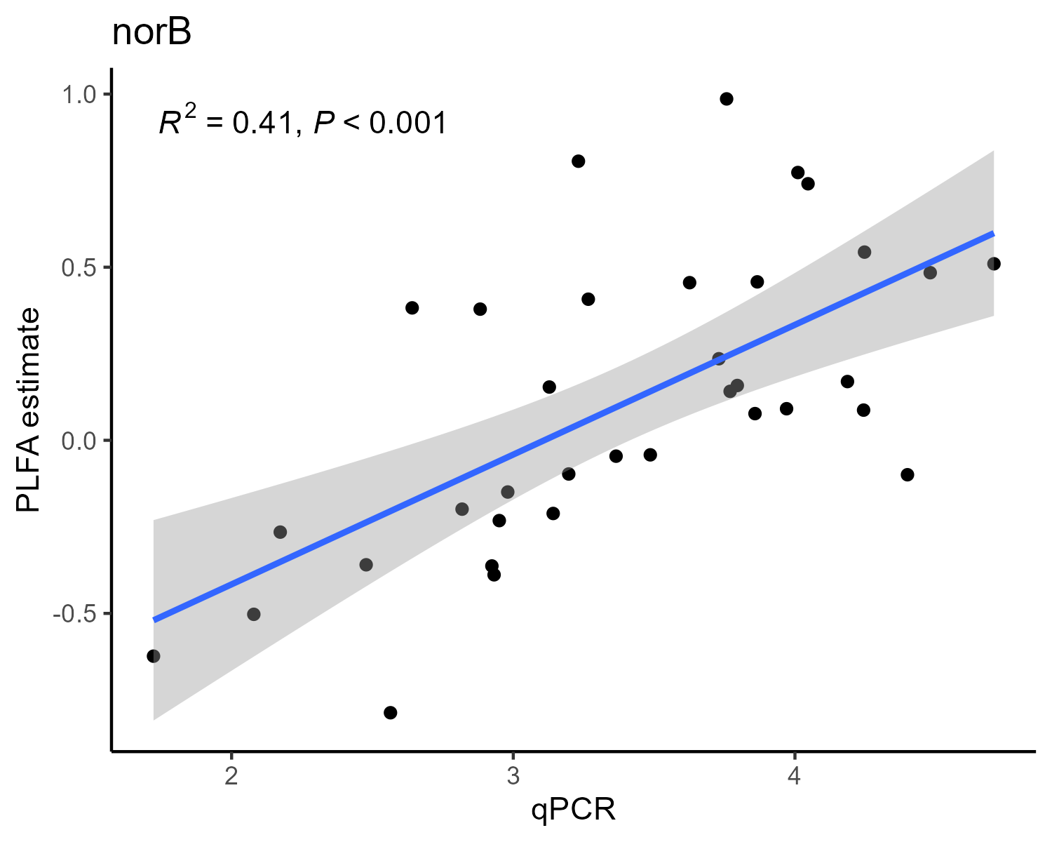
qPCR results vs PLFA estimation
Both axes are log-transformed

Slide 13
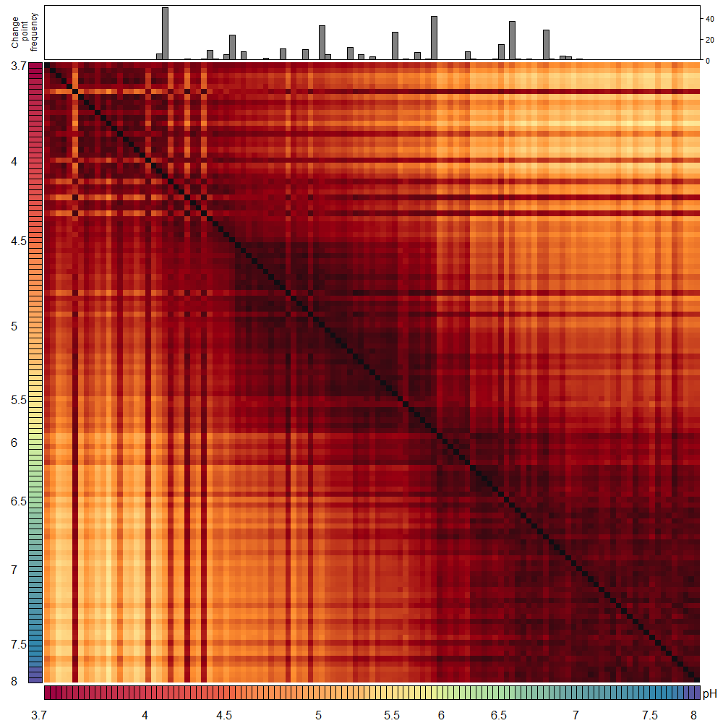
Hellinger distances
PERMANOVA results
Df | SumOfSqs | R2 | F | Pr(>F)
1 | 0.2527882 | 0.4746947 | 103.9203 | 0.001
115 | 0.2797397 | 0.5253053 | NA | NA
116 | 0.5325279 | 1.0000000 | NA | NA

Slide 14
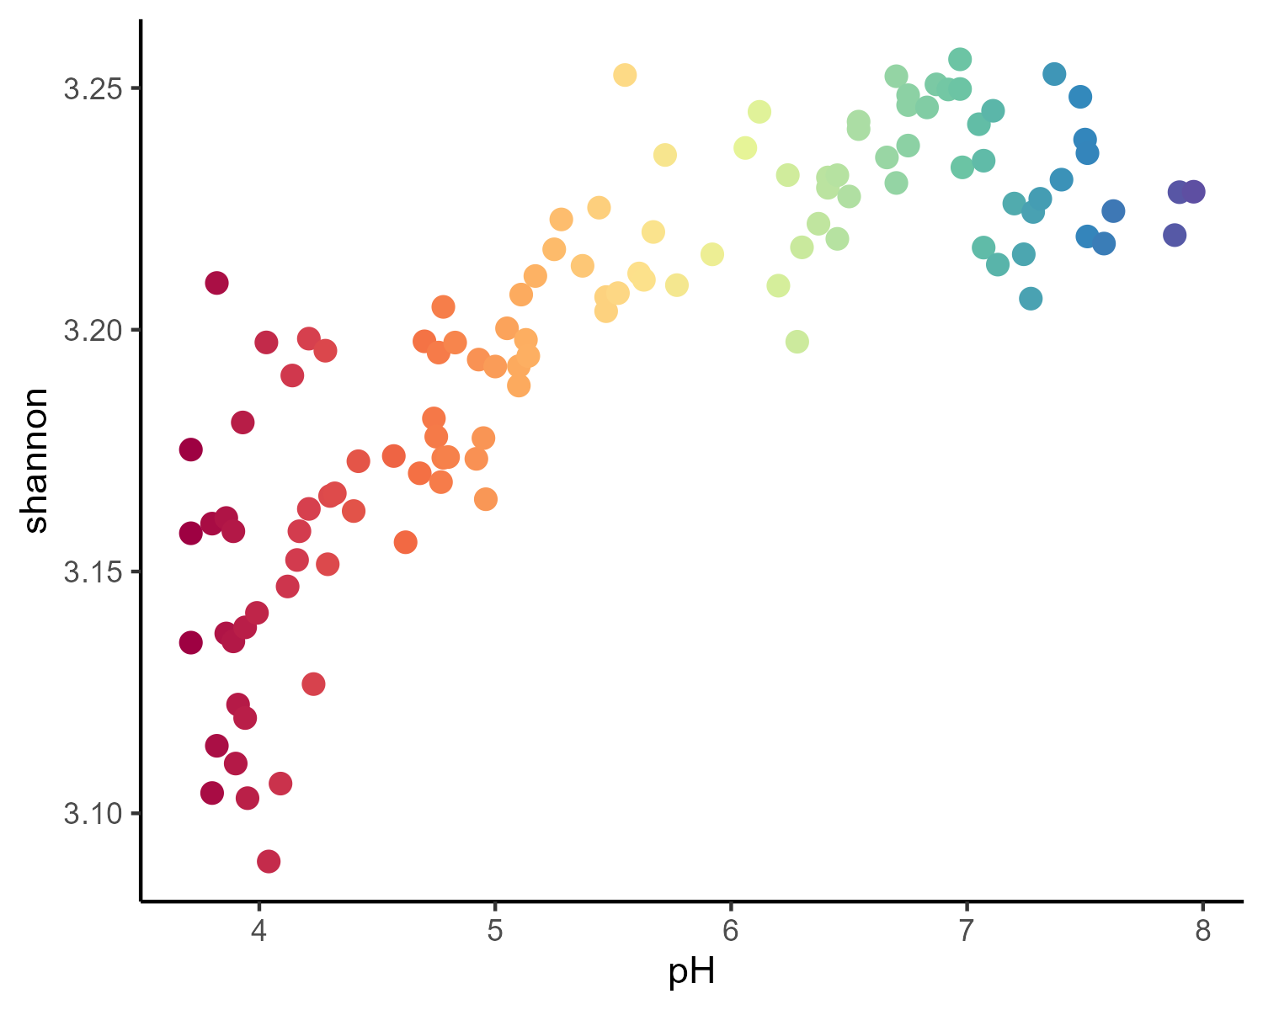
Alpha diversity
ANOVA results
Data | F_value | p_value | Signif
shannon | 246.32 | 0 | ***

Slide 15
singleM nitrogen genes

Slide 16
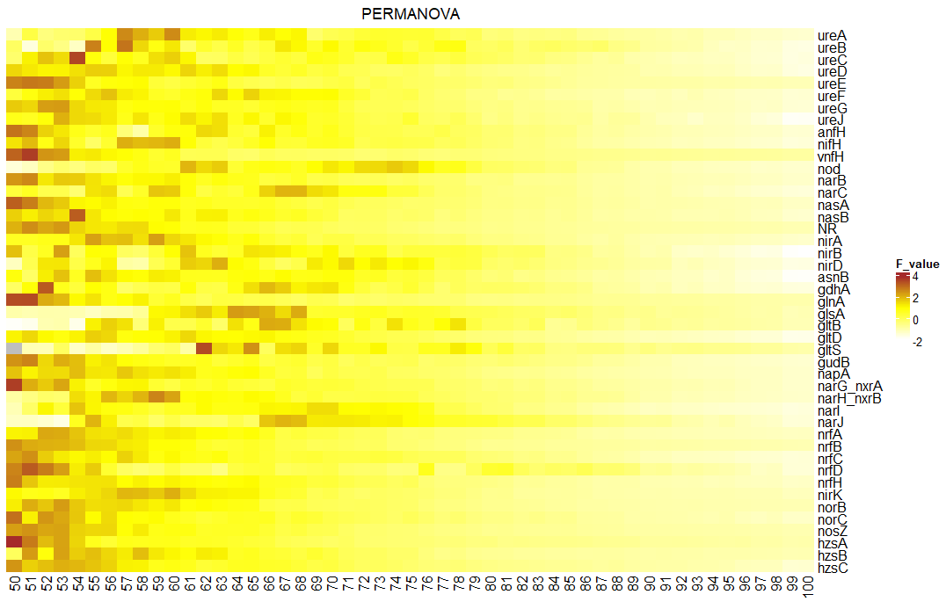
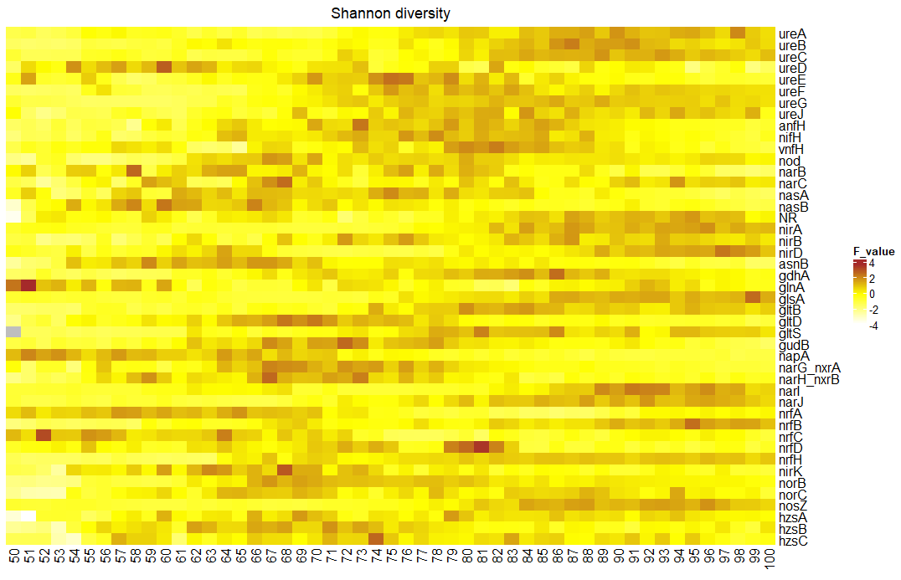
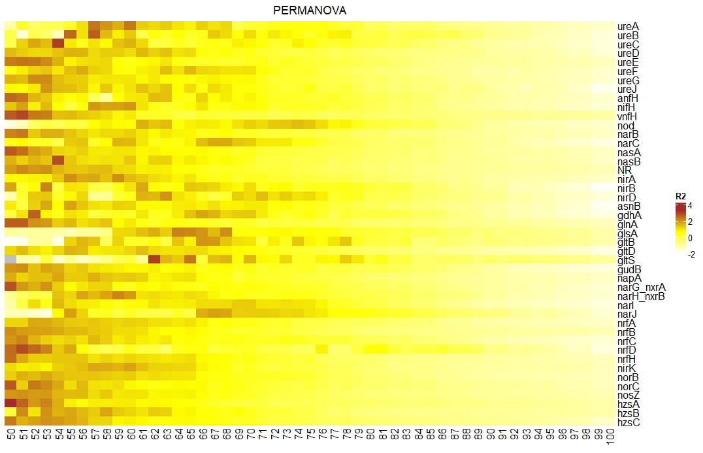
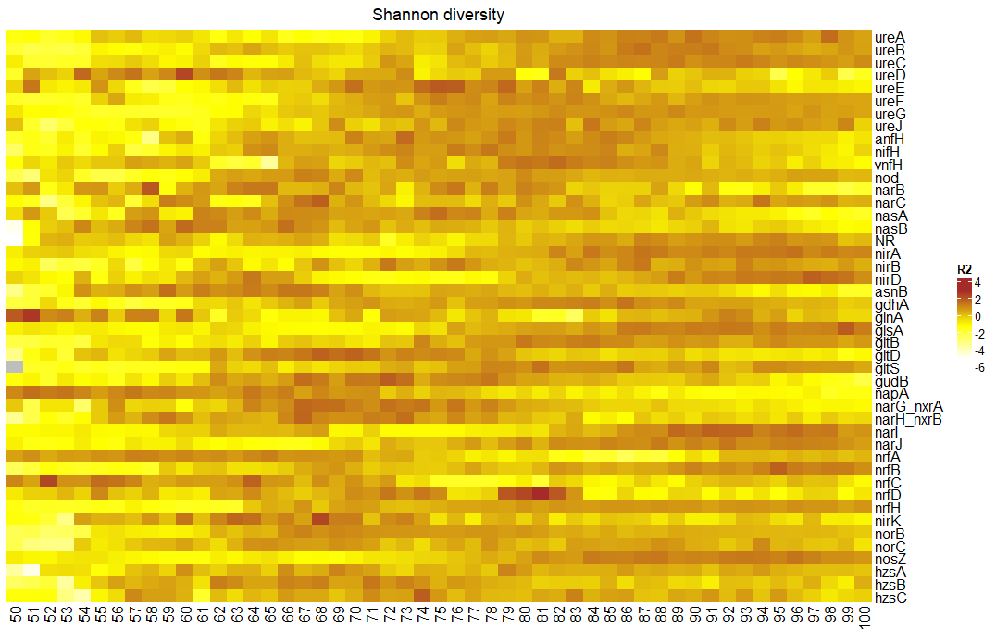
Best cluster identification

Slide 17
cluster | Gene
57 | ureA
87 | ureB
89 | ureC
60 | ureD
51 | ureE
75 | ureF
73 | ureG
84 | ureJ
70 | anfH
76 | nifH
51 | vnfH
74 | nod
58 | narB
68 | narC
51 | nasA
60 | nasB
53 | NR
87 | nirA
72 | nirB
64 | nirD
59 | asnB
67 | gdhA
51 | glnA
99 | glsA
80 | gltB
68 | gltD
81 | gltS
62 | gudB
53 | napA
67 | narG_nxrA
59 | narH_nxrB
68 | narI
80 | narJ
57 | nrfA
52 | nrfB
52 | nrfC
51 | nrfD
67 | nrfH
60 | nirK
56 | norB
65 | norC
51 | nosZ
60 | hzsA
62 | hzsB
74 | hzsC
cluster | Gene
98 | ureA
87 | ureB
89 | ureC
60 | ureD
75 | ureE
75 | ureF
86 | ureG
84 | ureJ
73 | anfH
78 | nifH
82 | vnfH
67 | nod
58 | narB
68 | narC
75 | nasA
60 | nasB
95 | NR
96 | nirA
87 | nirB
97 | nirD
59 | asnB
86 | gdhA
51 | glnA
99 | glsA
80 | gltB
68 | gltD
81 | gltS
72 | gudB
51 | napA
67 | narG_nxrA
67 | narH_nxrB
91 | narI
92 | narJ
65 | nrfA
95 | nrfB
52 | nrfC
81 | nrfD
96 | nrfH
68 | nirK
67 | norB
94 | norC
96 | nosZ
69 | hzsA
71 | hzsB
74 | hzsC
PERMANOVA + Alpha
Only Alpha

Slide 18
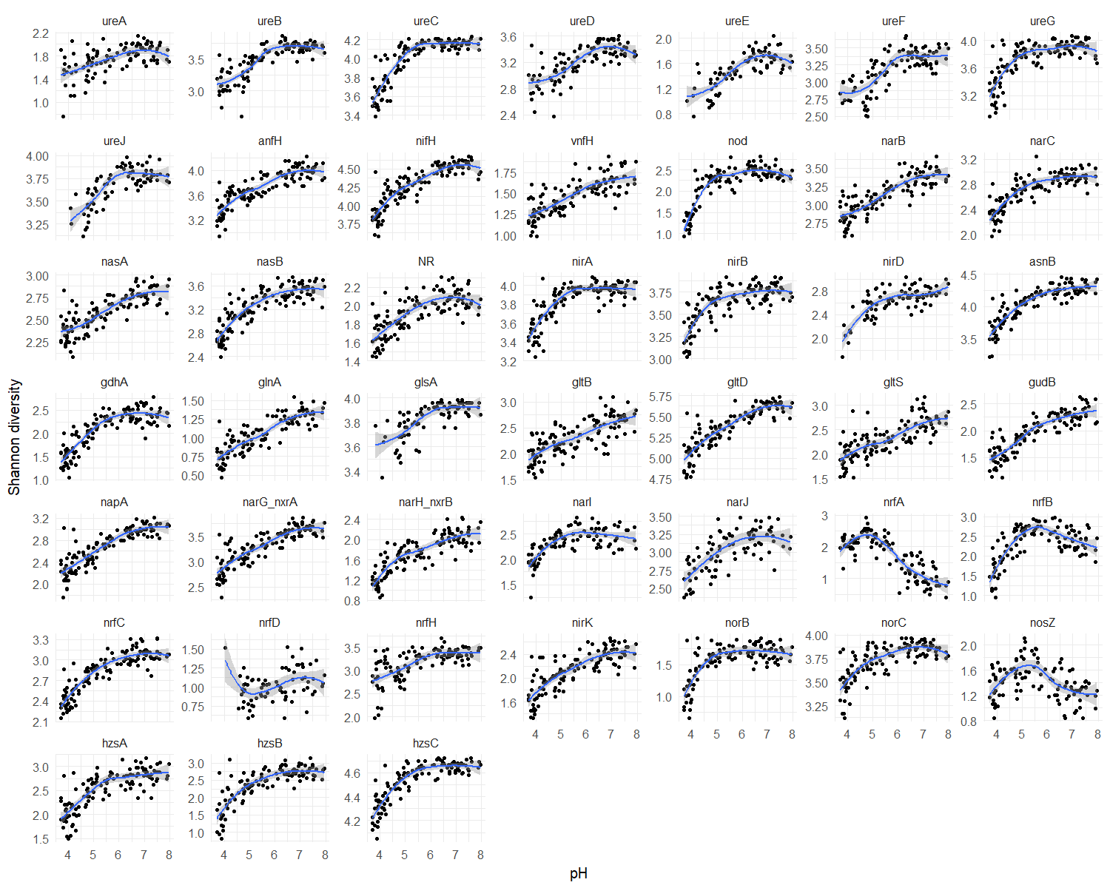
Alpha-diversity
PERMANOVA + Alpha

Slide 19
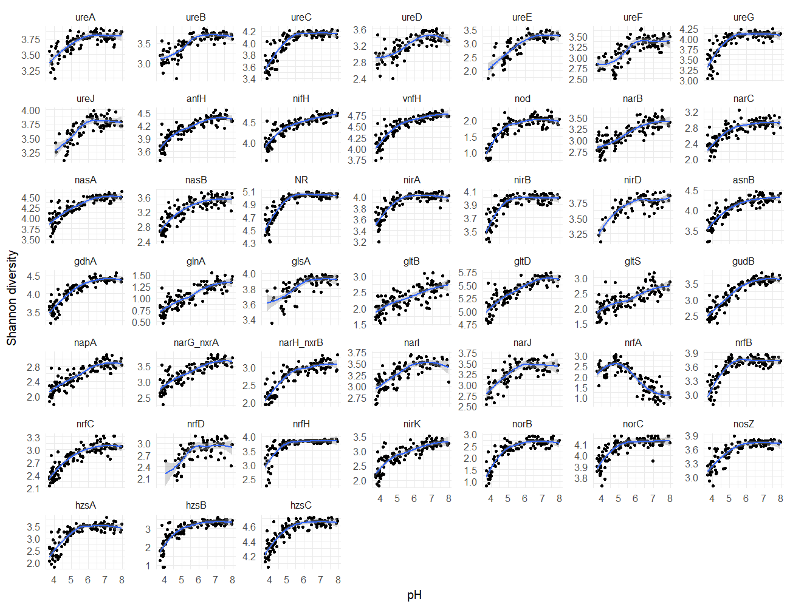
Only Alpha

Slide 20
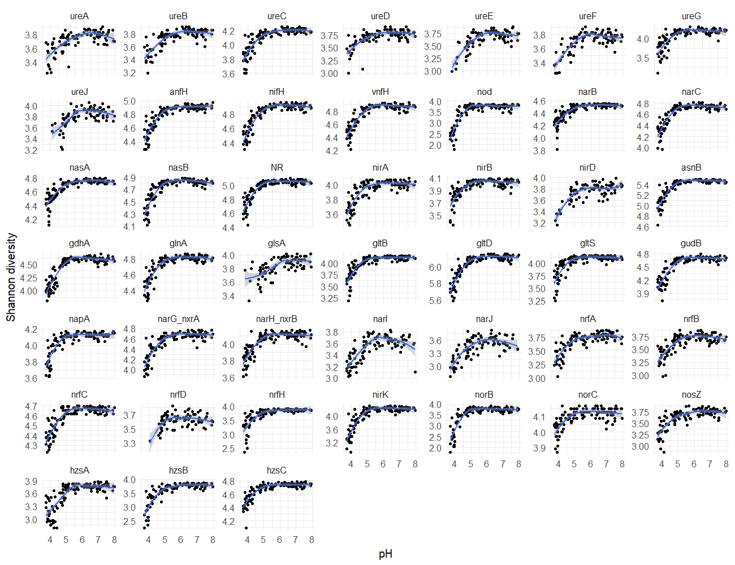
Clustering level 65

Slide 21
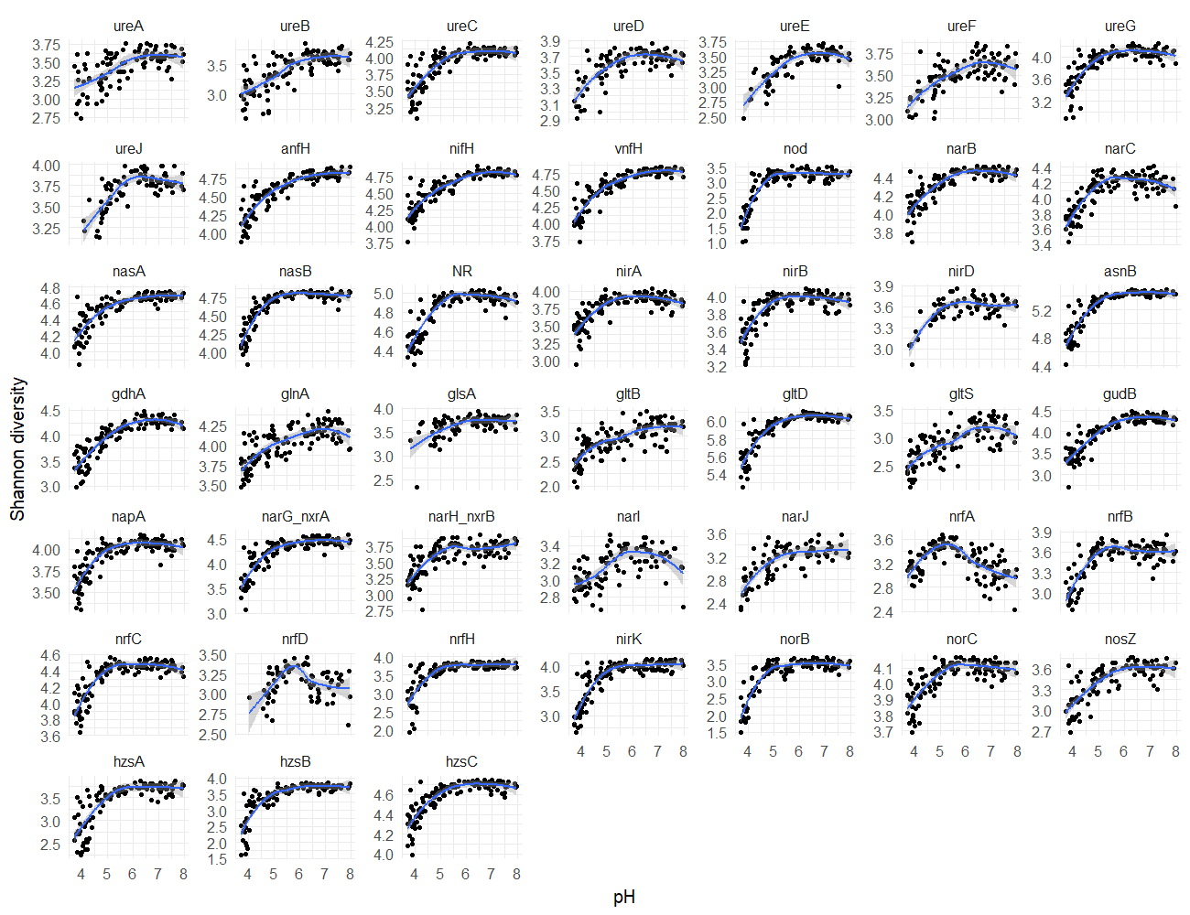
Clustering level 85

Slide 22
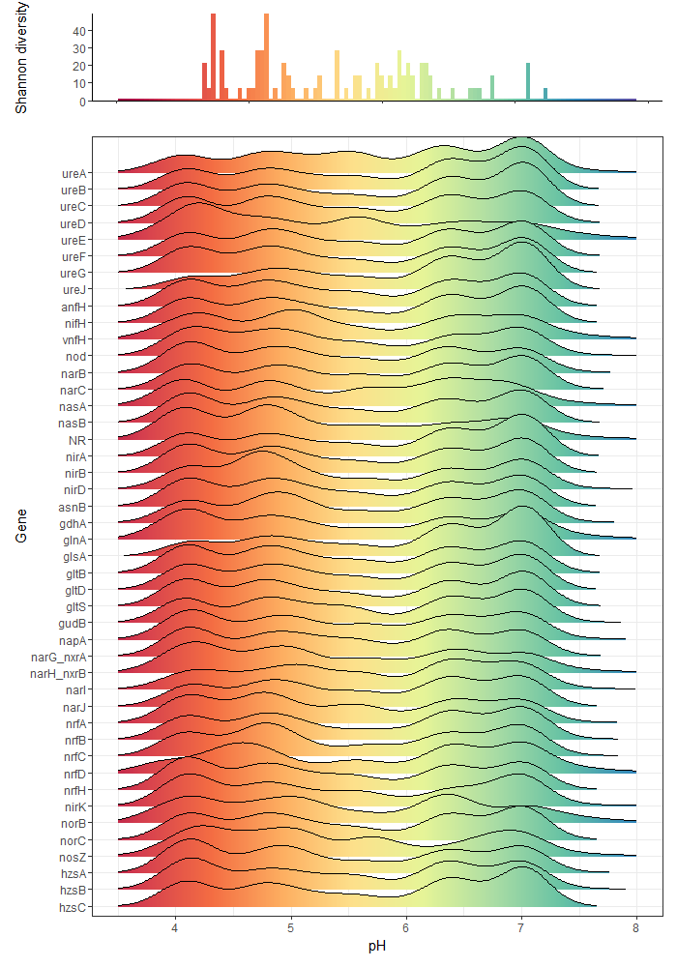
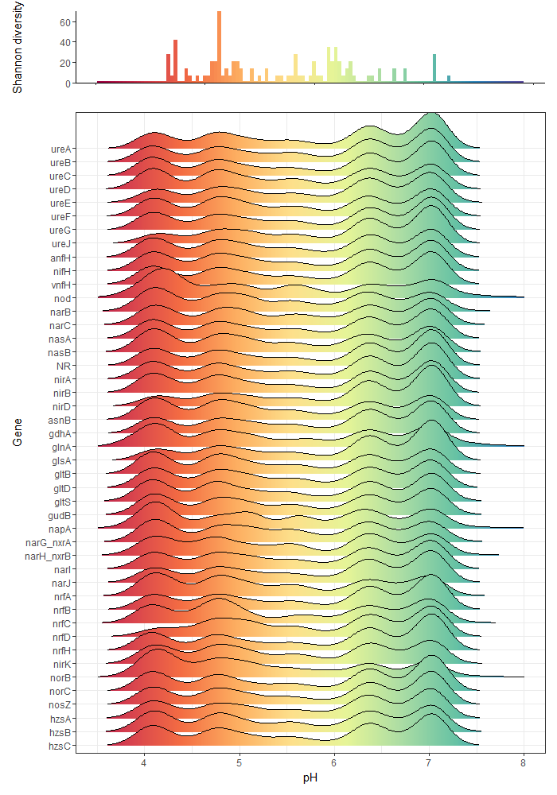

Change point frequency
PERMANOVA + Alpha
Only Alpha

Slide 23
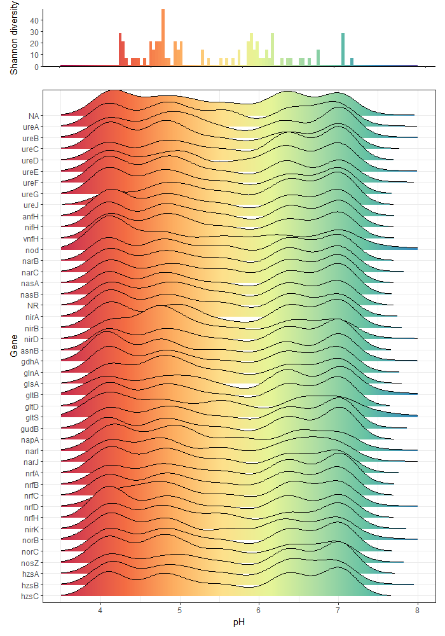
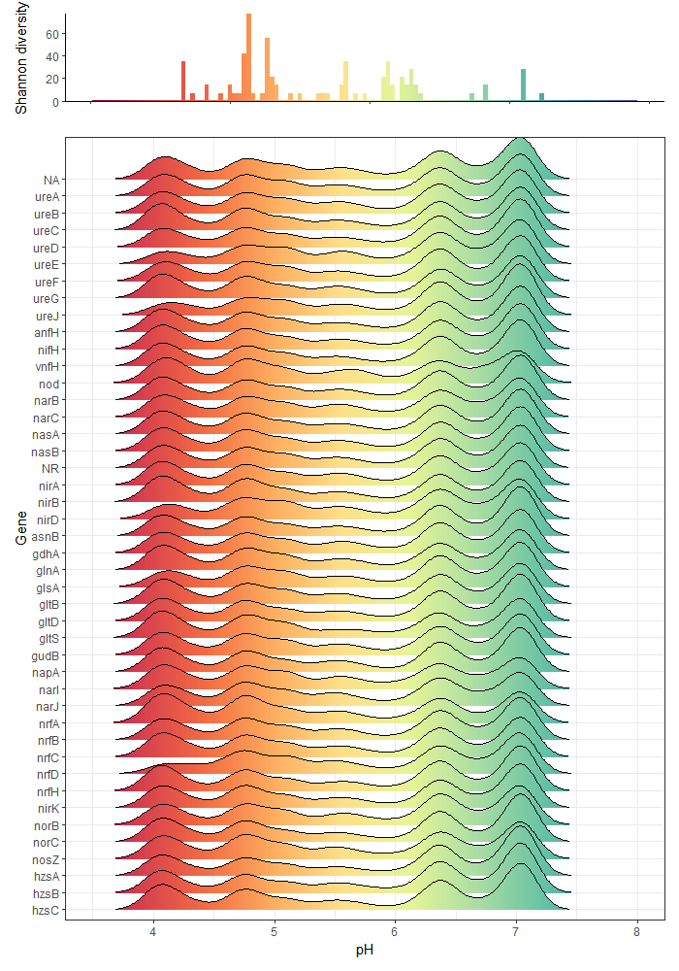
Clustering level 65
Clustering level 85

