Slide 1
graftM

Slide 2
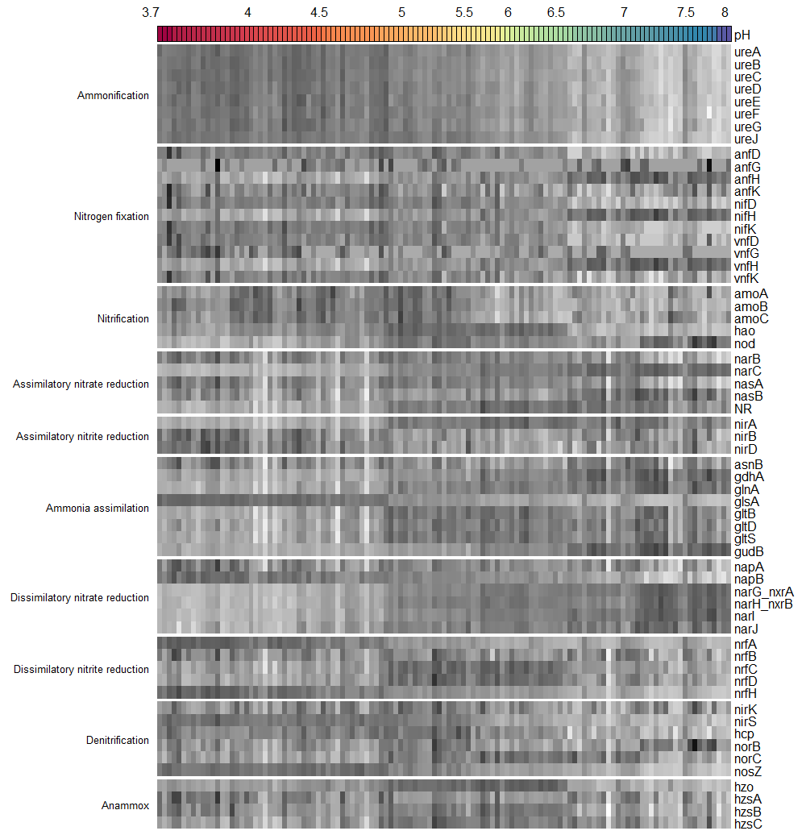
Relative abundance
ANOVA results
Data | F_value | p_value | Signif
ureA | 421.63 | 0.0000 | ***
ureB | 452.27 | 0.0000 | ***
ureC | 444.15 | 0.0000 | ***
ureD | 320.68 | 0.0000 | ***
ureE | 242.76 | 0.0000 | ***
ureF | 230.72 | 0.0000 | ***
ureG | 206.85 | 0.0000 | ***
ureJ | 229.16 | 0.0000 | ***
anfD | 58.42 | 0.0000 | ***
anfG | 0.05 | 0.8321
anfH | 97.20 | 0.0000 | ***
anfK | 12.26 | 0.0007 | ***
nifD | 55.29 | 0.0000 | ***
nifH | 103.45 | 0.0000 | ***
nifK | 88.42 | 0.0000 | ***
vnfD | 47.33 | 0.0000 | ***
vnfG | 18.76 | 0.0000 | ***
vnfH | 109.56 | 0.0000 | ***
vnfK | 33.80 | 0.0000 | ***
amoA | 11.60 | 0.0009 | ***
amoB | 54.37 | 0.0000 | ***
amoC | 15.12 | 0.0002 | ***
hao | 3.19 | 0.0765
nod | 77.93 | 0.0000 | ***
narB | 20.82 | 0.0000 | ***
narC | 581.44 | 0.0000 | ***
nasA | 16.82 | 0.0001 | ***
nasB | 16.61 | 0.0001 | ***
NR | 91.95 | 0.0000 | ***
nirA | 110.31 | 0.0000 | ***
nirB | 19.40 | 0.0000 | ***
nirD | 37.55 | 0.0000 | ***
asnB | 0.44 | 0.5073
gdhA | 141.00 | 0.0000 | ***
glnA | 164.30 | 0.0000 | ***
glsA | 827.29 | 0.0000 | ***
gltB | 44.32 | 0.0000 | ***
gltD | 37.31 | 0.0000 | ***
gltS | 44.81 | 0.0000 | ***
gudB | 225.47 | 0.0000 | ***
napA | 14.46 | 0.0002 | ***
napB | 222.85 | 0.0000 | ***
narG_nxrA | 677.71 | 0.0000 | ***
narH_nxrB | 346.81 | 0.0000 | ***
narI | 551.96 | 0.0000 | ***
narJ | 178.71 | 0.0000 | ***
nrfA | 430.66 | 0.0000 | ***
nrfB | 4.68 | 0.0325 | *
nrfC | 3.85 | 0.0521
nrfD | 6.74 | 0.0106 | *
nrfH | 472.19 | 0.0000 | ***
nirK | 1.52 | 0.2206
nirS | 319.23 | 0.0000 | ***
hcp | 37.69 | 0.0000 | ***
norB | 1.45 | 0.2303
norC | 4.79 | 0.0307 | *
nosZ | 441.27 | 0.0000 | ***
hzo | 0.05 | 0.8199
hzsA | 19.34 | 0.0000 | ***
hzsB | 6.89 | 0.0098 | **
hzsC | 3.54 | 0.0625

