Slide 1
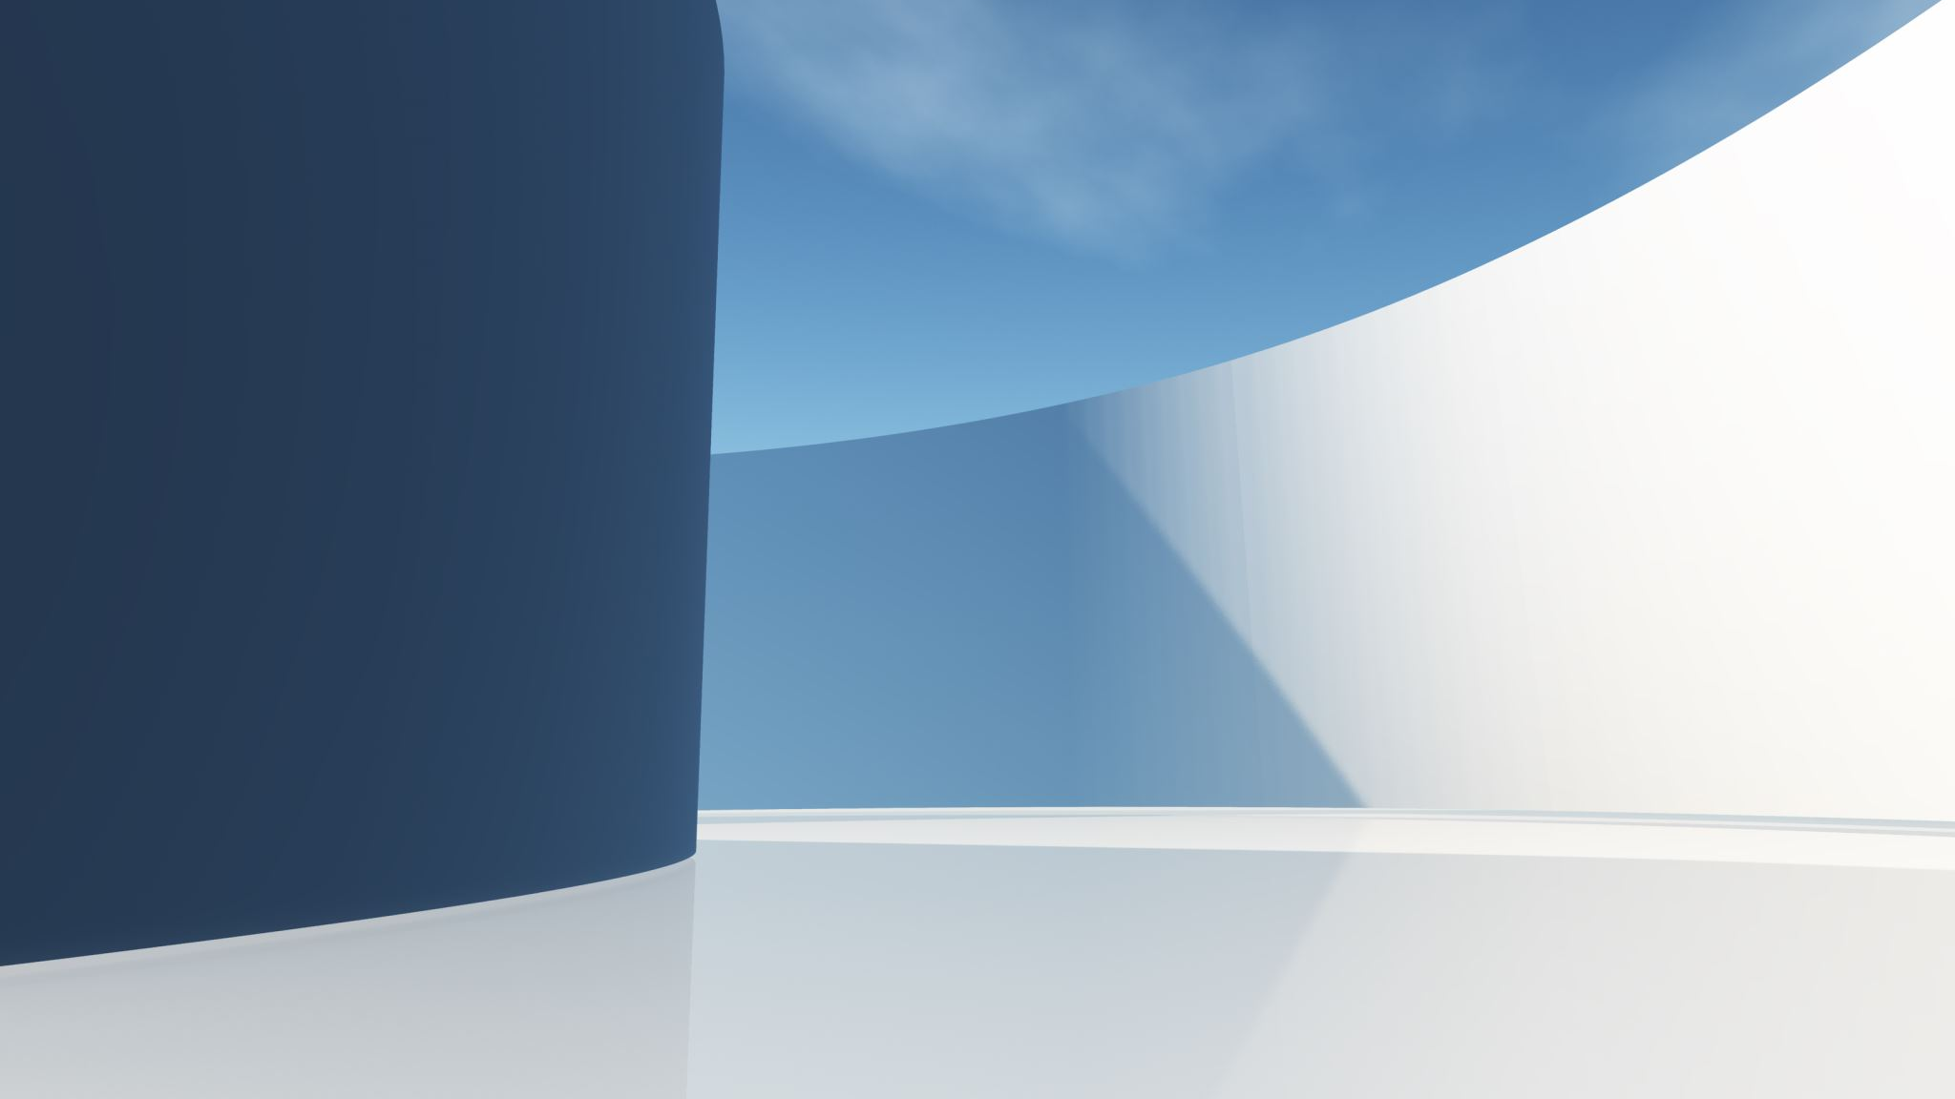
Natural language processing with disaster tweets
Olzhas Shortanbaiuly
Rauan Omarov

Slide 2
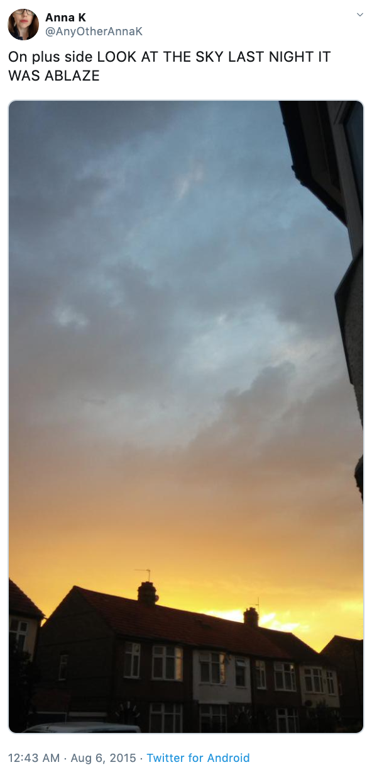
Topic description
Lately, there have been researches about using natural language processing in assessing extreme weather circumstances such as heavy rainfall [1]. Therefore, the question regarding the NLP being used to predict natural disasters is raised as well, resulting in the creation of the Kaggle competition named "Natural Language Processing with Disaster Tweets".

Slide 3
the dataset
Dataset is for a classification problem from Natural Language Processing. For the given tweet about a natural disaster, the model is expected to predict whether it is about a true disaster (class 1) or not (class 0).
Contains 10,876 hand-classified tweets: train.csv (7,613 tweets), test.csv (3,263 tweets)
Data columns: - id (unique identifier); - text (text/content of the tweet); - location (location tweet was sent from, may be blank); - keyword (particular keyword from the tweet, may be blank); - target (real disaster or not)

Slide 4
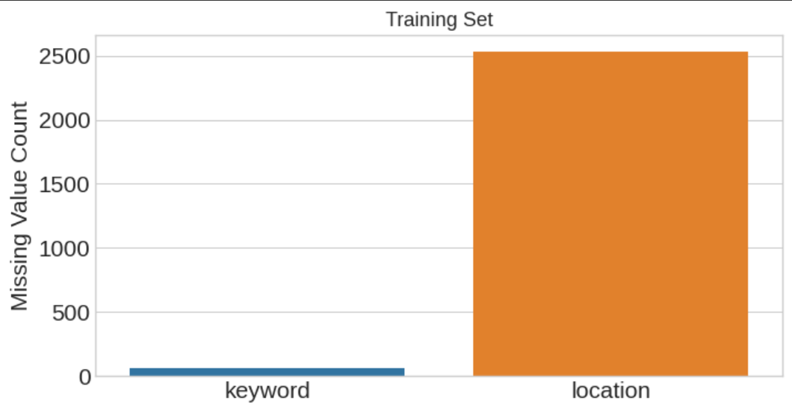
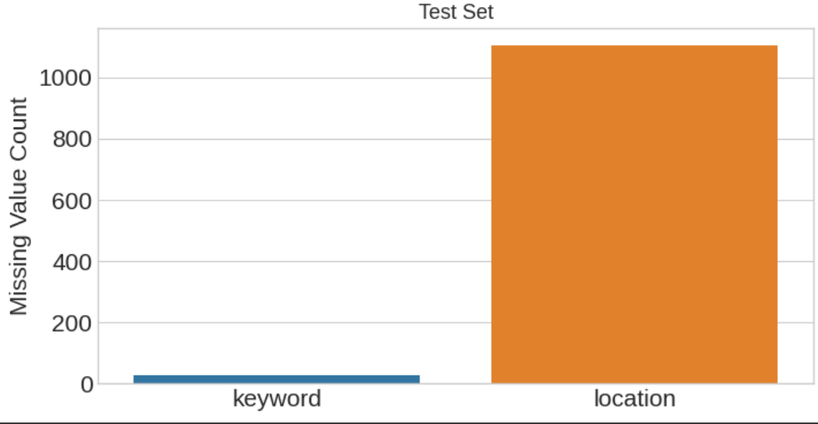
STUDYING THE DATASET
Missing values
Value distribution
Number of unique values in keyword = 222 (Training) - 222 (Test)
Number of unique values in location = 3342 (Training) - 1603 (Test)

Slide 5
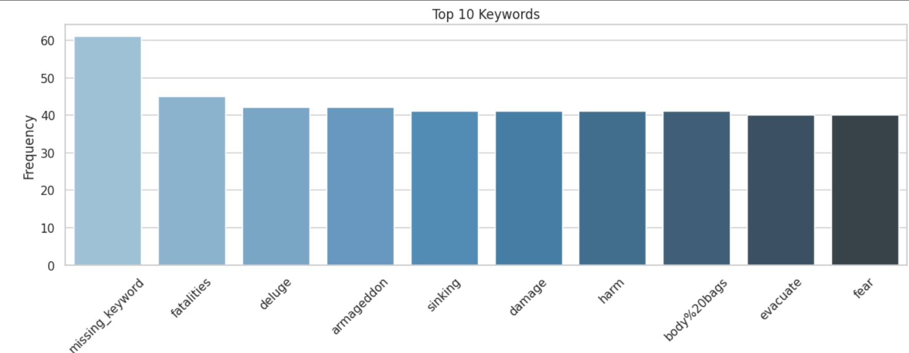
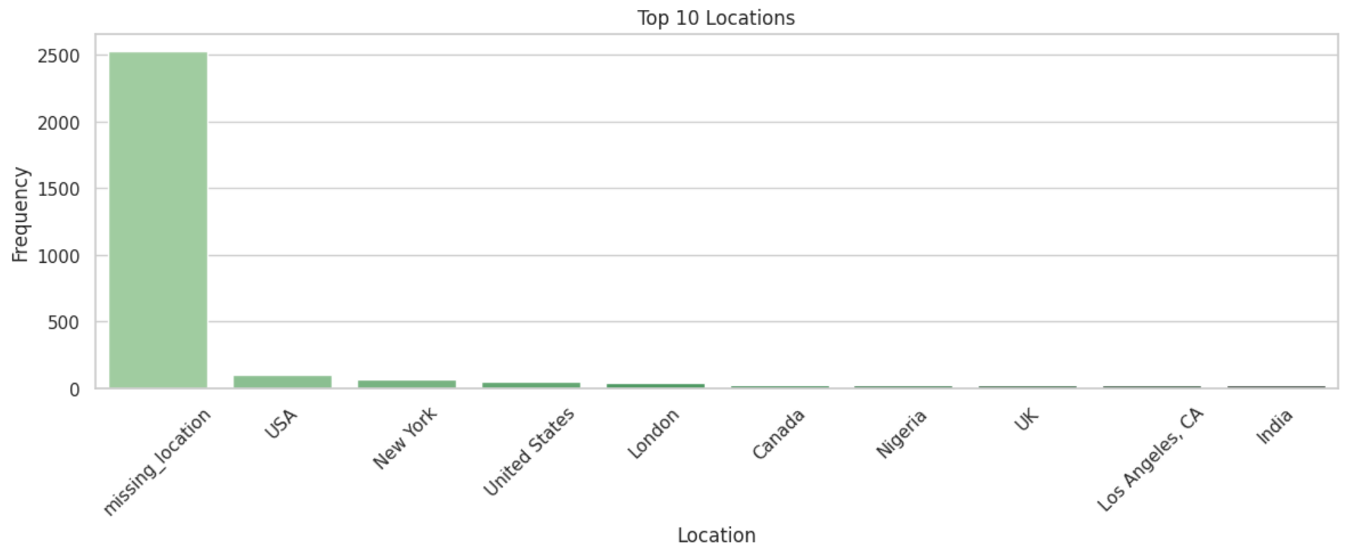
STUDYING THE DATASET: FEATURES

Slide 6
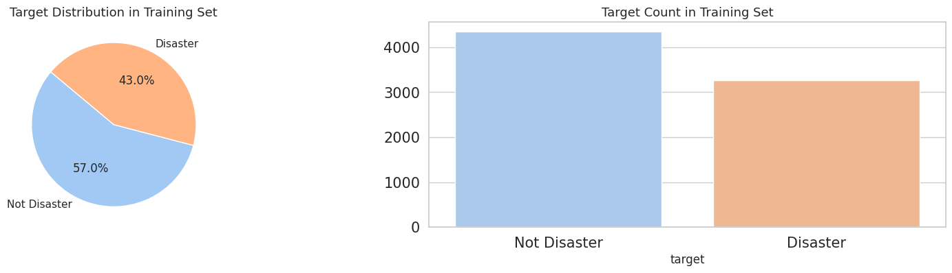
STUDYING THE DATASET: TARGETS

Slide 7
Embedding and text cleaning
Embeddings used: GloVe-300d-840B, FastText-Crawl-300d-2M (having 50% and 80% text coverage without cleaning
Text cleaning: clean() function dealing with (using ReGex)
- Special characters that are attached to words removed completely
- Contractions are expanded
- Urls are removed
- Character entity references are replaced with their actual symbols
- Typos and slang are corrected, and informal abbreviations are written in their long forms
- Some words are replaced with their acronyms and some words are grouped into one
- Expanding informational usernames and hashtags as much as possible;

Slide 8
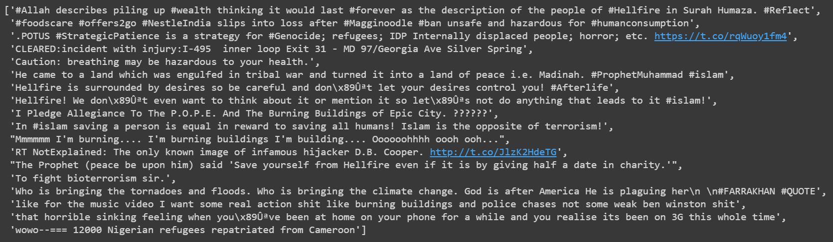
MISLABELED SAMPLES

Slide 9
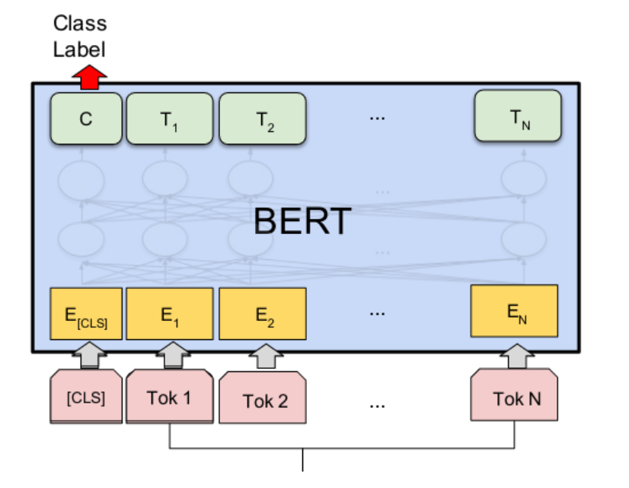
BASELINE MODEL
BERT architecture (with L=12 hidden layers, a hidden size of H=768, and A=12 attention heads, 10 epochs, learning rate 0.0001, batch size of 32) used in https://www.kaggle.com/code/gunesevitan/nlp-with-disaster-tweets-eda-cleaning-and-bert was chosen as a baseline model. Validation set accuracy: 0.7982

Slide 10
ATTEMPTS with other models
Similar to some solutions in Kaggle, simple and classic machine learning methods for classification, such as logistic regression were attempted to be used:
- Logistic Regression (0.6845);
- SVM (0.7232);
- k-neighbors Classifier (0.62487);
Therefore, it was decided to stick to BERT architectures judging from the performance of the baseline model (0.7982)

Slide 11
BERT models
Were taken from: https://tfhub.dev/google/collections/bert/1:
bert_en_uncased_L-24_H-1024_A-16;
bert_en_wwm_uncased_L-24_H-1024_A-16;
bert_en_cased_L-12_H-768_A-12;
bert_en_cased_L-24_H-1024_A-16;
bert_en_wwm_cased_L-24_H-1024_A-16;

Slide 12
Implementation details
ClassificationReport(reporting performance metrics) and DisasterDetector (encoding text, building and training model);
SGD optimizer with momentum 0.8, metrics of ‘accuracy’;
Starting initially with 10 epochs, then work with 5 epochs, as the performance metric values converge to certain value after 5 epochs;

Slide 13
Results
Model | Validation Loss | Validation Accuracy | Validation Recall | Validation F1
bert_en_uncased_L-12_H-768_A-12 (baseline) | 0.4521 | 0.7982 | 0.792688 | 0.79343
bert_en_uncased_L-24_H-1024_A-16 | 0.3818 | 0.8306 | 0.826957 | 0.827910
bert_en_wwm_uncased_L-24_H-1024_A-16 | 0.4295 | 0.8332 | 0.811493 | 0.820398
bert_en_cased_L-12_H-768_A-12 | 0.3958 | 0.8345 | 0.818175 | 0.825031
bert_en_cased_L-24_H-1024_A-16 | 0.4150 | 0.8398 | 0.832123 | 0.835019
bert_en_wwm_cased_L-24_H-1024_A-16 | 0.3989 | 0.8365 | 0.827307 | 0.831283

Slide 14
RESULTS
As the bert_en_cased_L-24_H-1024_A-16 model gives the best performance, some hyperparameters were varied with an attempt of increasing it, the variations that resulted performance closest to original model were selected:
Model | Validation loss | Validation Accuracy | Validation Recall | Validation F1
Learning rate = 0.00005 | 0.4220 | 0.8306 | 0.820158 | 0.823520
Batch_size = 16 | 0.4198 | 0.8286 | 0.810257 | 0.817095
Learning rate = 0.00005 & Batch_size = 16 | 0.3944 | 0.8201 | 0.810351 | 0.813563

Slide 15
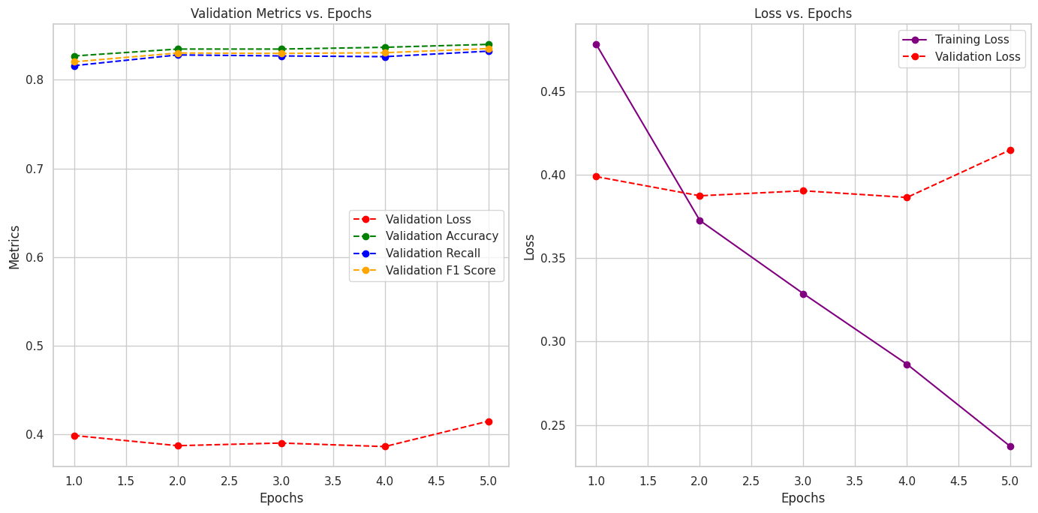
RESULTS: the best model

Slide 16
ROOM for improvement
It was deduced that the original model bert_en_wwm_cased_L-24_H-1024_A-16 gave the best performance indicating that it was to not run all experiments with batch size of 16 as in baseline solution.
Since BERT architectures are quite complex, most of the time I ran out of RAM memory, execution was stopped and it also took very long time.
Suggested models are not efficient in terms of executed time and allocated memory (in comparison to baseline model too), but gives very high performance metric values. The chosen model is suggested to be used for users that prefer high accuracy to time and memory.

Slide 17
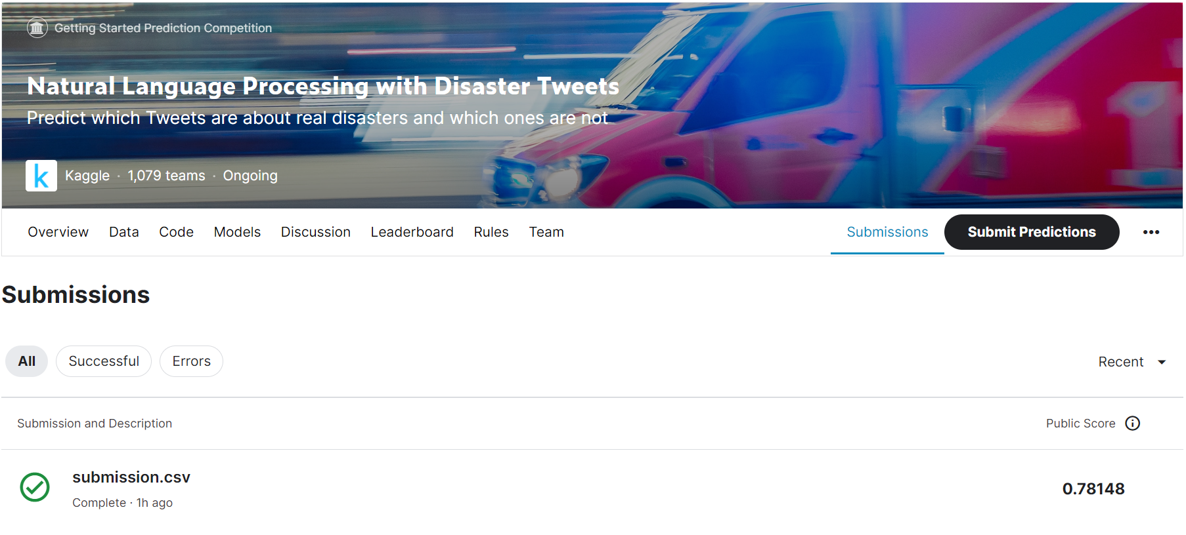
KAGGLE SUBMISSION
The project code was submitted to Kaggle
The obtained score was: 0.78148

Slide 18
THANKS FOR YOUR ATTENTION

