Slide 1

Is it possible to predict sales amount for a video game according to the game sales features?
Data Mining and Machine learning
Ori Amrani
Oshri Moalem

Slide 2
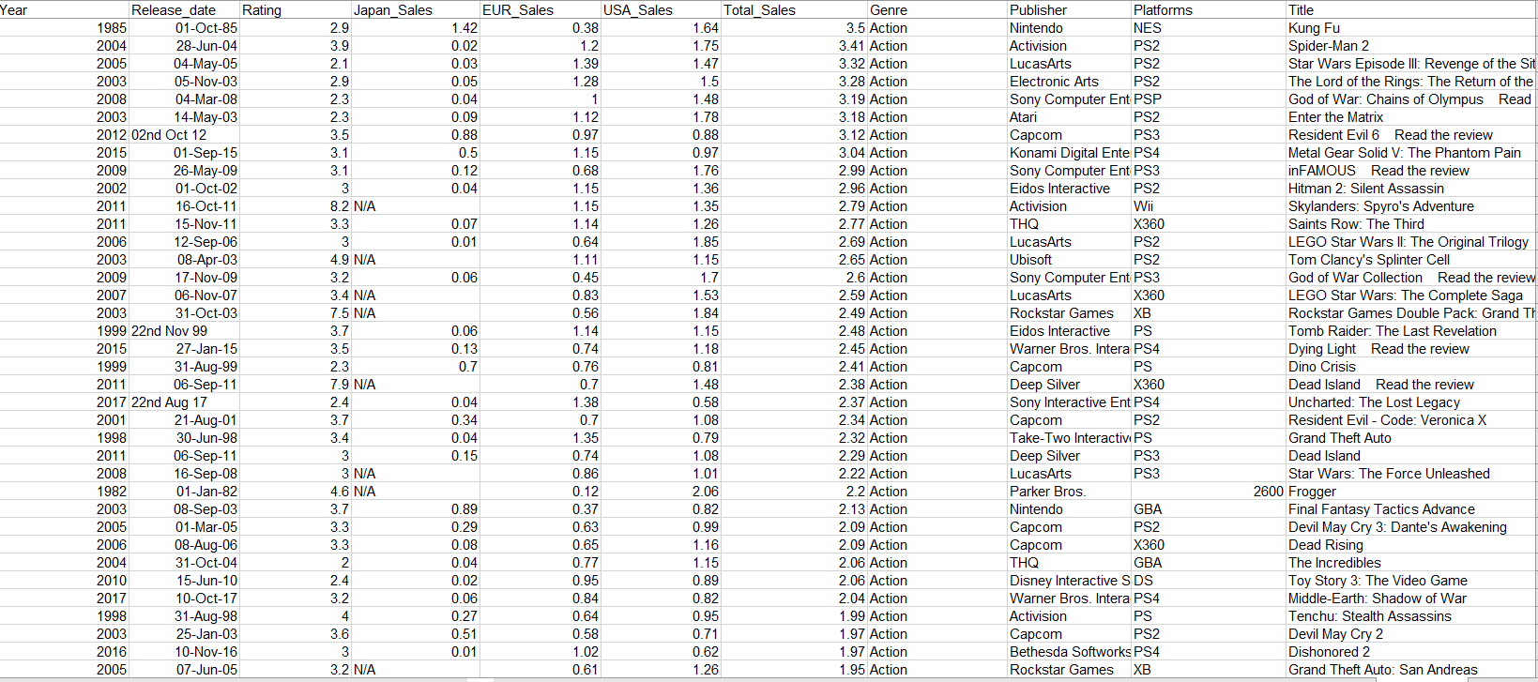
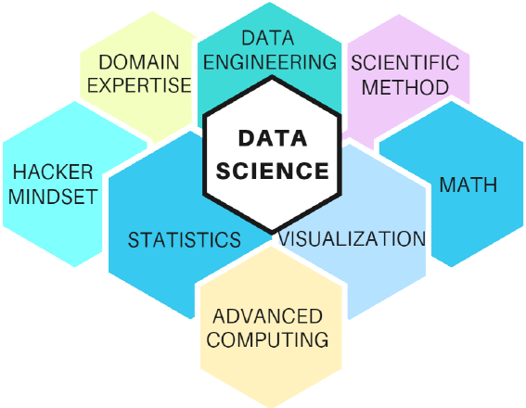
Our research - intro
Research questions:
Can we predict sales amount of video game according to the certain properties? (Genre, Publisher, Rating, Console etc..)

Slide 3
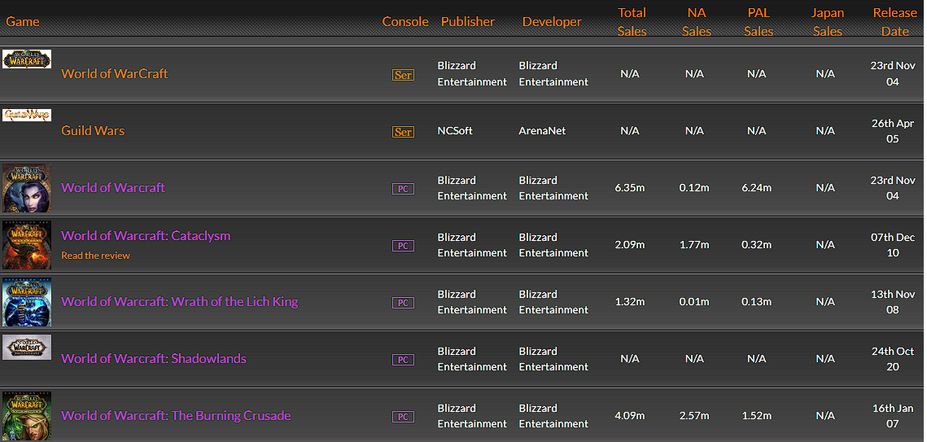

Research process- Data Acquisition
Source
Vgcharz Site

Slide 4
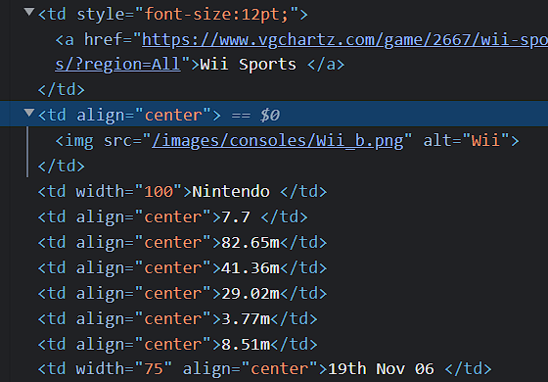

Research process- Data Acquisition
Acquisition method :Crawling
Used a function from ‘BeautifulSoup’ to crawl the
all 60,000+ games by genre.
Acquisition of data was difficult, because the site's architecture is built in an old way without identifiers like classes or Id, so we had to create an array of all the tags and take only the information that is relevant for us.

Slide 5
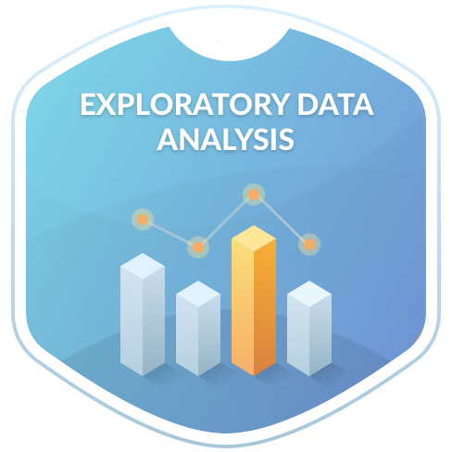
Research process – Data Handling
Concatenation of all the information into one table.
Drop all ‘m’ letters from different sales columns.
Handling NULL and N/A Values.
We rounded the values of sales to one decimal place.
We created a column of game release year from game release date column.

Slide 6
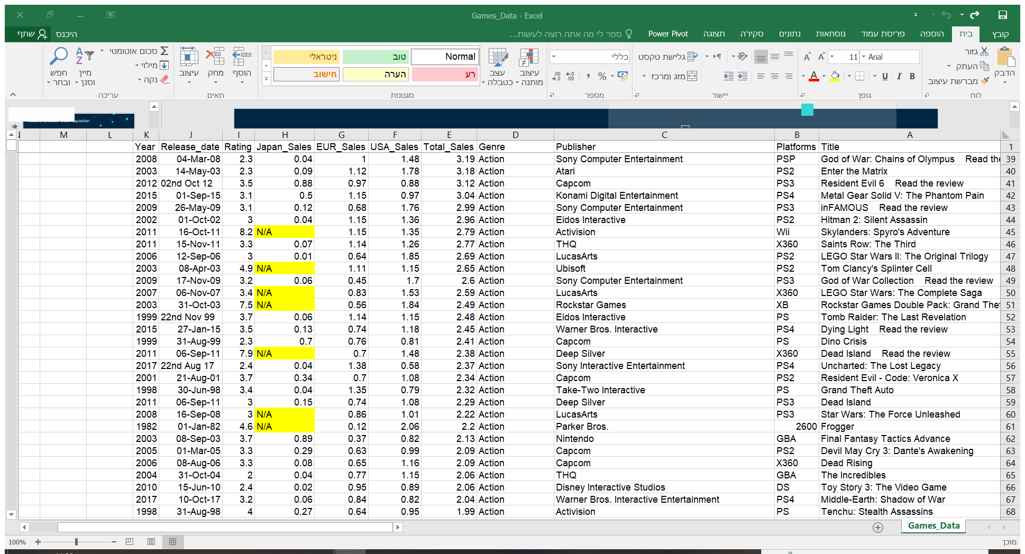
Research process – Data Handling
Handling NULL and N/A Values and combined two tables -
In our project there were a N/A values after crawling from Vgcharz Site we chose to drop all of them due to the fact that we had a lot of data after the acquisition .
We acquired the data in two tables because some of the games were presented in a different way on the HTML page and we wanted to acquire all the games, then we combined these two tables into one table that contains all the games.

Slide 7

Research process – EDA

Slide 8
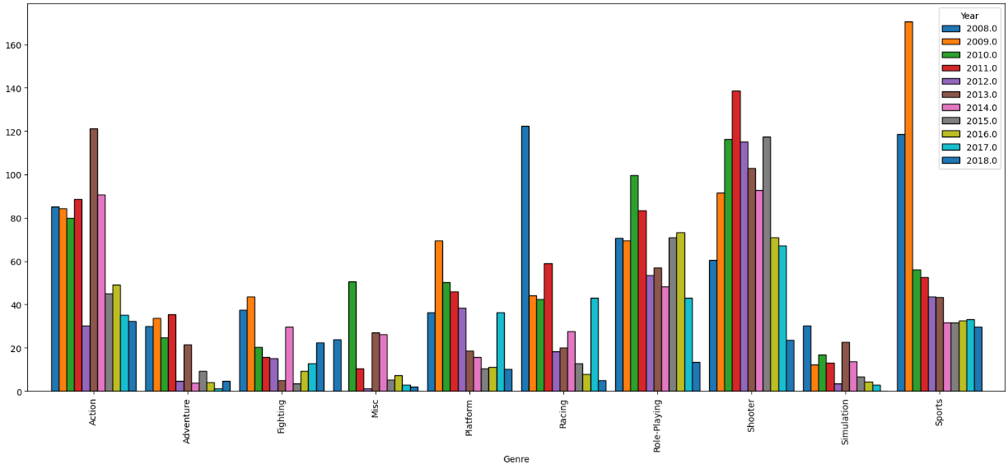
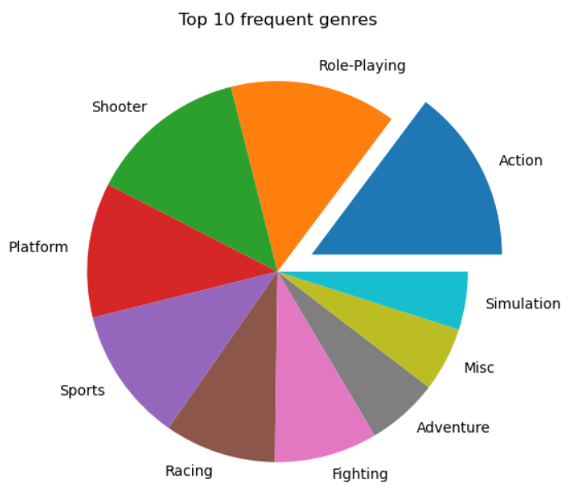
Some insights:
Games release distribution by genres in years 2008-2018
The 10 genres that released
the most video games

Slide 9
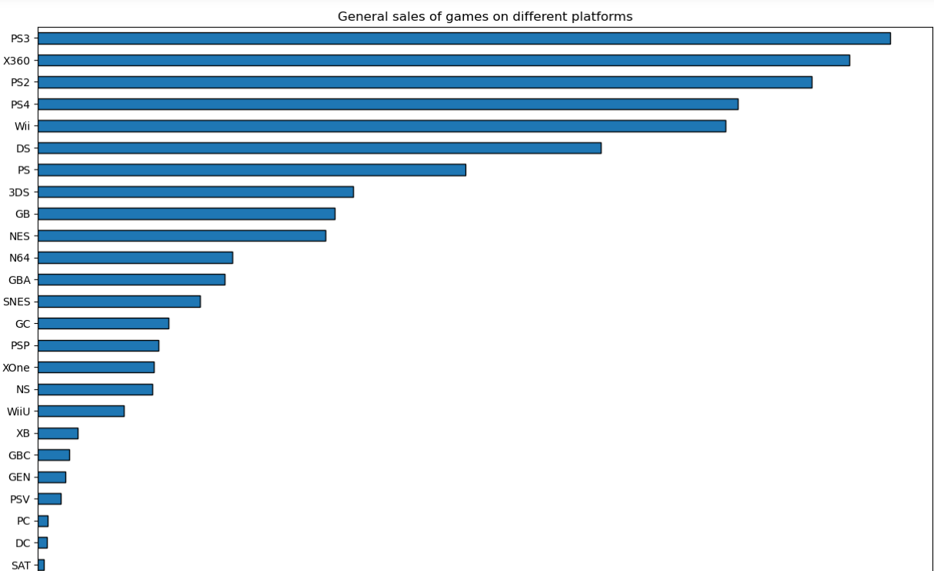
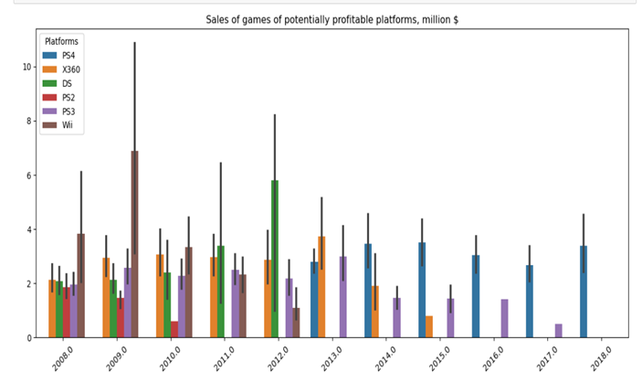
Some insights:
Here we checked the amount of sales of each platform,
as we can see, we have 5 platforms that exceed the amount of one million sales.
It can be seen that between the years 2014-2018 ps4 ​​clearly leads, this is probably because that some consoles became obsolete and stopped releasing games.

Slide 10
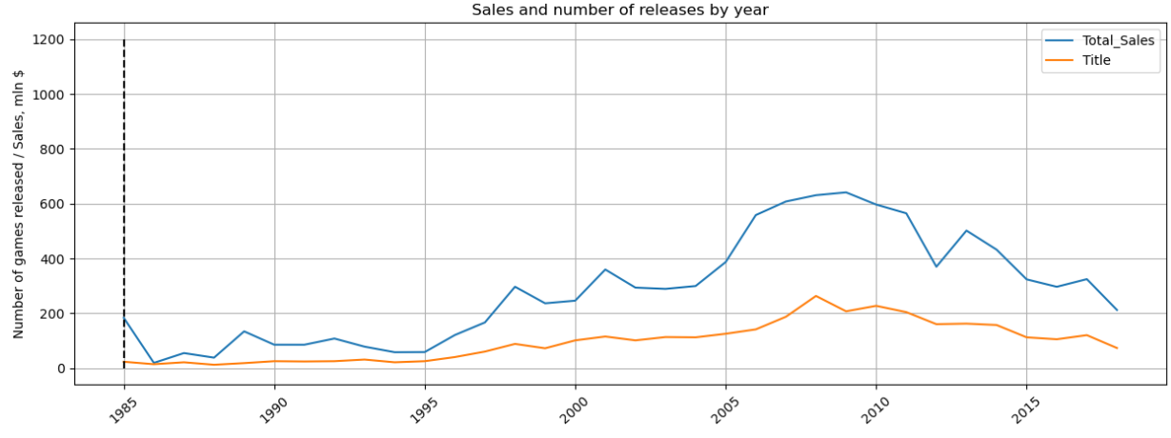
Some insights:
Over the years the amount of sales
has increased , although in recent years there seems to be a decline in sales due to not releasing new games like in previous years

Slide 11
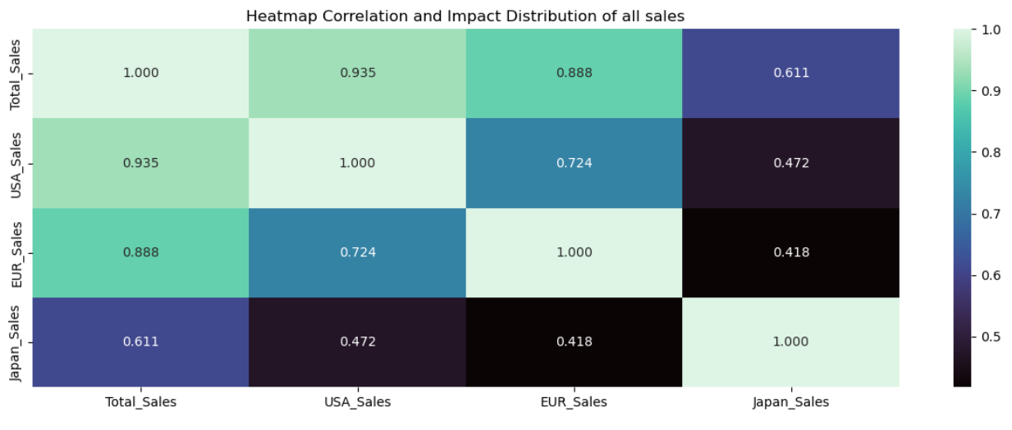
Some insights:
Here we checked the correlation between the total sales and the sales in the different regions, there is a high correlation between the general sales and the sales in the USA, the correlation between the sales in Europe and the general sales is smaller but still there is a relatively large correlation, in contrast the correlation between the general sales and the sales In Japan it is relatively small.

Slide 12
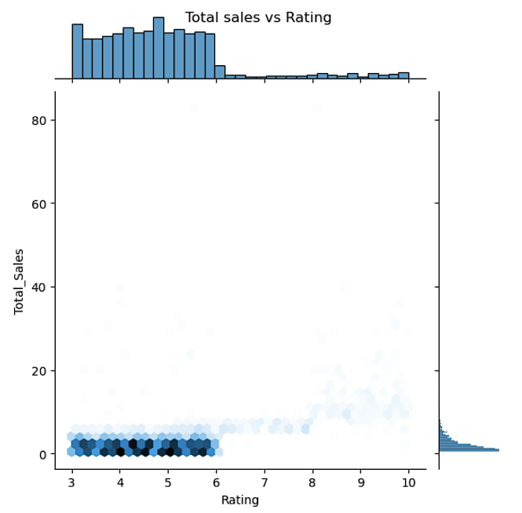
We can see that the most games rated between 3-6 and the amount of sales don’t exceed the 10mil in those games.

Slide 13
Machine Learning
Linear regression
Using the `sklearn` library and linear regression we were able
to train a model that predicts the sales of games based
on crew features. We added some columns based on our data,
that described the rating of game,genre,platform,publisher and year.

Slide 14
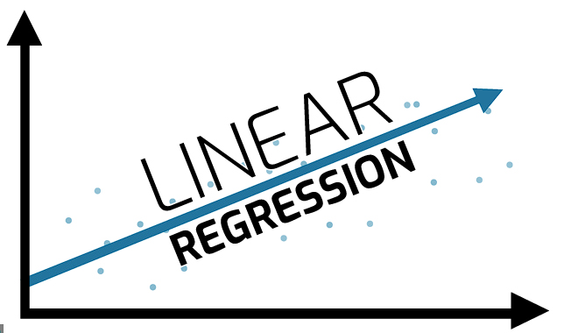
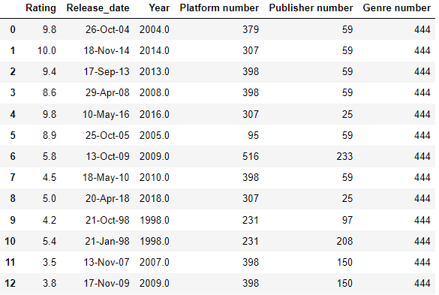
Machine Learning
Linear regression
The final table for the machine learning model
We encoded the categorial labels to numbers so that we can use them in the machine learning

Slide 15
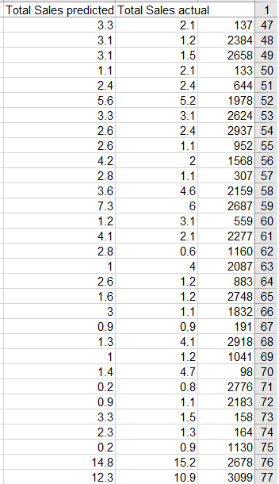
Machine Learning
The prediction rating VS versus the original rating

Slide 16

Conclusions
According to the success rates of the prediction,
it is possible to see and even predict whether a game
will succeed according to the game sales features

Slide 17





Thank You
Oshri Moalem
Ori Amrani

